Slide 1
Digital Portfolio
STUDENT NAME: KUMARESAN K
REGISTERNOANDNMID:
24134080500121025/4FF1F6F3CD79A24AE394D0A5DD1D33A7
DEPARTMENT:BCA DEPARTMENT OF COMPUTER SCIENCE
COLLEGE: TBML, COLLEGE/ANNAMALAI UNIVERSITY

Slide 2
PROJECT TITLE
SMART DIGITAL PORTFOLIO WITH SKILL RECOMMENDATION AND RECRUITER ANALYTICS A digital portfolio is a collection of digital artifacts that showcase an individual’s work, skills, and achievements. It’s often used by students, professionals, and creatives to demonstrate their expertise and accomplishments. A digital portfolio can include:- Projects and assignments

Slide 3


AGENDA
Problem Statement
Project Overview
End Users
Tools and Technologies
Portfolio design and Layout
Features and Functionality
Results and Screenshots
Conclusion
Github Link
3/21/2024 Annual Review

Slide 4

PROBLEM STATEMENT
In today's digital era, traditional resumes alone are not enough to showcase skills and projects effectively. Many students and professionals lack a structured online presence to highlight their work. A digital portfolio provides an interactive and accessible platform to present achievements, skills, and experiences.

Slide 5

PROJECT OVERVIEW
•Brief summary of your project
•What your portfolio contains (About Me, Projects, Skills, Contact).
•Main idea: Showcase personal achievements, skills, and projects.

Slide 6

WHO ARE THE END USERS?
•Students (academic projects, resumes).
•Job seekers (to share with recruiters).
•Freelancers (to show clients).Professionals (to highlight experience and achievements).

Slide 7

TOOLS AND TECHNIQUES
•HTML Structure (pages, sections).
•CSS Styling (colors, layouts, responsiveness).
•JavaScript Interactivity (navigation menu, animations, form validation), Mention code editor (VS Code) or CODEPEN and hosting platform (GitHub Pages)

Slide 8
POTFOLIO DESIGN AND LAYOUT
•Sections included: •Home/About Me •Projects •Skills •Contact •Responsive layout (mobile + desktop view).
8

Slide 9
FEATURES AND FUNCTIONALITY
•Navigation bar with smooth scrolling. •Project showcase with images/details. •Interactive elements (hover effects, animations). •Contact form (with validation). •Responsive design for all devices.

Slide 10
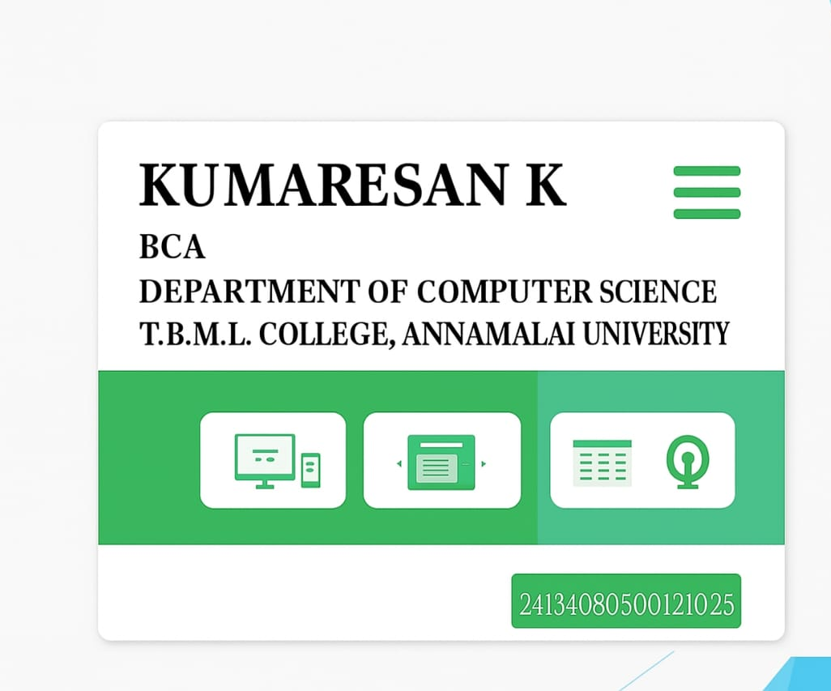

RESULTS AND SCREENSHOTS
3/21/2024 Annual Review
10

Slide 11
CONCLUSION
Highlights of your project Final summary Benefits to society
https://github.com/kumaresankarunak-commits/Kumaresan-k-TNSDC-FWD-DP.git
11

