Slide 1
Microservices
Angular JS
06-03-2017

Slide 2
Why AngularJs?
A Structural Framework to develop dynamic web apps.
It is not a library, It is a Framework
Supports clean MVC architecture and supports Separation of concerns (Sos)
It is a cross browser compliant, handles the Javascript code suitable to each browser
It provides reusable components
Less coding because of data binding and dependency injection features
Can build single page application ( SPA )
Notes:
Availability: Rolling out a new version of a microservice requires little downtime
Scalability: Each microservice can be scaled independently using pools, clusters, grids.
Time to Market: No dependency on other services. In monolithic approach, changing a component requires a thorough impact analysis and regression
Resiliency: Components are maintained and deployed independently. Each service can be developed independently and any failure in one app/service doesn’t affect other
Flexible Architecture: Application is broken down into multiple smaller services. Each maintained & deployed independently. Use Technology Stack based on Business function. Each service is independently maintained – Ability to leverage an emerging technical stack where ever required.

Slide 3
AngularJs Architecture
Separation of concerns is a key feature.
It is a client side application and it uses a clean MVC architecture.
  Model − It is the lowest level of the pattern responsible for maintaining data.
  View − It is responsible for displaying all or a portion of the data to the user.
  Controller − It is a software Code that controls the interactions between the Model and View.
$scope is a special JavaScript object which connects controller with the view. The values stored by controller in the $scope object has accessed in the view part.

Slide 4
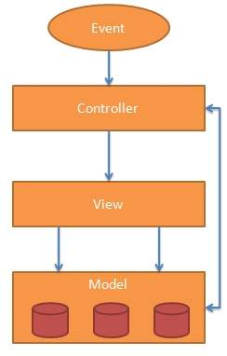
AngularJs Architecture
As suggested in the architecture section, front-end is (almost) completely decoupled from the back-end.
This decoupling allows us to develop back-end and front-end independently from each other.
With client side rendering, browser is the API consumer in the same way as an Android, iPhone or desktop application would be.

Slide 5
AngularJs Setup
There two different ways to setup angular
1) Downloading and hosting files locally
2) CDN access
Steps to make angular setup
1) Include the AngularJS JavaScript file in the HTML page so we can use AngularJS
2)Next we tell what part of the HTML contains the AngularJS app. This done by adding the ng-app attribute to the root HTML element of the AngularJS app. You can either add it to a specific html element or body element
3)Now we define a ng-controller and we write the functions need in the controller and then execute the HTML file to see the desired result.

Slide 6
AngularJs Script Details
here are two types of AngularJS script URLs you can point to, one for development and one for production:
1) angular.js — This is the human-readable, non-minified version, suitable for web development.
2) angular.min.js — This is the minified version, which we strongly suggest you use in production.

Slide 7
AngularJs Configuration and Modules
A module is a collection of the different block of codes which can be used in the angular application
These codes contain information about directives, controllers, services, filters, different functions and values that can be used anywhere within the application.
The basic syntax of a module is
angular.module('Module Name',[ 'Dependencies' ]);
– Module Name: Name of the module to create. The same name will be used by the directive to retrieve module.

Slide 8
AngularJs Configuration and Modules
For example:-
// AngularJS module for the application
var myProduct = angular.module('myProduct', []);
// Controller for the application
myProduct.controller('productController', []);
Here, there are two modules created. First module is created for the application with name myProduct and another module is created for the controller with name productController.
In application, these modules can be used by directives such as ng-app, ng-controller

Slide 9
AngularJs Configuration and Modules
Dependencies
Sometimes a module depends upon another module, service or function. In such case, it is required to include it in the module as a dependency in order to use its functionality.
Dependencies should be written inside [] between quotes
angular.module('Module Name',[ 'Dependencies' ]);
Thus dependency injection makes us code less and makes it easier for reusing the components.

Slide 10
AngularJs Configuration and Modules
Example:-
// Controller for the application
myProduct.controller('productController', ['$scope', function($scope) {
// Product array containing values in JSON format
$scope.products = [
{
"prod_name": "Foogo-PRO Theme",
},
{
"prod_name": "Video Member Theme",
}
]
}]);

Slide 11
AngularJs Configuration and Modules
Controllers
AngularJS application mainly relies on controllers to control the flow of data in the application.
A controller is defined using ng-controller directive. A controller is a JavaScript object containing attributes/properties and functions.
Each controller accepts $scope as a parameter which refers to the application/module that controller is to control.

Slide 12
AngularJs Configuration and Modules
Directives
AngularJS directives are used to extend HTML. These are special attributes starting with ng- prefix.
1) ng-app − This directive starts an AngularJS Application.
2) ng-init − This directive initializes application data.
3) ng-model − This directive defines the model that is variable to be used in AngularJS.
4) ng-repeat − This directive repeats html elements for each item in a collection and many more.
5) Custom Directives can also be used

Slide 13
AngularJs Configuration and Modules
Services
Services are javascript functions and are responsible to do a specific tasks only.
Services are normally injected using dependency injection mechanism of AngularJS.
AngularJS provides many inbuilt services for example, $https:, $route, $window, $location etc.
eg: $route is used to define the routing information
Inbuilt services are always prefixed with $ symbol.

Slide 14
AngularJs Configuration and Modules
There are two ways to create a service.
1) factory
2) service

Slide 15
AngularJs Configuration and Modules
Filters
Filters format the value of an expression for display to the user. They can be used in view templates, controllers or services.
AngularJS comes with a collection of built-in filters, but it is easy to define your own as well eg: uppercase, lowercase, currency etc.
Using filters in View Templates:
Filters can be applied to expressions in view templates using the following syntax:
{{ expression | filter }}
eg: {{ 12 | currency }} which will provide us with $12.00

Slide 16
AngularJs Configuration and Modules
Using filters in controllers, services, and directives
For this, inject a dependency with the name <filterName>Filter into your controller/service/directive.
E.g. a filter called number is injected by using the dependency numberFilter.
Eg: https://plnkr.co/edit/?p=preview

Slide 17
AngularJs DOM elements
AngularJs makes use of HTML DOM elements such as Div , HTML, body on a page.
Directives can be used to bind application data to attributes of HTML DOM Elements.
1) ng-bind/expressions
2) ng-model
3) ng-show
4) ng-hide
5) ng-disabled
6) ng-click and many more

Slide 18
AngularJs Building Blocks
Create a html page
Include the AngularJs file to the project
Create a module for the application and define it in HTML using ng-app
Then create a controller and write a function to perform and define it using ng-controller
Then bind the value using ng-model in the HTML page
Execute the file by running the HTML.
Eg: https://www.tutorialspoint.com/angularjs/angularjs_controllers.htm

Slide 19
AngularJs Custom Directives
The legal restrict values are:
Element directives (E) − Directive activates when a matching element is encountered.
Attribute (A)− Directive activates when a matching attribute is encountered.
Class (C)− Directive activates when a matching class is encountered.
Comment (M)− Directive activates when a matching comment is encountered.
Syntax
modulename.directive('directivename', function() {
});

Slide 20
AngularJs Server Communication
$http is an AngularJS service for reading data from remote servers.
Methods
.delete()
.get()
.head()
.jsonp()
.patch()
.post()
.put()

Slide 21
AngularJs Server Communication
Properties
The response from the server is an object with these properties:
.config the object used to generate the request.
.data a string, or an object, carrying the response from the server.
.headers a function to use to get header information.
.status a number defining the HTTP status.
.statusText a string defining the HTTP status.
"Separation of Concerns" using services architecture.

Slide 22
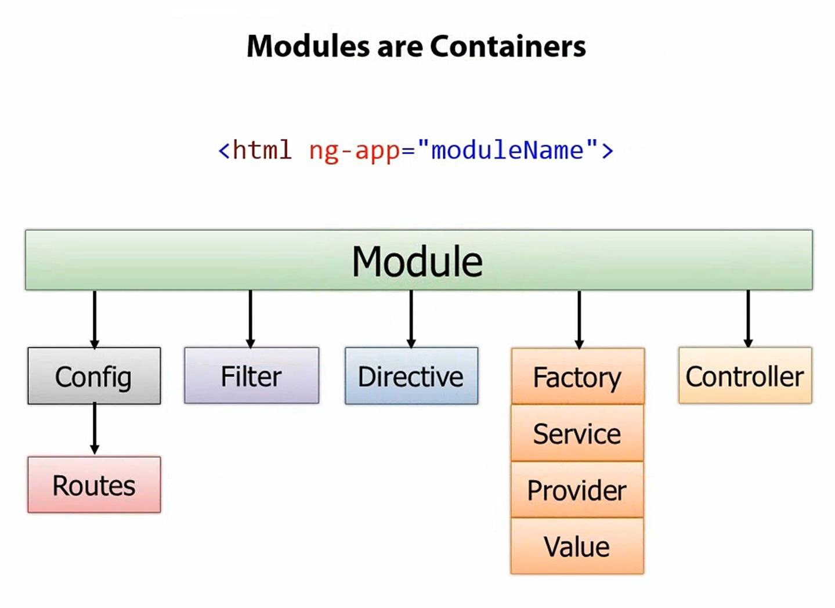
AngularJs Configuration and Modules

Slide 23
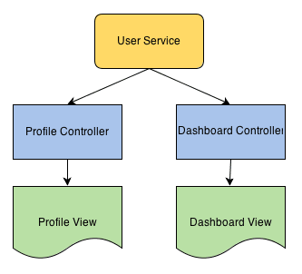
Angular Services
Angular supports "Separation of Concerns"concept through Services.
responsible to do a specific tasks.
Controllers, filters can call services as on requirement basis.
Injected into controllers using dependency injection.
Inbuilt services in angular $https, $route, $window, $location.
Services can be created in two ways i.e service&Factory
  Syntax for creating Service-
app.service('CarService', function() {
this.dealer="Bad";
this.numCylinder = 4;
});
Services - If you use a service you will get the instance of a function ("this" keyword). Could be useful for sharing utility functions

Slide 24
Angular Services
Syntax for creating factory:
app.factory('CarFactory', function() {
return function(numCylinder) {
this.dealer="Bad";
this.numCylinder = numCylinder
};
});
Factory : If you use a factory you will get the value that is returned by invoking the function reference (the return statement in factory).

Slide 25
Angular Routing
Single Page Application - loads a single HTML page via multiple views i.e. dynamically updates that page as the user interacts with the web app.
AngularJS provides ng-view and ng-template directives and $routeProvider services to achieve this.
  ng-view -creates a place holder where a corresponding view (html or ng-template ) can be placed based on the configuration.
  Ng-template - creates an html view using script tag. Its id attribute is used by $routeProvider to map a view with a controller
  $routeProvider - sets the configuration of urls. Map the urls with the corresponding html page or ng-template and attach a controller
    Demo of angular router - http://jsfiddle.net/biondifabio/95wEL/

Slide 26
Angular Form Validation
AngularJS offers client-side form validation.
AngularJS monitors the state of the form and input fields (input, textarea, select), and lets you notify the user about the current state.
AngularJS also holds information about whether they have been touched, or modified, or not.
$untouched The field has not been touched yet
$touched The field has been touched
$pristine The field has not been modified yet
$dirty The field has been modified
$invalid The field content is not valid
$valid The field content is valid

