Slide 1
Blockchain
Micro lending Platform

Slide 2

Platform description
1. Anyone can register themselves as lender ( Name,Rate of Interest).
2. Anyone can register themselves as borrower ( Name ).
3. View lenders available on the platform (Address, Name, Rate of Interest).
4. Register Borrower ( Name ).
5. Create Request ( Registered Borrowers can request for funds ).
6. Borrowers can browse through their requests and make payments to the lenders.
7. Anyone can browse through all the transactions.
8. Lenders can browse through their requests queue ( Approve, Reject, View Borrower Rating, Close Request (Once request moves to "BORROWER_PAID" state, submit Borrower Rating ).
9. There is no EMI option. Loan has to be paid in full at once.

Slide 3
Problem being solved
Loans can be applied by borrowers directly.
There are no chances of fraud as all transactions are visible to everyone.
People with good score will be able to avail credit very easily.
Paperwork for the loan is not required anymore.
Being available on internet it is available everywhere.
It allows competition among lenders as the platforms aggregates all lenders together and the are no hidden/complicated rules for the borrowers.

Slide 4
Technology/Tool/Cloud Stack
Blockchain
Docker
Solidity ( programming language )
Node js ( UI Server )
React ( Frontend programming language )
Shell Script

Slide 5
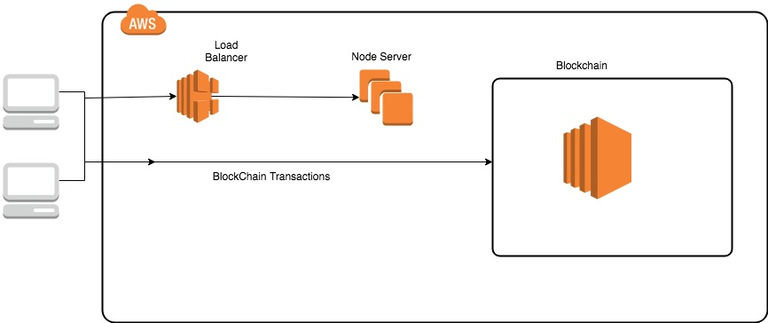
Platform architecture

Slide 6
Demonstration video/ prototype demo

Slide 7
Challenges faced
Local setup which can be replicated and tested.
Uniform build and deployment.
Handling version incompatibilities ( experimental ABIEncoderV2 has many features but we had to revert it back as web3 does not support it yet ).

Slide 8
Possible Improvement
There needs to be an offline component for borrower verification as people might use different addresses to get loans( although getting new address comes with 0 rating hence lender reluctance ).
The browsing section can be moved to another database( for faster access). In case of verification Blockchain can be used again.

Slide 9


