Slide 1
Problem Statement
Swift Route Logistics needs a centralized system to analyze delivery operations across hubs, drivers, and vehicles.
Currently, it is difficult to track key metrics such as total orders, on-time delivery rate, customer satisfaction, and delivery time. The objective of this project is to develop an interactive Power BI dashboard that provides insights into operational performance and supports better decision-making.

Slide 2
Project Objective
Swift Route Logistics handles a large number of deliveries through multiple hubs, drivers, and vehicles. However, the objective is to get a power bI dashboard build to track and visualize the logistics parameters such as :
Tracking total orders and delivery trends over time
Monitoring on-time delivery performance and identifying delays
Measuring customer satisfaction (CSAT) levels
Analyzing average delivery time across operations
Evaluating hub performance and capacity utilization
Assessing driver performance, experience, and delay patterns
Monitoring vehicle utilization, breakdowns .

Slide 3
Dataset Overview
The dataset used in this project represents the logistics operations of Swift Route Logistics for the years 2023 and 2024. It contains delivery data related to orders, drivers, vehicles, and distribution hubs.
The dataset consists of 4 interconnected tables:
Orders Table (27,979 records): Contains core delivery information such as order dates, delivery time, driver details, hub information, vehicle used, delay status, and customer satisfaction score.
Drivers Table (55 records): Includes driver-related details such as driver ID, name, employment type, hire date, experience, and performance rating.
Vehicles Table (45 records): Provides fleet information including vehicle model, purchase date, vehicle status, breakdown records, and maintenance alerts.
Hubs Table (6 records): Contains information about distribution hubs including hub ID, hub name, and hub capacity.

Slide 4
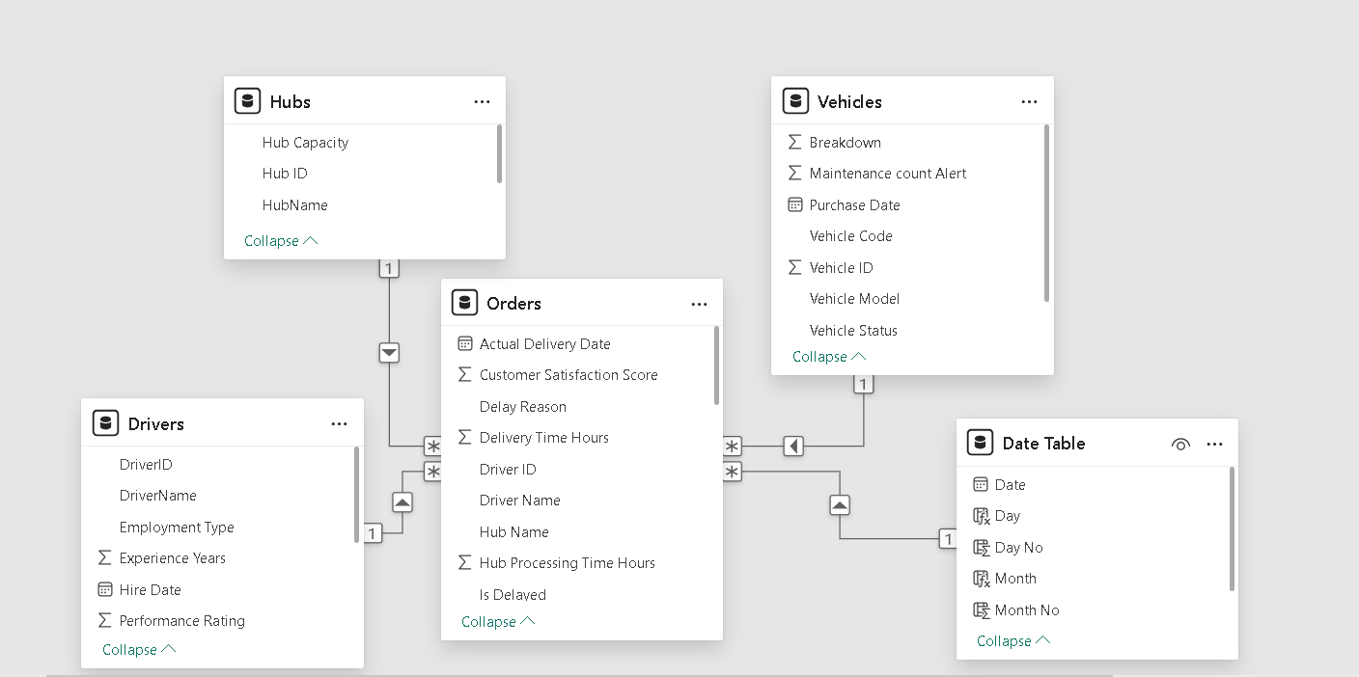
Data Modelling
· Orders to Drivers Connected using Driver ID to link each order with the driver responsible for the delivery.
· Orders to Hubs Connected using Hub Name to identify which distribution hubprocessed the order.
· Orders to Vehicles Connected using Vehicle Name / Vehicle Code to determine which vehicle was used for the delivery.
· Orders to Date Table Connected using Date to link each on the basis of order date.

Slide 5
Important KPIs
1. Total Orders
Total number of orders for the selected Year and Month
Total orders for the Previous Month
Month-over-Month (MoM) growth / decline % in total orders
2. On-Time Delivery Rate (%)
On-time delivery percentage for the selected Year and Month
On-time delivery percentage for the Previous Month
MoM change (%) in on-time delivery rate
3. Customer Satisfaction Score (CSAT %)
Overall CSAT % for the selected Year and Month
CSAT % for the Previous Month
MoM change (%) in customer satisfaction
4. Average Delivery Time (Hours)
Average delivery time (in hours) for the selected Year and Month
Average delivery time for the Previous Month
MoM change (%) in average delivery duration

Slide 6
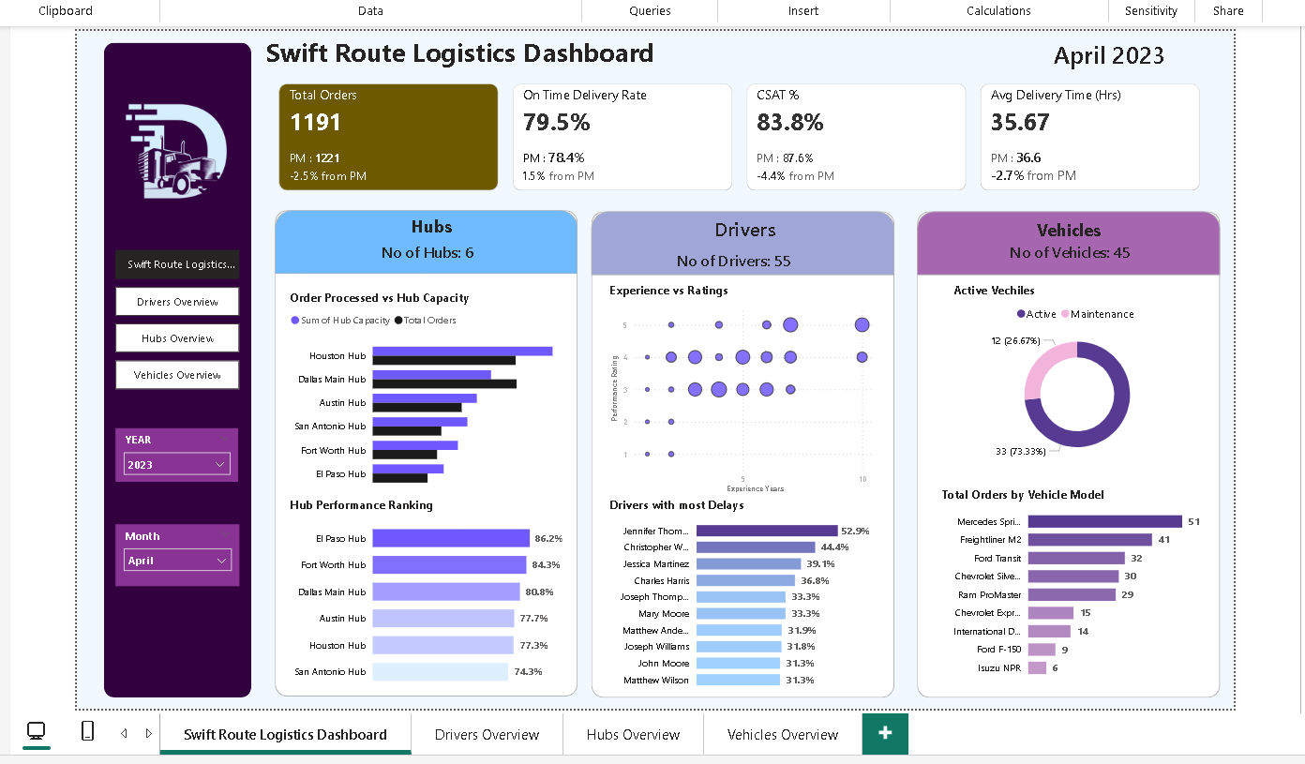
Dash Board Overview

Slide 7
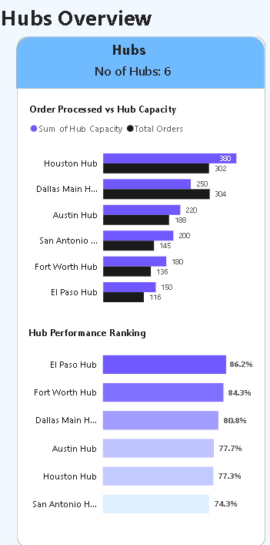
Key Insights from Hubs Overview
1. Total Number of Hubs
Chart Used: KPI Card
Business Use Case: Provides quick visibility into the total operational hubs to assess network size and coverage.
2. Orders Processed vs Hub Capacity
Chart Used: Clustered Column Chart
Business Use Case: Helps identify hubs operating above or below capacity, enabling better workload distribution and capacity planning.
3. Hub Performance Ranking
Chart Used: Bar Chart (Ranked)
Business Use Case: Enables comparison of hub efficiency and helps management identify top-performing and underperforming hubs.

Slide 8
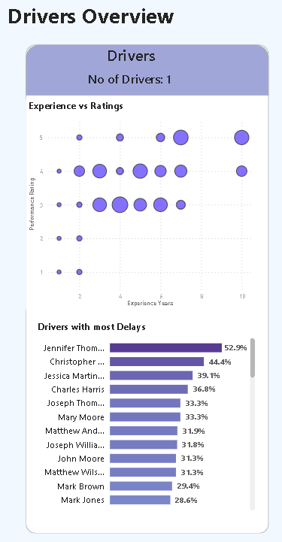
Key Insights from Drivers Overview
1. Number of Drivers
Chart Used: KPI Card
Business Use Case: Provides visibility into the total active drivers to support workforce planning and capacity assessment.
2. Experience vs Rating
Chart Used: Scatter Plot
Business Use Case: Analyses the relationship between driver experience and performance rating to identify skill gaps and training needs.
3. Drivers with Most Delays
Chart Used: Bar Chart
Business Use Case: Identifies drivers contributing to the highest number of delays, enabling targeted coaching and performance improvement.

Slide 9
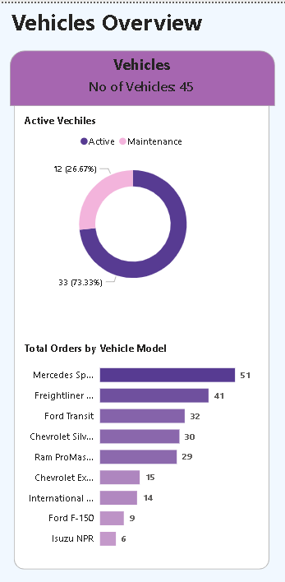
Key Insights from Vehicles Overview
1. Number of Vehicles
Chart Used: KPI Card
Business Use Case: Displays the total fleet size to support high-level fleet capacity and planning decisions.
2. Active Vehicles
Chart Used: Donut
Business Use Case: Shows the number of vehicles currently active to monitor fleet availability and operational readiness.
3. Total Orders by Vehicle Model
Chart Used: Bar Chart
Business Use Case: Compares order volumes handled by different vehicle models to identify high-utilization vehicles and optimize fleet usage.

Slide 10
Key Business Impacts
Improved Delivery Performance Monitoring on-time delivery rates helps identify delays and improve delivery efficiency.
Better Hub Capacity Management Analysis of orders processed vs hub capacity helps optimize workload distribution across hubs.
Enhanced Driver Performance Monitoring Tracking driver experience, ratings, and delay patterns helps identify training needs and improve driver productivity.
Optimized Fleet Utilization Insights into vehicle usage, breakdowns, and maintenance alerts help improve fleet reliability.
Higher Customer Satisfaction Monitoring CSAT scores and delivery times helps improve customer experience and service quality.
Data-Driven Decision Making Interactive dashboards allow management to quickly analyze trends and take strategic actions to improve logistics.

Slide 11
Future Scope
Integrate real-time data to track deliveries, drivers, and vehicles instantly.
Use predictive analytics to forecast delivery delays and demand trends.
Implement route optimization to reduce delivery time and fuel costs.
Add geographical maps to visualize hub performance and delivery locations.
Develop automated alerts for vehicle maintenance, hub overload, and delayed orders.

