Slide 1




Git & Github

Slide 2
Version Control
Collaboration Versioning Rolling Back Understanding
Scenario : Multiple students are doing a project together
Question: Why not Google drive & One drive ????
source code management vs file storage management

Slide 3
Objectives
Version Control
Git, Git repository
Git vs Github
Setup git environment
Create a git repository ( adding file, adding folder)
Checkout different version/ignore files…
Git tools

Slide 4
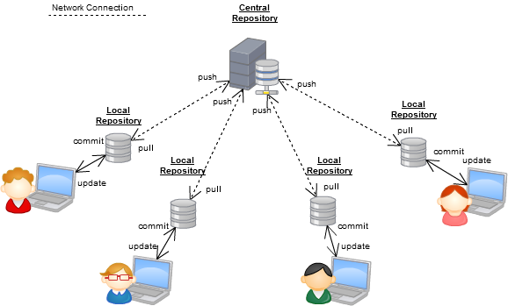
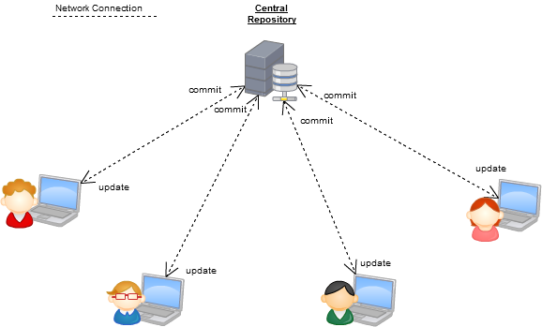
Version Control Systems
Some well-known version control systems are CVS, Subversion, Mercurial, and Git

Slide 5
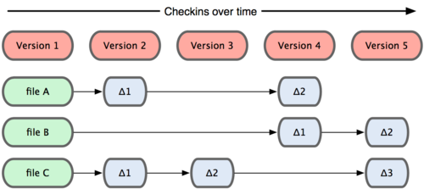
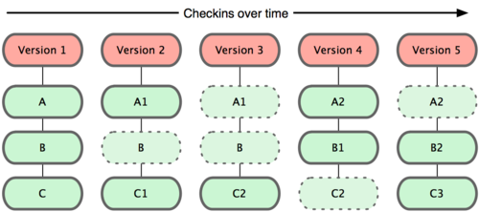
Why Git?
Git :most commonly used software for tracking changes in any set of files, usually used for coordinating work among programmers collaboratively developing source code during software development.
Git has many advantages over earlier systems such as CVS and Subversion
Subversion
Git

Slide 6

Git History
Came out of Linux development community
Linus Torvalds, 2005
Initial goals:
  Speed
  Support for non-linear development (thousands of parallel branches)
  Fully distributed
  Able to handle large projects like Linux efficiently
  Global Information Tracker (acronym name)

Slide 7

What is Github?
GitHub was developed by Chris Wanstrath, P. J. Hyett, Tom Preston-Werner and Scott Chacon using Ruby on Rails, and started in February 2008
It is a subsidiary of Microsoft, which acquired the company in 2018 for $7.5 billion
GitHub.com is a site for online storage of Git repositories.
You can get free space for open source projects or you can pay for private projects.
Question: Do I have to use Github in order to use Git?
Answer: No!
you can use Git completely locally for your own purposes, or
you or someone else could set up a server to share files, or
you could share a repo with users on the same file system.

Slide 8
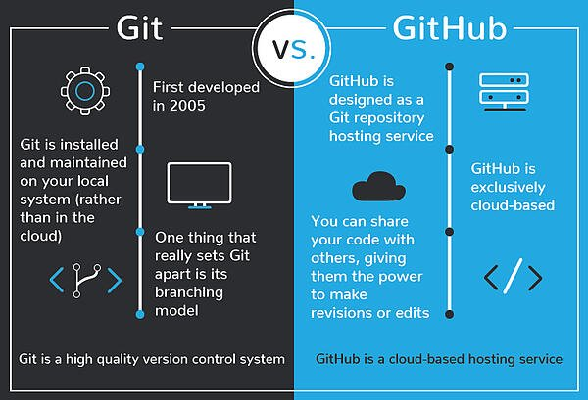
Git vs GitHub

Slide 9
Download and install Git
Here’s the standard one:
http://git-scm.com/downloads
Git Repository is a place where Git can store versions of our files
$ git –version
git version 2.30.2.windows.1

Slide 10
Configure Git
Enter these lines (with appropriate changes):
  git config user.name "JohnSmith"
  git config user.email jsmith@gmu.edu
--global param

Slide 11
command | description
git clone url [dir] | copy a git repository so you can add to it
git add files | adds file contents to the staging area
git commit | records a snapshot of the staging area
git status | view the status of your files in the working directory and staging area
git diff | shows diff of what is staged and what is modified but unstaged
git help [command] | get help info about a particular command
git pull | fetch from a remote repo and try to merge into the current branch
git push | push your new branches and data to a remote repository
others: init, reset, branch, checkout, merge, log, tag
Git Command

Slide 12
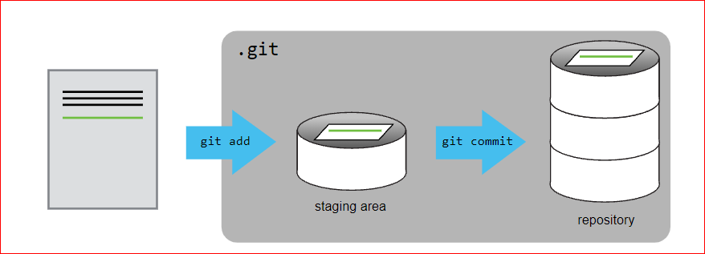
Adding a file to git repository

Slide 13
Adding a file to git repository
Create a file, copy file to myproject folder
$ mkdir myproject
$ cd myproject
$ git init
add a file to the folder

Slide 14
$ git add f1.txt
$ git commit -m "First release of Hello World!"
[master (root-commit) 221ec6e] First release of Hello World!
3 files changed, 26 insertions(+)
create mode 100644 README.md
create mode 100644 bluestyle.css
Git Commit without Stage
To commit changes directly, skipping the staging environment. The -a option will automatically stage every changed, already tracked file
And check the status of our repository. But this time, we will use the --short option to see the changes in a more compact way:
$ git status --short M index.html
Short status flags are:
?? - Untracked files
A - Files added to stage
M - Modified files
D - Deleted files

Slide 15
We see the file we expected is modified. So let's commit it directly:
$ git commit -a -m "Updated index.html with a new line"
Git Commit Log
$ git log

Slide 16
$ git status
Git Add More than One File
$ git add --all
$ git status
Now all files are added to the Staging Environment, and we are ready to do our first commit.

Slide 17
Tracked - files that Git knows about and are added to the repository
Untracked - files that are in your working directory, but not added to the repository
$ git status
On branch master
No commits yet
Untracked files:
(use "git add ..." to include in what will be committed)
index.html
nothing added to commit but untracked files present (use "git add" to track)

Slide 18
$ git checkout -b main
Git status $git status
$ git add rose.txt
$ git status
$ git commit -m “my first file checked in “
$ git log

Slide 19
Continue…
Change rose.txt file
$git status
$git diff
$git commit -a –m “new message….”

Slide 20
git diff HEAD~1 mars.txt
Adding new folder
$mkdir poem
copy two text files to that poem folder
$git add poem

Slide 21
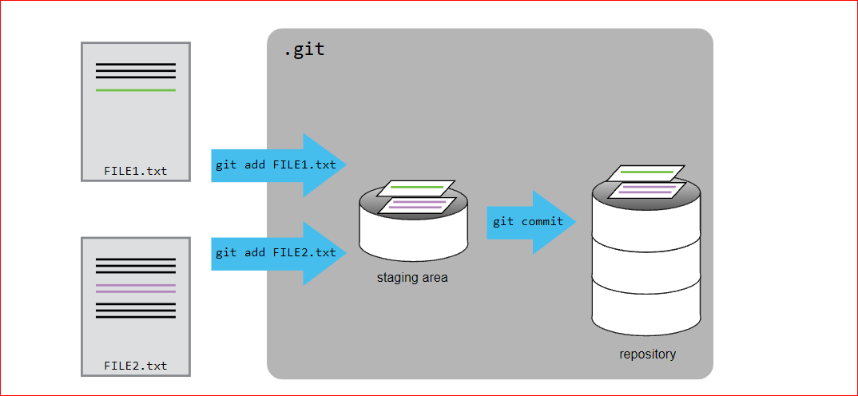
Adding Multiple files…

Slide 22
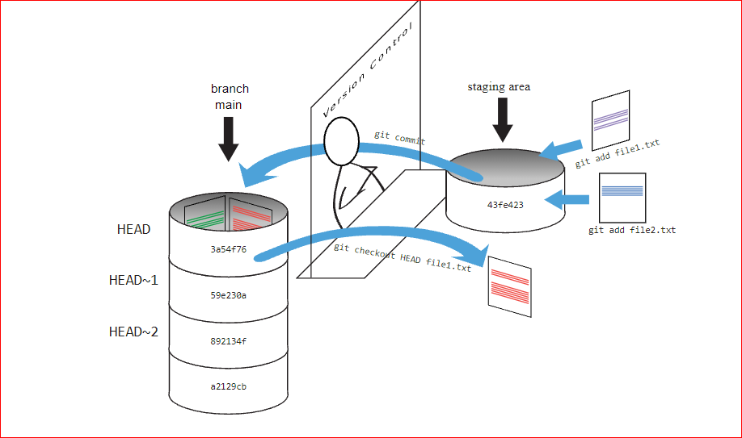

Slide 23
Checking previous version
$ git diff HEAD~1 rose.txt
$git checkout HEAD~1 rose.txt
$git checkout HEAD rose.txt

Slide 24
Branches and Tags
* ….. is a new/separate version of the main repository
* allow you to work on different parts of a project without impacting the main branch.
* When the work is complete, a branch can be merged with the main project.
* You can even switch between branches and work on different projects without them interfering with each other.
* Branching in Git is very lightweight and fast!

Slide 25
Creating Branch
$ git branch hello-world-images
List of Branches
$ git branch
Checkout : To move to a branch
$ git checkout hello-world-images
$ git checkout -b br1 (To create and checkout to new branch)
$ git status
$ git add –all
$ git status
$ git commit -m "Added image to Hello World"

Slide 26
Switching Between Branches
$ git checkout master
Switched to branch 'master'
Emergency Branch
Now imagine that we are not yet done with hello-world-images, but we need to fix an error on master.
I don't want to mess with master directly, and I do not want to mess with hello-world-images, since it is not done yet.
So we create a new branch to deal with the emergency:
Example
git checkout -b emergency-fix
Switched to a new branch 'emergency-fix'
Now we have created a new branch from master, and changed to it. We can safely fix the error without disturbing the other branches.

Slide 27
Commit Branch
$ git status
On branch emergency-fix
Changes not staged for commit:
(use "git add ..." to update what will be committed)
(use "git restore ..." to discard changes in working directory)
modified: index.html
no changes added to commit (use "git add" and/or "git commit -a")
$ git add index.html
git commit -m "updated index.html with emergency fix"
[emergency-fix dfa79db] updated index.html with emergency fix
1 file changed, 1 insertion(+), 1 deletion(-)

Slide 28
Merge Branch
$ git add –all
$ git commit -m "added new image"
$ git checkout master
$ git merge hello-world-images
Auto-merging index.html
CONFLICT (content): Merge conflict in index.html
Automatic merge failed; fix conflicts and then commit the result.
$ git status
$ git add index.html
$ git status
$ git commit -m "merged with hello-world-images after fixing conflicts"
[master e0b6038] merged with hello-world-images after fixing conflicts

Slide 29
Merge Branch
$ git checkout master
Switched to branch 'master'
$ git merge emergency-fix
Updating 09f4acd..dfa79db
Fast-forward
index.html | 2 +-
1 file changed, 1 insertion(+), 1 deletion(-)
$ git branch -d emergency-fix
Deleted branch emergency-fix (was dfa79db).
Merge Conflict
Now we can move over to hello-world-images and keep working. Add another image file (img_hello_git.jpg) and change index.html, so it shows it:
Example
$ git checkout hello-world-images
Switched to branch 'hello-world-images'
$ git checkout master
$ git merge hello-world-images
CONFLICT (content): Merge conflict in index.html

Slide 30
Ignoring Things
Configure Git to ignore specific files.
Explain why ignoring files can be useful.
Copy results folder with files
Create .gitignore file
Add
    *.dat
    results/

Slide 31


Git Tools
Windows Git Clients:
Sourcetree
GitHub for Windows .
Tortoise Git
Mac Git Clients:
GitUp
GitBox
Git-Xdev

Slide 32
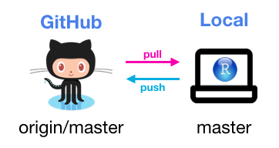
Thank You

