Slide 1
Retail Giant forecasting Assignment
Name : Kumar Gaurav Sinha

Slide 2
What are the 21 market Segments?
'US Consumer', 'APAC Corporate', 'APAC Consumer', 'EU Home Office',
'Africa Consumer', 'US Corporate', 'EMEA Consumer',
'LATAM Home Office', 'EU Corporate', 'EMEA Corporate',
'LATAM Consumer', 'EU Consumer', 'US Home Office',
'LATAM Corporate', 'Africa Corporate', 'APAC Home Office',
'EMEA Home Office', 'Africa Home Office', 'Canada Corporate',
'Canada Home Office', 'Canada Consumer'

Slide 3
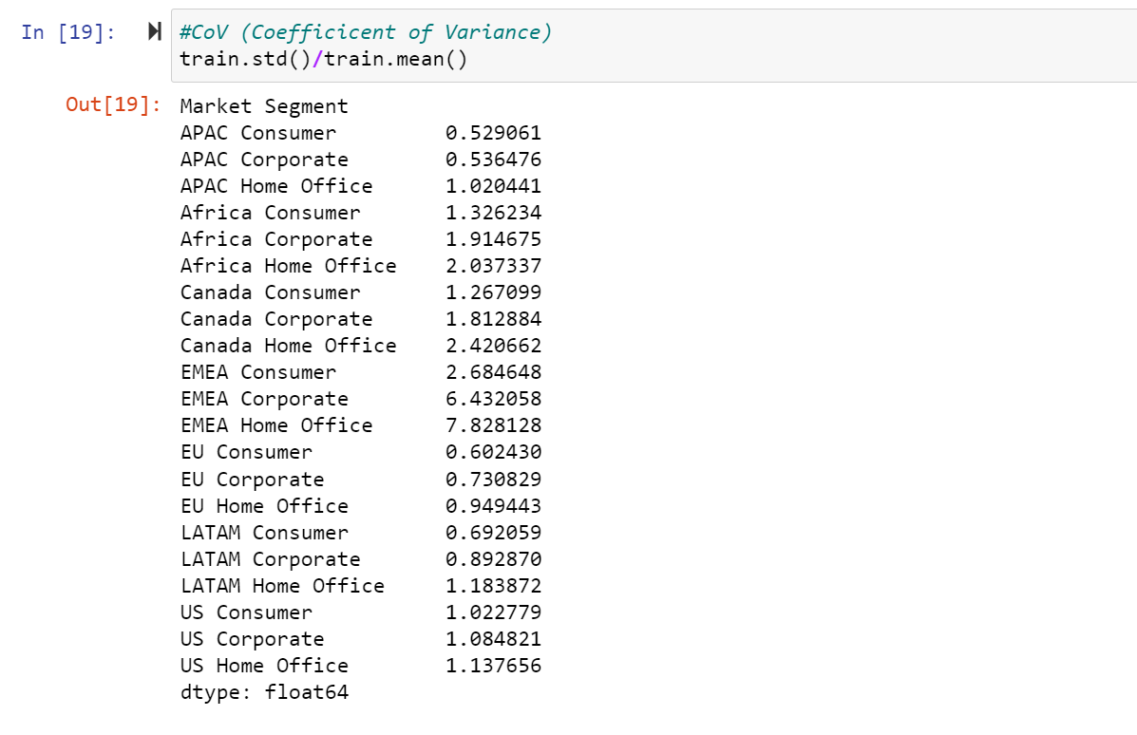
Comparison showing the table of values for the coefficient of variation calculated on the profit for the 21 market segments.

Slide 4
The reason why a market segment “ABC” is the most profitable market segment
APAC Consumers is the most profitable market segment because it has the lowest CoV value.

Slide 5
Concluding the optimum technique from the flow chart that might work best for the sales forecast.
Importing the data
Cleaning the data
Additive and Multiplicative decomposition
Building model and calculating error using smoothing technique and AR model
Recommending the best model

Slide 6
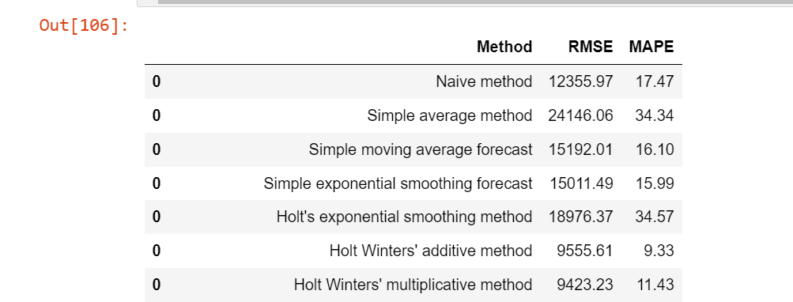
Comparing the sales forecast plots for all the smoothing techniques and their MAPE values.
All the smoothing echniques methods are given in the table. We can see that

Slide 7
Comparing the sales forecast plots for all the smoothing techniques and their MAPE values.
After comparing all the smoothing techniques, the best technique is Holt’s winter additive method because it has least MAPE value

Slide 8
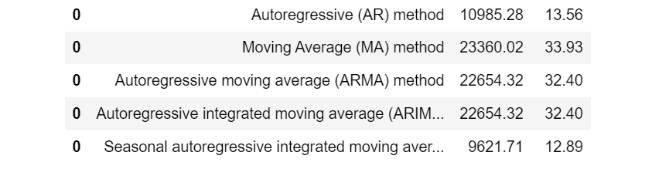
Comparing the sales forecast plots for all the ARIMA techniques and their MAPE values.

Slide 9
Conclusions on which technique works the best for the sales forecast and why? Then reason this using the forecast plot and the MAPE values both.
For AR model, we will be using SARIMA model because it has least MAPE value
After performing smoothing technique, we will be using Holt Winters additive method is best for sales forecast.

