Slide 1

Baugh-Wooley Multiplier
By: Kumar Sai Reddy Guntaka

Slide 2
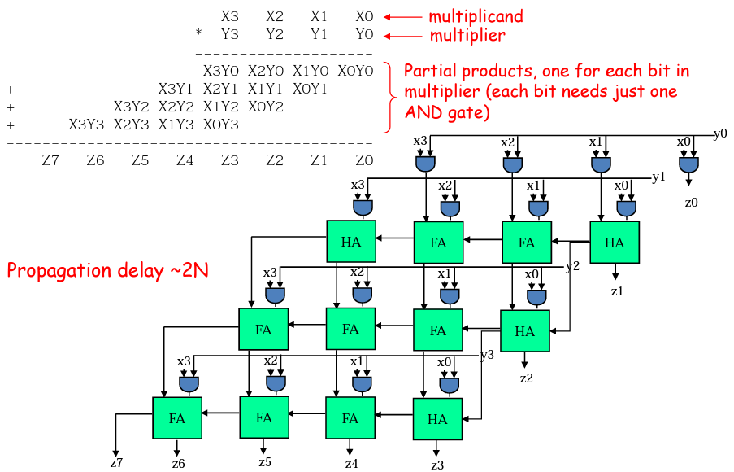
Combinational Multiplier (unsigned)

Slide 3
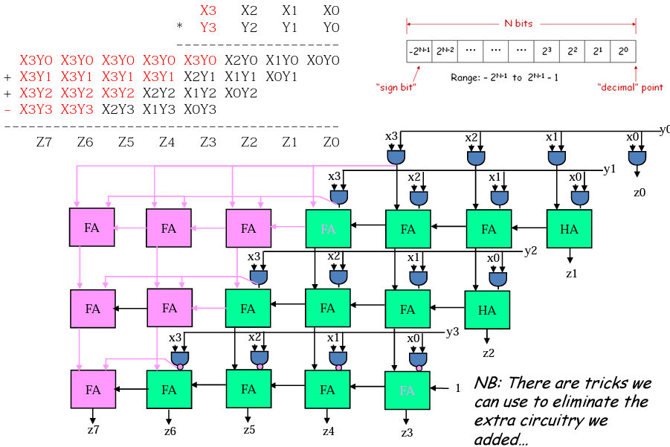
Combinational Multiplier (signed!)

Slide 4
Limitations of signed multiplier:
Signed 2’s complement is widely used because if the result is with in the limits, we can neglect the intermediate overflows or underflows.
Used mostly in microprocessors and DSP processors.

Slide 5
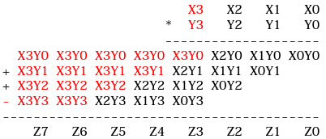
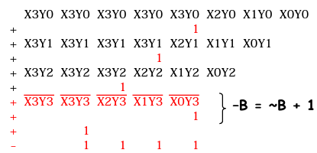
2’s Complement Multiplication (Baugh-Wooley Multiplier):
Step 1: use two's complement operands such that the highest order bit is -2N-1. It is necessary to sign extend partial products and remove the last one.
Step 2: To avoid all those additional adds, add a properly chosen constant and remember to remove it at the end. Subtraction is converted into the addition of (complement + 1).

Slide 6
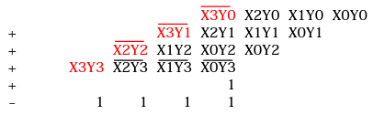
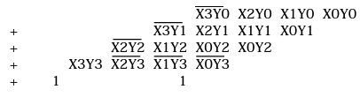
2’s Complement Multiplication (Baugh-Wooley Multiplier):
Step 3: combine the ones and propagate the carries. All the sign extension pieces are removed!
Step 4: Complete the constants computation...
As a result, multiplying 2's complement operands requires almost the same hardware as multiplying unsigned operands!

Slide 7
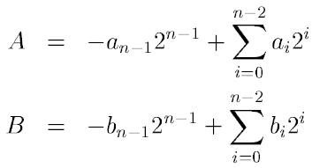
Formulation:
The Baugh-Wooley multiplication technique is an effective method for dealing with sign bits. This approach was created in order to create multipliers for 2's complement numbers. Consider the following two n-bit integers. A and B should be multiplied. A and B can be written as:

Slide 8
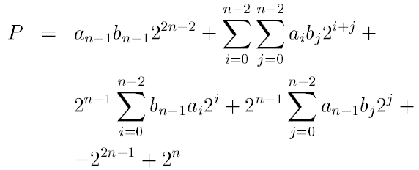
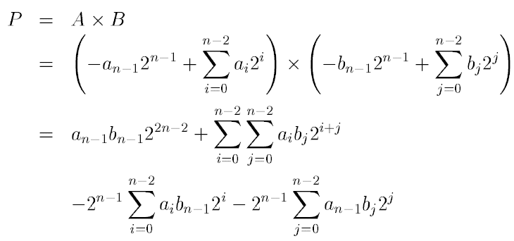
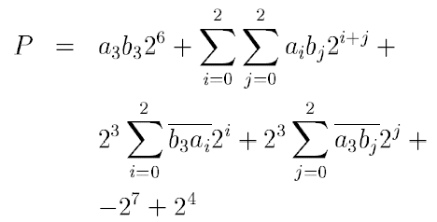
Multiplication:
Assuming 4-bit binary number:

Slide 9
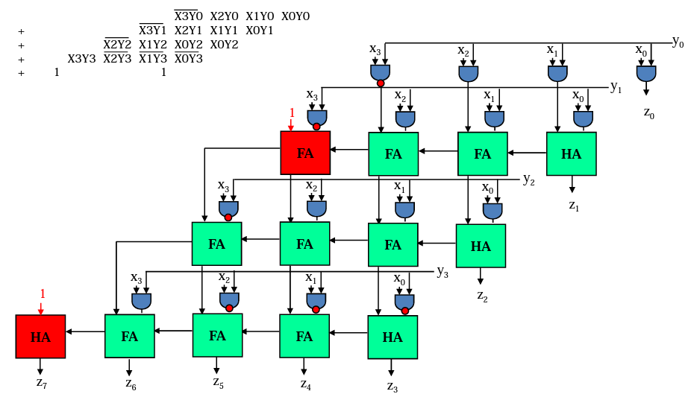
2’s Complement Multiplication:

Slide 10

Thank you

