Slide 1

SRT Division Algorithm
By: Kumar Sai Reddy Guntaka

Slide 2
Introduction:
Digit recurrence algorithm consists of n iterations, where each iteration produces one digit of the quotient. However, digit recurrence algorithms do have preprocessing as well as post processing steps, which are vital in order to, make sure that the dividend, divisor, quotient and remainder are presented correctly.
The most challenging step in the division procedure is the comparison between the divisor and remainder to determine the quotient bit. If this is done by subtracting d from wi , one has to be careful if the result is negative. If so, a correction operation occurs restoring the remainder to the previous interaction, this method is called restoring division. Non-restoring division is an alternative for sequential division by having specific logic for not correcting the quotient; this is achieved by allowing a correlation factor within the algorithm.

Slide 3

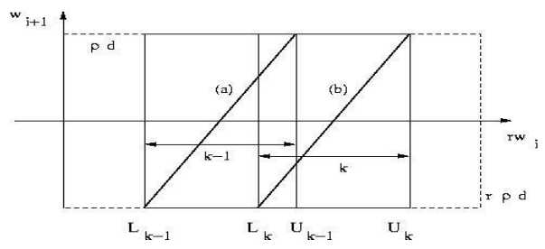


Quotient Selection Table:
Containment condition:
Continuity Condition:
The basic idea of the QST is to choose the value of quotient digit qi+1, based on comparison between shifted partial remainder and the divisor.
This proves that minimum bound on the redundancy factor P is 1/2

Slide 4
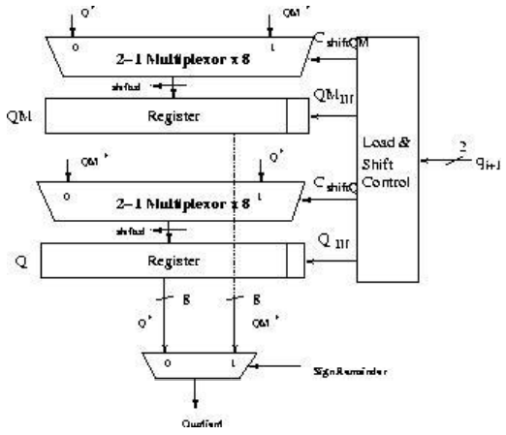
On the fly conversion:
In order to implement on-the-fly conversion, it requires 2 registers to hold qi and qmi . These registers are shifted one digit left with insertion into the least-significant digit, depending on the value of qi+1. In other words, depending on what the subsequent quotient digit, the register either chooses q or qm and concatenates the current converted quotient digit into the least significant digits. The figure4 shows on the fly conversion technique implemented for Radix2 division. In all the implementations, structure of on-the-fly technique remains the same except number of bits of quotient shifted in every iteration changes; number of bits shifted into 2 registers depends on the radix of the divider.

Slide 5
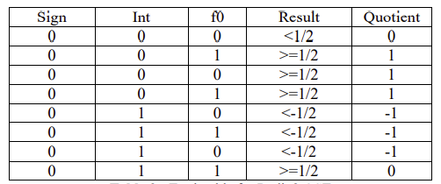
METHODOLOGY:
Radix2 Division: This algorithm is an extension of non-restoring division with a quotient digit set of {-1, 0, 1}. The equation used for this division is as follows:

Slide 6
Steps involved in Radix2 SRT divide:
On reset operand x is loaded in. 2 bits are added to it at the start which serves as sign and integer bit. It acts as first partial remainder w [0]
Partial reminder is shifted by 2 every iteration
First 3 bits of partial reminder identifies correct quotient which is recoded into 2 bits as q+ and q
Selected quotient chooses appropriate value of d from {d, 0, -d}
When -d is selected multiplexor chooses inverted version of d & additional 1 required to produce its 2’s compliment is added as carry input to the CPA adder.
Redundant quotient bit is sent to OTF (On The Fly) converter.
When algorithm requires input operands to be of size greater than double precision, delay due to carry propagate adder becomes the critical path, CPA can be replaced by carry save format adder.

Slide 7
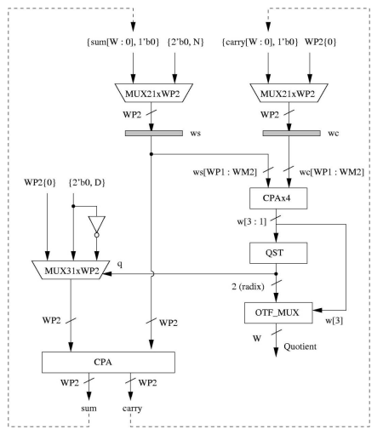


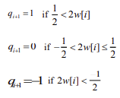
Radix2 hardware block diagram:

Slide 8
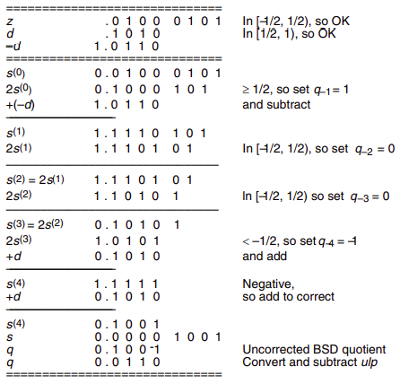
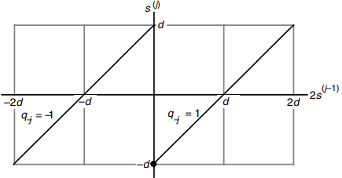
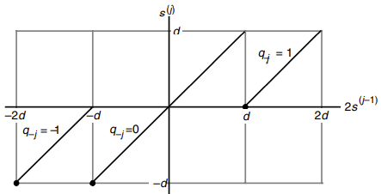
Example:

Slide 9

Thank you

