Slide 1




Floating Point
By: Kumar Sai Reddy Guntaka
Instructor: Shahnam Mirzaei
Date: 12/05/2022

Slide 2


Introduction:
Floating Point arithmetic is by far the most used way of approximating real number arithmetic for performing numerical calculations on modern computers. Each computer had a different arithmetic for long time: bases, significant and exponents’ sizes, formats, etc. Each company implemented its own model, and it hindered the portability between different equipment's until IEEE 754 standard appeared defining a single and universal standard.
One of them, the floating-point arithmetic, is clearly the most efficient way of representing real numbers in computers. Representing an infinite, continuous set (real numbers) with a finite set (machine numbers) is not an easy task: some compromises must be found between speed, accuracy, ease of use and implementation and memory cost. Floating Point Arithmetic represent a very good compromise for most numerical applications.

Slide 3

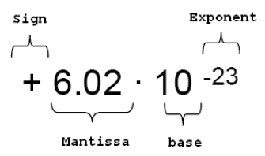
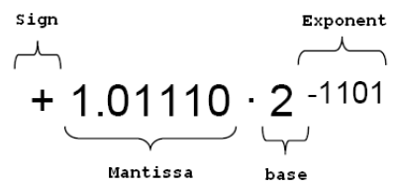
Floating Point Numbers
Sign: it indicates the sign of the number (0 positive and 1 negative).
Mantissa: it sets the value of the number.
Exponent: it contains the value of the base power (biased).
Base: the base (or radix) is implied, and it is common to all the numbers (2 for binary numbers).

Slide 4
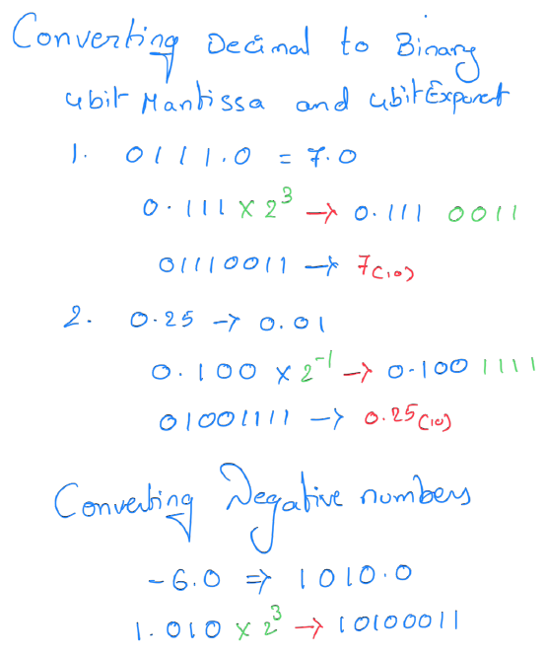
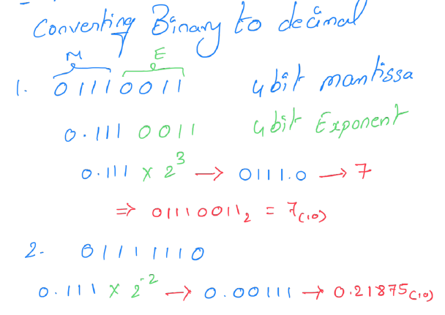
Converting

Slide 5
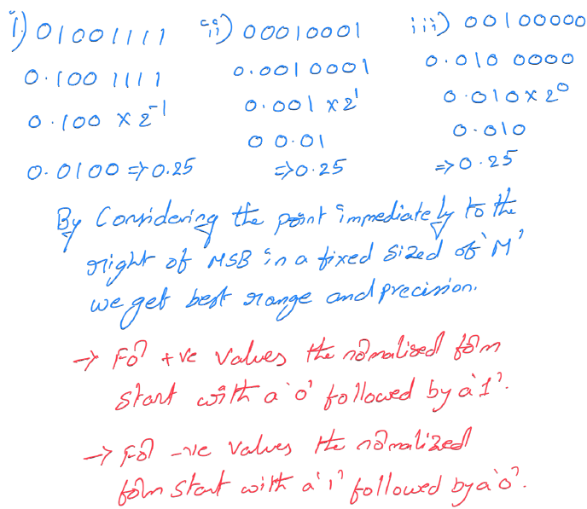
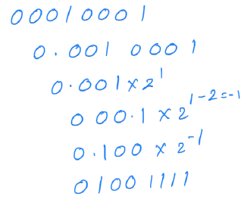
Normalized Floating Point

Slide 6

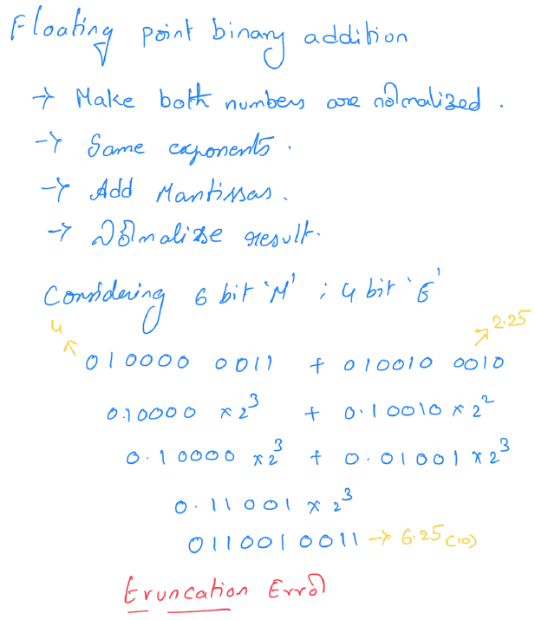
Addition

Slide 7
Data Formats of IEEE 754 Standard
The standard specifies:
Formats for binary and decimal floating-point data for computation and data interchange.
Different operations as addition, subtraction, multiplication and other operations.
Conversion between integer-floating point formats and the other way around.
Different properties to be satisfied when rounding numbers during arithmetic and conversions.
Floating point exceptions and their handling (NaN, ―∞ or zero).
IEEE 754 specifies four different formats to representing the floating-point values:
Simple Precision (32 bits).
Double precision (64 bits).

Slide 8
Addition Steps
1. Extracting signs, exponents and mantissas of both A and B numbers.
2. Treating the special cases:
Operations with A or B equal to zero.
Operations with ―∞.
Operations with NaN.
3. Finding out what type of numbers are given:
Normal
Subnormal
Mixed
4. Shifting the lower exponent number mantissa to the right [Exp1- Exp2] bits.
Setting the output exponent as the highest exponent.
A’s Exponent 3 B’s Exponent -1 Difference (A-B) 4
Number B:
1 1 0 1 0 0 1-→0 0 0 0 1 1 0 1 0 0 1
5. Addition/Subtraction of the numbers and detection of mantissa overflow (carry bit).

Slide 9
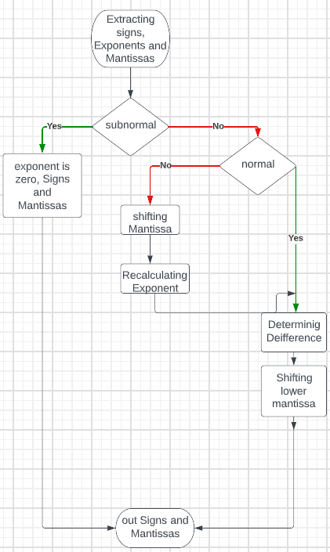
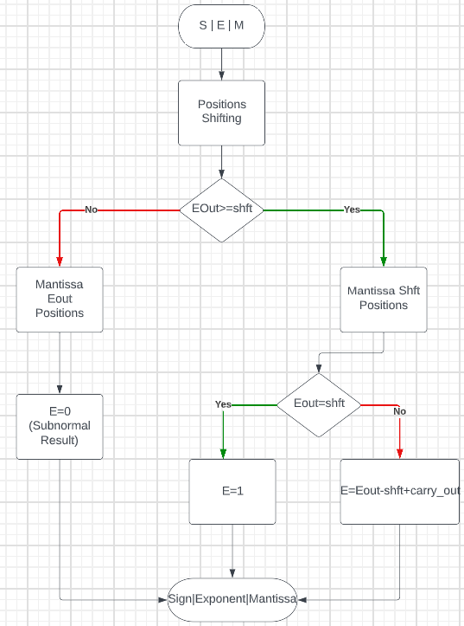
Floating Point Addition
6. Standardizing mantissa shifting it to the left up the first one will be at the first position and updating the value of the exponent according with the carry bit and the shifting over the mantissa. 0.1010101*2^3 1.010101*2^2.
7. Detecting exponent overflow or underflow (result NaN or ―∞).

Slide 10
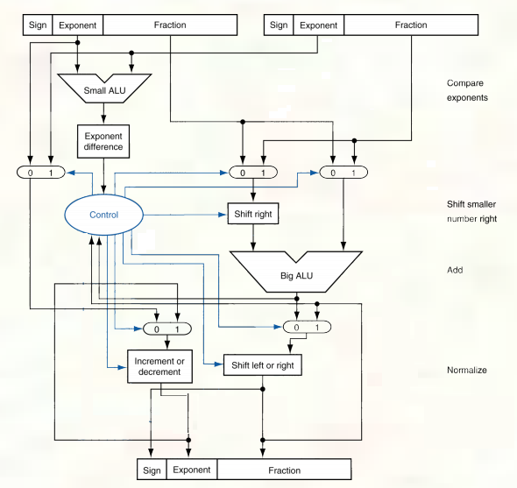
simple architecture of the Floating-Point adder

Slide 11
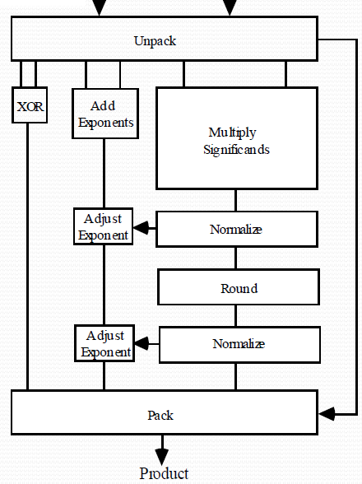
Multiplication
Floating Point Operations:
Procedures for Multiplication:
Check Zeros If one or both operands is equal to zero, return the result as zero.
Compute the sign of the result Sx XOR Sy Multiply mantissa Mx*My Round the result to the allowed number of mantissa bits.
Add exponents biased exponent (Ex) + biased exponent (Ey) -bias biased exponent (Ex) biased exponent (Ey) bias.
Normalize the result Left shift result, decrement result exponent (e.g., 0.001xx…) o Right shift result, increment result exponent (e.g.,10.1xx…).
Check result If larger/smaller than maximum exponent allowed return exponent overflow/underflow.

Slide 12
Exceptions
The exponent value has a bias of 127. It means the exponent value will be between -126 (00000000(2) and +127 (11111110(2) being zero at the value 01111111(2).
Exponent and mantissa values determine the different number r cases that it can be had.
If E = 2w −1 and T ≠ 0 , then r is NaN regardless of S
If E = 2w −1 and T = 0 , then r is ―infinity according with the sign bit
If 1 ≤ E ≤ 2w − 2 , then r is a normal number
If E = 0 and T ≠ 0 , then r is a subnormal number
If E = 0 and T = 0 , then r is ―zero according with

Slide 13
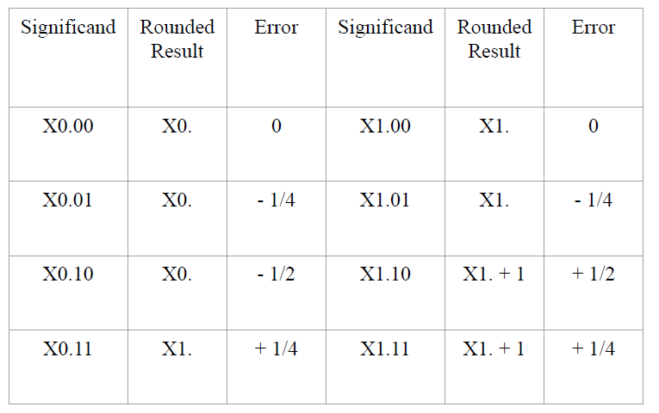
Rounding
Four types of rounding are described by the standard:
Rounding to the nearest (to even number in case of tie) is the floating-point number that is the closest to x.
Rounding to +∞ is the smallest floating-point number (possibly +∞) greater than or equal to x.
Rounding to -∞ is the largest floating-point number (possibly -∞) less than or equal to x.
Rounding to zero is the closest floating-point number to x that is no greater in magnitude than x (it is equal to rounding to -∞ if x ≥ 0 and to +∞ if x ≤ 0.

Slide 14
Barrel Shifter
A barrel shifter is a digital device that can shift a data word by a specific number of bits using just pure combinational logic and no sequential logic. It contains a control input that defines how many bit places it shifts. The Shift Register (Multi-bit) is identical to the Barrel Shifter, except that the bits moved out of the register are shifted back into the opposite end of the register. In right shift operations, for example, the LSBs relocated out of the register are shifted into the MSBs.
Barrel shifters can be used in digital signal processors and processors. A barrel shifter can be implemented as a series of multiplexers, with the output of one multiplexer coupled to the input of the next multiplexer in a fashion that relies on the shift distance. When a barrel shifter is implemented using a series of shift multiplexers, each shifts a word by 2k bit positions (1,2,4,8,16,32...) for varying values of k. The number of stages of multiplexing is proportional to the breadth of the input vector.

Slide 15
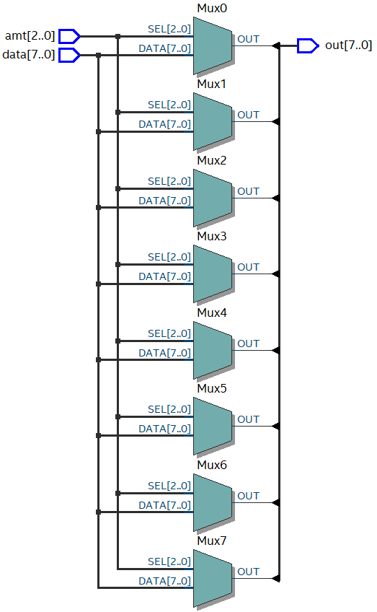
Simple 8-bit right rotator
a simple 8-bit barrel shifter that rotates and arbitrary number of bits to the right. The circuit has an 8-bit data input, data, and a 3-bit control signal, amt, which specifies the amount to be rotated.

Slide 16
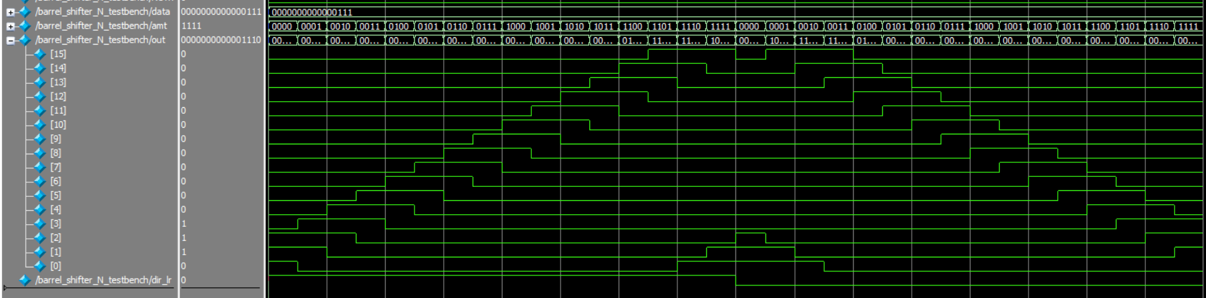
Multifunction Barrel Shifter

Slide 17

Thank you

