Slide 1
Introduction to PETA Linux
By:
Kethana rao
Shivani
Sai chand T
Kumar sai reddy

Slide 2
Agenda:
About PetaLunix.
Yocto Project.
PetaLunix Command Line Interface(CLI) Tools.
Setup of PetaLunix in different environments.

Slide 3
What Is PetaLinux?
PetaLinux is a set of high-level commands built on the Yocto Linux distribution. PetaLinux tools let you to create, configure, and deploy Embedded Linux solutions/Linux images for Xilinx processing systems. It is designed to increase design productivity and integrates with Xilinx hardware design tools (such as Vivado) to simplify the creation of Linux systems for Zynq® UltraScale+TM MPSoCs, Zynq®-7000 SoCs, and MicroBlazeTM. It is essentially a collection of simplified instructions that can be used to rapidly and simply create bespoke Linux systems/images for Xilinx devices!
As new features and devices are added to the PetaLinux platform, developers may use the tools to synchronize the software platform with the hardware design. PetaLinux tools will produce a specific Linux Board Support Package for Xilinx embedded processing IP cores, as well as kernel and boot loader settings.

Slide 4
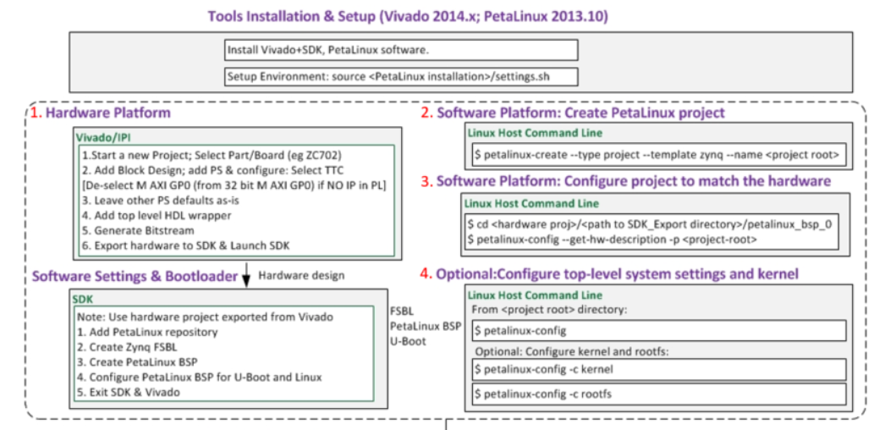
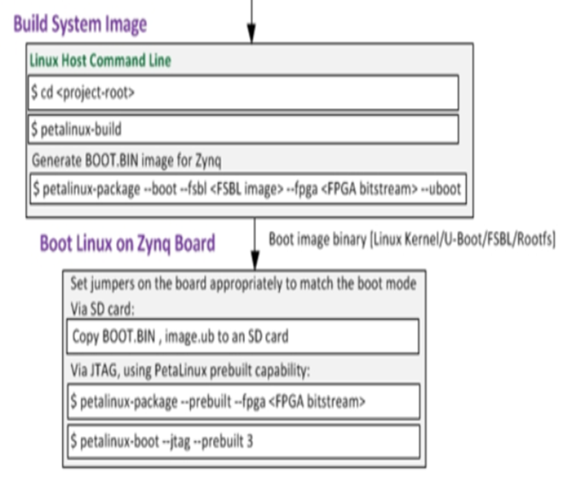
PetaLinux Design Flow:

Slide 5
Step 1: Create the Hardware Platform:
In order to build a targeted PetaLinux project for a board, the PetaLinux tools need to be aware of the underlying hardware system on the board. The HDF file describes the hardware architecture of your board. It is mandatory if you want to build a PetaLinux project, so that the resulting image can configure the board correctly when powered on.
Create the Output Products for the block diagram
Create the Hardware Description Language (HDL) wrapper
Generate the Bitstream
Export the hardware to SDK to create the Hardware Description Language (HDF) file

Slide 6
General Flow:
Step 1: Creating the Project
Step 2: Running Tcl and Tcl Scripts
Step 3: Creating a Block Design & Adding IP
Step 4: Customizing the IP
Step 5: Building and Adding HDL IP
Step 6: Making & Breaking Connections
Step 7: Adding I/O and Interfaces
Step 8: Navigating and Finding Objects
Step 9: Marking Nets for Debug
Step 10: Adding Processors and PS
Step 11: Using Designer Assistance
Step 12: Managing Addresses
Step 13:Getting the View You Want
Step 14: Wrapping Up the Design
Step 15: Turning the Design into Reusable IP
Step 16: Using BDs as Containers
https://classroom.github.com/a/n8MhFXl5

Slide 7
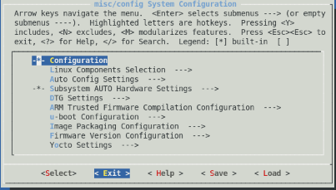

Step 2: Create the PetaLinux Project:
Creating a project:
Petalinux –create –type project –template zynMP --name first_linux
Extract hardware:
1. cd first_linux
2. Petalinux-config –get-hw- description=<path of HDF>
BSP:
This contains some pre-built files which can be used to speed up the development process. It can only be used with standard Xilinx development boards as it contains a HDF file that describes the underlying architecture of the board.
Because it contains a HDF file, you can skip Step 1 above if you use this method. In total, it contains the following:
PetaLinux Project and Workspace
HDF and bitstream
Prebuilt images for FS-BOOT (in case of MicroBlaze), ATF (bl31 in case of Zynq UltraScale+), Linux, U-Boot, pmufw (Zynq UltraScale+), rootfs, dtb (device tree blob), BOOT.bin etc.
Petalinux-create –t project –s <path to BSP>

Slide 8
Step 3: Editing the Image:
PetaLinux uses recipes to perform tasks. For example, if you wanted to generate a device tree, normally you would need to complete a series of different steps to do this (Download the source, import the HDF file... etc.). These steps can be combined and run as a single 'device tree' recipe in PetaLinux.
The recipes are built using Bitbake. It will check if the recipes are dependent on each other/other tasks and distribute the build tasks appropriately. Users can pass information to Bitbake via the local.conf file in the conf folder.
PetaLinux recipes are also organized into Layers.
A number of standard recipes are used to create an image in PetaLinux. However, if you want to customize an image, you cannot directly modify a recipe or a PetaLinux build directory.
This is because, due to the tools-flow, the recipes and directories are overwritten every time you rebuild the project, so any changes will be lost. Instead, you must create something called a ‘recipe append’. This is simply a file which contains all requested modifications to the standard recipes. The system checks the ‘recipe appends’ at build time and uses them to modify the image.

Slide 9
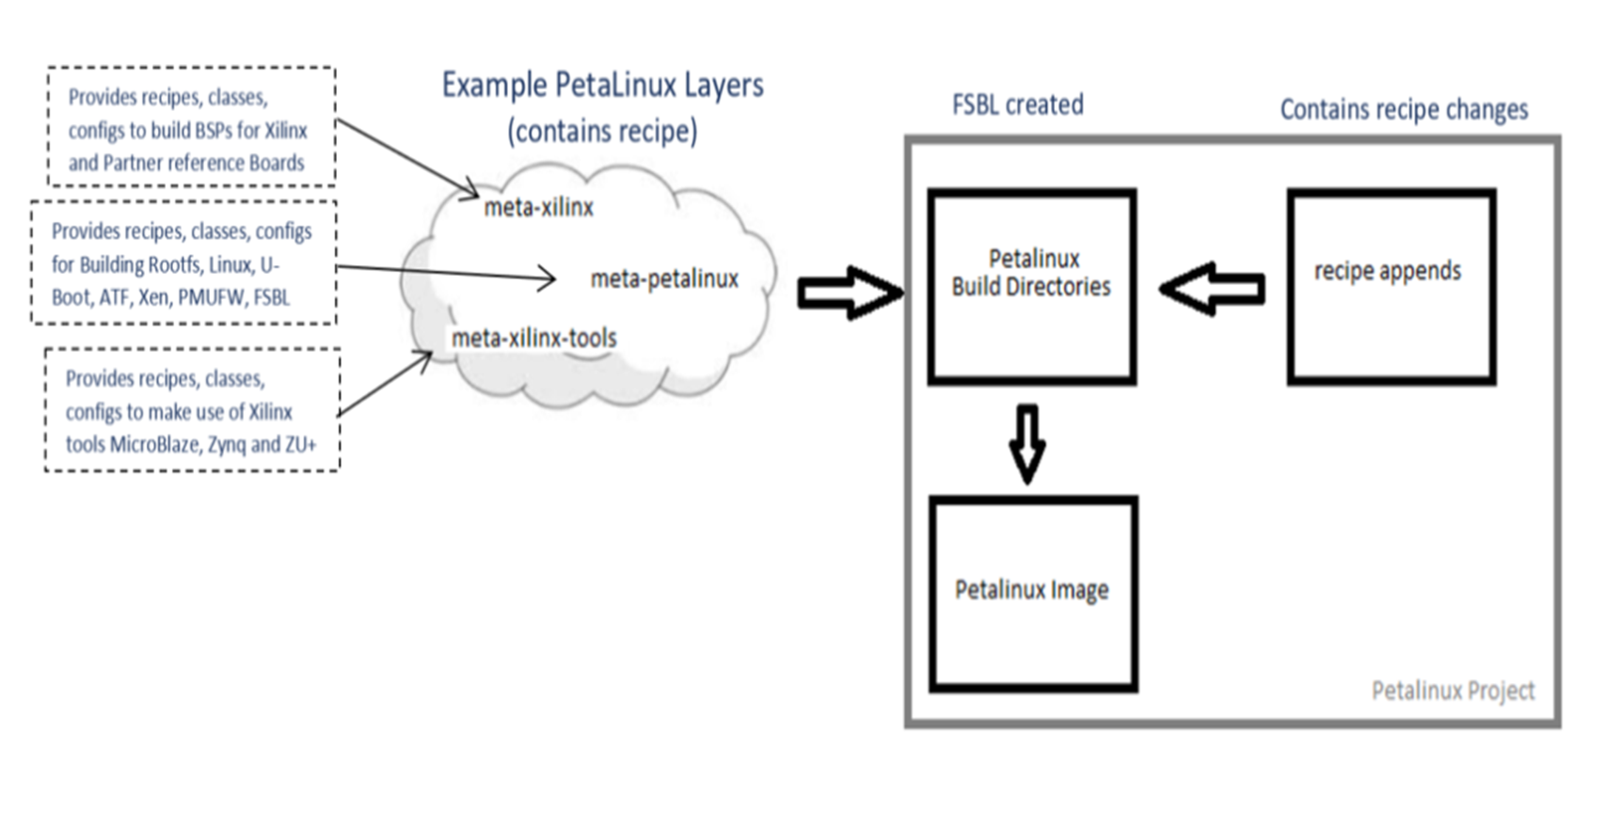
creating ‘recipe append’:
https://support.xilinx.com/s/article/968413?language=en_US#:~:text=PetaLinux%20is%20a%20set%20of,images%20for%20Xilinx%20processing%20systems.

Slide 10
What is yocto project:
It is an ecosystem that helps to build a custom embedded linux distribution hosted by the linux foundation.
Active community of developers maintaining 2000+ linux packages.
It is hardware independent hence helps in solving many enterprise level problems.
It is easier to migrate from one platform/architecture to the next.

Slide 11
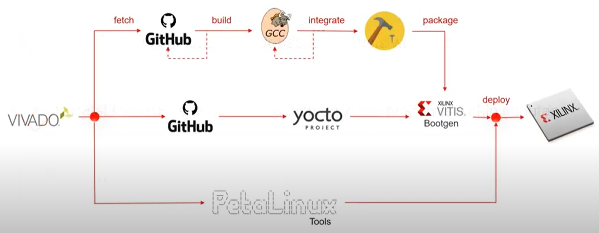
Options for building embedded software for xilinx device:

Slide 12
Workflow:
The workflow breaks down into the following steps:
Fetch – get the source code
Extract – unpack the sources
Patch – apply patches for bug fixes and new capability
Configure – set up your environment specifications
Build – compile and link
Install – copy files to target directories
Package – bundle files for installation

Slide 13
Few things about yocto project:
All layers can be found in the layer index. Layers which have applied for Yocto Project Compatible status can be found in the Yocto Project Compatible index.
Intel, TI, NXP and others have information on what BSP layers to use with their silicon. These layers have names such as “meta-intel” or “meta-ti”.
Different layers can be used to logically separate information in your build. As an example, you could have a BSP layer, a GUI layer, a distro configuration, middleware, or an application.Putting your entire build into one layer limits and complicates future customization and reuse.

Slide 14
Petalinux vs yocto:
Yocto is the "disto builder" while PetaLinux is the higher level tool suite. PetaLinux has Xilinx tool integeration, e.g. ability to link to Vivado HW projects and generate DTBs with soft-IP. It also has tools for booting, and integrating HW and SW projects. There are some extra tools for creation of custom kernel modules and apps without Yoctos learning curve. So its all about preferred developer workflow. There should be none (or very little) difference in the actual generated distro, and nothing board specific.

Slide 15
Yocto vs petalinux:
If you are just going to evaluate the platform PetaLinux will get you going faster. Yocto will let you do more customization long term. petalinux can't be easily customized and it's not very flexible(like which kernel config to use).
Petalinux uses Yocto to build the root filesystem, so it effectively sits on top of Yocto. For a Zynq-7000, this isn't a huge advantage, but with the MPsoc it is really helpful. The MPsoc needs a bootloader, ATF firmware, the bitstream and u-boot. Changing the settings to use different bitstreams, kernels and root filesystems with Petalinux is quite straightforward. You can do most of it with directly Yocto, but having the FPGA support makes it easier.

Slide 16
Command Line Interface(CLI) Tools:
petalinux-create
petalinux-config
petalinux-build
petalinux-util
petalinux-package
petalinux-upgrade
petalinux-devtool
petalinux-boot

Slide 17
Petalinux-create:
The petalinux-create tool creates objects that are part of a PetaLinux project
This tool provides two separate workflows
Petalinux-create -t project workflow
petalinux-create -tCOMPONENT workflow
In the petalinux-create -t project workflow, the tool creates a new PetaLinux project directory structure
In the petalinux-create -tCOMPONENT workflow, the tool creates a component within the specified project

Slide 18
petalinux-config:
This allows us to customize the specified project
This tool provides two separate workflows
petalinux-config --get-hw-description workflow
petalinux-config -c COMPONENT
In the petalinux-config --get-hw-description workflow, a project is initialized or updated to reflect the specified hardware configuration
In the petalinux-config -c COMPONENT workflow, the specified component is customized using a menuconfig interface.

Slide 19
petalinux-build :
The petalinux-build tool builds either the entire embedded Linux system or a specified component of the Linux system.
This tool uses the Yocto Project underneath.
Whenever petalinux-build is invoked, it internally calls bitbake.
Operation of petalinux build can be dictated using the petalinux-build -c and petalinux-build -x options

Slide 20
Petalinux-util :
The petalinux-util program assists the other PetaLinux processes with a variety of tasks.
Depending on the support function required, the tool provides multiple workflows.
1. petalinux-util --gdb
2. petalinux-util --dfu-util
petalinux-util --gdb
This wraps the normal GNU GDB debugger and simply launches it in the current terminal
petalinux-util --dfu-util
The petalinux-util —dfu-util command runs dfu-util in the current terminal as a wrapper over the ordinary dfu-util command.
At the terminal prompt, type petalinux-util —dfuutil —help to get a list of verbose dfu-util options.

Slide 21
petalinux-package:
The petalinux-package program converts a PetaLinux project into a deployment-ready format.
The program includes a number of processes, each of which has different operations based on the target package format.
Boot, bsp, and pre-built are the formats/workflows that are supported.
The petalinux-package tool is used to provide a custom workflow using the package type name in the format petalinux-package —PACKAGETYPE

Slide 22
petalinux-upgrade:
This command allows you to upgrade between different PetaLinux versions.
We can use the upgrade command to update BSPs or projects developed in previous versions to the current release.
When transferring existing projects between Vivado versions, this can save a lot of time.

Slide 23
petalinux-boot:
The petalinux-boot command boots MicroBlaze™ CPU, Zynq® devices, and Zynq UltraScale+™ devices with PetaLinux images through JTAG/QEMU.
1) petalinux-boot –jtag
2) petalinux-boot --qemu
petalinux-boot —jtag workflow.
Images are downloaded and booted on a physical board via a JTAG cable connection
petalinux-boot —qemu
Images are loaded and booted using the QEMU software emulator in the petalinux-boot —qemu workflow.
Either the --jtag or the --qemu is mandatory for the petalinux-boot tool

Slide 24
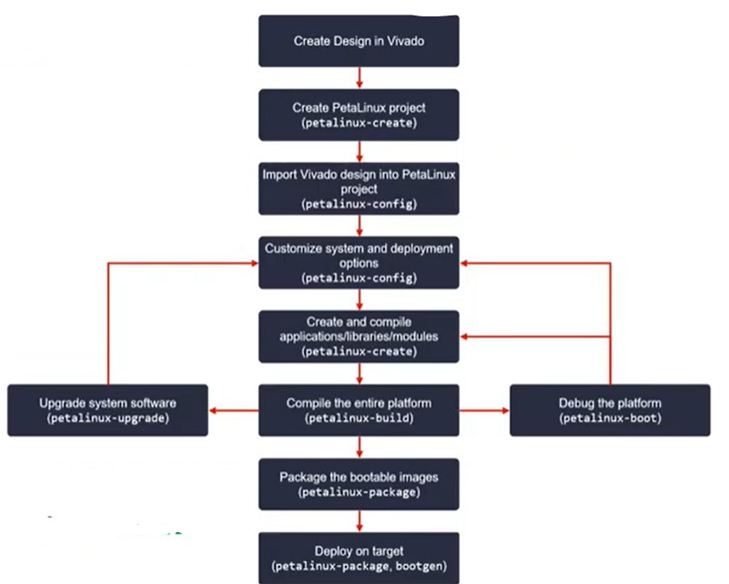
Command Flow:

Slide 25
How to Setup PetaLinux build environment on Windows WSL:
Enable WSL
Check if virtualization is enabled
Enable Virtual Machine feature
Restart machine
Download the Linux kernel update package
Set WSL 2 as default version
Install a Linux distribution
(Optional) Check WSL version assigned to Linux distributions

Slide 26
Prerequisites for WSL:
You can check your OS Build and System Type by going to Settings > System > About
Windows 10 Pro
Have a x64 or ARM64 machine
For x64 systems: Version 1903 or higher, with Build 18362 or higher.
For ARM64 systems: Version 2004 or higher, with Build 19041 or higher.
WSL stands short for “Windows Subsystem for Linux”. It allows you to run a Linux environment directly on Windows, where you can use all command-line tools you know from Linux.

Slide 27
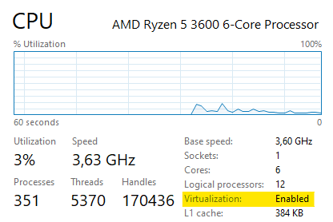
Enable WSL:
Open your PowerShell as an Administrator and run the below mentioned command.
2. Check if virtualization is enabled:
To enable the virtual machine feature (in step 3), your machine will require virtualization capabilities. You can check this in your Task Manager. In your CPU overview you can see if virtualization is enabled.
3. Enable Virtual Machine feature:
Before installing WSL2 you have to enable this feature. Open PowerShell as Administrator and run the below mentioned command.
dism.exe /online /enable-feature /featurename:VirtualMachinePlatform /all /norestart
4. Restart machine:
After running both commands, you have to restart your machine to complete the WSL install and update to WSL 2.

Slide 28
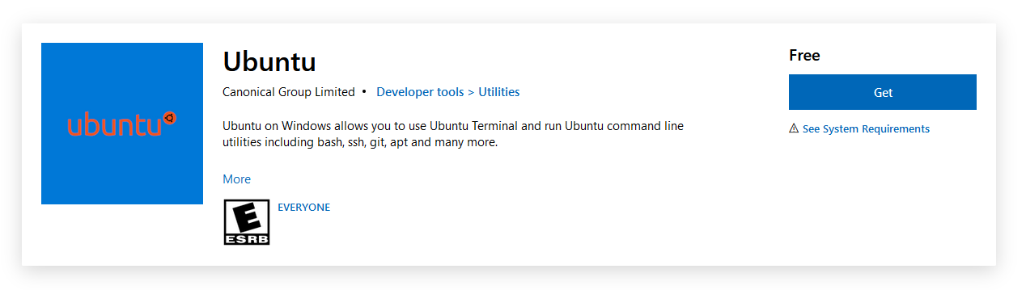
5. Download the Linux kernel update package:
If you don’t know which architecture you have, you can check it in your settings which mentioned above under Prerequisites.
After downloading it, install the package.
6. Set WSL 2 as default version:
Open PowerShell and run the below mentioned command.
wsl --set-default-version 2
7. Install a Linux distribution:
You can search for a Linux distribution in the Microsoft Store. You can also install more than one distro and switch between them.
I would recommend installing Ubuntu, as the publisher Canonical worked together with Microsoft to develop WSL.
Open Microsoft Store: Ubuntu
When you first start Ubuntu, you will be asked to create a user and a password. If you want, you can just type in the credentials you already use on your Windows login.

Slide 29
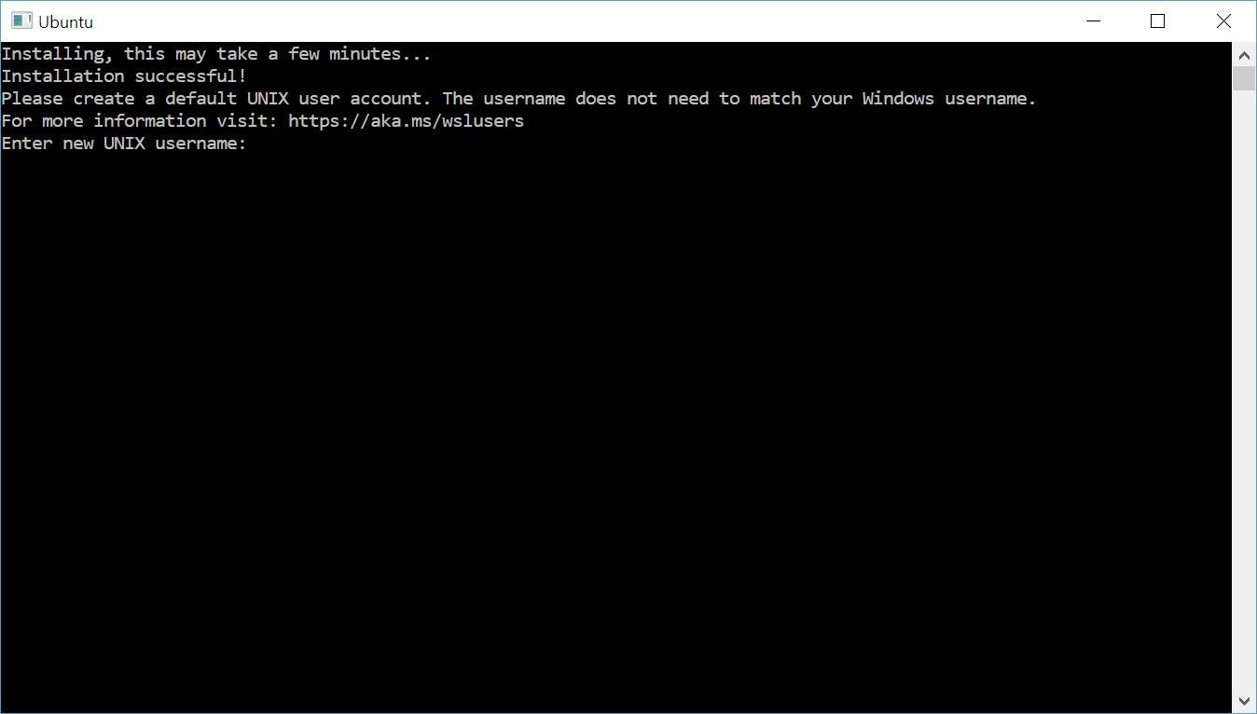
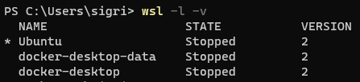
If you have everything set up for WSL 2 (Virtual Machine feature enabled and Linux kernel update) and a distro is still on version 1 you can easily update it with following command
8. (Optional) Check WSL version assigned to Linux distributions:
With the command wsl -l –v in the PowerShell you can list all your Linux distros and check the version. The output looks like this:
wsl --set-version <distribution name> <versionNumber>
Windows then automatically updates the assigned WSL version.

Slide 30
Thank you

