Slide 1
Smart-Cab
Project By :
Anmol Kapoor 1MS17IS026
Kumar Hegde 1MS18IS406
Pranav Hegde 1MS18IS412

Slide 2
SmartCab
In the not-so-distant future, taxicab companies across the United States no longer employ human drivers to operate their fleet of vehicles. Instead, the taxicabs are operated by self-driving agents, known as SmartCabs,
to transport people from one location to another within the cities those companies operate. In major metropolitan areas, such as Chicago, New York City, and San Francisco, an increasing number of people have come to depend on smartcabs to get to where they need to go as safely and reliably as possible.

Slide 3
Although smartcabs have become the transport of choice, concerns have arose that a self-driving agent might not be as safe or reliable as human drivers, particularly when considering city traffic lights and other vehicles. To alleviate these concerns, My task as an employee for a national taxicab company is to use reinforcement learning techniques to construct a demonstration of a smartcab operating in real-time to prove that both safety and reliability can be achieved.

Slide 4
The scope of this project is very broad.
Few of them are:
• This can be implemented in Some amount of time for proper Travelling process.
• This can be accessed anytime anywhere, since it is a web application provided only an internet connection.
• The user had to travel a long distance or maybe short distance in the automated system.

Slide 5
The smartcab operates in an ideal, grid-like city (similar to New York City), with roads going in the North-South and East-West directions. Other vehicles will certainly be present on the road, but there will be no pedestrians to be concerned with. At each intersection there is a traffic light that either allows traffic in the North-South direction or the East-West direction. U.S. Right-of-Way rules apply:
On a green light, a left turn is permitted if there is no oncoming traffic making a right turn or coming straight through the intersection.
On a red light, a right turn is permitted if no oncoming traffic is approaching from your left through the intersection. To understand how to correctly yield to oncoming traffic when turning left.

Slide 6
Woking Of SmartCab
smartcab is assigned a route plan based on the passengers' starting location and destination.
The route is split at each intersection into waypoints, and the smartcab, at any instant, is at some intersection in the world .
Therefore, the next waypoint to the destination, assuming the destination has not already been reached, is one intersection away in one direction (North, South, East, or West).
The smartcab has only an egocentric view of the intersection it is at: It can determine the state of the traffic light for its direction of movement, and whether there is a vehicle at the intersection for each of the oncoming directions.

Slide 7
For each action, the smartcab may either idle at the intersection, or drive to the next intersection to the left, right, or ahead of it.
Finally, each trip has a time to reach the destination which decreases for each action taken (the passengers want to get there quickly).
If the allotted time becomes zero before reaching the destination, the trip has failed.

Slide 8
Rewards and Goal
The smartcab will receive positive or negative rewards based on the action it has taken. Expectedly,
Tthe smartcab will receive a small positive reward when making a good action, and a varying amount of negative reward dependent on the severity of the traffic violation it would have committed.
Based on the rewards and penalties the smartcab receives, the self-driving agent implementation should learn an optimal policy for driving on the city roads while obeying traffic rules, avoiding accidents, and reaching passengers' destinations in the allotted time.

Slide 9
Highlights
In this project i have applied reinforcement learning techniques for a self-driving agent in a simplified world to aid it in effectively reaching its destinations in the allotted time.
we have first investigated the environment, the agent operates in, by constructing a very basic driving implementation. Once the agent was successful at operating within the environment, we have then identified each possible state the agent can be in when considering such things as traffic lights and oncoming traffic at each intersection. With states identified,

Slide 10
we have then implemented a Q-Learning algorithm for the self-driving agent to guide the agent towards its destination within the allotted time.
Finally, we have improved upon the Q-Learning algorithm to find the best configuration of learning and exploration factors to ensure the self-driving agent is reaching its destinations with consistently positive results.

Slide 11
Algorithm
Q-Learning Algorithm
Q-learning is an off policy reinforcement learning algorithm that seeks to find the best action to take given the current state. It’s considered off-policy because the q-learning function learns from actions that are outside the current policy, like taking random actions, and therefore a policy isn’t needed. More specifically,
q-learning seeks to learn a policy that maximizes the total reward.
What’s ‘Q’?
The ‘q’ in q-learning stands for quality. Quality in this case represents how useful a given action is in gaining some future reward.

Slide 12
Create a q-table
When q-learning is performed we create what’s called a q-table or matrix that follows the shape of [state, action] and we initialize our values to zero.
We then update and store our q-values after an episode. This q-table becomes a reference table for our agent to select the best action based on the q-value.

Slide 13
in this smartcab project we are constructing an optimized Q-Learning driving agent that will navigate a Smartcab through its environment towards a goal.
Since the Smartcab is expected to drive passengers from one location to another, the driving agent will be evaluated on two very important metrics:
Safety and Reliability. A driving agent that gets the Smartcab to its destination while running red lights or narrowly avoiding accidents would be considered unsafe. Similarly, a driving agent that frequently fails to reach the destination in time would be considered unreliable.
Maximizing the driving agent's safety and reliability would ensure that Smartcabs have a permanent place in the transportation industry.

Slide 14
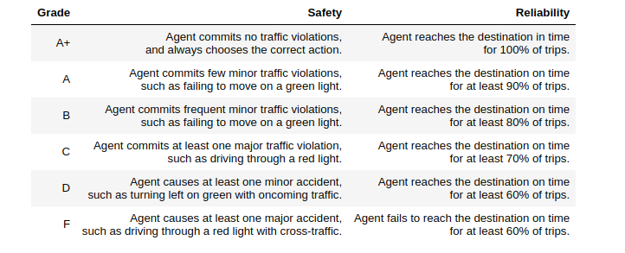
Safety and Reliability are measured using a letter-grade system as follows

Slide 15
Software and Libraries used:
Python 2.7
NumPy
Pandas
Scikit-learn
Matplotlib
Jupyter Notebook
PyGame

Slide 16
Understand the World
Before starting to work on implementing driving agent, it's necessary to first understand the world (environment) which the Smartcab and driving agent work in
One of the major components to building a self-learning agent is understanding the characteristics about the agent, which includes how the agent operates.
To begin, agent.py agent code exactly how it is. Note that in the visual simulation the white vehicle is our Smartcab.

Slide 17
Driving Agent
The first step to creating an optimized Q-Learning driving agent is getting the agent to actually take valid actions.
In this case, a valid action is one of `None`, (do nothing) `'Left'` (turn left), `'Right'` (turn right), or `'Forward'` (go forward).
For the first implementation, navigate to the `'choose_action()'` agent function and make the driving agent randomly choose one of these actions.
Note that before we have access to several class variables that will help you write this functionality, such as `'self.learning'` and `'self.valid_actions'`. Once implemented, run the agent file and simulation briefly to confirm that driving agent is taking a random action each time step.

Slide 18
Inform the Driving Agent
The second step to creating an optimized Q-learning driving agent is defining a set of states that the agent can occupy in the environment.
Depending on the input, sensory data, and additional variables available to the driving agent, a set of states can be defined for the agent so that it can eventually learn what action it should take when occupying a state.
The condition of 'if state then action' for each state is called a policy, and is ultimately what the driving agent is expected to learn.

Slide 19
Identify States
Inspecting the 'build_state()' agent function shows that the driving agent is given the following data from the environment:
'waypoint', which is the direction the Smartcab should drive leading to the destination, relative to the Smartcab's heading.
'inputs', which is the sensor data from the Smartcab. It includes
'light', the color of the light.
'left', the intended direction of travel for a vehicle to the Smartcab's left. Returns None if no vehicle is present.

Slide 20
'right', the intended direction of travel for a vehicle to the Smartcab's right. Returns None if no vehicle is present.
'oncoming', the intended direction of travel for a vehicle across the intersection from the Smartcab. Returns None if no vehicle is present.
'deadline', which is the number of actions remaining for the Smartcab to reach the destination before running out of time.

Slide 21
State Space
The total size of state can be calculated as follows :
waypoints are of 3 type :
left, right, forward = 3
inputs are of four types:
light, left, right and oncomming.
light could be of 2 type:
Red and Green = 2
left could have 4 value:
Right, Left, forward and none = 4

Slide 22
right could have 4 value:
Right, Left, Forward and none = 4
oncomming could have 4 values:
Right, Left, Forward and none = 4
But for driving in US we don't actually need to see vehichle form right side. So iwe are skipping this input also.
Total combination = 4 * 4* 2 = 32
So the size of state space would be = 3 * 32 = 96

Slide 23
Implement a Q-Learning Driving Agent
The third step to creating an optimized Q-Learning agent is to begin implementing the functionality of Q-Learning itself.
The concept of Q-Learning is fairly straightforward: ” For every state the agent visits, create an entry in the Q-table for all state-action pairs available”
Then, when the agent encounters a state and performs an action, update the Q-value associated with that state-action pair based on the reward received and the interative update rule implemented.

Slide 24
Basic Agent Simulation Results
To obtain results from the initial simulation, you will need to adjust following flags:
'enforce_deadline' - Set this to True to force the driving agent to capture whether it reaches the destination in time.
'update_delay' - Set this to a small value (such as 0.01) to reduce the time between steps in each trial.
'log_metrics' - Set this to True to log the simluation results as a .csv file in /logs/.
'n_test' - Set this to '10' to perform 10 testing trials.

Slide 25
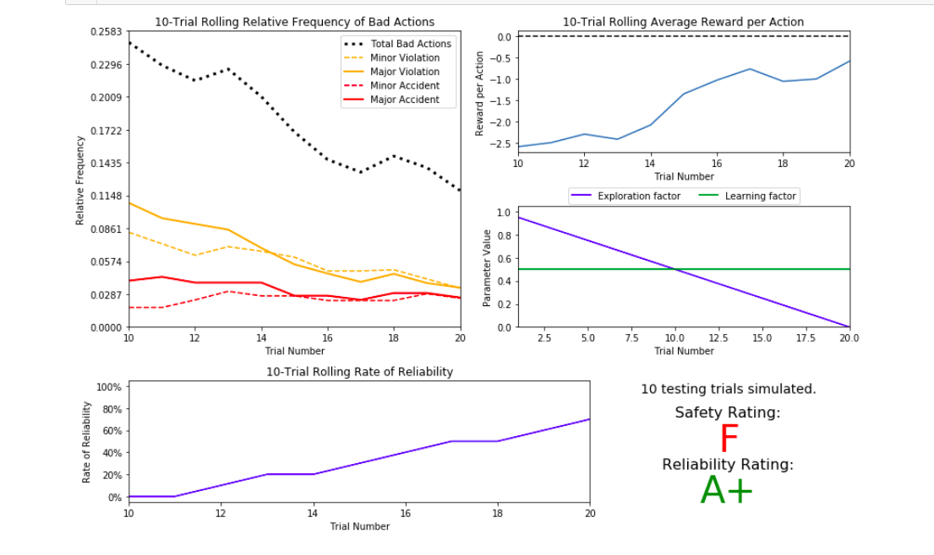
Result of Q-Learning Trail Test

Slide 26
Example of optimal policy
state combination of following :
waypoint : left right and forward
Inputs: left light oncoming
An optimal policy should have these outputs for given states :
State 1:
waypoint: forward
inputs[light]: red
inputs[oncomming]: right
inputs[left]: None
Idle Output:
Stop

Slide 27
State 2:
waypoint: right
inputs[light]: green
inputs[oncomming]: forward
inputs[left]: None
Idle Output:
Go Right
this clearly shows that moving right is optimal.

Slide 28
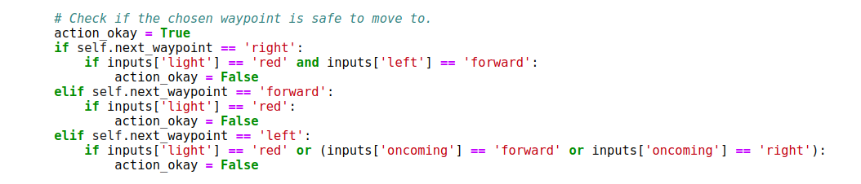
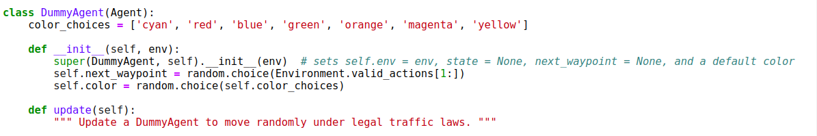
Sample Implementation
Creating a Dummy Traffic Example :

Slide 29
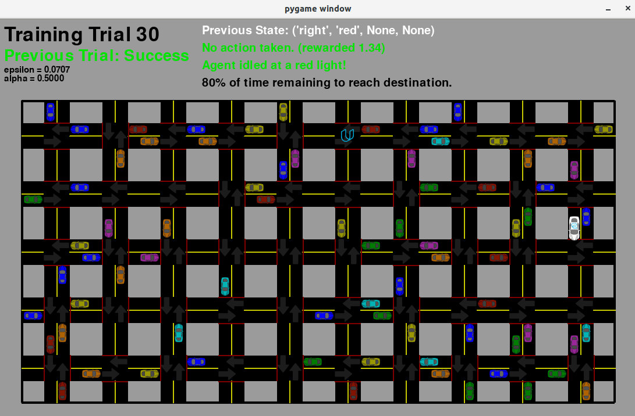
Training Trails

Slide 30
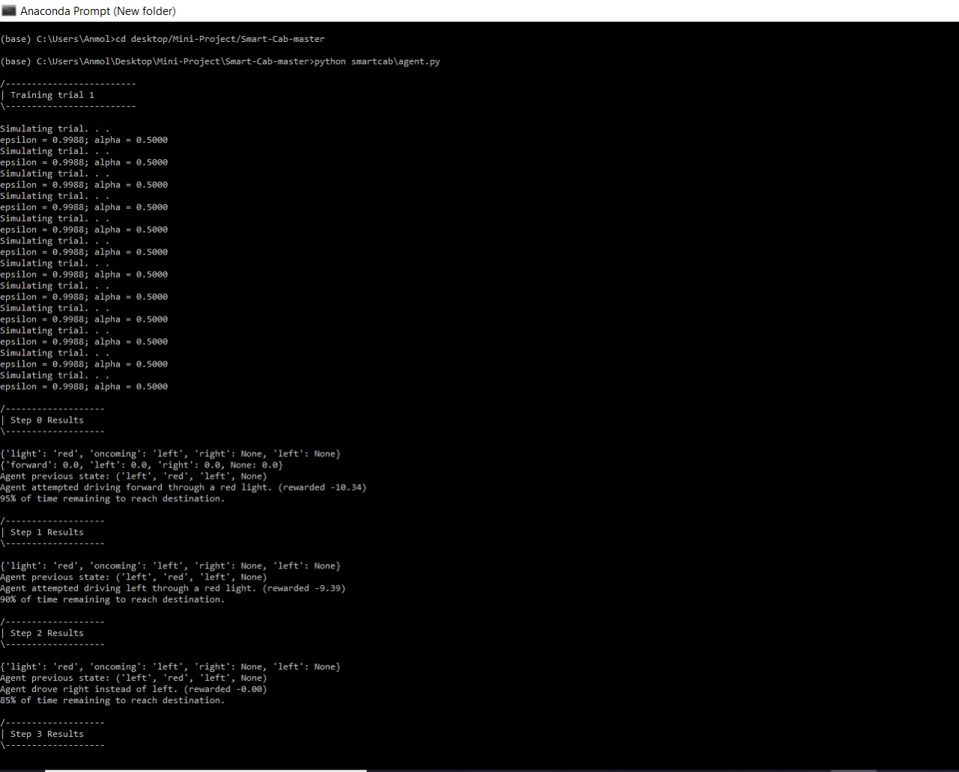
Training Trails

Slide 31
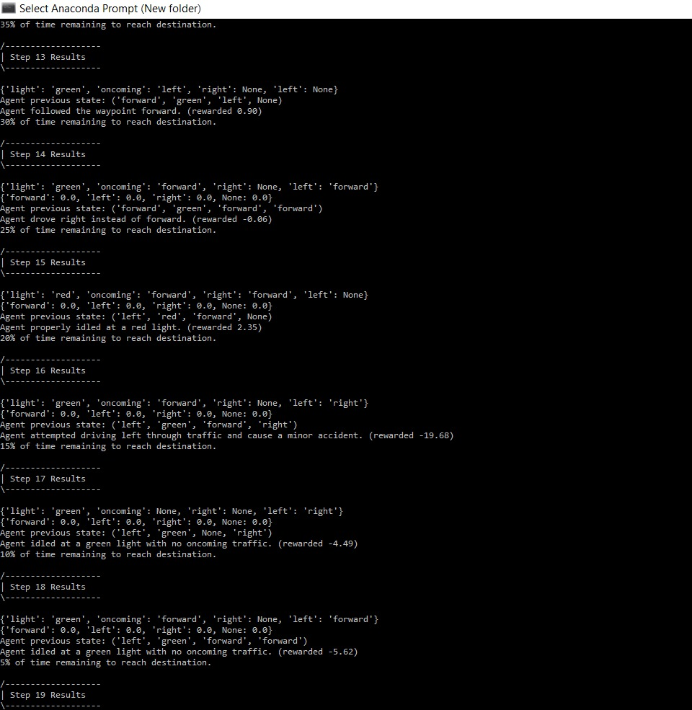

Slide 32
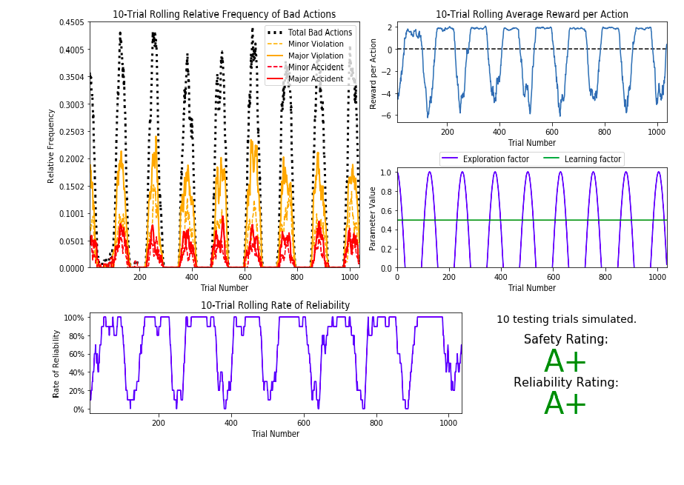
Output

Slide 33
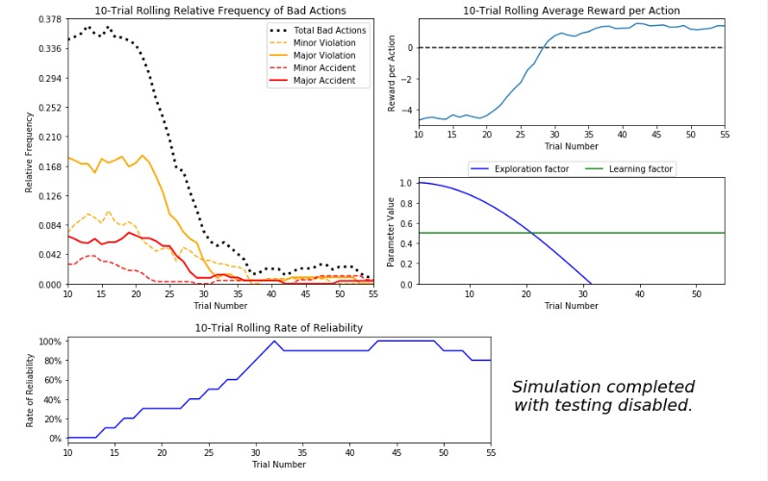

Slide 34
Thank You

