Slide 1
CadetX Warehouse Analytics
Week 12 – Final Analytics, Insights & Recommendations

Slide 2
Project Overview
End-to-end warehouse analytics project covering product, inventory, sales, supplier and customer data.
Week 12 consolidates final KPIs, business insights, dashboard outputs and recommendations.
Python and Pandas were used for analytics and output generation.
Final deliverables include KPI summary, insights, recommendations and dashboard.

Slide 3
Final KPI Snapshot
Total Products: 30 Count
Total Inventory Records: 180 Count
Total Sales Order Lines: 130402 Count
Total Suppliers: 8 Count
Total Branches: 6 Count
Total Customers: 500 Count
Total Units Sold: 1368534 Units
Total Sales Value: 25447392560 Currency
Total Current Stock: 19303266 Units

Slide 4
Key Business Insights
Total Products (30): Total Products: 30 Count
Total Inventory Records (180): Total Inventory Records: 180 Count
Total Sales Order Lines (130402): Total Sales Order Lines: 130402 Count
Total Suppliers (8): The business works with 8 suppliers, supporting procurement and supply operations.
Total Branches (6): The analysis covers 6 branches, providing a multi-branch operational view.
Total Customers (500): The dataset contains 500 customers, representing the customer base included in the analysis.
Total Units Sold (1368534): Total units sold are 1368534 Units, representing overall sales volume.
Total Sales Value (25447392560): Total sales value recorded is 25447392560 Currency, providing an overall view of business sales performance.
Total Current Stock (19303266): Current inventory stands at 19303266 Units, indicating the total stock available across the warehouse network.

Slide 5
Business Recommendations
Total Products: Maintain a structured product master and regularly review product-level performance.
Total Inventory Records: Monitor inventory records regularly to maintain accurate stock visibility and data quality.
Total Sales Order Lines: Use sales order trends to identify high-demand products and support inventory planning.
Total Suppliers: Monitor supplier performance and dependency to improve procurement reliability.
Total Branches: Compare branch-level performance to identify operational differences and improvement opportunities.
Total Customers: Use customer-level sales patterns to support segmentation and targeted business decisions.
Total Units Sold: Track unit sales trends to identify demand patterns and improve replenishment planning.
Total Sales Value: Monitor sales value regularly and connect revenue trends with product, customer, and branch performance.
Total Current Stock: Monitor current inventory against demand to reduce excess stock and potential stockout risk.

Slide 6
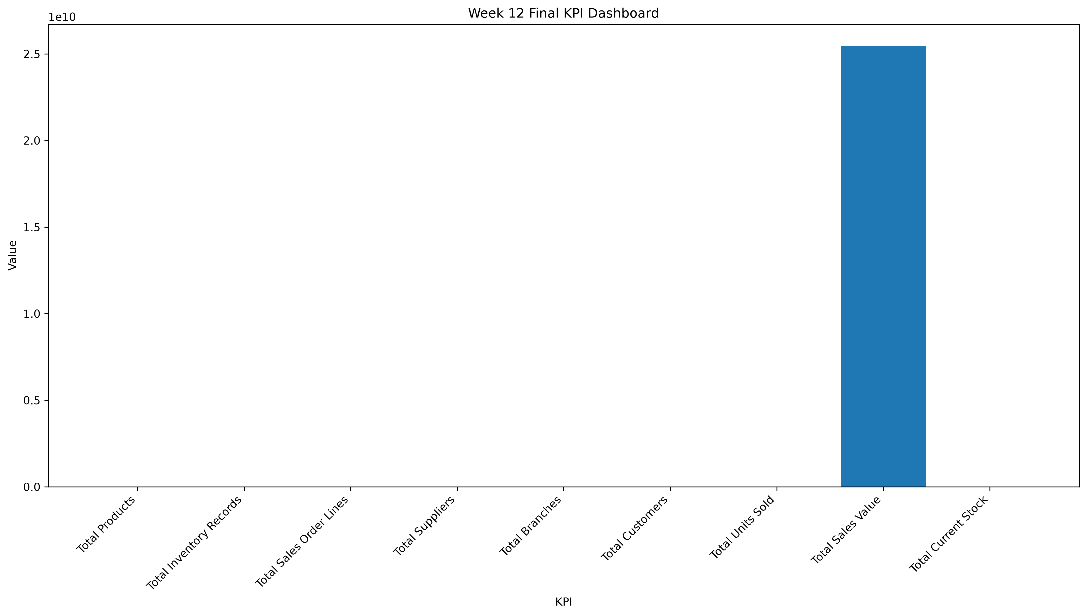
Final KPI Dashboard

Slide 7
Conclusion
The Week 12 phase consolidates the warehouse analytics project into final decision-support outputs.
Final KPIs provide a concise view of products, inventory, customers, suppliers, branches and sales.
Insights translate the analytical results into understandable business observations.
Recommendations provide practical areas for monitoring inventory, sales and customer activity.
The final dashboard brings the major KPIs together for management-level review.

