Slide 1
Nutrition Deficiency Detection System Smart-Bridge Project
Submitted By:
Team Lead: Bidla Kumari – 23AK1A0453 Team Members: Lavanya Thokala – 23AK1A0455 Vuchuru Aswini – 23AK1A0412 Haneesh Sherkat Chandan – 23AK1A0420 Moddu Maheswari – 23AK1A0461
Department: Electronics and Communication Engineering (ECE)
Name Of The Collage: Annamacharya Institute of Technology and Sciences, Tirupati
Academic Year: 2023–2027

Slide 2
Introduction
Nutrition deficiency occurs when the body does not receive enough essential nutrients. This project: • Collects health details • Analyzes symptoms • Identifies nutrient deficiencies • Suggests food recommendations • Supports healthy diet management Technologies: Frontend – React.js Backend – Node.js + Express.js Database – MongoDB

Slide 3
Problem Statement
1. Lack of Nutrition Awareness Many people do not understand the importance of balanced nutrition and cannot identify early symptoms of nutrient deficiencies. This leads to delayed health improvement.
2. Delayed Detection of Deficiencies Traditional health checkups require time and medical consultation. As a result, nutritional deficiencies are often detected at later stages.
3. Difficulty in Tracking Daily Nutrition People find it difficult to monitor food intake and maintain proper nutrient balance regularly. This affects overall health.
4. Limited Access to Instant Guidance Users may not always have immediate access to nutrition experts or diet recommendations for maintaining healthy habits.
5. Need for an Automated Solution There is a need for a digital system that analyzes health information and provides quick nutrition deficiency detection with food recommendations.

Slide 4
Project Objectives
1. To Detect Nutritional Deficiencies Develop a system that identifies possible nutrient deficiencies based on user symptoms and health information. This helps users take preventive action early.
2. To Collect User Health Data Allow users to enter health details such as age, weight, eating habits, and symptoms for nutritional analysis.
3. To Provide Food Recommendations Suggest suitable foods and dietary changes based on identified nutritional deficiencies to improve health.
4. To Increase Health Awareness Educate users about balanced nutrition and encourage healthier eating habits through regular monitoring.
5. To Maintain User Records Store user information and previous reports securely for future reference and tracking progress.
6. To Build an Easy and User-Friendly System Create a simple and accessible platform that allows users to check nutritional status quickly and efficiently.

Slide 5
Existing System
1. Manual Health Consultation People usually depend on doctors, hospitals, or nutrition experts to identify nutritional deficiencies. This process requires appointments and personal visits.
2. Traditional Nutritional Assessment Health reports and diet analysis are mostly done manually through laboratory tests and medical evaluations, which may take time.
3. Limited Continuous Monitoring Existing methods do not provide regular tracking of daily nutrition intake and deficiency changes over time.
4. Higher Cost and Time Consumption Medical consultations and nutritional assessments can be expensive and time consuming for frequent monitoring.
5. Lack of Instant Recommendations Traditional systems generally do not provide immediate food suggestions or quick nutritional guidance after assessment.

Slide 6
Proposed System
1. User Registration and Login The system allows users to create an account and securely log in to access nutrition analysis and personalized recommendations.
2. Health Data Collection Users enter details such as age, weight, symptoms, food habits, and lifestyle information for accurate nutritional assessment.
3. Nutrition Deficiency Detection The system analyzes the entered data and predicts possible nutrient deficiencies using predefined conditions and logic.
4. Personalized Food Recommendations Based on the detected deficiency, the application suggests suitable foods and dietary improvements to support better health.
5. Report Generation and Monitoring The system generates nutrition reports and stores user data for future tracking and continuous health monitoring.

Slide 7
Technical Architecture
1. Frontend Layer The frontend is developed using React.js, HTML, and CSS to create an interactive and user-friendly interface where users can enter health details and view results.
2. Backend Layer The backend is developed using Node.js and Express.js to process user requests, manage application logic, and connect with the database.
3. Database Layer MongoDB is used to store user information, health records, nutritional data, and generated reports securely.
4. API Communication Layer REST APIs are used for communication between frontend and backend to send user input and retrieve analysis results.
5. Output Layer The system processes the collected information and displays nutrition deficiency results along with personalized food recommendations and reports.
Architecture Flow:
User → Frontend (React.js) → Backend (Node.js + Express.js) → MongoDB → Nutrition Report → User

Slide 8
Functional Requirements
1. User Registration and Login The system should allow users to create an account and securely log in to access nutrition assessment features and personal reports.
2. Health Data Input The system should collect user details such as age, weight, symptoms, food habits, and health information for analysis.
3. Nutrition Deficiency Analysis The application should process the entered data and identify possible nutritional deficiencies based on predefined conditions.
4. Food Recommendation System The system should provide suitable food suggestions and dietary recommendations according to the detected deficiency.
5. Report Generation and Data Storage The system should generate nutrition reports and store user data securely for future monitoring and reference.

Slide 9
Non-Functional Requirements
1. Performance The system should process user inputs and generate nutrition deficiency results quickly with minimum response time.
2. Reliability The application should provide accurate and consistent results while maintaining stable performance during usage.
3. Security User health information and personal details should be stored securely and protected from unauthorized access.
4. Scalability The system should support an increasing number of users and additional features without affecting performance.
5. Usability and Maintainability The application should have a simple user interface and allow easy updates, maintenance, and future improvements.

Slide 10
Database Design
1. User Collection This collection stores user registration details such as Name, Email, Password, Age, and Gender to manage user accounts securely.
2. Health Data Collection This collection stores health-related information including Weight, Height, Symptoms, Food Habits, and Nutrient Levels entered by users.
3. Nutrition Analysis Collection This collection stores the processed results of nutritional assessment and identified deficiency details.
4. Recommendation Collection This collection contains personalized food suggestions and dietary recommendations generated based on deficiency results.
5. Report Collection This collection stores final nutrition reports and maintains previous records for future tracking and monitoring.
Database Flow:
User → Health Data → Nutrition Analysis → Food Recommendation → Report Storage

Slide 11
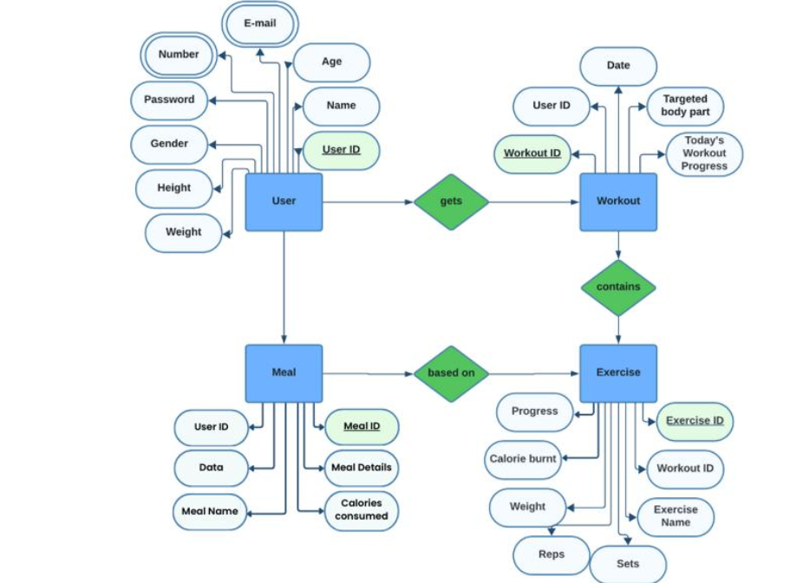
ER Diagram

Slide 12
Development Process
1. Requirement Analysis The project requirements were collected and Analyzed to understand user needs, nutritional deficiency detection methods, and system functionalities.
2. System Design The overall architecture, database schema, user interface design, and application workflow were planned before development.
3. Frontend Development The user interface was developed using React.js, HTML, and CSS to allow users to register, enter health details, and view results.
4. Backend Development The backend was developed using Node.js and Express.js to handle business logic, process requests, and connect with the database.
5. Database Integration MongoDB was configured to store user information, health records, deficiency results, and food recommendations securely.
6. Testing and Deployment The application was tested for functionality, performance, and accuracy before final deployment and demonstration.

Slide 13
Execution Flow
1. User Registration and Login The user creates an account and logs into the system to access nutrition deficiency analysis and personalized recommendations.
2. Enter Health Information The user enters required details such as age, weight, symptoms, food habits, and other health-related information.
3. Data Processing and Analysis The system processes the entered information and Analyzes the data to identify possible nutritional deficiencies.
4. Generate Nutrition Report Based on the analysis, the system generates a detailed report showing deficiency status and health insights.
5. Store Results for Future Reference The generated reports and recommendations are stored in the database for monitoring and future access.
Flow Representation:
Login → Enter Health Data → Submit → Analyzes→ Generate Report → Food Recommendation → Store Results

Slide 14
Results and Output
1. Successful User Registration and Login The system allows users to create accounts and securely log in to access nutrition analysis and personalized reports.
2. Health Data Collection Users can successfully enter health details such as age, weight, symptoms, and food habits through the application interface.
3. Nutrition Deficiency Detection The system analyzes the entered information and identifies possible nutritional deficiencies accurately.
4. Generation of Nutrition Reports After analysis, the application generates a report showing detected deficiencies and health recommendations.
5. Personalized Food Recommendations The system provides suitable food suggestions and dietary plans based on the identified nutritional deficiency.
6. Data Storage and Monitoring All user information and generated reports are stored in the database for future reference and continuous health tracking.

Slide 15
Results and Output
Sample Output:
User Input: Age – 20 Years Weight – 55 kg Symptoms – Fatigue, Weakness
Detected Result: Iron Deficiency
Recommended Foods: Spinach, Eggs, Beans, Green Leafy Vegetables, Dry Fruits

Slide 16
Future Scope
1. Artificial Intelligence Integration Advanced AI models can be implemented to improve prediction accuracy and provide smarter health analysis.
2. Mobile Application Development The project can be expanded into a mobile application for easy access anytime and anywhere.
3. Real-Time Health Monitoring Integration with wearable devices can enable continuous monitoring of user health and nutrition.
4. Personalized Diet Planning The system can generate customized diet plans according to user preferences and nutritional requirements.
5. Multi-Language Support Future versions can support multiple languages to make the application accessible to more users.
6. Cloud-Based Data Management Cloud integration can improve data storage, security, and accessibility across different devices.

Slide 17
Conclusion
The Nutrition Deficiency Detection System is developed to help users identify possible nutritional deficiencies based on their health information and symptoms. The application provides quick analysis, generates nutrition reports, and recommends suitable foods for improving overall health. This system makes nutritional monitoring easier, faster, and more accessible for users.

