Slide 1
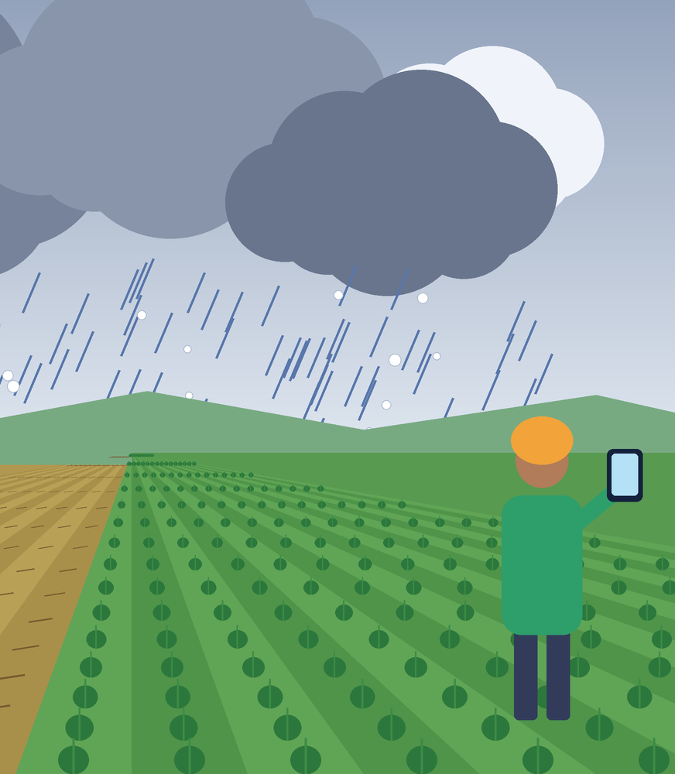
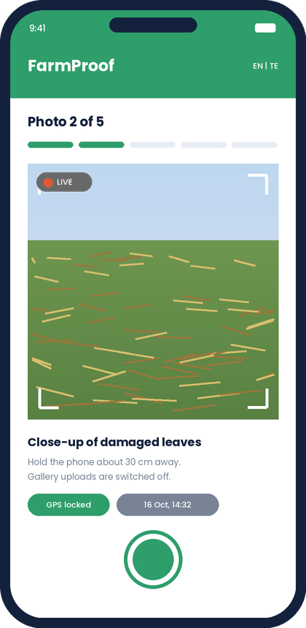
IMPACT TANK '26 | SOLUTION CONCEPT DECK
FarmProof
Farm-level proof of loss for every crop-insurance claim, captured by the farmer within 72 hours
Live photos geotagged and time-stamped
Weather check matched to the claim date
One claim file ranked for surveyors
Team Nexus.DTU
Sameer Raja | Gaurav Kumar | Akshat Bhati | Naynika Rani
Notes:
Illustrations are drawn concept visuals with sample data, not real photos or claims.

Slide 2
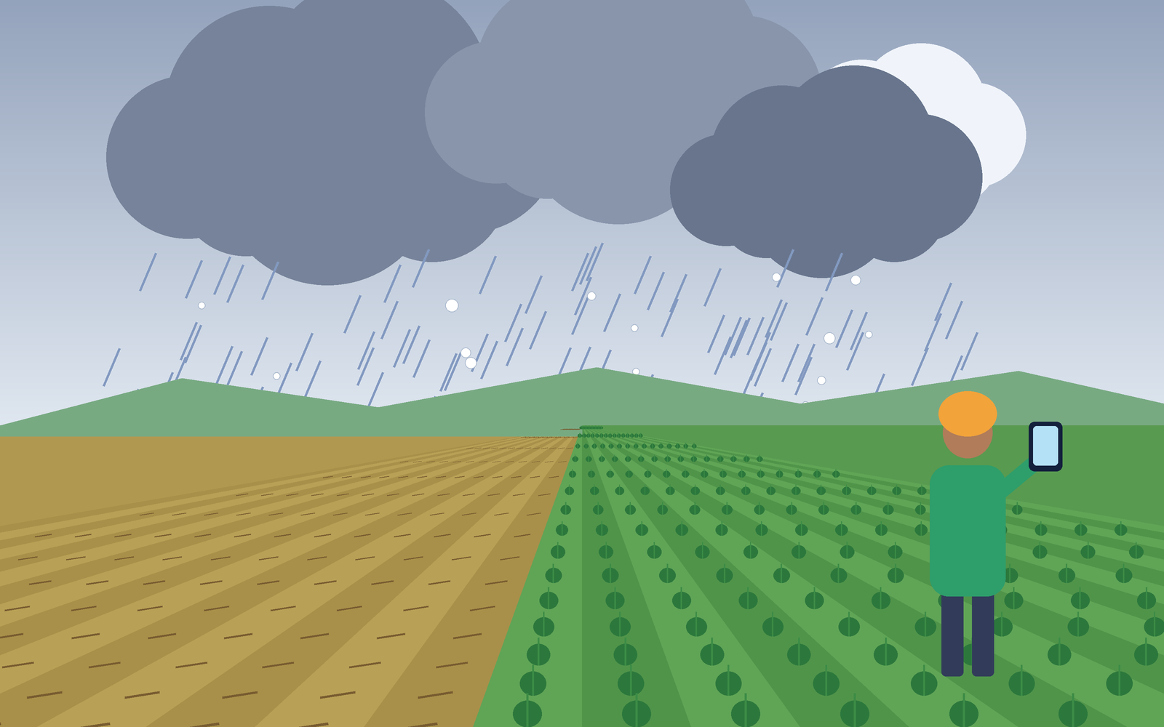
Small farmers wait for payouts because nobody can quickly prove one farm's loss
ROOT CAUSE: 5 WHYS
1
Why are payouts delayed?
Losses must be verified before claims are settled.
2
Why is verification slow?
It relies on manual surveys and sample-plot yield tests.
3
Why only samples?
Fieldwork across thousands of villages is costly, with limited staff.
4
Why do disputes arise?
Village-level averages can hide one farm's real loss.
5
Root cause
No trusted, low-cost, farm-level evidence in the claim process.
5
PROBLEM STATEMENT
Small and marginal farmers face difficulty getting timely, fair crop-insurance payouts after weather damage because loss assessment relies on slow, sample-based manual surveys, resulting in delayed or under-paid claims and a fall back into informal debt.
~86%
72 hrs
362 to 248 lakh
of Indian farmers are small or marginal
window to report localised crop loss
farmers insured under PMFBY, 2016 to 2021
Scope note: delays also come from crop-cutting timelines and state subsidy releases (CAG, 2017). FarmProof targets the evidence gap, the part a technology tool can fix.
Sources: Agriculture Census 2015-16; PMFBY guidelines; CAG audit 2017; Dalwai committee. Verify before final submission.
IMPACT TANK '26 | SOLUTION CONCEPT DECK | FarmProof | Team Nexus.DTU
2
Notes:
Problem recap. The CAG audit shows delays also come from crop-cutting timelines and state subsidy releases; we target the evidence gap. Verify all figures against primary sources.

Slide 3

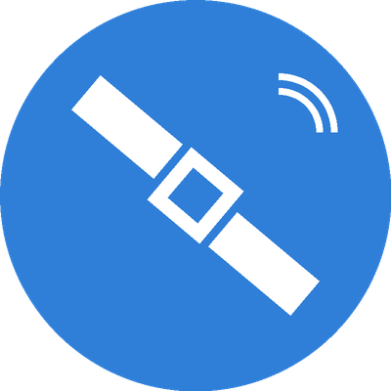


We explored four different routes to the same problem, then picked the one that fixes its root cause
FarmProof
AgroFusion
ClaimTrack
Village Verifiers
Event-triggered farmer evidence kit
Plot-level satellite + weather loss map
WhatsApp / voice claim assistant
Trained local verifier network
HOW IT WORKS
After damage, the farmer takes guided, geotagged photos inside the 72-hour window. AI rates severity and local weather data is cross-checked.
BORROWED FROM
Photo claims in motor insurance (first notice of loss).
GAP IT CLOSES
Evidence is village-level, not farm-level.
WATCH-OUT
Needs a smartphone; photos can be faked.
HOW IT WORKS
Combine Sentinel imagery, rainfall data and land records to estimate loss plot by plot for insurers and officials.
BORROWED FROM
Predictive demand planning (multi-source forecasting).
GAP IT CLOSES
Satellite, weather and land data sit in silos.
WATCH-OUT
Monsoon cloud cover; 10 m pixels vs plots under 2 ha; heavy data work.
HOW IT WORKS
Farmers report loss and follow claim status through WhatsApp or a toll-free voice call, in their own language.
BORROWED FROM
Parcel and food-delivery tracking (live status).
GAP IT CLOSES
Farmers cannot see how a claim is decided.
WATCH-OUT
Creates no new evidence; portals and helplines already show some status.
HOW IT WORKS
Paid, trained local youth or SHG members verify damage with a checklist and photos for a cluster of villages.
BORROWED FROM
Community-driven models: health workers, banking correspondents.
GAP IT CLOSES
Too few surveyors for too many villages.
WATCH-OUT
Needs recruitment, training and trust; hard to prototype in a week.
IMPACT TANK '26 | SOLUTION CONCEPT DECK | FarmProof | Team Nexus.DTU
3
Notes:
Each concept targets a different gap: evidence (A), data silos (B), claim visibility (C), surveyor shortage (D).

Slide 4
FarmProof scores highest: it fixes the root cause and can be prototyped in one week
Concept | Impact | Feasibility (1 week) | Differentiation | Total /15
A. FarmProof farmer evidence kit | 4 Proof for each claiming farm; surveyors verify instead of starting from zero. | 4 Phone camera, GPS, free weather data and a vision-model API are off the shelf. | 4 Triggered by a damage event, tied to one claim, tamper-checked. CROPIC is season-long monitoring. | 12
B. AgroFusion map satellite + weather | 5 Covers every plot without a field visit. | 2 Cloud cover, coarse pixels and land-record joins are too heavy for a week. | 3 Remote-sensing pilots already exist under PMFBY. | 10
C. ClaimTrack WhatsApp / voice | 3 Visible status helps trust, but the evidence gap stays. | 5 Chat bot and status page are quick to build. | 2 Portals and helplines already give status. | 10
D. Village Verifier Network trained local verifiers | 4 Trusted local eyes on each claim. | 2 Needs people, training and funding, not just software. | 3 Similar to existing surveyor and agent models. | 9
How we scored: 1 = low, 5 = high, equal weight. We compared against what already exists: crop-cutting experiments, CROPIC photo-and-AI pilots, satellite and drone estimates, and weather-index insurance. B has the biggest ceiling but fails the one-week test; C and D are useful add-ons, not fixes for the root cause.
IMPACT TANK '26 | SOLUTION CONCEPT DECK | FarmProof | Team Nexus.DTU
4
Notes:
Scores are 1 (low) to 5 (high), equal weight. Impact = reduction of the problem for the farmer. Feasibility = prototype in one week with our skills, tools, budget. Differentiation = how meaningfully better than what exists (crop-cutting, CROPIC, satellite pilots, weather-index insurance). Adjust scores to your team's honest view.

Slide 5
We chose FarmProof: proof from the farm itself, checked against local weather data
SOLUTION STATEMENT
HOW WE DIFFER FROM WHAT EXISTS
Our solution is FarmProof, a guided photo-evidence claim app for small farmers that gives insurers verifiable farm-level damage proof inside the 72-hour window by combining live geotagged photos, AI damage scoring and a local weather check, unlike sample-based crop-cutting surveys that rely on village averages.
Existing approach | What it does | What FarmProof adds
Crop-cutting experiments | Village sample plots, measured weeks later | Proof for each claiming farm within 72 hours
CROPIC (PMFBY) | Geotagged crop-stage photos plus AI, for monitoring | Triggered by a damage event, tied to one claim, with weather match and tamper checks
Satellite and drone pilots | Remote and coarse; cloud-limited | Ground-level proof; satellite can be added later
Claim portals and helplines | Status on request | Live status for the farmer, in local language
WHY IT BEAT THE OTHERS
1
Fixes the root cause. The root cause is missing farm-level evidence. FarmProof creates exactly that, for every claim.
2
Buildable in one week. Phone camera, GPS, free weather data and a vision-model API. No new hardware and no data deals.
3
Borrows the best of B and C. B's weather check and C's live status become small features, without their cost.
Not a copy: CROPIC shows that photos plus AI are accepted for claims. We focus on the moment of loss and on trust for the farmer and the surveyor.
IMPACT TANK '26 | SOLUTION CONCEPT DECK | FarmProof | Team Nexus.DTU
5
Notes:
CROPIC is described publicly by the Ministry of Agriculture and Farmers Welfare as geotagged crop photos plus AI for monitoring and claim support. Check its current status before pitching. Our difference: event-triggered, per-claim, 72-hour evidence with weather match and tamper checks, plus a farmer-facing tracker.

Slide 6
Six steps from hailstorm to decision, with the 72-hour clock built in
Meet Ramulu (illustrative): 1.2 ha paddy farmer near Warangal, basic Android phone, prefers Telugu. A hailstorm flattens half his crop. He has to prove it, fast.
1
Damage
2
Report
3
Capture
4
Check
5
Review
6
Decision
Hour 0
Within 72 hrs
Same visit
Minutes
Days 1 to 3
Insurer timeline
FARMER DOES
Hail flattens half his paddy plot.
Opens the app, picks the cause (hail) and crop, pins his plot on the map.
Follows prompts for 5 live photos: wide, close-up, plant count, boundary.
Taps Submit.
Gets an SMS: claim received.
Tracks status; gets decision and payout alert.
APP DOES
Starts the 72-hour clock. Saves offline if there is no signal.
Locks GPS and time on each photo. Blocks gallery uploads.
AI rates the damage band. Checks rain and hail record near the plot for that date.
Builds one evidence pack and tags it: verified, review or visit.
Updates the timeline in the farmer's language.
OFFICER / INSURER
Sees a ranked list. Visits only the flagged claims.
Insurer settles using the evidence pack.
Moment of value: proof exists the same week as the damage, so surveyors verify instead of starting from zero.
IMPACT TANK '26 | SOLUTION CONCEPT DECK | FarmProof | Team Nexus.DTU
6
Notes:
Persona is illustrative (not a real interview). Replace with a real quote from your farmer interviews if you have one. Step times after submission depend on the insurer; we do not promise payout days.

Slide 7
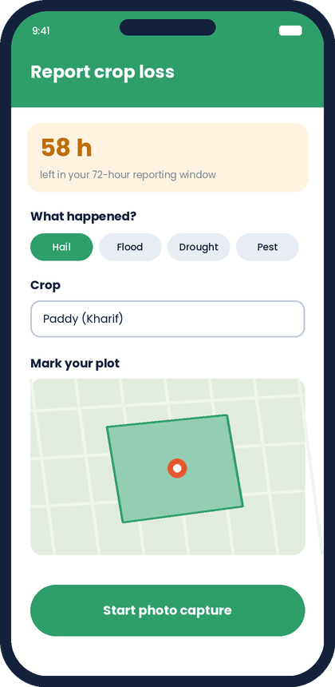
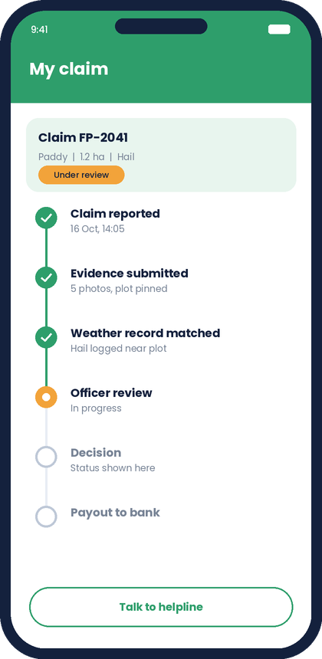
Six core features turn an ordinary phone into a trusted evidence kit
ESSENTIAL FEATURES
VALUE PROPOSITION
1
Guided live capture
Prompts for 5 photos; camera only, no gallery uploads.
A verifiable, time-stamped record of a farmer's own loss, captured in the 72-hour window, so insurers can trust it and surveyors visit only the unclear cases.
2
Plot pin, GPS and time
Ties proof to one farm, not a village average.
3
AI damage estimate
Severity band with confidence; an officer can always override.
FARMER
Pain: slow, disputed payouts.
Gain: own proof and live status.
4
Weather cross-check
Matches the claim date and place to local rain or hail records.
INSURER
5
Offline and local language
Saves when signal drops; Telugu and English labels.
Pain: cannot verify farm loss cheaply.
Gain: credible, geotagged evidence.
Concept screens: report, capture, track (sample data)
6
Claim tracker + officer triage
Farmer sees status; officer sees a ranked list.
SURVEYOR
Pain: too many villages, few staff.
Gain: a ranked list; visit the doubtful.
IMPACT TANK '26 | SOLUTION CONCEPT DECK | FarmProof | Team Nexus.DTU
7
Notes:
Mockups are concept screens with sample data. Prototype scope: features 1 to 4 and 6 fully, feature 5 as English/Telugu labels plus a basic offline queue.

Slide 8
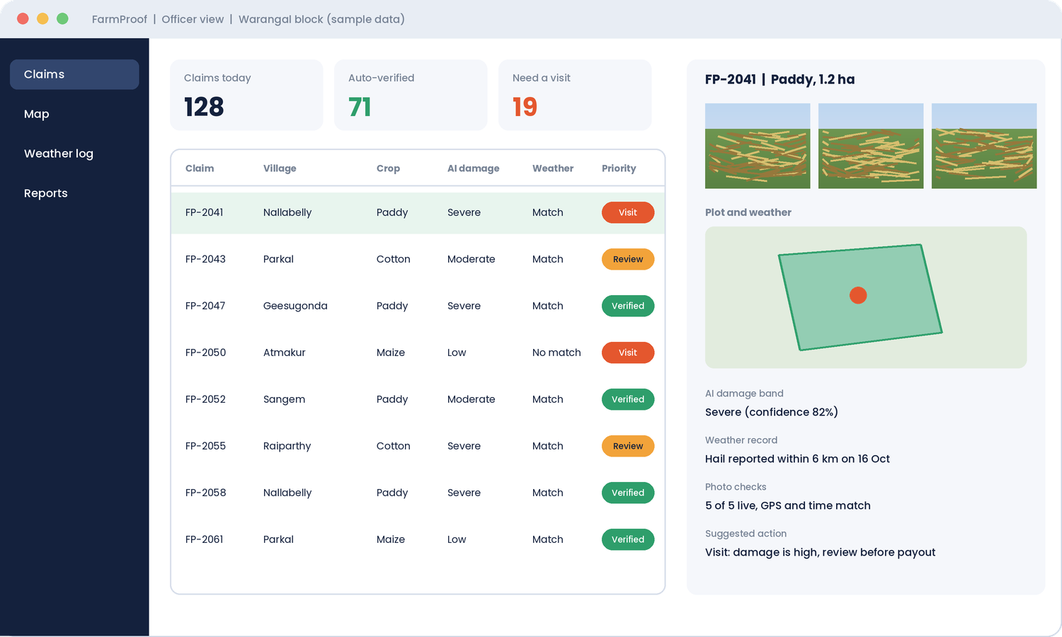
How the app works: four screens cover the whole claim path
4 Officer view
Ranked claims with the evidence pack, AI damage band, weather record and a suggested action. The officer can always override.
1 Report
2 Capture
3 Track
Farmer picks the cause and crop, pins the plot. The 72-hour timer starts.
Five guided live photos. GPS and time are locked; gallery uploads are blocked.
Live timeline from submission to decision, with a helpline shortcut.
Built for low digital access: offline saving, Telugu and English labels, photo prompts instead of typing, and an option for a village helper to capture on the farmer's behalf.
IMPACT TANK '26 | SOLUTION CONCEPT DECK | FarmProof | Team Nexus.DTU
8
Notes:
Concept screens with sample data. This is the demo path for the prototype: report, capture, track, officer review.

Slide 9
If it works, claims move from village averages to proof for each farm
TODAY VS WITH FARMPROOF
HOW WE WILL MEASURE IT (PROTOTYPE TARGETS)
Area | Today | With FarmProof
Level of evidence | Village sample plots | Photos, GPS and time for each claiming farm
Time to first evidence | After a survey is scheduled | Inside the 72-hour window
Surveyor visits | Most claims need one | Flagged claims visited first
Farmer visibility | Little or none | Live status in local language
Basis of disputes | Averages vs one farm's loss | Photo plus weather record
Time to evidence
Complete pack inside the 72-hour window for every test claim
Pack completeness
At least 90% of test claims with 5 photos, GPS, time and plot pin
AI agreement
Damage band matches an expert's rating on a small labelled set; target 70% or more
Usability
4 of 5 test users finish a claim unaided in 10 minutes or less
Surveyor load
Visits per 100 claims after triage, compared with 100 today
WHO BENEFITS
Farmers
faster, fairer payouts; less informal debt
Insurers
credible loss proof
Banks & co-ops
loan recovery timing
Officials
transparent, auditable claims
Aligned with UN SDG 1 (No Poverty), SDG 2 (Zero Hunger) and SDG 13 (Climate Action).
IMPACT TANK '26 | SOLUTION CONCEPT DECK | FarmProof | Team Nexus.DTU
9
Notes:
Targets below are prototype targets to be tested with pilot users, not results. Do not present them as achieved numbers.

Slide 10
Technical approach: a lightweight web stack that turns five photos into a scored claim file
1 FARMER APP
React PWA, mobile web
2 BACKEND
Supabase
3 EVIDENCE ENGINE
Serverless functions
4 OFFICER DASHBOARD
React web app
Live camera only through the browser camera API; no gallery picker
GPS plus plot pin and boundary on a Leaflet map
Offline queue: service worker and IndexedDB, syncs when signal returns
English and Telugu labels
Phone-number login (OTP)
Postgres tables: farmers, plots, claims, photos, scores
Private storage bucket for photos, opened by signed links
Row-level security by role: farmer, officer, insurer
Integrity checks on every photo
Vision-model API gives damage band and confidence as JSON
Open-Meteo history for the plot and claim date
Rules engine: verified, review or visit
Ranked claim list with filters
Evidence pack: photos, map, weather, AI result
Override and comment; every override is logged
Status updates flow back to the farmer's tracker
DATA FLOW FOR ONE CLAIM
1
Capture
2
Upload
3
Integrity
4
AI + weather
5
Score
6
Review
Five live photos, GPS and time stored on the phone
Sent when online; saved in the queue if not
Location, time and duplicate checks
Damage band and weather record for the plot
Verified, review or visit; claim ranked
Officer checks the pack; farmer sees status
Why this stack: free tiers and open data, no model training, one codebase for farmer and officer, and every piece can be built and tested within the build week.
IMPACT TANK '26 | SOLUTION CONCEPT DECK | FarmProof | Team Nexus.DTU
10
Notes:
All components use free tiers or open data. No custom model training is needed in build week. Thresholds and rules are prototype defaults.

Slide 11
How the evidence is checked: integrity, AI scoring, weather match and a clear decision rule
1
Photo integrity checks
DECISION RULE (PROTOTYPE DEFAULTS)
Outcome | When | What happens
Verified | Integrity passes, damage moderate or severe, weather consistent, confidence 0.7 or higher | Fast-tracked to the insurer with the evidence pack
Review | One signal is weak or confidence is low | Officer checks the pack remotely
Visit | Integrity fails, or a severe claim has no weather support | Surveyor visits first
Live camera only; five required shots: wide, close-up, plant count, boundary, undamaged comparison
GPS within about 100 m of the pinned plot; device time matches server time; inside the 72-hour window
File hash catches reused or duplicate photos across claims
2
AI damage scoring
Vision-model API with a written rubric: lodging, leaf loss, waterlogging, hail marks
Returns JSON: damage band (low, moderate, severe), likely cause, confidence from 0 to 1
Low confidence goes to review; the model never rejects a claim
SAFEGUARDS AND LIMITS
3
Weather cross-check
Only officers decide; the system ranks and recommends
Photos stored privately; visible only to the insurer and officers on that claim; consent taken at the start
Confidence is always shown, and every override is logged to improve the rubric
Honest limit: a clever fake or a very local storm can still slip through, which is why borderline claims go to review
Open-Meteo history for the plot's coordinates on the claim date, plus or minus one day
Checks rainfall, wind gusts and hail or thunderstorm codes against the claimed cause
Grid is kilometre-scale, so weather supports the claim but never decides it alone
IMPACT TANK '26 | SOLUTION CONCEPT DECK | FarmProof | Team Nexus.DTU
11
Notes:
Open-Meteo provides free historical weather including precipitation, wind gusts and a weather code that flags thunderstorms with hail; its grid is coarse, so weather supports a claim rather than deciding it. Thresholds shown are starting values to tune on test data.

Slide 12
Prototype plan: one working claim flow, end to end, on demo data
WILL BUILD
OUT OF SCOPE
Farmer flow: report, 5-photo guided capture, plot pin, submit
AI damage band with confidence (vision model + rubric)
Weather cross-check for the claim date and place
Claim tracker with status timeline
Officer view: ranked claims, evidence pack, override
Live insurer systems
Payments
Satellite imagery
Full language coverage
Layer | Tool | Why
Front end | React PWA (mobile web) | Runs on any Android browser; offline cache
Backend | Supabase | Auth, database and photo storage on a free tier
AI | Vision-model API + damage rubric | No training data needed in one week
Weather | Open-Meteo / NASA POWER | Free historical rain and wind data
Map | Leaflet + OpenStreetMap | Free plot pin and boundary
Planned officer view (concept, sample data)
BUILD PLAN (WEEK 2)
Days 1-2
Capture flow, plot pin, offline queue
Days 3-4
AI damage scoring + weather check
Days 5-6
Officer view, tracker, test with 5 users
Day 7
Fixes, demo video, submission
Target maturity: functional MVP. Farmer flow and officer view work end to end on realistic demo data; AI scoring checked on a small labelled image set; no live insurer integration.
IMPACT TANK '26 | SOLUTION CONCEPT DECK | FarmProof | Team Nexus.DTU
12
Notes:
Prototype must be built during the competition; pre-built prototypes are not eligible. Keep scope to essential features only.

