Slide 1
INT234- PREDICTIVE ANALYTICS PROJECT REPORT
(Project Semester September-December 2025)
Public_Libraries
Submitted by
Roshani Kumari
Registration no: 12307183
Section: K23CG Course Code: INT234
Under the Guidance of Anchal Kaundal, (29612)
Discipline of CSE/IT
Lovely School of Computer Science Engineering Lovely Professional University, Phagwara

Slide 2
DECLARATION
I, Roshani Kumari, student of B.tech under CSE/IT Discipline at, Lovely Professional University, Punjab, hereby declare that all the information furnished in this project report is based on my own intensive work and is genuine.
Date: 18th December, 2025
Signature
Registration No.12307183
Roshani Kumari

Slide 3
CERTIFICATE
This is to certify that Roshani Kumari bearing Registration no. 12307183 has completed INT234 project titled, “Public_Libraries” under my guidance and supervision. To the best of my knowledge, the present work is the result of his/her original development, effort and study.
Anchal Kaundal Professor
School of Computer Science Engineering Lovely Professional University Phagwara, Punjab.
Date: 18th December, 2025

Slide 4
Acknowledgment
I would like to express my deepest gratitude to Prof. Anchal Kaundal, for his exceptional mentorship and unwavering support throughout the duration of this project. His vast knowledge in the fields of data science and machine learning, combined with his patient and thoughtful guidance, played a pivotal role in the successful completion of this work. His insightful suggestions and feedback consistently challenged me to think critically and improve the quality of my research. I am also grateful for the learning environment he fostered, which encouraged exploration and innovation.
In addition, I sincerely thank my peers and classmates for their helpful discussions, encouragement, and collaborative spirit during this project. Their input provided fresh perspectives that contributed meaningfully to the final outcome. I am also thankful to the open-source community for providing the tools, libraries, and resources that made the implementation of this project possible. Lastly, I acknowledge the dataset contributors for making this analysis feasible.

Slide 5
1. Introduction
In the digital age, data has become a powerful tool for uncovering patterns, shaping policies, and improving services—even in traditional institutions like public libraries. This project, titled "Public Library Analytics Using Python," focuses on analyzing public library data to explore key relationships such as population vs. library visits, resource allocation, and borrower trends.
By leveraging Python libraries like Pandas, Matplotlib, and Seaborn, this study extracts meaningful insights from real-world datasets. The goal is to understand how public libraries serve their communities, how resources are distributed across different regions, and what factors influence library usage.
This analysis not only highlights disparities in public investment and access but also reinforces the role of libraries as vital community assets. Through data visualization and interpretation, this project aims to inform better decisionmaking and advocate for equitable access to knowledge resources.

Slide 6
Source of Dataset
The dataset used for this project was sourced from the Institute of Museum and Library Services (IMLS) through the Data.gov platform — a U.S. government open data portal that provides public access to high-quality datasets across various domains such as education, public services, climate, and more.
Specifically, this dataset is part of the Public Libraries Survey (PLS), which collects and reports key data about public library systems in the United States. It includes detailed information on population served, total visits, registered borrowers, library collections, staffing, and operating expenditures. About Data.gov:
  Managed By: U.S. General Services Administration (GSA)
  Goal: To promote transparency, innovation, and data-driven decision-making by making government-collected data openly accessible
  URL: https://catalog.data.gov/dataset/public-libraries-b1aaf
  Licensing: Most datasets are released under open licenses, allowing public use for research, analysis, and innovation
Using this dataset ensures that the project is grounded in authentic, real-world data gathered through standardized reporting practices. This strengthens the credibility of insights drawn from the analysis and helps support data-informed improvements in public library policies and access.
EDA process
The EDA phase was crucial to understand the structure, quality, and trends in the Public Libraries dataset. It involved several steps:
Data Inspection & Loading
  Loaded the dataset using Pandas
  Displayed the first few rows using .head() to get an overview
  Checked data types, missing values, and column names using .info() and .isnull().sum()
Data Cleaning
  Removed or handled missing/null values
  Standardized column names for better readability
  Converted relevant fields to proper data types (e.g., float, int, string)
  Dropped irrelevant or duplicate columns
Descriptive Statistics
  Used .describe() to compute basic statistics like mean, median, min, max, and standard deviation
  Identified outliers and skewed data distributions
Correlation Analysis
  Created a correlation matrix to observe relationships between numerical features
  Found moderate to strong correlations between population, total visits, and number of borrowers
Visual Exploration (with Seaborn & Matplotlib)
Several visualizations were created to extract meaningful insights:
Handling Outliers
  Visualized numerical distributions using boxplots and histograms
  Identified and optionally removed extreme values to improve visualization accuracy

Slide 7
Objective
Visualization
Insight
Used
Population vs Total Visits Scatter Plot
Positive trend with some variance in dense areas
Moderate positive correlation
Population vs Borrowers Regression Plot Avg Operating
Bar Chart
Expenditure
Top Countries by Visits
Collection Per Capita
Highlighted disparities across countries
Pie Chart Box Plot
Showed most engaged library users Displayed fairness in resource distribution

Slide 8
Analysis on Dataset(for each analysis)
Objective 1: Relationship between Population and Total Library Visits
  Introduction
The objective of this analysis is to examine whether an increase in the population of a service area leads to a corresponding rise in the number of total library visits.
Understanding this relationship helps assess how population density influences library usage.
  General Description
Both Population of Service Area and Total Library Visits are continuous numerical variables. A positive relationship is expected, as larger populations typically result in higher public service utilization.
  Specific Requirements, Functions, and Formulas Used
    Used scatterplot() function from Seaborn to visualize the relationship
    Calculated Pearson correlation coefficient using pandas.corr()
Analysis Results
  A strong positive correlation of 0.84 was observed
  More populated service areas generally recorded higher library visits
  Significant variance exists at higher population levels, indicating other influencing factors such as accessibility and service quality
v) Visualization
A scatter plot illustrated dense clustering for small to medium populations with a clear upward trend, confirming a positive association between population and library visits.

Slide 9
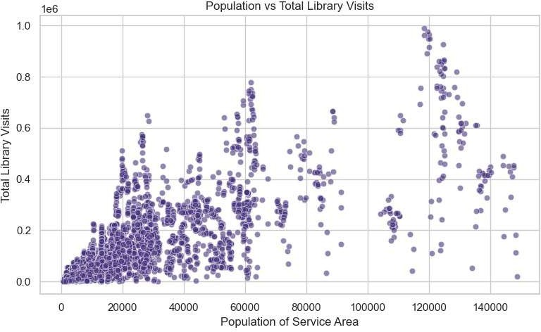
Objective 2: Population vs Total Registered Borrowers
Introduction
This objective aims to analyze how population size impacts the number of registered library borrowers.
General Description
Both variables are numerical and logically connected, as a higher population is likely to produce more registered users.
Specific Requirements, Functions, and Formulas Used
  Used regplot() from Seaborn to display regression and trend line
  Computed Pearson correlation coefficient
Analysis Results
  Correlation coefficient observed was 0.80

Slide 10
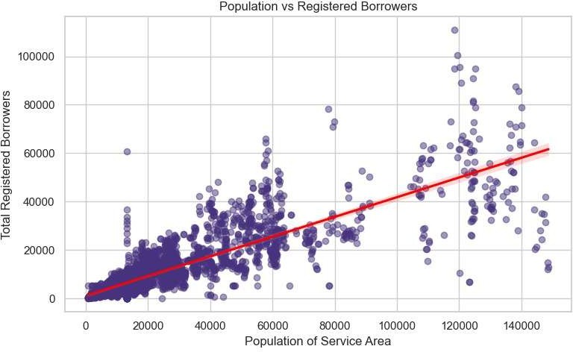
A strong positive linear trend exists between population and registered borrowers
Some outliers were observed in high-population areas, possibly due to alternative digital services
v) Visualization
The regression plot with a fitted trend line highlighted the linear relationship and demonstrated the overall positive association between population and borrower registration.
Objective 3: Average Operating Expenditure by County
Introduction
The purpose of this analysis is to compare average library operating expenditures across different counties.
General Description
Operating expenditure data was grouped by County and averaged to assess differences in funding allocation.
Specific Requirements, Functions, and Formulas Used
  Used groupby() and mean() functions from Pandas

Slide 11
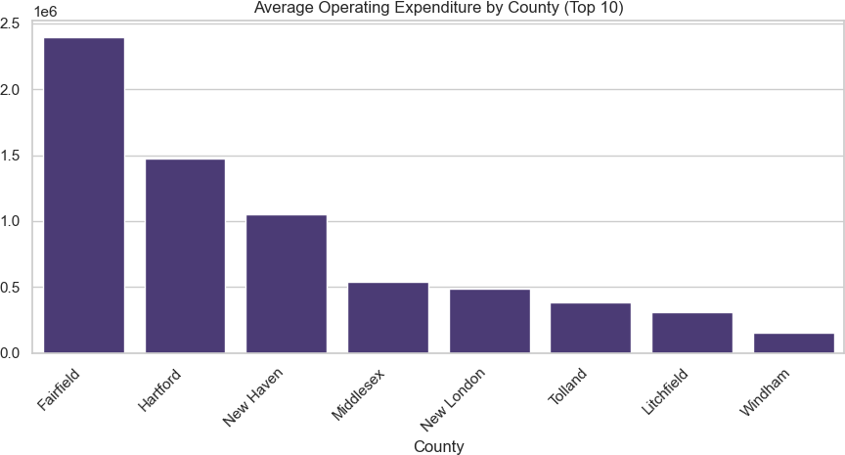
Visualized results using barplot() from Seaborn
Analysis Results
  Considerable disparities in spending were observed among counties
  Some counties consistently invest more in library operations
  Higher expenditure may indicate larger populations, better funding policies, or enhanced infrastructure
v) Visualization
A bar chart ordered by average expenditure clearly highlighted counties with the highest and lowest library spending.
Objective 4: Top Counties by Total Library Visits
Introduction
This analysis identifies counties with the highest total library footfall to understand regional engagement levels.
General Description
Total library visits were aggregated across all libraries within each county.
Specific Requirements, Functions, and Formulas Used

Slide 12
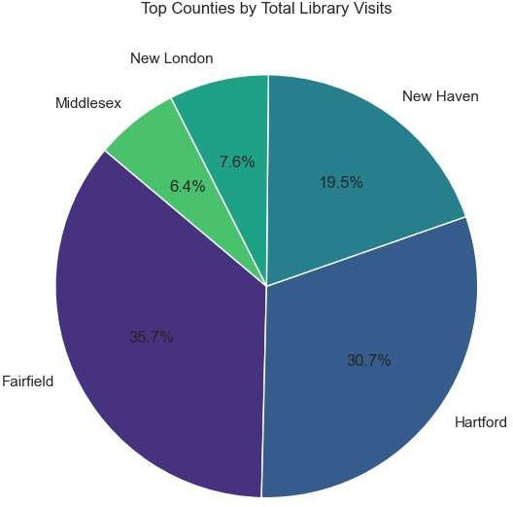
Used groupby() and sum() from Pandas
Selected top five counties using nlargest()
Visualized using pie() from Matplotlib
Analysis Results
  A small number of counties contribute a significant share of total visits
  High footfall likely reflects higher population density and strong community participation
v) Visualization
A pie chart displayed the percentage contribution of the top five counties to overall library visits.

Slide 13
Objective 5: Distribution of Collection Per Capita by County
Introduction
The objective is to assess fairness and consistency in the availability of library collections per person across counties.
General Description
Collection Per Capita Served is a numerical variable grouped by county to analyze distribution patterns.
Specific Requirements, Functions, and Formulas Used
  Used boxplot() from Seaborn
  Identified spread, median values, and outliers
Analysis Results
  Some counties exhibited higher median collection per capita values
  Presence of outliers indicates uneven resource distribution
  Variability suggests inconsistencies in funding or collection policies
v) Visualization
The box plot effectively captured variation, skewness, and outliers in collection distribution across counties.

Slide 14
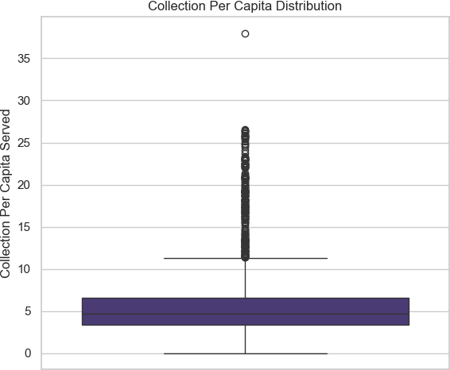
Regression Metrics
MAE : 45651.58654838799
MSE : 5943521627.537629
RMSE: 77094.23861442324

Slide 15
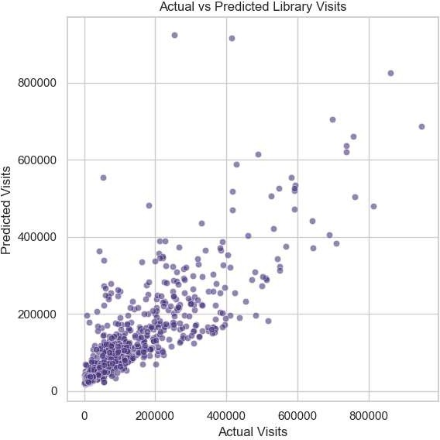
Classification Metrics Accuracy: 0.8611111111111112
Confusion Matrix: [[424 51]
[ 79 382]]

Slide 16
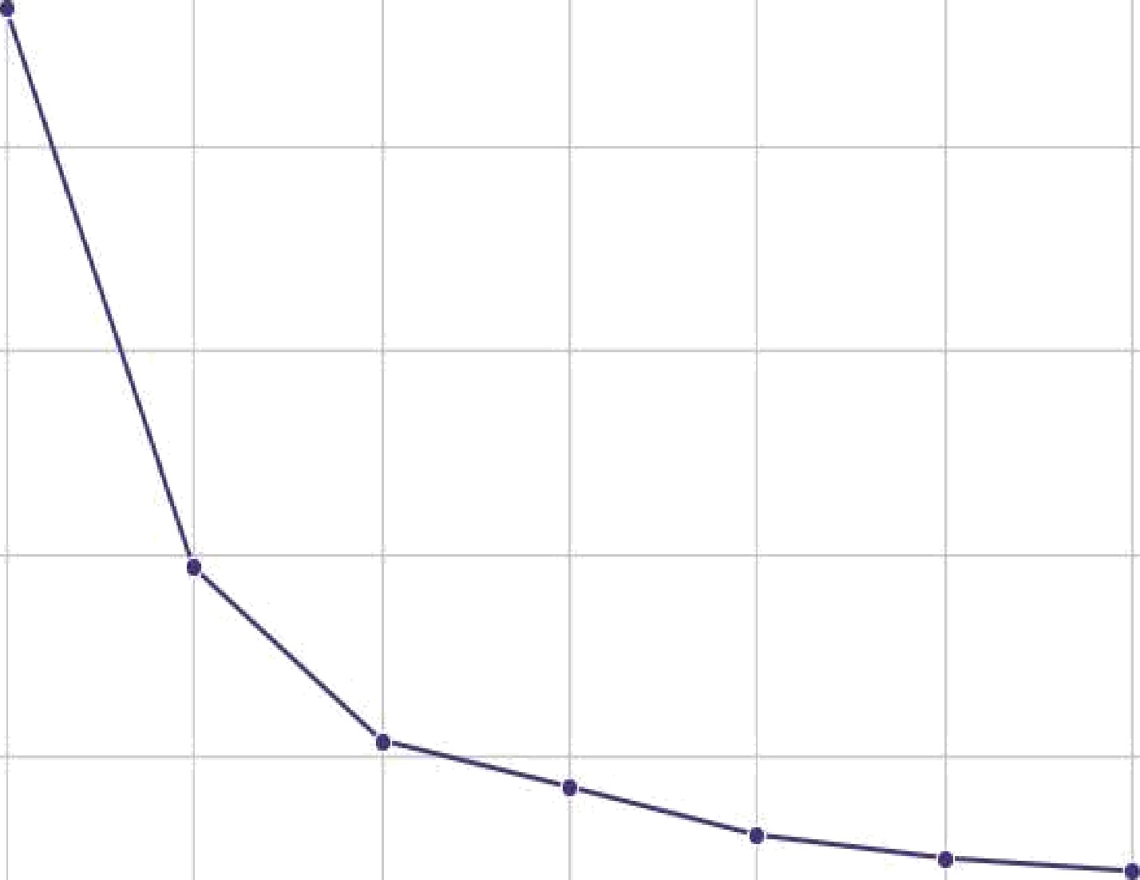

Elbow Method for K-Means
8000
@O0
VVC SS
4000
2000
1
2
3
4
Number of Clusters
6
1e7
Library Segmentation using K-Means
Cluster
0
10
2
% 08
0.6
04
0.2
DO
0
20000 40000 @00O @00O 100000
Population of Service Area
120000 140000

Slide 17
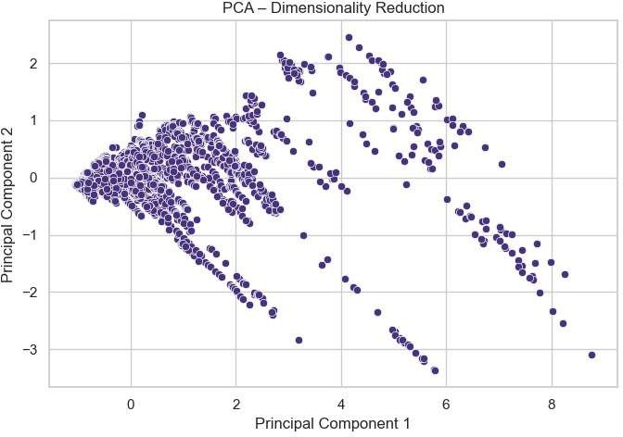
Cross Validation Scores: [ 0.69031998 0.73339492 0.80341633 0.8810454 -0.60228442]
Average CV Score: 0.501178444296955
.

Slide 18
5. Source Code
# INT234 PREDICTIVE ANALYTICS PROJECT
# Dataset: Public Libraries # Concepts Covered:
# Unit I : Data Preparation & EDA # Unit II : Regression + Evaluation # Unit III: Classification + Metrics # Unit IV : Clustering (K-Means)
# Unit V : PCA
# Unit VI : Cross Validation
# STEP 1: IMPORT LIBRARIES
import pandas as pd import numpy as np
import matplotlib.pyplot as plt import seaborn as sns
from sklearn.model_selection import train_test_split, cross_val_score from sklearn.linear_model import LinearRegression, LogisticRegression from sklearn.metrics import (
mean_absolute_error, mean_squared_error, r2_score, accuracy_score, confusion_matrix
)
from sklearn.preprocessing import StandardScaler from sklearn.cluster import KMeans
from sklearn.decomposition import PCA
# Seaborn theme for BEAUTIFUL plots sns.set_theme(style="whitegrid", palette="viridis")
# ========================= # STEP 2: LOAD DATASET
# =========================
df = pd.read_csv("C:/Users/Dell/OneDrive/Documents/Public_Libraries (1)_Cleaned.csv")
print("Dataset Shape:", df.shape) print(df.info())
print(df.head())
# Handle missing values df = df.dropna()

Slide 19
# ========================================================= # OBJECTIVE 1: DATA UNDERSTANDING & EDA (UNIT I)
# =========================================================
# 🔹 Visualization 1: Population vs Total Visits (Scatter) plt.figure(figsize=(8,5))
sns.scatterplot( data=df,
x="Population of Service Area", y="Total Library Visits", alpha=0.6
)
plt.title("Population vs Total Library Visits") plt.tight_layout()
plt.show()
# 🔹 Visualization 2: Population vs Borrowers (Regression) plt.figure(figsize=(8,5))
sns.regplot( data=df,
x="Population of Service Area",
y="Total Registered Borrowers", scatter_kws={"alpha":0.5}, line_kws={"color":"red"}
)
plt.title("Population vs Registered Borrowers") plt.tight_layout()
plt.show()
# 🔹 Visualization 3: Avg Operating Expenditure by County (Bar) avg_exp = (
df.groupby("County")["Operating Expenditures"]
.mean()
.sort_values(ascending=False)
.head(10)
)
plt.figure(figsize=(9,5)) sns.barplot(x=avg_exp.index, y=avg_exp.values) plt.xticks(rotation=45, ha="right")
plt.title("Average Operating Expenditure by County (Top 10)") plt.tight_layout()
plt.show()

Slide 20
# 🔹 Visualization 4: Top Counties by Visits (Pie) top_visits = (
df.groupby("County")["Total Library Visits"]
.sum()
.sort_values(ascending=False)
.head(5)
)
plt.figure(figsize=(6,6)) plt.pie(
top_visits, labels=top_visits.index, autopct="%1.1f%%", startangle=140
)
plt.title("Top Counties by Total Library Visits") plt.tight_layout()
plt.show()
# 🔹 Visualization 5: Collection Per Capita (Box Plot) plt.figure(figsize=(6,5))
sns.boxplot(y="Collection Per Capita Served", data=df) plt.title("Collection Per Capita Distribution") plt.tight_layout()
plt.show()

Slide 21
# ========================================================= # OBJECTIVE 2: REGRESSION (UNIT II)
# =========================================================
# Features & Target X = df[[
"Population of Service Area", "Total Registered Borrowers", "Operating Expenditures"
]]
y = df["Total Library Visits"]
# Train-Test Split
X_train, X_test, y_train, y_test = train_test_split( X, y, test_size=0.2, random_state=42
)
# Train Model
reg_model = LinearRegression() reg_model.fit(X_train, y_train)
# Prediction
y_pred = reg_model.predict(X_test)
# Evaluation Metrics print("\nRegression Metrics")
print("MAE :", mean_absolute_error(y_test, y_pred)) print("MSE :", mean_squared_error(y_test, y_pred)) print("RMSE:", np.sqrt(mean_squared_error(y_test, y_pred))) print("R2 :", r2_score(y_test, y_pred))
# 🔹 Actual vs Predicted plt.figure(figsize=(6,6)) sns.scatterplot(x=y_test, y=y_pred, alpha=0.6) plt.xlabel("Actual Visits") plt.ylabel("Predicted Visits")
plt.title("Actual vs Predicted Library Visits") plt.tight_layout()
plt.show()

Slide 22
# ========================================================= # OBJECTIVE 3: CLASSIFICATION (UNIT III)
# =========================================================
# Create Binary Target
df["Usage_Level"] = (df["Total Library Visits"] >
df["Total Library Visits"].median()).astype(int)
X_cls = df[["Population of Service Area", "Operating Expenditures"]] y_cls = df["Usage_Level"]
# Split
X_train, X_test, y_train, y_test = train_test_split( X_cls, y_cls, test_size=0.2, random_state=42
)
# Logistic Regression
clf = LogisticRegression(max_iter=1000) clf.fit(X_train, y_train)
# Prediction
y_pred = clf.predict(X_test)
# Metrics print("\nClassification Metrics")
print("Accuracy:", accuracy_score(y_test, y_pred)) print("Confusion Matrix:\n", confusion_matrix(y_test, y_pred))

Slide 23
# ========================================================= # OBJECTIVE 4: CLUSTERING (UNIT IV)
# =========================================================
# Scaling
scaler = StandardScaler()
X_scaled = scaler.fit_transform(X_cls)
# Elbow Method wcss = []
for k in range(1,8):
kmeans = KMeans(n_clusters=k, random_state=42) kmeans.fit(X_scaled) wcss.append(kmeans.inertia_)
plt.figure(figsize=(7,5)) sns.lineplot(x=range(1,8), y=wcss, marker="o") plt.xlabel("Number of Clusters") plt.ylabel("WCSS")
plt.title("Elbow Method for K-Means") plt.tight_layout()
plt.show()
# Apply K-Means
kmeans = KMeans(n_clusters=3, random_state=42) df["Cluster"] = kmeans.fit_predict(X_scaled)
# Cluster Visualization plt.figure(figsize=(7,5)) sns.scatterplot(
data=df,
x="Population of Service Area",
y="Operating Expenditures", hue="Cluster", palette="Set2"
)
plt.title("Library Segmentation using K-Means") plt.tight_layout()
plt.show()

Slide 24
# ========================================================= # OBJECTIVE 5: PCA & MODEL PERFORMANCE (UNIT V & VI)
# =========================================================
# PCA
pca = PCA(n_components=2)
pca_result = pca.fit_transform(X_scaled)
plt.figure(figsize=(7,5)) sns.scatterplot(x=pca_result[:,0], y=pca_result[:,1]) plt.xlabel("Principal Component 1")
plt.ylabel("Principal Component 2") plt.title("PCA – Dimensionality Reduction") plt.tight_layout()
plt.show()
# Cross Validation
cv_scores = cross_val_score(reg_model, X, y, cv=5) print("\nCross Validation Scores:", cv_scores) print("Average CV Score:", cv_scores.mean())

Slide 25
Conclusion
This project provided a comprehensive exploration of public library services across various counties using realworld data from the U.S. government’s Data.gov portal. Through systematic Exploratory Data Analysis (EDA), the following key insights were drawn:
  Population Correlation: There is a strong positive correlation between the population of a service area and both the total library visits and the number of registered borrowers. This suggests that libraries in more populated areas tend to serve more people, though utilization can vary based on additional factors.
  Resource Allocation: Significant variation exists in operating expenditures across counties. Some counties invest considerably more, which may influence service quality, program offerings, and community outreach.
  Library Engagement: A few counties dominate in terms of total library visits, highlighting higher community engagement or better library accessibility.
  Equity of Access: The distribution of collections per capita reveals disparities between counties. Some provide significantly more resources per person than others, indicating potential areas for policy improvement and reallocation.
Overall, the analysis emphasizes the importance of data-driven decision-making in improving library services. Insights from population trends, usage patterns, and expenditure gaps can support evidence-based planning, funding allocation, and community engagement strategies in public library systems.
7. Future Scope
This project lays the groundwork for more advanced analysis and decision-making in public library management. In the future, the dataset can be expanded with historical data across multiple years to perform trend analysis and forecast future demands.
Integrating external factors such as population growth, literacy rates, internet penetration, and funding allocations can offer deeper, more actionable insights.
Additionally, geospatial analysis using library locations and service areas can help identify underserved regions and optimize resource distribution. Predictive analytics and machine learning models can also be applied to forecast visitor counts, program attendance, and budget needs—ultimately assisting in strategic planning and policy formulation for better community engagement.
8. References
U.S. General Services Administration, “Public Libraries Dataset,” Data.gov. [Online]. Available: https://data.gov. [Accessed: Apr. 12, 2025].
W. McKinney, *Python for Data Analysis*, 2nd ed. Sebastopol, CA: O'Reilly Media, 2018.
J. D. Hunter, “Matplotlib: A 2D Graphics Environment,” *Computing in Science & Engineering*, vol. 9, no. 3, pp. 90–95, 2007. [4] Seaborn Developers, “Seaborn: Statistical Data Visualization,” [Online].
Available: https://seaborn.pydata.org. [Accessed: Apr. 12, 2025].

Slide 26
LINKEDIN LINK:
https://www.linkedin.com/feed/update/urn:li:activity:7408191780632072192/
GITHUB LINK:
https://github.com/kumariroshani-890/INT234ProjectPublicLibraries

