Slide 1

Instagram Data Analysis
Presented by: Kumari Shreesty

Slide 2

Introduction
Social media platforms generate a massive amount of user interaction data every day. Analysing this data helps organizations understand user behaviour, measure engagement, identify influential users, and improve business decision-making.
In this project, I performed an end-to-end analysis of an Instagram Clone dataset using SQL. The dataset includes users, photos, likes, comments, followers, hashtags, and photo tags. Through SQL queries, I analysed user engagement, hashtag performance, follower relationships, influencer identification, and user segmentation to derive meaningful business insights.
The findings from this analysis can support marketing strategies, improve user engagement, assist in influencer collaborations, and help platforms make data-driven decisions to enhance user experience.

Slide 3

Slide 3 title
Problem Statement
Instagram collects millions of interactions every day, but raw data alone does not provide actionable insights.
The objective of this project is to answer key business questions, such as:
Which users have the highest engagement?
Which hashtags perform the best?
Who are the most valuable users?
How can businesses improve engagement?
Which users are suitable for influencer marketing?

Slide 4
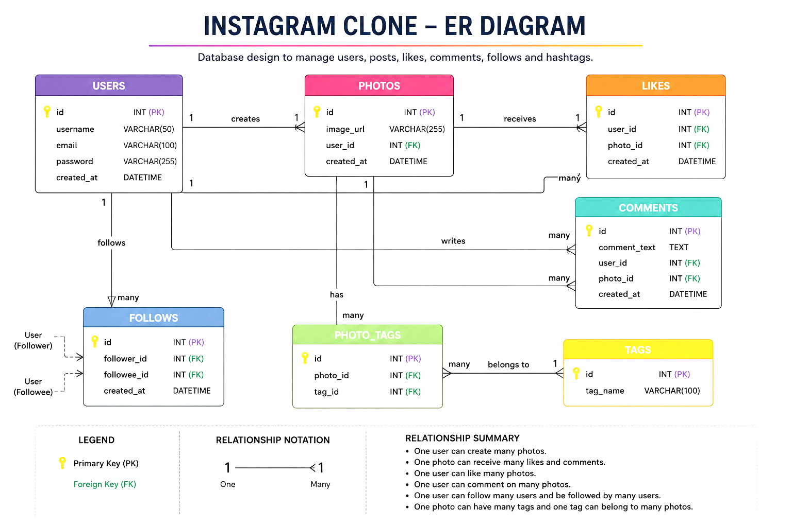
Slide 4 title
Data Overview

Slide 5
Slide 5 title
SQL Concept Use
SQL Concept | Purpose
Joins | Combine tables
GROUP BY | Aggregation
COUNT() | Calculate totals
AVG() | Average engagement
ORDER BY | Ranking
CTE | Hashtag analysis
UPDATE | Data modification

Slide 6
Slide 6 title
Objective Analysis
100
257
405
Total Users
Total Photos
Highest Engagement
21
Total Hashtags
Eveline95
77
Top Influencer
Max Followers

Slide 7
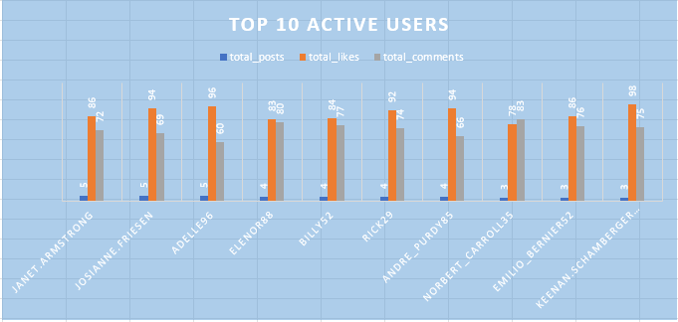
Data of the top 10 active users
Key Insights
High user engagement is driven primarily by likes and comments rather than the number of posts.
Some users with only 3–5 posts have received exceptionally high likes and comments, indicating that content quality has a greater impact than posting frequency.
Keenan.Schamberger60 received the highest number of comments (75) despite posting only three photos.

Slide 8
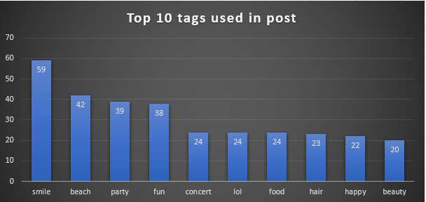
Trending tags
Key Insights
The hashtag "smile" is the most frequently used tag, appearing in 59 posts
Lifestyle and entertainment-related hashtags dominate the platform.
The usage frequency declines gradually after the top four hashtags.
Popular hashtags can be leveraged to improve content discoverability and marketing campaigns.

Slide 9
Hashtag Performance Analysis
Key Findings
#dreamy achieved the highest average engagement.
Popular hashtags consistently improve post visibility.
Using trending hashtags can increase audience interaction.
Businesses can use these hashtags to improve campaign reach.
Hashtag | Average Engagement
Dreamy | 35.75
Beauty | 34.95
Stunning | 34.94
Delicious | 34.93
Foodie | 34.73

Slide 10
Top User Engagement Analysis
User | Total Engagement
Eveline95 | 405
Cesar93 | 385
Clint27 | 375
Delfina_VonRueden68 | 347
Aurelie71 | 318
Jaime53 | 302
Donald.Fritsch | 247
Janet.Armstrong | 222
Alexandro35 | 220
Zack_Kemmer93 | 219
Key Findings
Eveline95 recorded the highest engagement score (405).
The top 5 users generated significantly higher engagement than the remaining users.
Highly engaged users are ideal candidates for influencer marketing and promotional campaigns.
Rewarding these users can improve user retention and community participation.

Slide 11
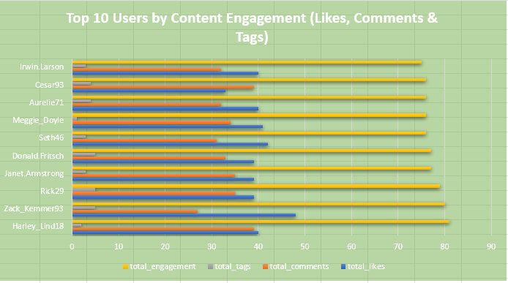
Top users with high engagement
Key Insights
Harley_Lind18 achieved the highest overall engagement score (80), making them the most engaging content creator among the top 10 users.
Likes contribute the largest share of total engagement for most users.
Highly engaged users maintain a balanced combination of likes, comments, and tagged content.
The top 10 engaged users are valuable candidates for influencer marketing and promotional campaigns.

Slide 12
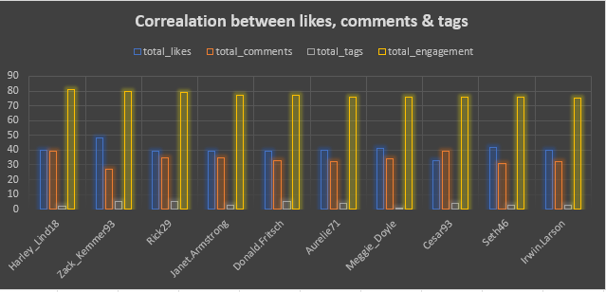
Analysis of user activity
Key Insights
Harley_Lind18 achieved the highest overall engagement score (80), making them the top-performing user in terms of combined likes, comments, and photo tags.
Likes are the largest contributor to total engagement for most users.
Users with higher likes generally also receive higher comments, indicating a positive relationship between these engagement metrics.
Photo tags contribute the least to overall engagement but improve content discoverability.

Slide 13
Strategies to Re-engage Inactive Users
Identify Inactive Users
1
Send Personalized Recommendations
3
Push Notifications & Rewards
4
Analyse User Interests
2
Community Challenges
5
Increase User Engagement
6
Improve User Retention
Key Insight
Personalized recommendations encourage users to return.
Rewards and community challenges increase participation.
Higher engagement leads to improved user retention and platform growth.

Slide 14
Content Strategy Using High-Engagement Hashtags
Analyse Hashtags
Identify High-Engagement Hashtags
Recommend Trending Hashtags
Increase Content Visibility
Improve User Engagement
Optimize Ad Campaigns
Key Insights
Identifying high-performing hashtags helps understand current user interests and trending topics.
Recommending relevant hashtags increases post visibility and attracts the right audience.
Using hashtag-based targeting improves user engagement and enables more personalized advertising campaigns.

Slide 15
Business Insights
Loyal Users
Influencer Marketing
High-engagement users drive performance activity.
Top users are suitable for brand collaborations.
Content Strategy
User Retention
Trending hashtags improve engagement.
Inactive users can be re-engaged with personalized campaigns.

Slide 16
Recommendations
🏆 Reward loyal users
📢 Personalize marketing campaigns
📊 Continuously monitor engagement
🌟 Collaborate with influencers
🏷️ Promote high-performing hashtags

Slide 17
Conclusion
This project demonstrates how SQL can transform raw social media data into actionable business insights. By analysing user engagement, follower relationships, and hashtag performance, the project identified opportunities to improve marketing strategies, increase user engagement, and support data-driven business decisions.

Slide 18
Thank You

