Slide 1

Minor Project
On
“Bill Management Application
AI Enabled Regression”
Submitted to : Submitted By:
Prof. Ajay Anand Mayank Kumar Singh
Assistant Professor 1806039
School of Computer Engineering Information Technology

Slide 2

Presentation Outline :
1. Introduction
2. Objective
3. Technology Platforms
4.Planning and Project Management
5. Project Implementation
6. Application Snapshots
7. Conclusion
8. Future Work

Slide 3
Introduction :
In a B2B world business work with other businesses on credit. Business-to-business refers to a business that is conducted between companies, rather than between a company and individual consumer.
In B2B when a buyer business orders goods from the seller business, the seller business issues an invoice for the same. This invoice for the goods contains various information like the details of the goods purchased and when they should be paid. Each invoice will have various important fields like a payment due date, invoice date, invoice amount, baseline date, etc. The buyer business needs to clear its amount due before the due date.
However, in real-world scenarios, the invoices are not always cleared i.e. paid in full amount by the due date. The date on which a customer clears the payment for an invoice is called the payment date or clear date.

Slide 4
Objectives :
1.Build a Machine Learning Model to predict the payment date of an invoice when it gets created in the system and categorize the invoice into different buckets based on the predicted payment date model. The different buckets will be as follows : 0-15 days, 16-30 days, 31-45 days, 46-60 days and greater than 60 days.
2.To build a full-stack Invoice Management Application using ReactJs, JDBC, Java, and JSP. Building a responsive Receivables Dashboard.Visualizing data in the form of grids. Enable Search operations on the invoices.Edit data in the editable fields of the grid.Download data of selected rows in predefined templates.

Slide 5

Technology Platforms :
For building the ML model:
i. Jupyter Notebook
For creating the responsive User Interface:
i.. Front-end Development: ReactJs
ii. Back-end Development: Java
iii. Database: MYSQL
iv. Design Architecture : Adobe XD

Slide 6
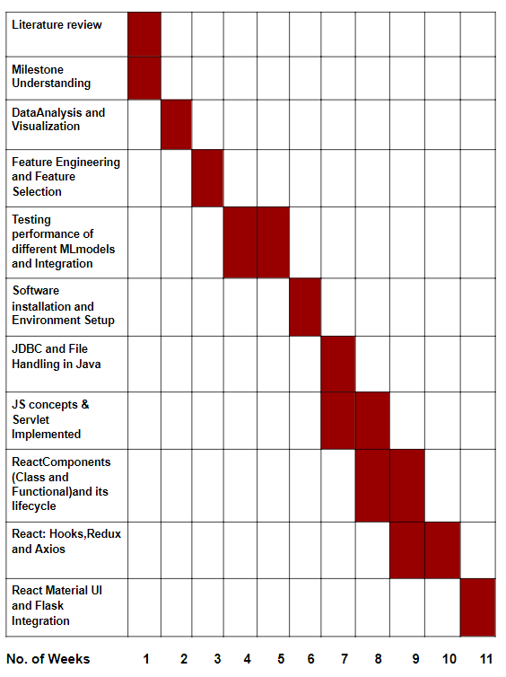
Planning And Project Management :

Slide 7
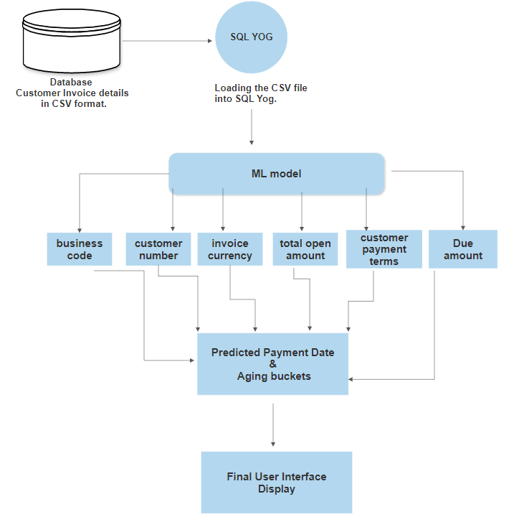
Project Implementation :

Slide 8
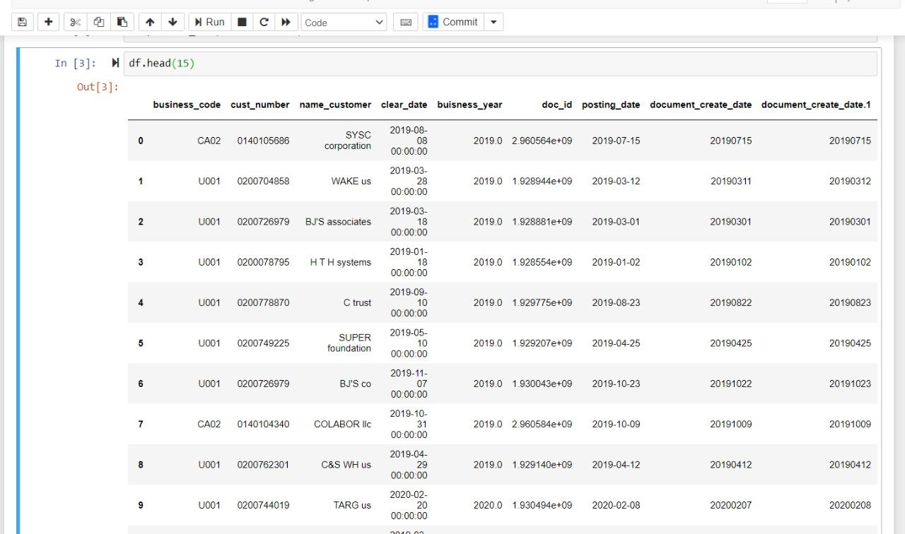
Project Snapshots :
Customer’s Invoice Dataset used

Slide 9
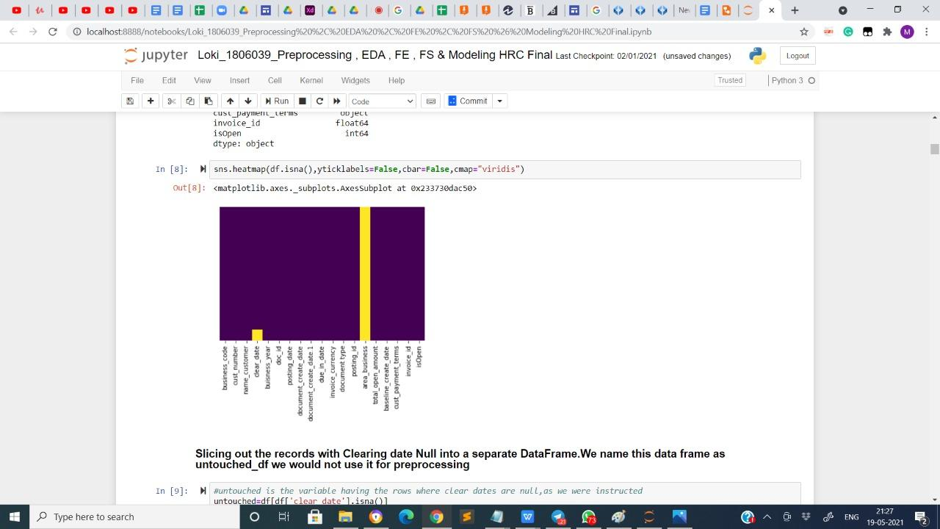
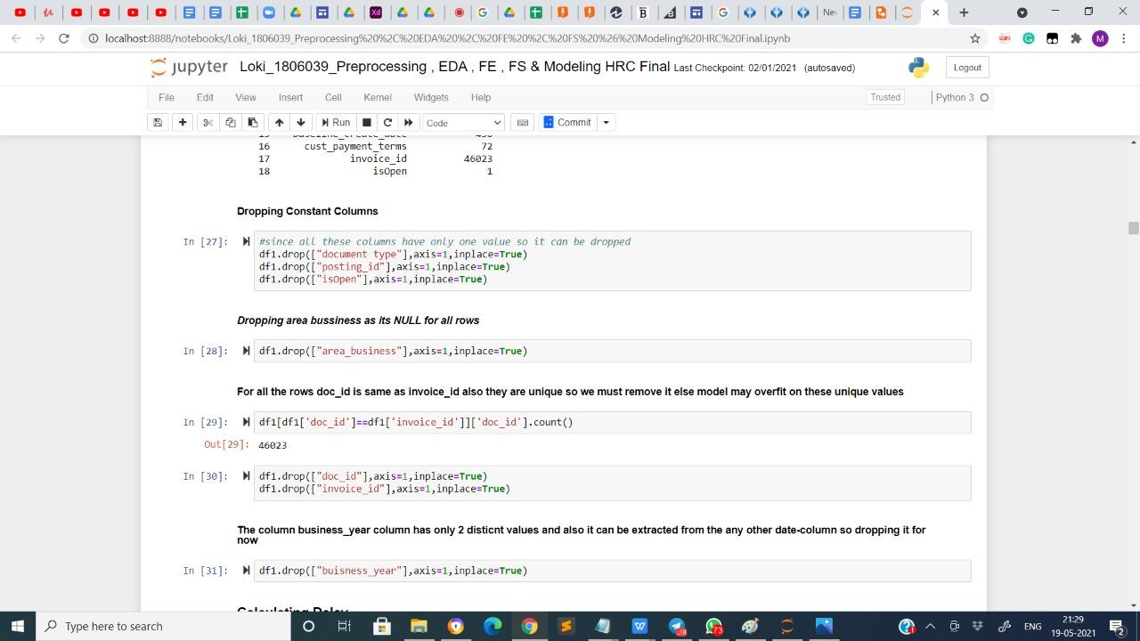
Exploratory Data Analysis :
1.Heat Map of NULL values 2. Dropping the NULL values

Slide 10
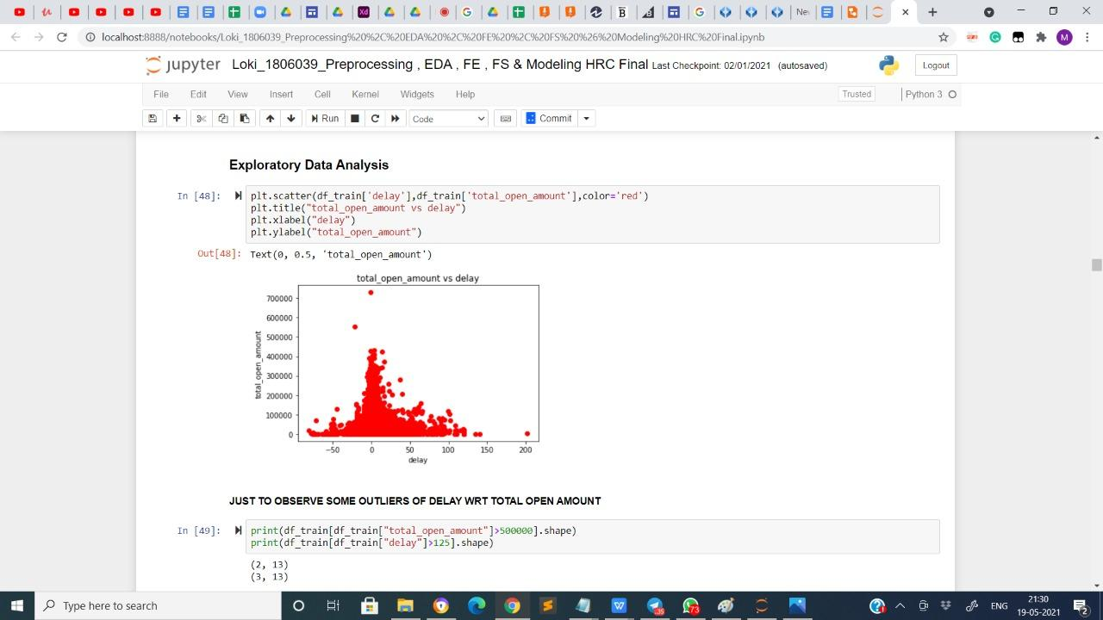
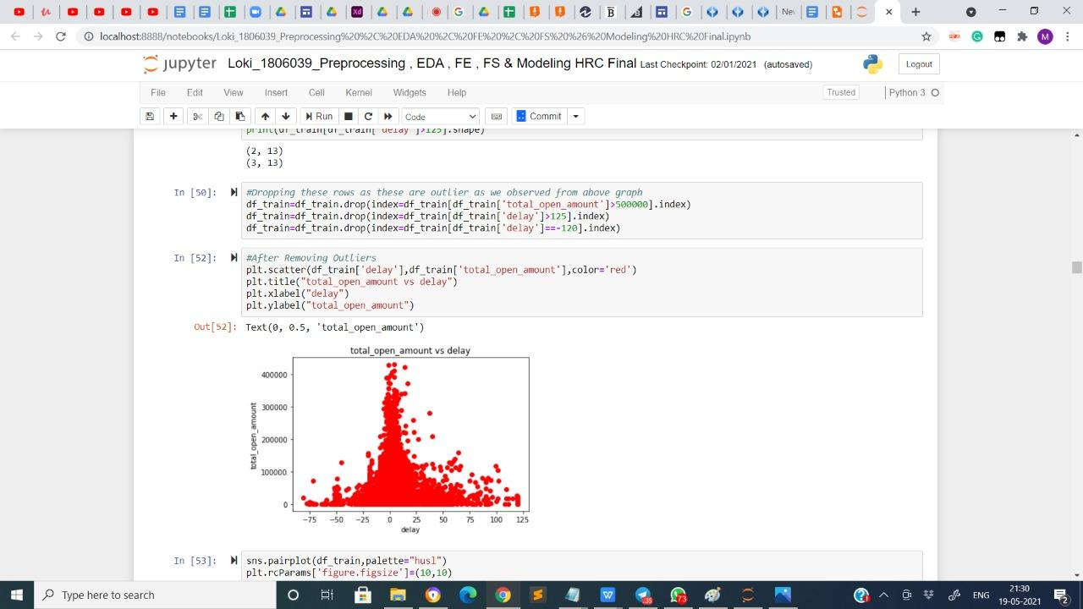
3. Outliers Detection 4. Outliers Removal

Slide 11
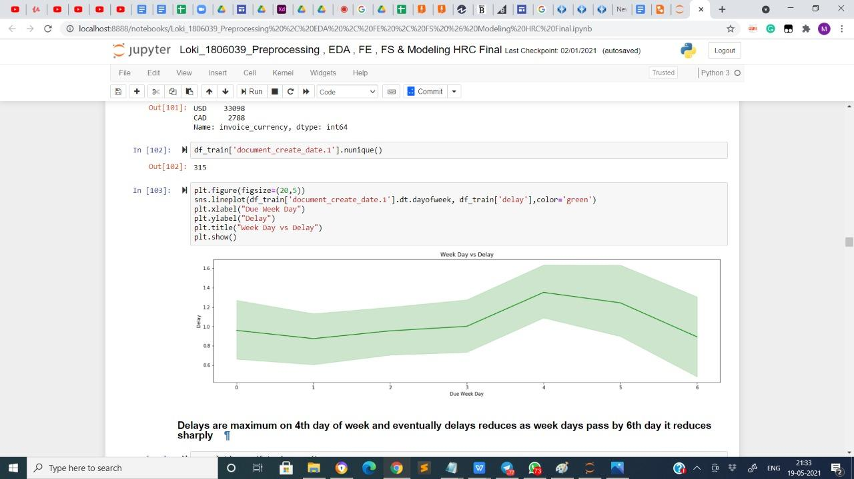
5. Insights derived from the data

Slide 12
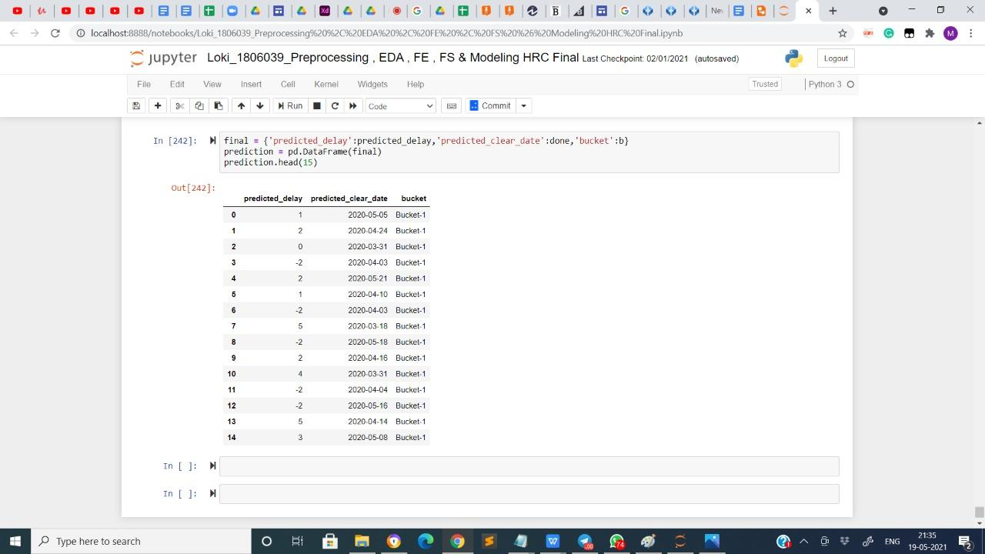
Predicted Payment date and Aging Bucket

Slide 13
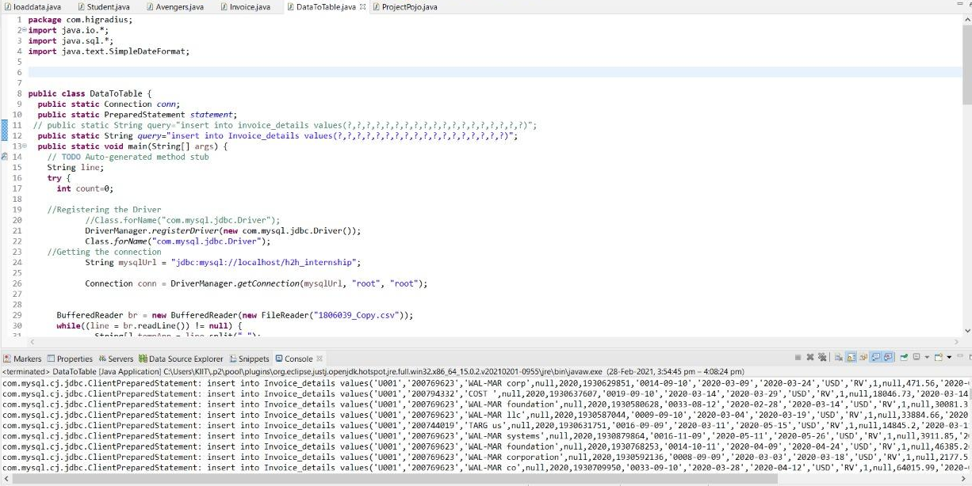
Data Loading

Slide 14
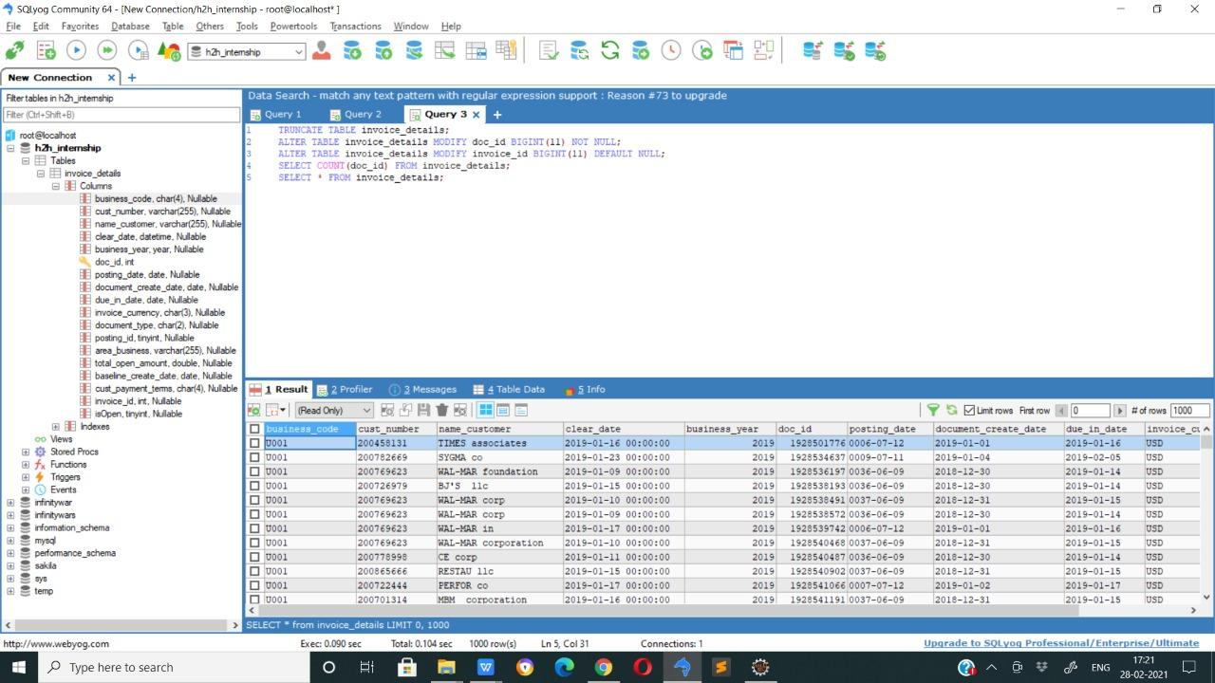
Data loaded from DB

Slide 15
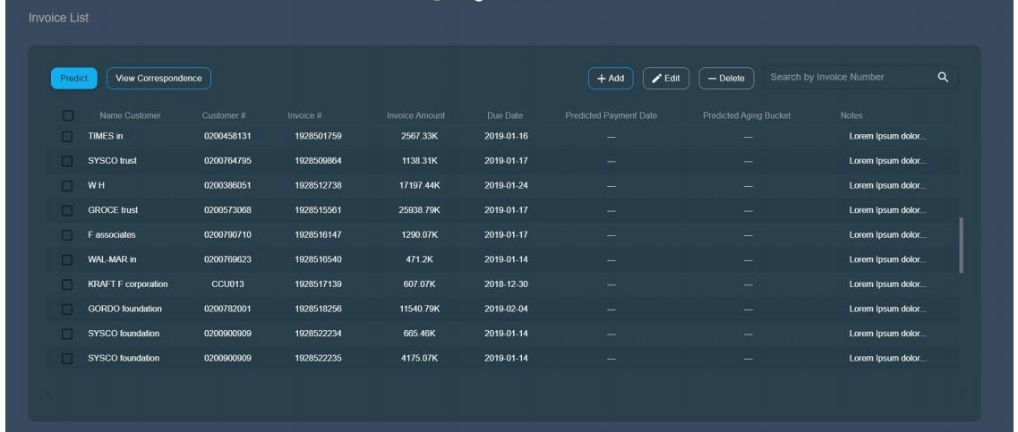
Displaying the data in the form of grids

Slide 16
Functionality :
The ML model needs to predict date of payment of an invoice. It also needs to predict aging bucket the invoice falls into based on the predicted payment date.
Responsive UI can display the invoice data loaded from the database.
The UI supports searching and infinite scrolling operations.
It supports editing of some editable fields.
Also adding a new row to the grid.
It allow deleting rows from the grid and downloading selected records from the grid.

Slide 17
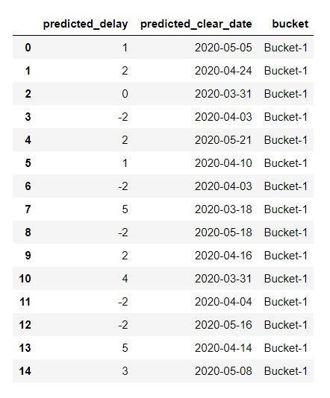
Results and Discussion
1.The accuracy of Support vector regressor is 44.17 whereas decision tree regressor gives accuracy of 72.74
2.Decision Tree Regressor gives better accuracy of 72.74 as compared to Support Vector Regressor.

Slide 18

Conclusion
This project was a great opportunity for me to apply my coding skills in order to solve a real world problem and gain some practical knowledge. I learnt how to work professionally within given deadlines and how to inculcate different ideas in the project in an organized fashion.

Slide 19

Future Work
This project is specifically built to meet the requirements of the company’s collection analyst, who otherwise would have to hunt for invoice history of different customers and accordingly arrange a follow up in order to receive the payment of the unpaid invoices from the buyer business.Also in future, we could enhance this project further by introducing a chat bot which will help with better user experience.

Slide 20


