Slide 1

SUPERMARKET BUSINESS ANALYSIS SALES PREDICTION
`
Group 4
Divya Rao
Kushal Patel
Nimish Kumar
Mohit Kumar
Viraj Modi

Slide 2

OUR GOAL
To analyze sales to plan marketing approach and to forecast sales.

Slide 3
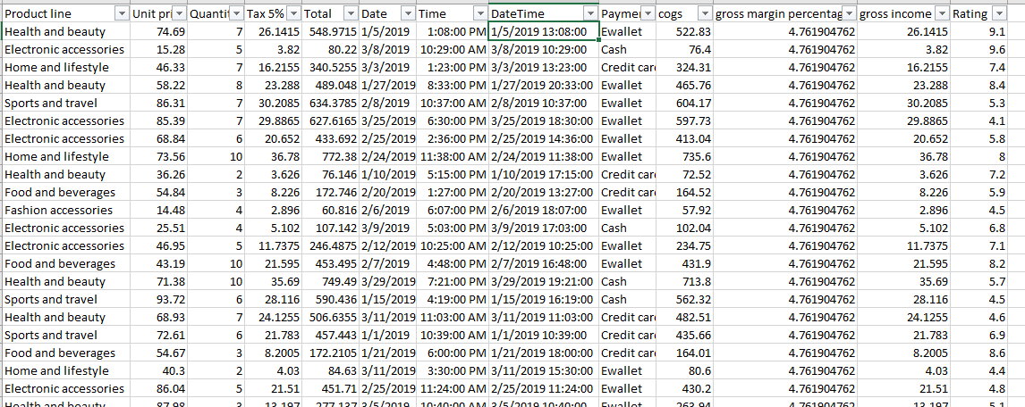
Glimpse of Dataset

Slide 4
Data Visualization and Analysis
To understand sales
To find potential customers for services
To plan and create marketing approach and techniques

Slide 5
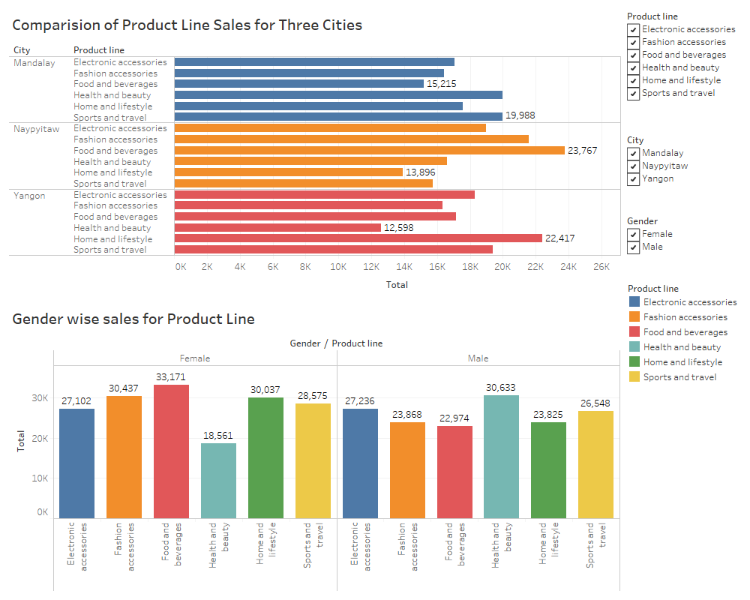
Dashboard 1

Slide 6
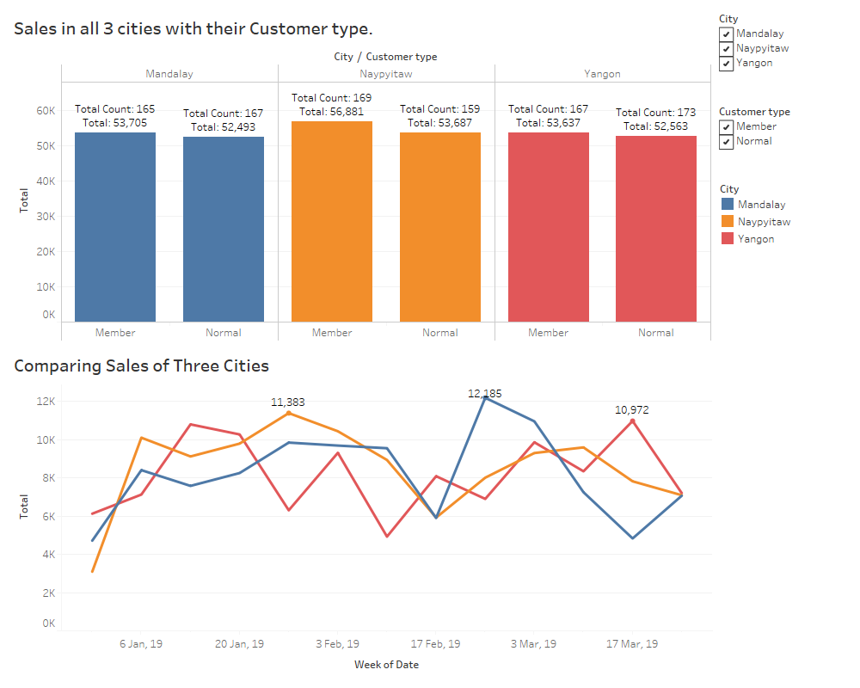
Dashboard 2

Slide 7
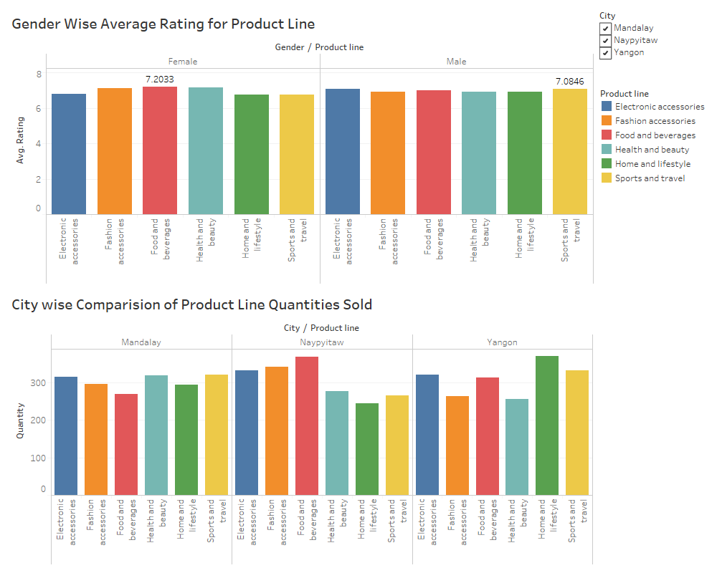
Dashboard 3

Slide 8
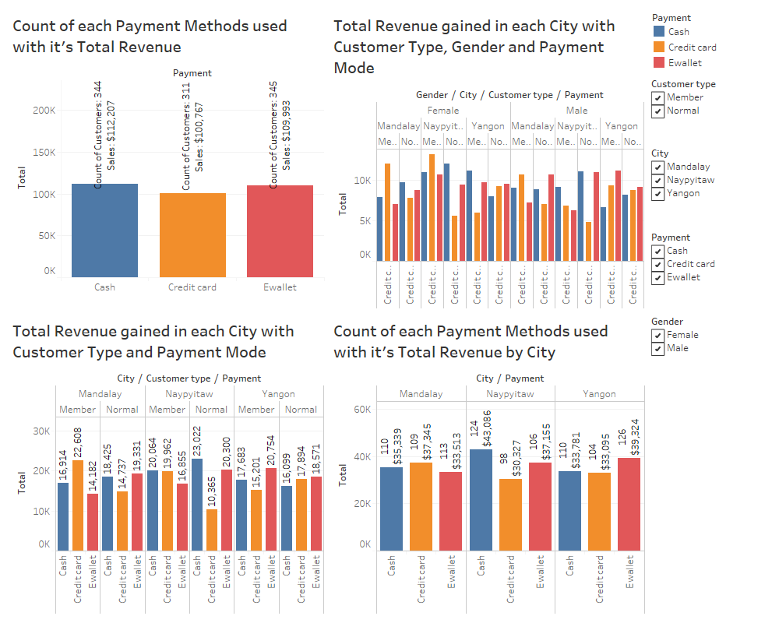
Dashboard 4

Slide 9
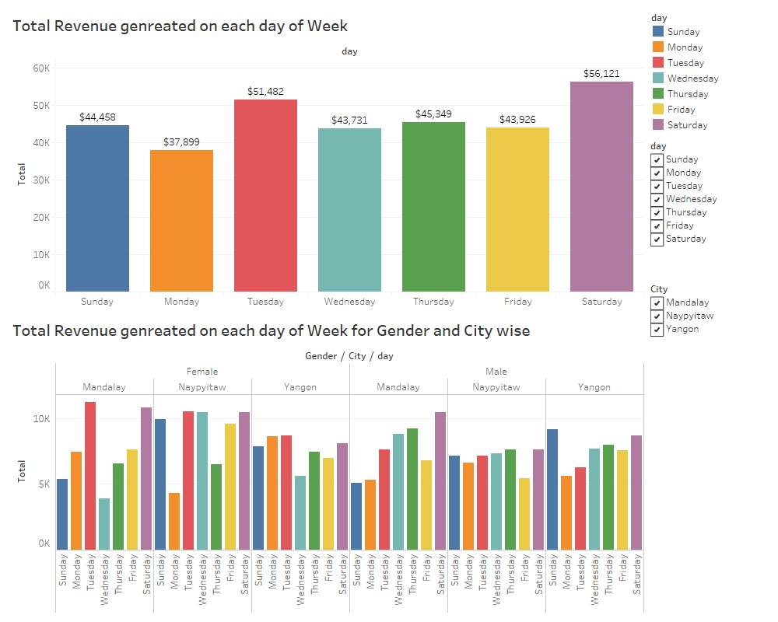
Dashboard 5

Slide 10
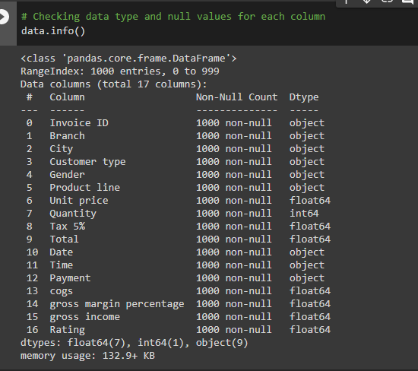
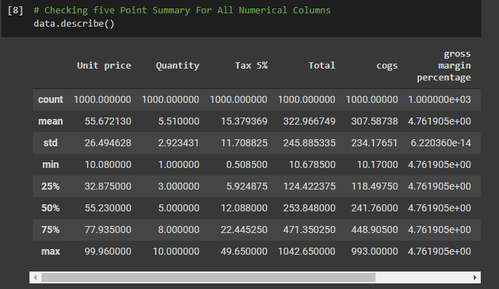
About the Data

Slide 11
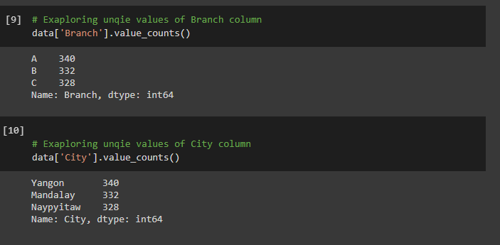
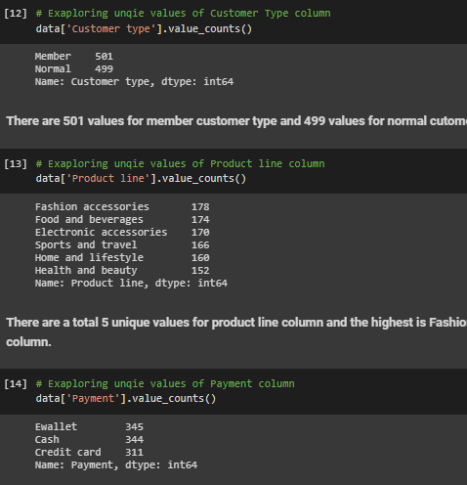
Exploratory Data Analysis

Slide 12
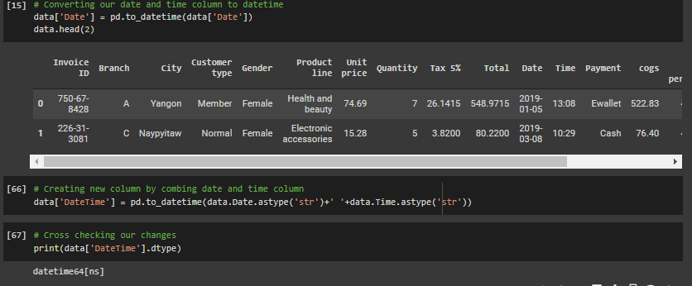
EDA: Changing Data Type

Slide 13
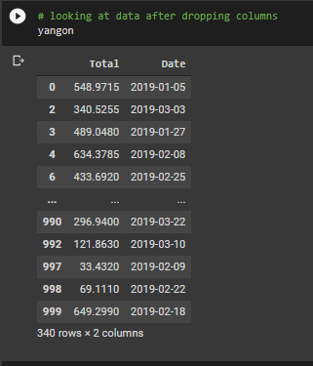
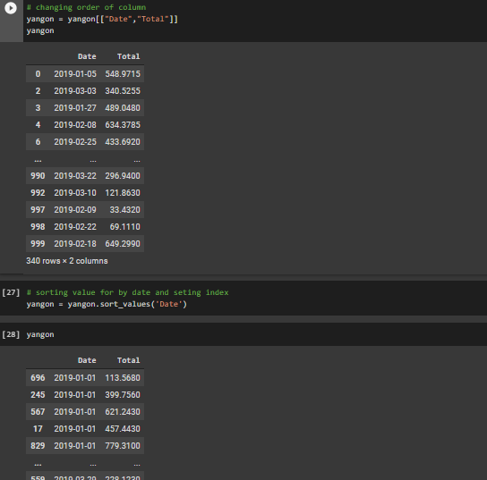
Filtering Yangon City for analysis and sales forecasting

Slide 14
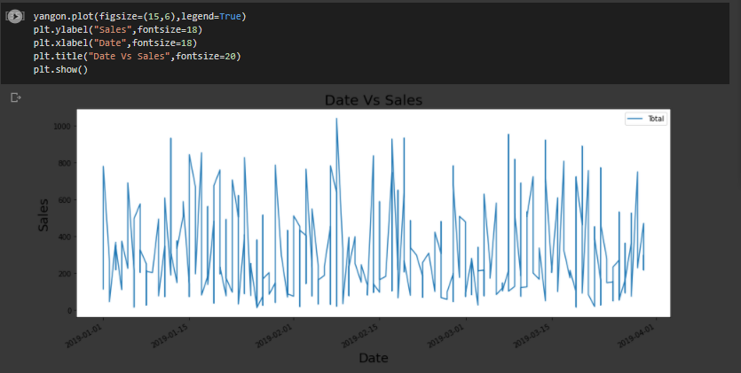
Sales in Yangon

Slide 15
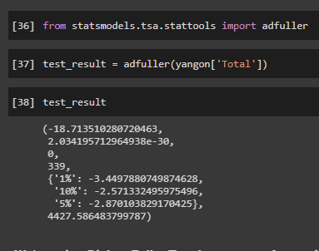
Checking if the data is stationary

Slide 16
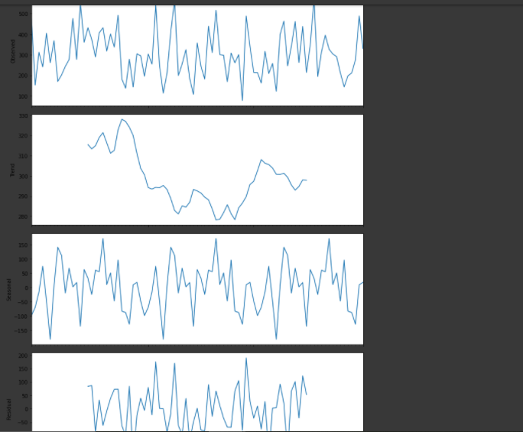
Decomposition Plot for Yangon City

Slide 17
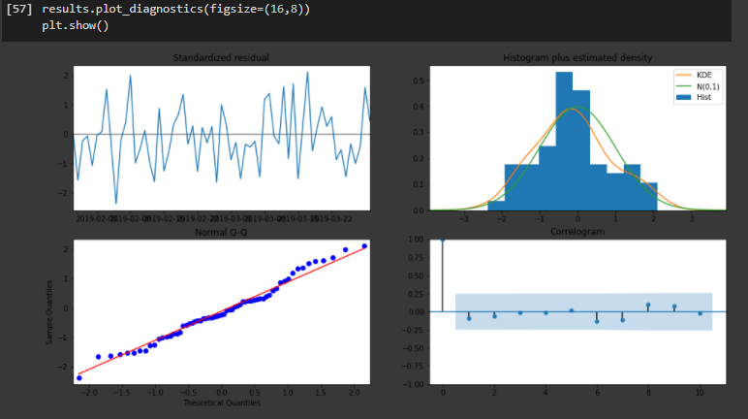
Diagnostic Plot for Yangon City

Slide 18
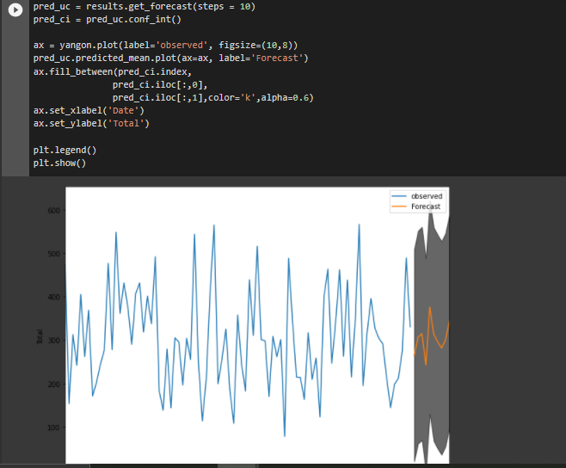
One Step Sales Forecasting Plot for Yangon City

Slide 19
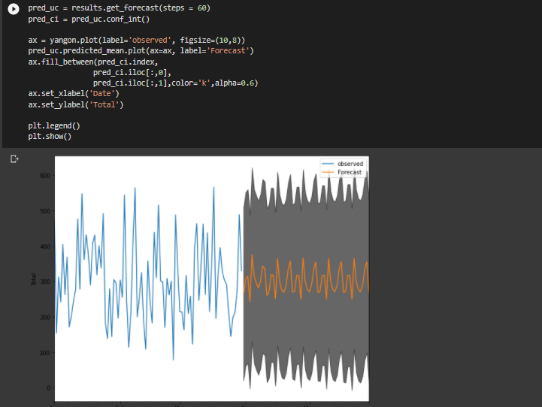
Upcoming 2 months(April, May) Sales Forecasting Plot for Yangon City

Slide 20

THANK YOU!
Any Questions?

