Slide 1
Easy APPointment
A tool for medical APPointment

Slide 2
Objectives
This App will make medical appointment easy and fast.
Will reduce the waiting time in the medical facilities.
Will let the professionals to manage their time.
Will allow the patient to choose the better medical option, date and time for the appointment.

Slide 3
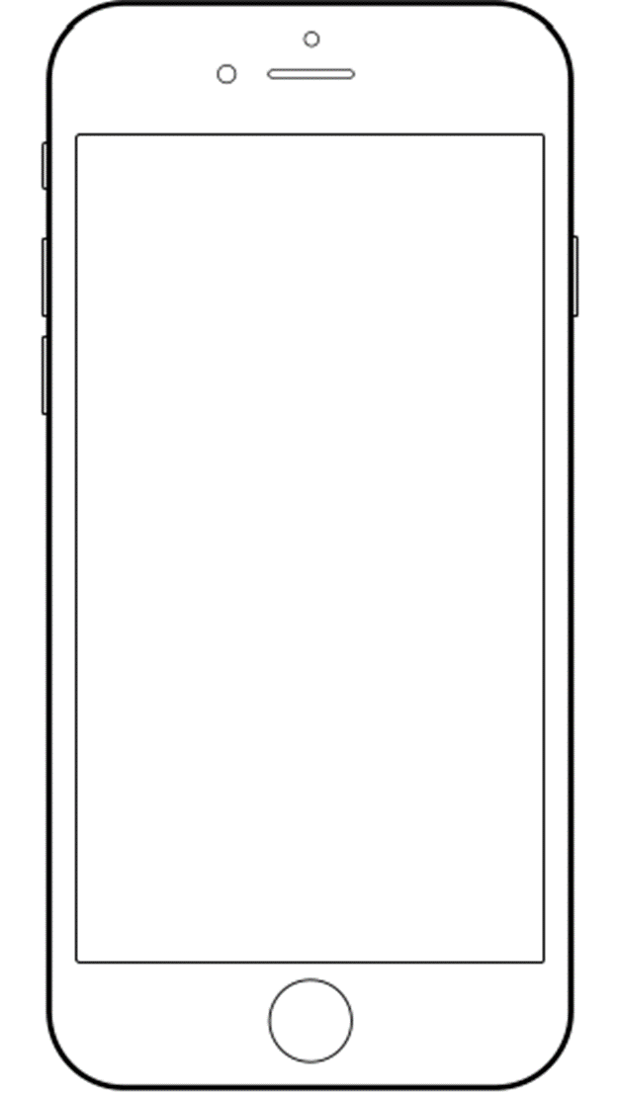
Description: App for costumers:
Easy APPointment

Slide 4

This fields should be filled only the first time and been corroborate for the insurance company
Name:
Health insurance:
Number:
General Doctor:
Professional Number:
NEXT

Slide 5
My APPointments
New APPointment

Slide 6
When you make a new appointment with your eneral Doctor, he will receive one notification in the App
NEW APPointemnt
General Doctor
New APPointment
Speciality

Slide 7

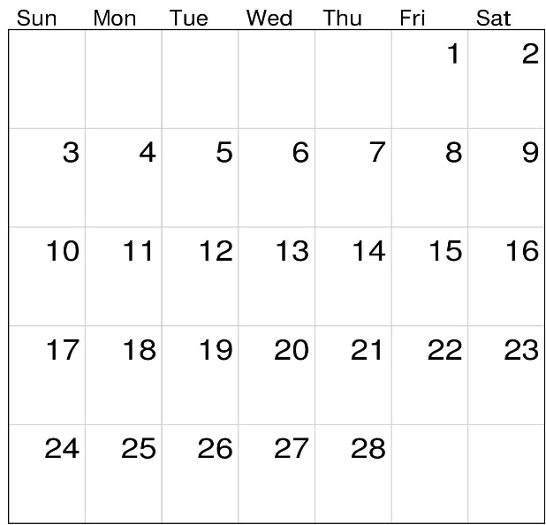
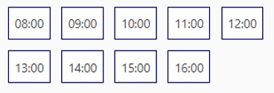
- Medical speciality -
You can access the professional profile of any doctor on the list
Internal medicine
Dermatology
Cardiology
Neurology
Ophthalmology
Urology
Other
- Professional -
Doctor A
Doctor B
Doctor C
Doctor D
Doctor E
Doctor F
- Appointment date -
- Appointment hour -
NEXT

Slide 8
The APPointment will be stored on the internal agenda
Your APPointment has been Schedule as follow:
Name: XXXXX XXXXXXX
Medical Specialty: XXXXXXXX
Doctor: XXXXXXX XXXXXX
Date: XX/XX/XX
Hour: XX:XX
Location: XXXXXX
You have to be at least 15 minutes before appointment
DONE

Slide 9
When a patient make an APPointment he receive a notification
1
Easy APPointment

Slide 10
1
My APPointments
New APPointment

Slide 11
Your APPointment has been Schedule as follow:
Name: XXXXX XXXXXXX
Medical Specialty: XXXXXXXX
Doctor: XXXXXXX XXXXXX
Date: XX/XX/XX
Hour: XX:XX
Location: XXXXXX
You have to be at least 15 minutes before APPointment
You can cancel the APPointment within 24 hours
DONE
CANCEL

Slide 12
You’re sure you want to CANCEL your current APPointment
YES
NO

Slide 13
My APPointments
New APPointment

Slide 14
- Medical speciality -
- Professional -
- Appointment date -
- Appointment hour -
NEXT

Slide 15
Description: App for Doctors:
Easy APPointment
PRO

Slide 16
This fields should be filled only the first time
Name:
Professional Specialty:
Professional Number:
NEXT

Slide 17
Upload Schedule
1.- Select available days
2.- Select available hours and press done
DONE
DONE
NEXT

Slide 18
Your Schedule has been Upload!
DONE

Slide 19
When a patient make an APPointment the doctor receive a notification
2
Easy APPointment
PRO

Slide 20
New APPointment
2

Slide 21
New APPointment
1
1
The appointment will be stored on the internal agenda
Day: XX/XX/XX
Hour: XX:XX
Patient: XXXX XXXXX
Health insurance: XXXXXXX
Number: XXXXXXXX

Slide 22
DANKE!

