Slide 1
EE462L, Spring 2014
DC−DC Buck Converter

Slide 2
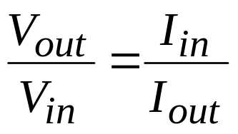
Objective – to efficiently reduce DC voltage
!
The DC equivalent of an AC transformer
I_{in}
I_{out}
DC−DC Buck Converter
+
V_{in}
−
+
V_{out}
−
Lossless objective: P_{in} = P_{out}, which means that V_{in}I_{in} = V_{out}I_{out} and

Slide 3
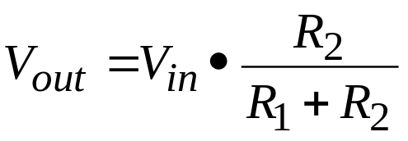
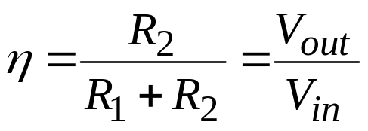
Here is an example of an inefficient DC−DC converter
R₁
The load
+
V_{in}
−
+
V_{out}
−
R₂
If V_{in} = 39V, and V_{out} = 13V, efficiency η is only 0.33
Unacceptable except in very low power applications

Slide 4
Another method – lossless conversion of 39Vdc to average 13Vdc
!
Taken from “Course Overview” PPT
Stereo voltage
Switch closed
Switch open
39
0
+
39Vdc
–
Rstereo
Switch state, Stereo voltage
Closed, 39Vdc
Open, 0Vdc
DT
T
If the duty cycle D of the switch is 0.33, then the average voltage to the expensive car stereo is 39 ● 0.33 = 13Vdc. This is lossless conversion, but is it acceptable?

Slide 5
Convert 39Vdc to 13Vdc, cont.
Taken from “Course Overview” PPT
Try adding a large C in parallel with the load to control ripple. But if the C has 13Vdc, then when the switch closes, the source current spikes to a huge value and burns out the switch.
+
39Vdc
–
C
Rstereo
L
Try adding an L to prevent the huge current spike. But now, if the L has current when the switch attempts to open, the inductor’s current momentum and resulting Ldi/dt burns out the switch.
+
39Vdc
–
C
Rstereo
lossless
L
By adding a “free wheeling” diode, the switch can open and the inductor current can continue to flow. With high-frequency switching, the load voltage ripple can be reduced to a small value.
+
39Vdc
–
C
Rstereo
A DC-DC Buck Converter

Slide 6
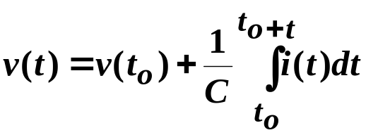
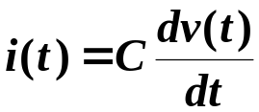
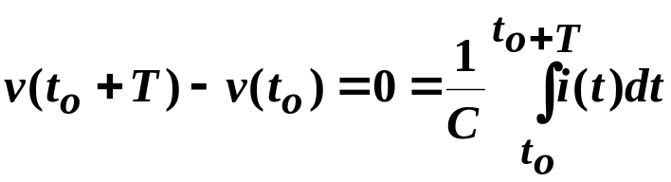

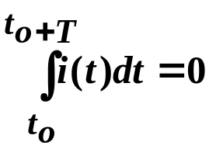
C’s and L’s operating in periodic steady-state
!
Taken from “Waveforms and Definitions” PPT
Examine the current passing through a capacitor that is operating in periodic steady state. The governing equation is
which leads to
Since the capacitor is in periodic steady state, then the voltage at time t_{o} is the same as the voltage one period T later, so
or
The conclusion is that
which means that
the average current through a capacitor operating in periodic steady state is zero

Slide 7
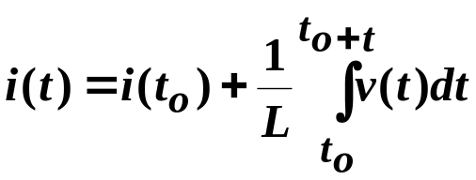
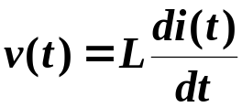


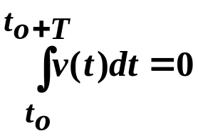
Now, an inductor
!
Taken from “Waveforms and Definitions” PPT
Examine the voltage across an inductor that is operating in periodic steady state. The governing equation is
which leads to
Since the inductor is in periodic steady state, then the voltage at time t_{o} is the same as the voltage one period T later, so
or
The conclusion is that
which means that
the average voltage across an inductor operating in periodic steady state is zero

Slide 8
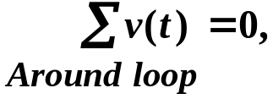
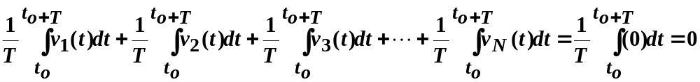
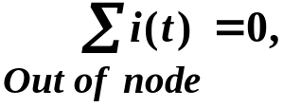
KVL and KCL in periodic steady-state
!
Taken from “Waveforms and Definitions” PPT
Since KVL and KCL apply at any instance, then they must also be valid in averages. Consider KVL,
KVL applies in the average sense
The same reasoning applies to KCL
KCL applies in the average sense

Slide 9
!
Capacitors and Inductors
In capacitors:
The voltage cannot change instantaneously
Capacitors tend to keep the voltage constant (voltage “inertia”). An ideal
capacitor with infinite capacitance acts as a constant voltage source.
Thus, a capacitor cannot be connected in parallel with a voltage source
or a switch (otherwise KVL would be violated, i.e. there will be a
short-circuit)
In inductors:
The current cannot change instantaneously
Inductors tend to keep the current constant (current “inertia”). An ideal
inductor with infinite inductance acts as a constant current source.
Thus, an inductor cannot be connected in series with a current source
or a switch (otherwise KCL would be violated)

Slide 10
!
Buck converter
Assume large C so that V_{out} has very low ripple
Since V_{out} has very low ripple, then assume I_{out} has very low ripple
+ v
L
–
i
i
L
I
out
in
L
+
V
in
C
V
out
i
C
–
What do we learn from inductor voltage and capacitor current in the average sense?
+ 0 V –
i
I
out
I
out
in
L
+
V
in
C
V
out
0 A
–

Slide 11
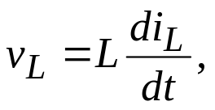

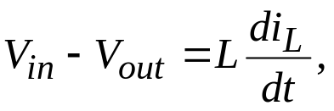
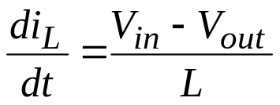
The input/output equation for DC-DC converters usually comes by examining inductor voltages
+ (V_{in} – V_{out}) –
i
in
i
L
I
out
Switch closed for DT seconds
L
+
V
in
C
V
out
(i_{L} – I_{out})
–
Reverse biased, thus the diode is open
for DT seconds
Note – if the switch stays closed, then V_{out} = V_{in}

Slide 12

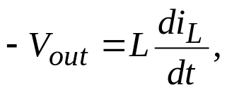
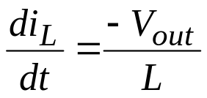
Switch open for (1 − D)T seconds
– V_{out} +
i
L
I
out
L
+
V
in
C
V
out
(i_{L} – I_{out})
–
i_{L} continues to flow, thus the diode is closed. This is the assumption of “continuous conduction” in the inductor which is the normal operating condition.
for (1−D)T seconds

Slide 13
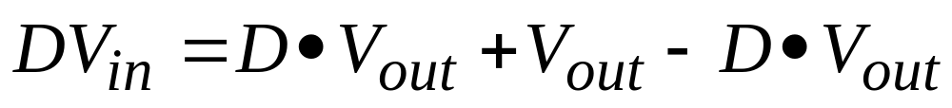
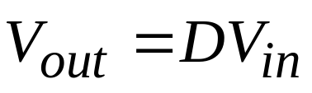
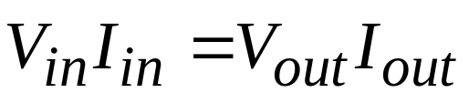
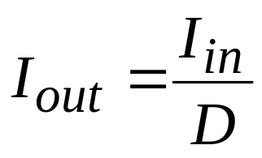
Since the average voltage across L is zero
!
The input/output equation becomes
From power balance,
, so
Note – even though i_{in} is not constant (i.e., i_{in} has harmonics), the input power is still simply V_{in} • I_{in} because V_{in} has no harmonics

Slide 14
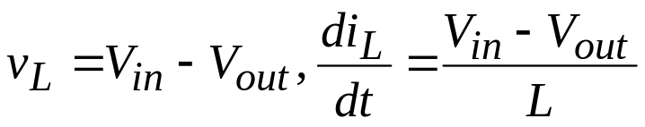
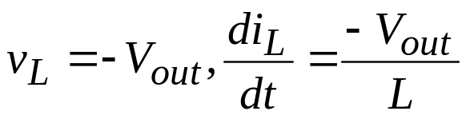


Examine the inductor current
Switch closed,
Switch open,
From geometry, I_{avg} = I_{out} is halfway between I_{max} and I_{min}
i_{L}
I_{max}
I_{avg} = I_{out}
ΔI
Periodic – finishes a period where it started
I_{min}
DT
(1 − D)T
T

Slide 15
Effect of raising and lowering I_{out} while holding V_{in}, V_{out}, f, and L constant
i_{L}
ΔI
Raise I_{out}
ΔI
Lower I_{out}
ΔI
ΔI is unchanged
Lowering I_{out} (and, therefore, P_{out} ) moves the circuit toward discontinuous operation

Slide 16
Effect of raising and lowering f while holding V_{in}, V_{out}, I_{out}, and L constant
i_{L}
Lower f
Raise f
Slopes of i_{L} are unchanged
Lowering f increases ΔI and moves the circuit toward discontinuous operation

Slide 17
Effect of raising and lowering L while holding V_{in}, V_{out}, I_{out} and f constant
i_{L}
Lower L
Raise L
Lowering L increases ΔI and moves the circuit toward discontinuous operation

Slide 18
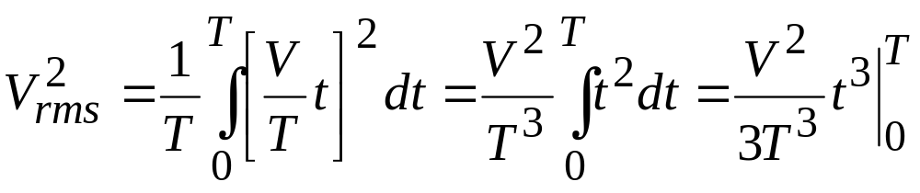
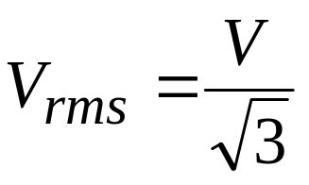
RMS of common periodic waveforms, cont.
!
Taken from “Waveforms and Definitions” PPT
Sawtooth
V
0
T

Slide 19
RMS of common periodic waveforms, cont.
!
Taken from “Waveforms and Definitions” PPT
Using the power concept, it is easy to reason that the following waveforms would all produce the same average power to a resistor, and thus their rms values are identical and equal to the previous example
V
0
V
0
0
-V
V
0
V
0
V
0
V
0

Slide 20








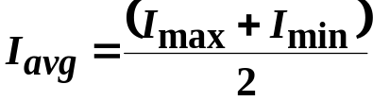
RMS of common periodic waveforms, cont.
!
Taken from “Waveforms and Definitions” PPT
Now, consider a useful example, based upon a waveform that is often seen in DC-DC converter currents. Decompose the waveform into its ripple, plus its minimum value.
the ripple
=
+
the minimum value
0

Slide 21

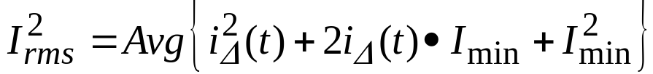
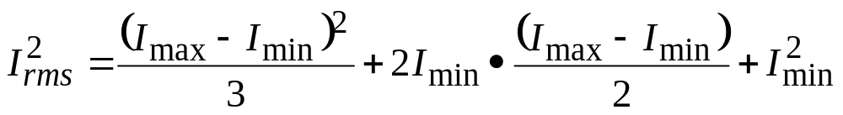

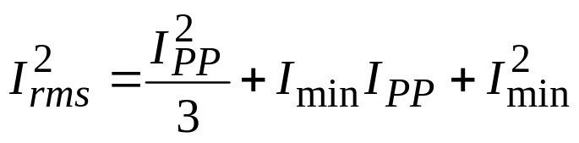
RMS of common periodic waveforms, cont.
Taken from “Waveforms and Definitions” PPT
Define

Slide 22
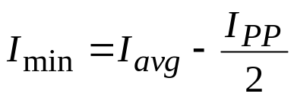
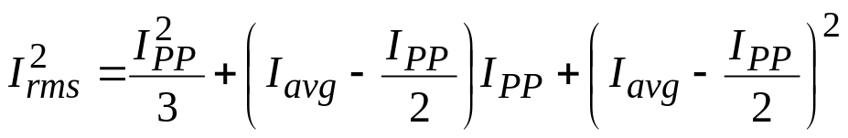
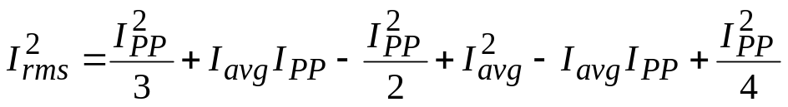
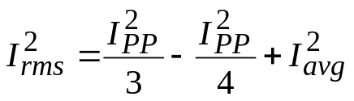
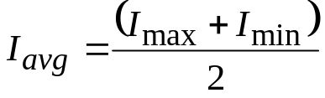


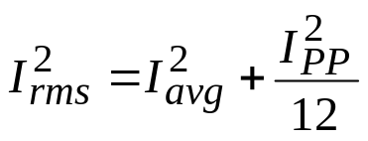
RMS of common periodic waveforms, cont.
Taken from “Waveforms and Definitions” PPT
Recognize that

Slide 23
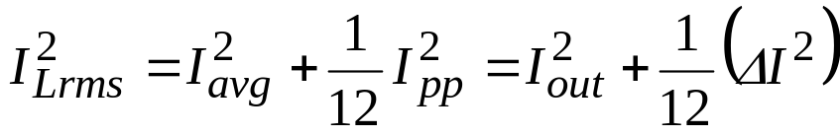
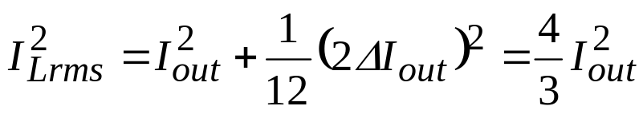
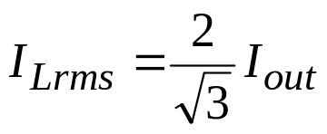
Inductor current rating
Max impact of ΔI on the rms current occurs at the boundary of continuous/discontinuous conduction, where ΔI =2I_{out}
i_{L}
2I_{out}
I_{avg} = I_{out}
ΔI
0
Use max

Slide 24
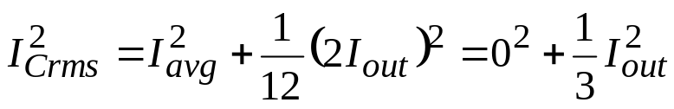
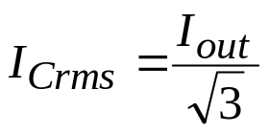
Capacitor current and current rating
i
L
I
out
L
C
(i_{L} – I_{out})
i_{C} = (i_{L} – I_{out})
Note – raising f or L, which lowers ΔI, reduces the capacitor current
I_{out}
0
ΔI
−I_{out}
Max rms current occurs at the boundary of continuous/discontinuous conduction, where ΔI =2I_{out}
Use max

Slide 25
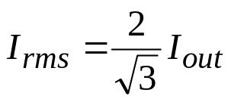
MOSFET and diode currents and current ratings
i
i
L
I
out
in
L
C
(i_{L} – I_{out})
2I_{out}
I_{out}
0
2I_{out}
I_{out}
0
Use max
Take worst case D for each

Slide 26
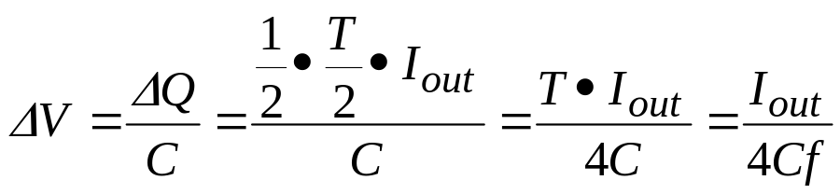
Worst-case load ripple voltage
!
i_{C} = (i_{L} – I_{out})
I_{out}
C charging
0
−I_{out}
T/2
During the charging period, the C voltage moves from the min to the max. The area of the triangle shown above gives the peak-to-peak ripple voltage.
Raising f or L reduces the load voltage ripple

Slide 27
Voltage ratings
i
in
i
L
I
out
C sees V_{out}
Switch Closed
L
+
V
in
C
V
out
i
C
–
Diode sees V_{in}
MOSFET sees V_{in}
i
L
I
out
Switch Open
L
+
V
in
C
V
out
i
C
–
Diode and MOSFET, use 2V_{in}
Capacitor, use 1.5V_{out}

Slide 28
There is a 3rd state – discontinuous
!
MOSFET
I
out
L
+
V
in
C
V
out
DIODE
I
out
–
Occurs for light loads, or low operating frequencies, where the inductor current eventually hits zero during the switch-open state
The diode opens to prevent backward current flow
The small capacitances of the MOSFET and diode, acting in parallel with each other as a net parasitic capacitance, interact with L to produce an oscillation
The output C is in series with the net parasitic capacitance, but C is so large that it can be ignored in the oscillation phenomenon

Slide 29
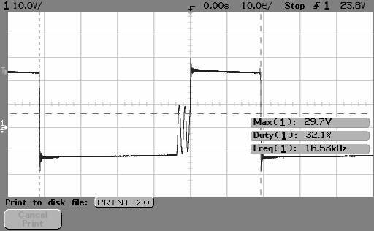
Inductor voltage showing oscillation during discontinuous current operation
v_{L} = (V_{in} – V_{out})
Switch closed
v_{L} = –V_{out}
Switch open
≈ 650kHz. With L = 100µH, this corresponds to net parasitic C = 0.6nF

Slide 30
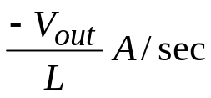
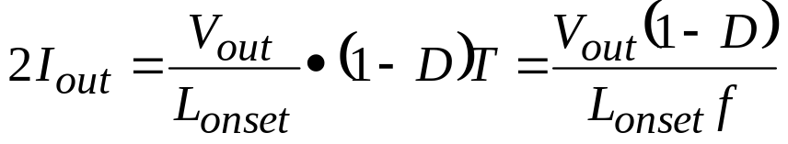
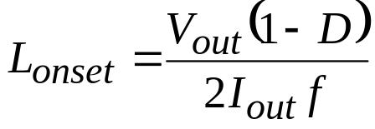
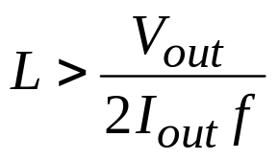
Onset of the discontinuous state
!
i_{L}
2I_{out}
I_{avg} = I_{out}
0
(1 − D)T
Then, considering the worst case (i.e., D → 0),
use max
guarantees continuous conduction
use min

Slide 31
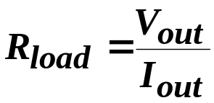

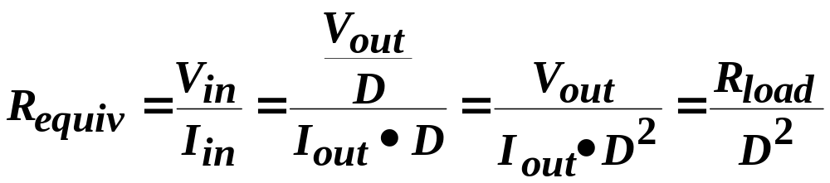
Impedance matching
!
I_{in}
I_{out} = I_{in} / D
DC−DC Buck Converter
+
V_{in}
−
+
V_{out} = DV_{in}
−
Source
I_{in}
+
V_{in}
−
Equivalent from source perspective
So, the buck converter makes the load resistance look larger to the source

Slide 32


Example of drawing maximum power from solar panel
P_{max} is approx. 130W (occurs at 29V, 4.5A)
I_{sc}
For max power from panels at this solar intensity level, attach
But as the sun conditions change, the “max power resistance” must also change
V_{oc}
I-V characteristic of 6.44Ω resistor

Slide 33

Connect a 2Ω resistor directly, extract only 55W
!
55W
130W
2Ω resistor
6.44Ω resistor
To draw maximum power (130W), connect a buck converter between the panel and the load resistor, and use D to modify the equivalent load resistance seen by the source so that maximum power is transferred

Slide 34
Buck converter for solar applications
The panel needs a ripple-free current to stay on the max power point. Wiring inductance reacts to the current switching with large voltage spikes.
+ v
L
–
i
i
L
I
out
panel
L
+
V
panel
C
V
out
i
C
–
Put a capacitor here to provide the ripple current required by the opening and closing of the MOSFET
In that way, the panel current can be ripple free and the voltage spikes can be controlled
We use a 10µF, 50V, 10A high-frequency bipolar (unpolarized) capacitor

Slide 35

BUCK DESIGN
Our components
9A
250V
5.66A
200V, 250V
16A, 20A
10A
40V
10A
40V
10A
Likely worst-case buck situation
Our L. 100µH, 9A
Our C. 1500µF, 250V, 5.66A p-p
Our D (Diode). 200V, 16A
Our M (MOSFET). 250V, 20A

Slide 36

BUCK DESIGN
10A
0.033V
1500µF
50kHz
Our L. 100µH, 9A
Our C. 1500µF, 250V, 5.66A p-p
Our D (Diode). 200V, 16A
Our M (MOSFET). 250V, 20A

Slide 37

BUCK DESIGN
40V
200µH
2A
50kHz
Our L. 100µH, 9A
Our C. 1500µF, 250V, 5.66A p-p
Our D (Diode). 200V, 16A
Our M (MOSFET). 250V, 20A

