Slide 1
Sprint 13

Slide 2
Work Item

Slide 3
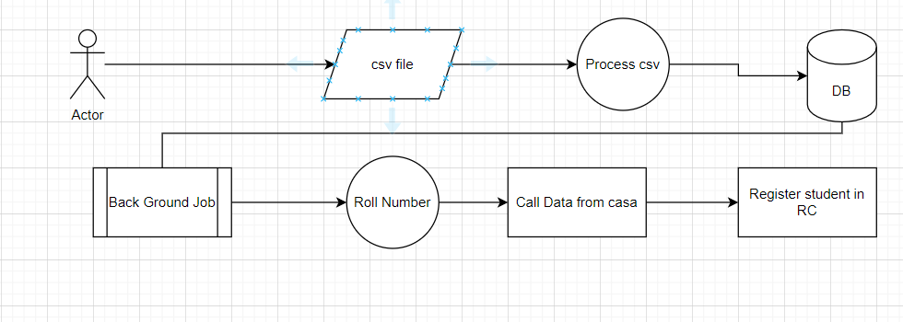
Data Upload flow

Slide 4
Spring 11
Check eligibility of Student for Issuance

Slide 5
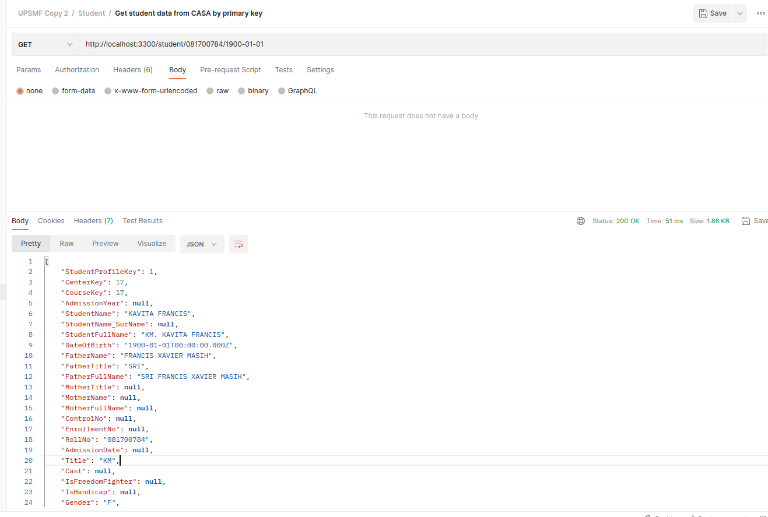
Fetch Data from CASA – roll number and DOB
Check eligibility of Student for Issuance

Slide 6
Create the DATA in Registry

