Slide 1
Sprint 14 – E-Creds

Slide 2
Demo Item
1. Generate Id card of As Web Copy
2. QR Code integration for Credentials Link
3. Upload to GCP storage
4. Get from Google storage
Note . Documentation of Steps in Jupiter note to execute steps

Slide 3
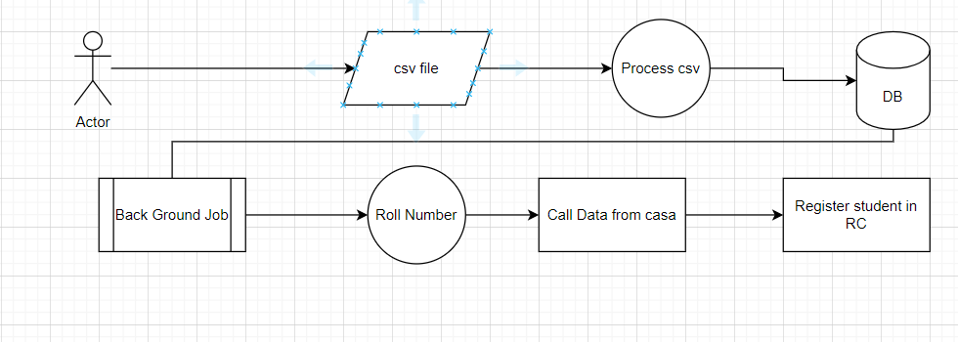
Data Upload flow

Slide 4
Spring 11
Check eligibility of Student for Issuance

Slide 5
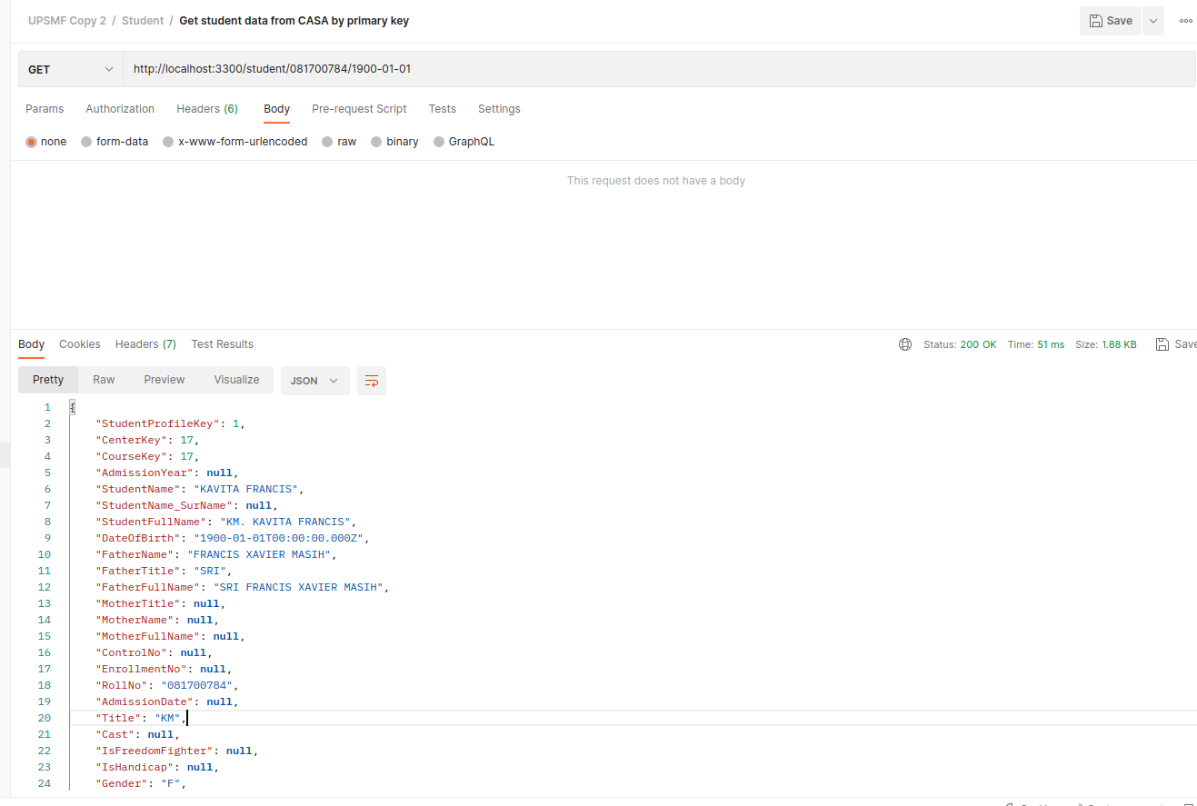
Fetch Data from CASA – roll number and DOB
Check eligibility of Student for Issuance

Slide 6
Create the DATA in Registry

