Slide 1

Sunbird-ED
Back-end Component Understanding

Slide 2
COMPONENTS
https://ed.sunbird.org/learn/technical-architecture/tech-stack
https://ed.sunbird.org/learn/technical-architecture/technical-architecture-diagram
Sunbird-ED
Sunbird-Knowledge
Sunbird In-query
Sunbird observe
Sunbird Learn

Slide 3
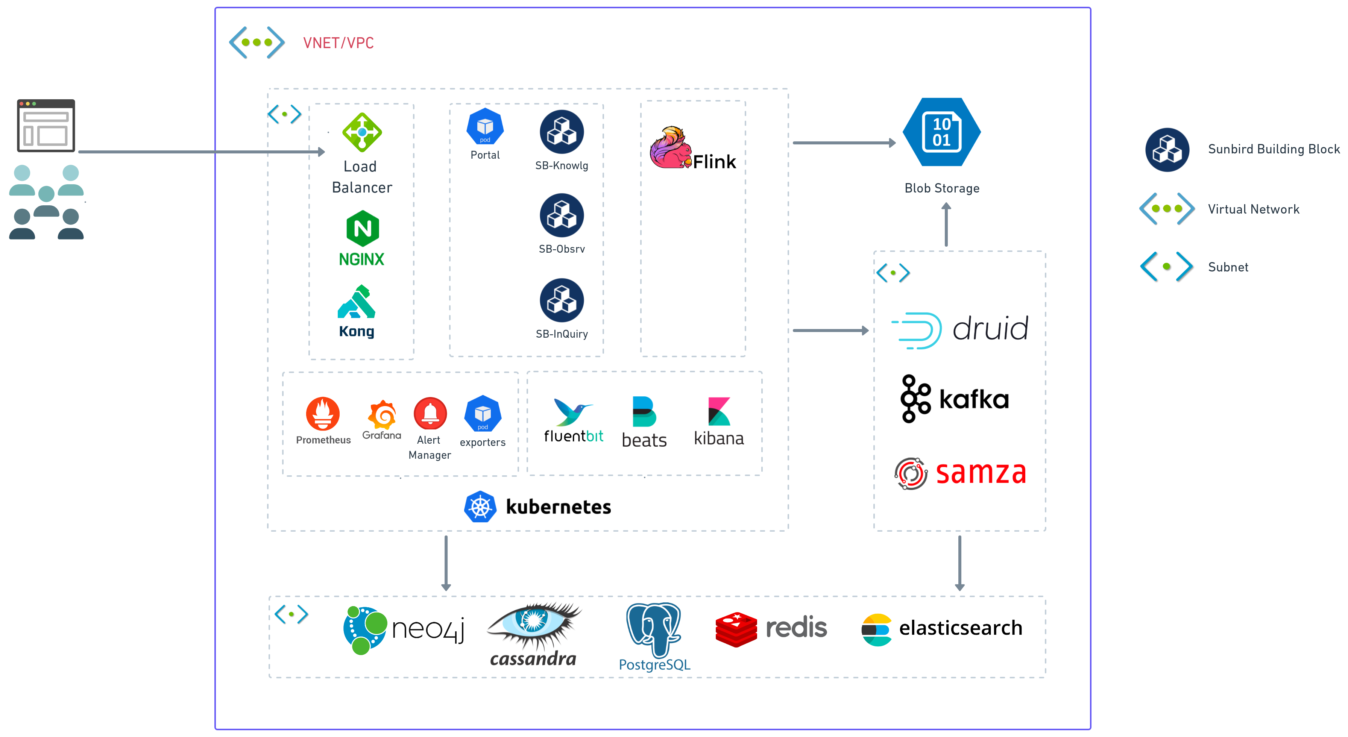

Slide 4
Sunbird knowledge
https://github.com/kumarpawantarento/knowledge-platform/
Search and discovery
Asset search service
Dial service
Service and management
Content service
Collection service
Taxonamy and Tagging
Media service
Status – able to run locally

Slide 5
Sunbird observ
Git -
Data and analytics
Telemetry
Data pipeline
Data service
Report service
Report Configuration
Summeriser

Slide 6
Sunbird learn – User and Learning management
https://github.com/Sunbird-Lern
User and organisation service
Groups service
Notification service
Batch service
Organisation service
Discussion forum
https://github.com/Sunbird-Lern/groups-service
https://github.com/Sunbird-Lern/sunbird-notification-service

Slide 7
Sunbird Inquiry
https://github.com/Sunbird-inQuiry/inquiry-api-service
Question service
Question set service

