Slide 1
Sprint 10 Goal

Slide 2
SPRINT items
Multiple issuance credentials – coding completed, testing pending.
Tried attestation process – Not completed
ULP API analysis and testing – completed, some clarification required.
API Analysis required for excel sheet - completed
Get all Student data from CASA based on roll number and DOB – completed
And create student in RC
Student Schema – completed
Push record of student in RC- completed
Issue Credentials
Certificate schema – completed
Push certificate data in RC
Certificate template
Generate template
Need to start
Render certificate
Generate certificates

Slide 3
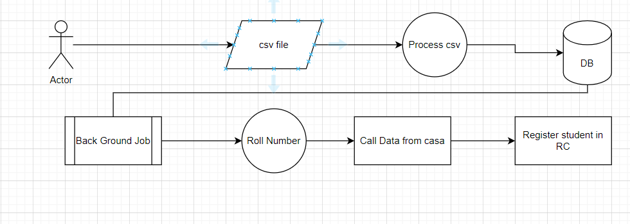
Data Upload flow

Slide 4
Spring 11
Check eligibility of Student for Issuance

Slide 5
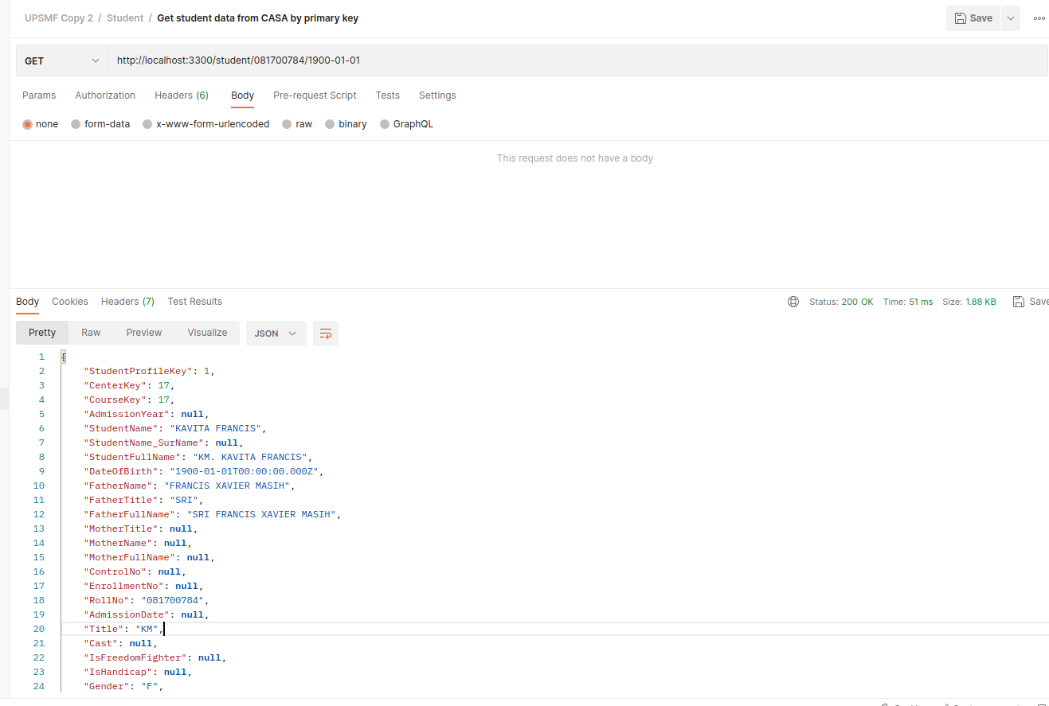
Fetch Data from CASA – roll number and DOB
Check eligibility of Student for Issuance

Slide 6
Create the DATA in Registry

