Slide 1
Sprint 12 Demp ITEMS

Slide 2
DEMO ITEM
Institute will upload the data – Data upload API
Verify Student From CASA – CASA DATA SERVICE API
Register the student in Registry by RC API
(Institute) Raise a claim
Regulator will attest a claim
Generate a Credentials – Certificate API
Send email to Student – Candidate will receive a link of Identity card

Slide 3
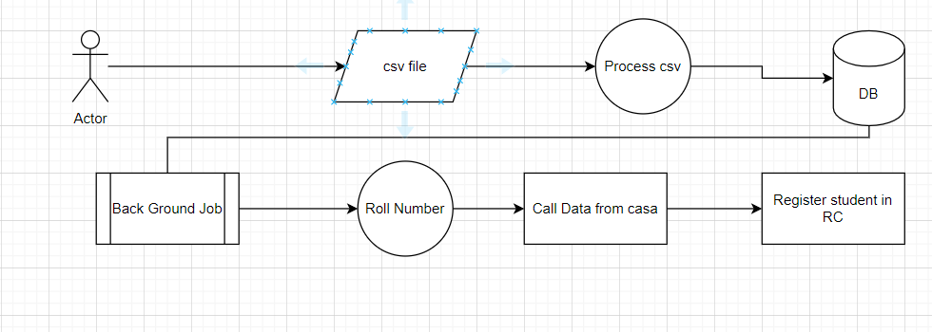
Data Upload flow

Slide 4
Spring 11
Check eligibility of Student for Issuance

Slide 5
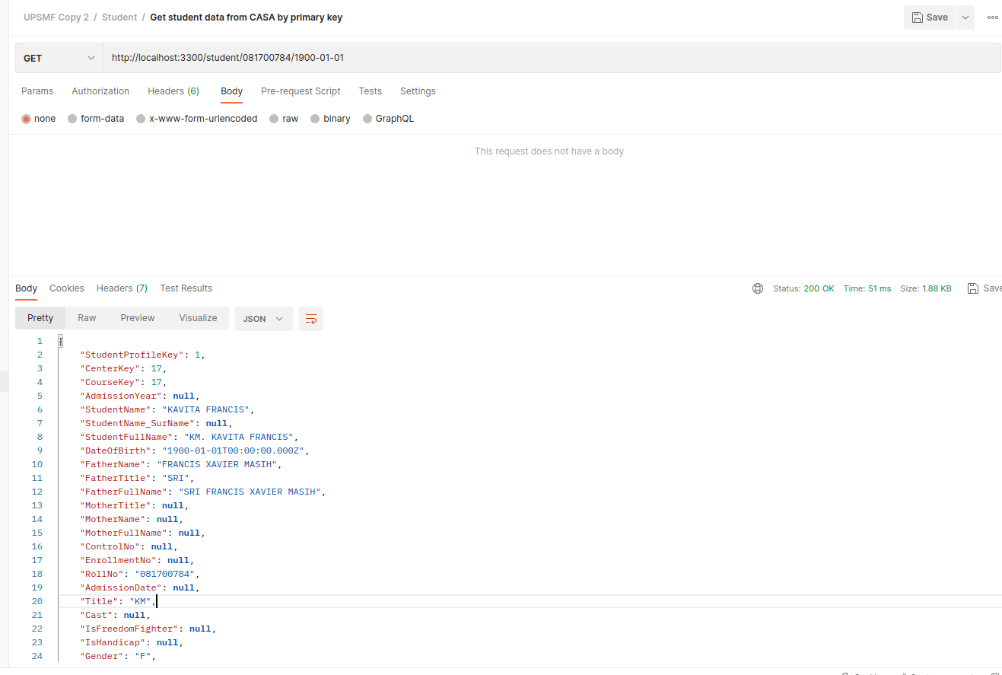
Fetch Data from CASA – roll number and DOB
Check eligibility of Student for Issuance

Slide 6
Create the DATA in Registry

