Slide 1

iRISE
I'm Reverse Image Search Engine

Slide 2


iRISE - Introduction
What is Reverse Image Search??
  Reverse image search is different kind of search where one does not provide keywords and instead provides an image and the search engine searches for images of similar kind.
  It uses what is called as Content-based image retrieval (CBIR), also known as query by image content (QBIC) and content-based visual information retrieval (CBVIR) .CBIR is the application of computer vision techniques to the image retrieval problem, that is, the problem of searching for digital images in large databases.

Slide 3


iRISE - Introduction
Why Reverse Image Search ??
  Not every piece of information can be accurately translated into text
  Increasing amounts of data
  Image Search basic to Unique Identification
  Uses image-identification technology rather than keywords, metadata, etc;

Slide 4
iRISE- How does it work?
iRISE works on the basic principle of matching of features of an Image.
Feature Extraction – Accomplished using Scale Invariant Feature Transform
Feature Matching - ”Fuzzy Matching” of Image Features

Slide 5
Scale Invariant Feature Transform
- And its not just scale Invariant

Slide 6
iRISE- Extracting Features
Scale-invariant feature transform (or SIFT) is an algorithm in computer vision to detect and describe local features in images. The algorithm was published by David Lowe in 1999.
The following are the major stages of computation:
  Scale-space extrema detection
  Keypoint localization
  Orientation assignment
  Keypoint descriptor

Slide 7
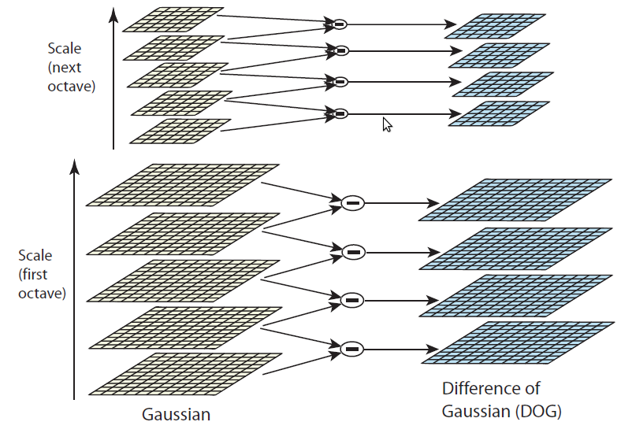

iRISE- Extracting Features
Scale-Space Extrema Detection
The first stage of computation searches over all scales and image locations. It is implemented efficiently by using a difference-of-Gaussian function to identify potential interest points that are invariant to scale and orientation.

Slide 8
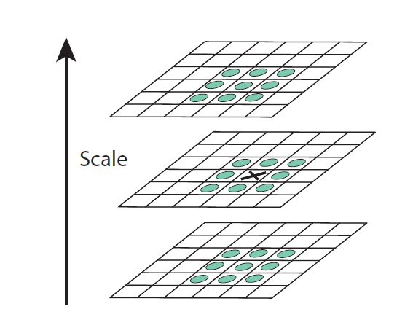
iRISE- Extracting Features
KeyPoint Localization
At each candidate location, a detailed model is fit to determine location and scale. Keypoints are selected based on measures of their stability.

Slide 9
iRISE- Extracting Features
Keypoint descriptor
The local image gradients are measured at the selected scale in the region around each keypoint. These are transformed into a representation that allows for significant levels of local shape distortion and change in illumination.

Slide 10
iRISE- Extracting Features
Orientation assignment
One or more orientations are assigned to each keypoint location based on local image gradient directions. All future operations are performed on image data that has been transformed relative to the assigned orientation, scale, and location for each feature, thereby providing invariance to these transformations.

Slide 11
iRISE
Structure and Implementation

Slide 12

iRISE
Structure and Implementation
The project was trisected into 3 modules:
Implementation of SIFT
  Used OpenCV library for the same
Matching in DataBase
  Used ”fuzzy Matching”
  Calculations done using python
Graphics-User Interface
  Use of FLTK

Slide 13
Feature Detection Implementation
Feature
Descriptor
SIFTransform
InitializeMemory()
BuildScaleSpace()
LocateExtremas()
OrientationAssgn()
AssgnDescriptors()

Slide 14
Feature Matching Implementaion
DataBase
FindSimilar()
finds similar images
Comparator()
Checks the criterion
for comparison

Slide 15
Algorithmic Aspects
SIFT Implementation-The toughest job (and the most time-consuming) was to understand, comprehend, and further code the SIFT (Scale Invariant Feature Transform) Algorithm.
Distances between the descriptors- The Descriptor vectors for the Features had too small component values. Hence, finding out the distances between each pair of descriptor was difficult to be implemented in C++ because of the precisional losses.
Matching Algorithm- Based on ”fuzzy-matching” of the Euclidian Distances between 2 the descriptors of the image

Slide 16
Further possible Modifications
If time permitted, we could improvise the matching algorithm for time efficiency by stage-by-stage rejection of various images based upon primary comparison of hashed descriptor-distances
We could improvise upon the Graphics-User interface

Slide 17
Work Distribution
Umang Mathur
- Read and understood the SIFT algorithm
- SIFT Implementation in OpenCv
- Implemented the Matching Algorithm
- DataBase Handling (partly done)
- Slides and reports
- Amounts to 50%

Slide 18
Work Distribution
Piyush Kumar
- SIFT Implementation in OpenCv (partly done)
- Designed the Algorithm for matching descriptors
- Descriptor distances in Python
- DataBase Handling (partly done)
- GUI in FLTK
- Amounts to 50%

Slide 19
Thank You
Hope You Enjoyed the working of iRISE

