Slide 1

SMART INDIA HACKATHON 2026 · PS ID: 26024
PraharAI
AI–Based Smart Command and Control Centre for Coal Mining Governance
Team Members
Tanmay Goel (24BCE2916) · Backend and Compliance Lead
Divanshu Singh Ramful (24BCE2915) · Database Lead
Ishan Arya (24BCE2228) · Security Lead
Apoorva R (24BEC0307) · AI/ML Lead
Madhav Mehrotra (24BEC0458) · Frontend Lead
Kumar Prathmesh (24BEC0680) · Innovation and Pitch Lead
Institution
Vellore Institute of Technology (VIT)
School of Electronics Engineering
Mentor
Dr. Jeeva J. B.
Associate Professor Sr., Dept. of Sensor & Biomedical Technology
jbjeeva@vit.ac.in

Slide 2
CRISIS AT CIL
Understanding the Problem
Problems
• Manual spreadsheets and paper trails
• Standard Operating Procedure is reactive, not preventive
• Fragmented record systems and delayed grievance handling
• Untraceable compliance failures
• Illegal mining pits and coal mafia
Impacts
• Over 800 injured, and 250+ killed in the last five years alone
• Over 4 million metric tonnes of coal goes missing every year
• hazards and violations like landslides , overhanging loose boulders, fire/smoke , etc are common occurrences

Slide 3
WHAT RESEARCH SAYS: GAPS IN THE COAL INDUSTRY
Literature Review
• Digital documentation exists, but is fragmented and difficult to follow, leading to hundreds of pending grievance handling cases as well as loss of accountability.
• Multiple underground sensors are present to track smoke, cracks, fire, and hazardous gases, but they sense them only after they are triggered, so evacuation is already delayed.
• No automation exists anywhere; retro-SCADA model is being followed, resulting in wastage of time as well as more than necessary manual labour.
• Security and surveillance are completely dependent on standard CCTV systems, making surveillance extremely tough in areas with wandering electricity and huge coverage.
• CIL, being a huge corporation which generates over a billion metric tonnes of coal every year, is divided into 8 humongous subsidiaries, which are then fragmented into over 300 mining sites, making unified governance and multi-site compliance extremely difficult in the existing manual system.

Slide 4
PRAHARAI: VIGILANCE MADE DIGITAL
Proposed Solution
• AI-based Drone Surveillance Analytics
• Integrated Vehicle Monitoring with ANPR, GPS, and RFID
• Digital Compliance Engine
• Multi-Mode Digital Dashboard
• AI/ML automation for existing manually controlled tech
• Digital Audit Trails
• Manual exception handling for AI-based failures

Slide 5
TECHNICAL ARCHITECTURE
System Architecture & Tech Stack
Presentation Layer
Dashboard, mobile app, portal, reports
Data Ingestion
CCTV, GPS/RFID, mobile forms, ANPR, IoT
Tech Stack
Frontend
HTML5 · Vanilla ES6+ JavaScript · Vanilla CSS3 (custom properties, grid and flexbox)
PraharAI Data Flow
Backend
Python 3.x · FastAPI · Uvicorn (ASGI server) · Jinja2 (templating)
AI / ML
YOLOv8 (object detection) · scikit-learn · OpenCV · TensorFlow Lite
Core Backend
FastAPI, PostgreSQL, RBAC, audit logs
Processing Layer
AI video analytics, rules, ML, OCR
Database
Redis (cache/alerts) · PostGIS (geo-tagging)
Data flows from field devices and surveillance systems through the AI processing layer into the backend, then surfaces through role-appropriate dashboards for field officers, mine managers, and regulators.
Infra & Integration
Docker · RTSP (CCTV) · ANPR API · MQTT (IoT) · AWS/GCP (cloud)

Slide 6
INNOVATION & NOVELTY
What Makes PraharAI Novel
First-of-Its-Kind Tech
First of its kind tech for the CIL corporation, substituting manual operations of checkposts, weighbridges, Vehicle Tracking System, and surveillance and supervision systems, making it more time efficient than existing solutions.
Eradication of Human Errors & Corruption
Automation will completely eradicate human errors and corruption, subduing any opportunity for theft, bribery, or inefficiency.
Unified Governance System
Unified governance system replaces the fragmented approach, which is designed from the ground up for CIL's multi-subsidiary structure, based on feedback from real employees and interns.
Role-Stratified Access
Role-Stratified Access: A single data model serves distinct designations, each with different read/write permissions, unlike generic dashboards that flatten all roles, for both subsidiaries and HQ.

Slide 7
REAL-WORLD IMPACT & BENEFITS FOR THE COAL INDUSTRY
Impact
• 70% faster compliance closure
• Preventive instead of reactive Standard Operating Procedures
• Directly covering and benefiting over 200K employees across CIL
• 100 million tonnes of target boost
• Smart fleet operations and accurate logistics for over 20,000 vehicles

Slide 8
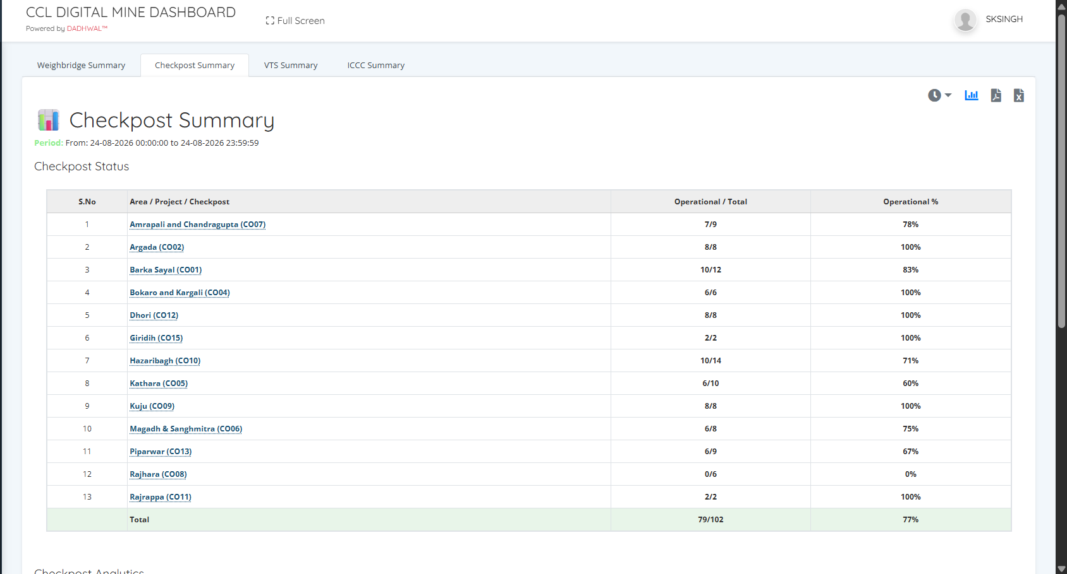
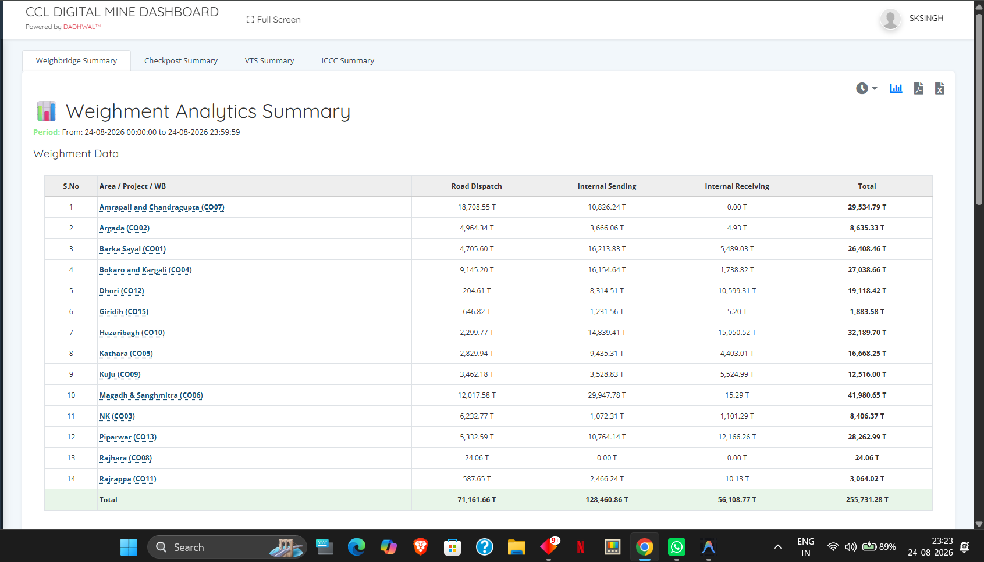
DEMO · TEAM · REFERENCES
Prototype, Team & References
Prototype / Demo Screenshots
Team Expertise Summary
Member | Core Skill
Tanmay Goel | Backend systems, compliance.
Divanshu Ramful | Database architecture, data pipelines
Ishan Arya | Security, RBAC, audit logging
Apoorva R | AI/ML anomaly detection
Madhav Mehrotra | Frontend, UX, mobile development
Kumar Prathmesh | vision, innovation and communication
Key References
[1] 2025 Systematic Review — AI/IoT hazard–detection fragmentation in mining.
[2] AI-Enabled Safety and Risk Management in Mining Environments — case studies on AI-driven hazard prevention.
[3] IoT-Based Coal Mine Safety Monitoring Systems — wireless sensor networks for real-time environmental alerts.
[4] Intelligent Monitoring of Underground Personnel Vital Signs — PMC review on wearable IoT in mining.
[5] Khanij Online 2.0 — Case study on India's digital mineral governance platform.
[6] Critical Review of Indian Mining Laws — ScienceDirect study on compliance–monitoring gaps in India.
[7] Digital Twin and Data Governance for Mining — IJERT framework on zero-trust security and operational compliance.
[8] Effects of Digital Transformation on Environmental Governance of Mining Enterprises — empirical study, China.
[9] CIL tenders.

