Slide 1
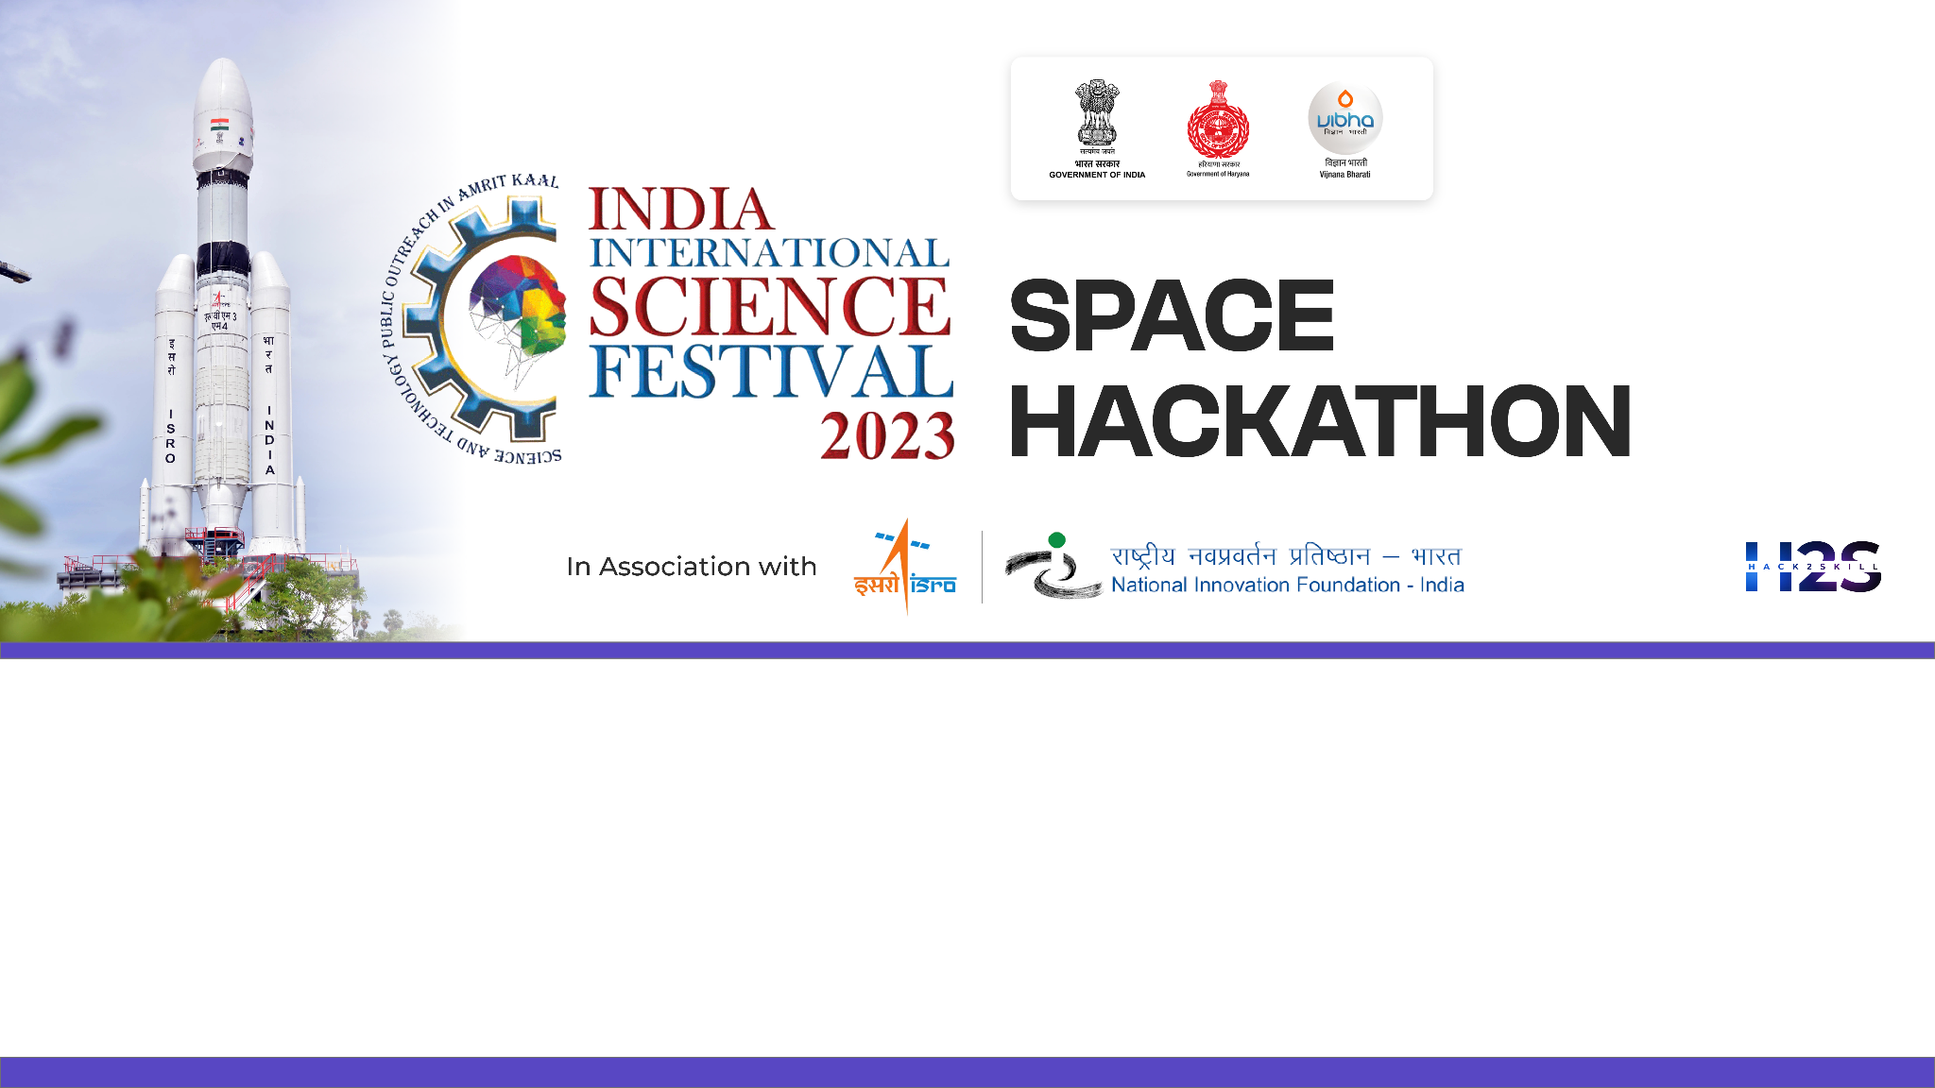
Team Name: DATA KERNELS
Name of College/University: RUNGTA COLLEGE OF ENGINEERING AND TECHNOLOGY , BHILAI
Team Member Details:
SARASWATI YADAV
RAJU KUMAR
VICKY KUMAR
KUMAR PRAKHAR

Slide 2

Problem Statement:
Explain your understanding on Problem Statement:
The goal is to provide a detailed analysis that shows how our use of land relates to how well a state’s economy is doing.
This project aims to thoroughly examine how different types of land use and land cover (like agriculture , barren lands , built-up , wet-lands , forests , etc.) affect the economic growth of different states . It helps us to understand the relationship between the LULC & GDP over time and the economic success of each state.
Brief about your approach:
STEP 1:- Used BHUVAN and RBI portal to get LULC data and GSDP for 6 states as reference .
STEP 2:- Worked on calculations and analyzation of data in excel for various LULC classes such as agriculture , forests , barren lands , wetlands ,built-ups , waste lands.
STEP 3:- Deployed Logistic Regression model on the dataset to analyze future trend.

Slide 3
Detailed Proposal & Solution Approach
1. Data Collection:
LULC Data:- We acquired LULC data of several states(like, Maharashtra, Gujrat, Tamil Nadu etc.) for for financial years 2005-06, 2011-12, 2015-16.
Economic Data:- Collected state-wise GDP data for the same time periods.-
2. Data Integration and Preprocessing:
We arranged LULC and GDP data of corresponding years in a single sheet.
3. Data Visualization:
Visualized the correlation between different LULC classes with the attributed GDP of the corresponding year using Matplotlib and Seaborn libraries.
4. Statistical Modeling:
Logistic Regression Models:- Used regression models that account for temporal dynamics to
quantify the relationship between specific LULC classes and GDP.
5. Policy Implications:
Develop policies that consider the temporal aspects of land use changes and economic growth.
Address short-term and long-term implications for sustainable development.

Slide 4
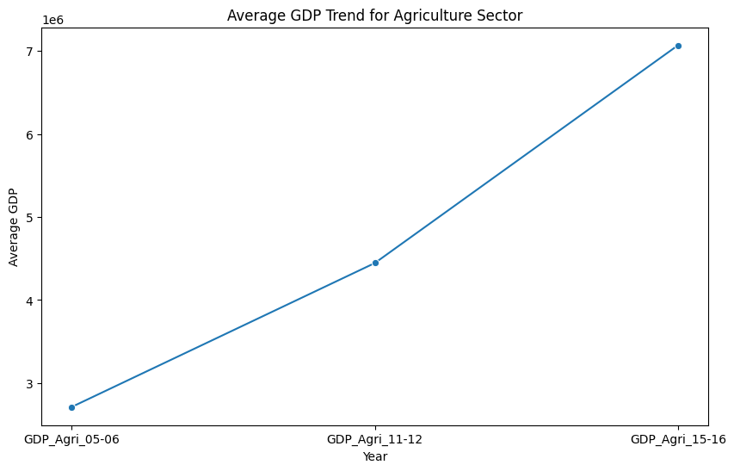
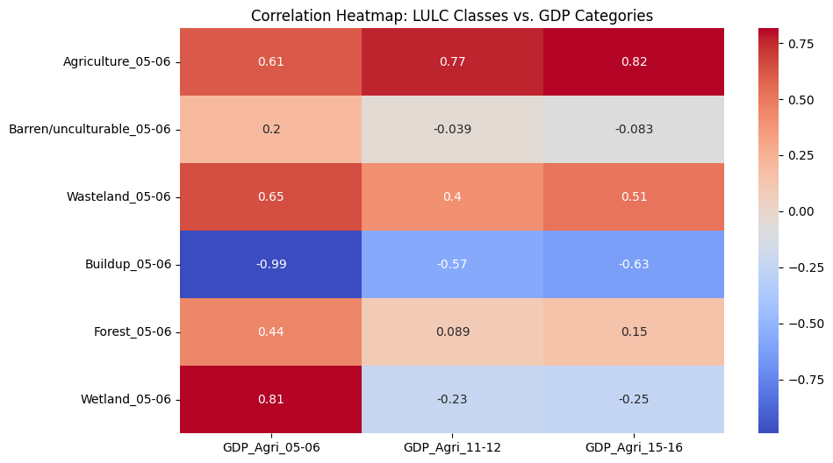
Detailed Proposal & Solution Approach
The conclusion we came across after analyzing the dataset
R2 SCORE after model deployment: 0.5
Visit our source code: https://github.com/kumarprakhar14/Indian-Space-Festival/blob/main/isf.ipynb

Slide 5
Tools and devices used on development
MS Excel
Google Colab Notebook
GitHub
Technologies involved/used
Machine Learning
Label Encoding
Imputation
Logistic Regression
References/Acknowledgement
LULC data
https://bhuvan-app1.nrsc.gov.in/thematic/thematic/index.php
GSDP data
https://www.rbi.org.in/Scripts/AnnualPublications.aspx?head=Handbook%20of%20Statistics%20on%20Indian%20States
Dataset prepared
https://drive.google.com/file/d/1AQPY9nrWGare_n9gnDjUe0WUvmKDtMPG/view?usp=drive_link

