Slide 1
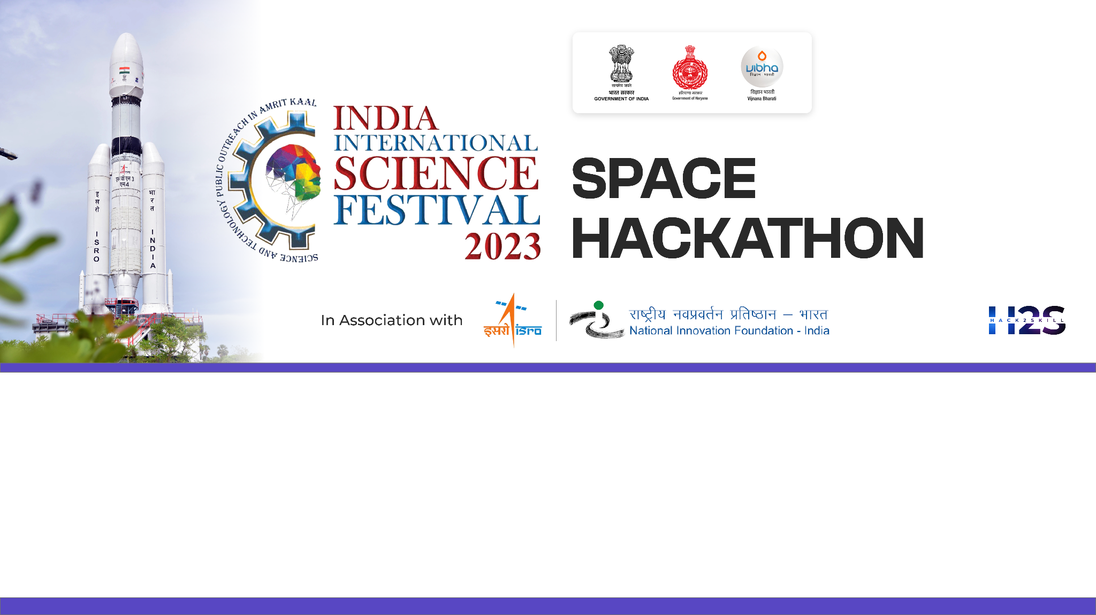
Team Name: DATA KERNELS
Name of College/University: RUNGTA COLLEGE OF ENGINEERING AND TECHNOLOGY , BHILAI
Team Member Details:
SARASWATI YADAV
RAJU KUMAR
VICKY KUMAR
KUMAR PRAKHAR

Slide 2
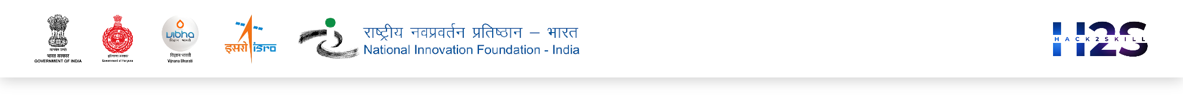
Problem Statement:
Explain your understanding on Problem Statement:
The goal is to provide a detailed analysis that shows how our use of land relates to how well a state’s economy is doing.
This project aims to thoroughly examine how different types of land use and land cover (like agriculture , barren lands , built-up , wet-lands , forests , etc.) affect the economic growth of different states . It helps us to understand the relationship between the LULC & GDP over time and the economic success of each state.
Brief about your approach:
STEP 1:- Used BHUVAN and RBI portal to get LULC data and GSDP for 6 states as reference .
STEP 2:- Worked on calculations and analyzation of data in excel for various LULC classes such as agriculture , forests , barren lands , wetlands ,built-ups , waste lands.
STEP 3:- Deployed Linear Regression model on the dataset to analyze future trend. can it be improved or is there any scope for writing it in detail

Slide 3
Detailed Proposal & Solution Approach
1. Data Collection:
LULC Data Acquisition (2005-06, 2011-12, 2015-16): Acquiring LULC data for various Indian states across these specific financial years is crucial. LULC data provides information about the types of land cover (e.g., forest, agriculture, urban areas) and land use (e.g., agricultural land, industrial land) which is pivotal in understanding how land characteristics relate to economic growth.
State-wise GDP Data Collection: Collecting state-wise GDP data for the same periods allows for a temporal analysis of economic growth trends, aligning with the LULC data timeline. This helps establish connections between land-use changes and economic performance over time.

Slide 4
Detailed Proposal & Solution Approach
2. Data Integration and Preprocessing:
Merging LULC and GDP Data: Combining LULC and GDP data for corresponding years into a single dataset is necessary for conducting meaningful analysis. This integration sets the stage for understanding the relationships between specific LULC classes and state-level economic performance.
3. Data Visualization:
Correlation Visualization: Using Matplotlib and Seaborn libraries for visualization, depicting correlations between different LULC classes and the attributed GDP of corresponding years. Visualization aids in understanding potential trends and patterns in how specific land-use types relate to economic indicators.

Slide 5
Detailed Proposal & Solution Approach
4. Statistical Modeling:
Linear Regression Models: Using regression models that account for temporal dynamics to quantify the relationship between specific LULC classes and GDP using scikit-learn. Linear regression is employed for continuous variables like GDP. Understanding how changes in LULC attributes affect GDP helps establish empirical relationships.
5. Policy Implications:
Sustainable Development Policies: Analyzing the relationship between land-use changes and economic growth over time provides insights for policymaking. Policies developed from this analysis can consider the temporal aspects of land-use changes to ensure sustainable development, addressing both short-term and long-term implications

Slide 6
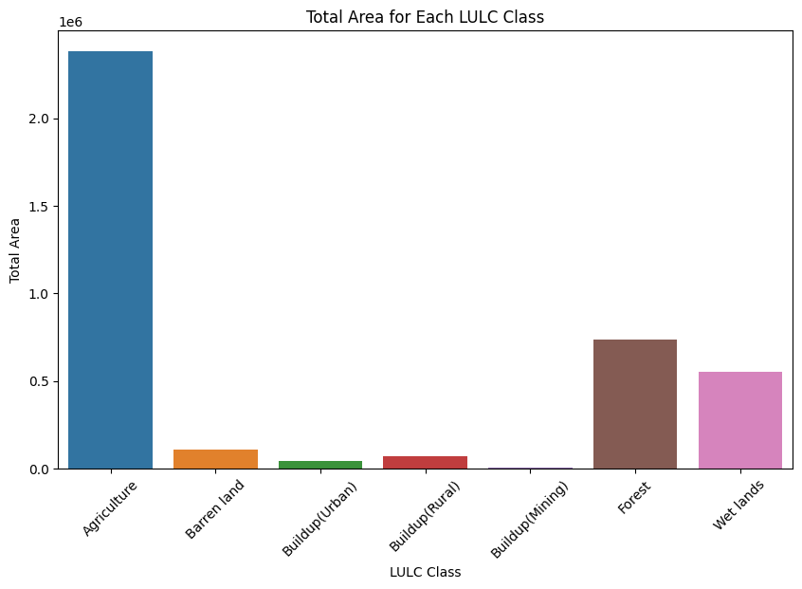
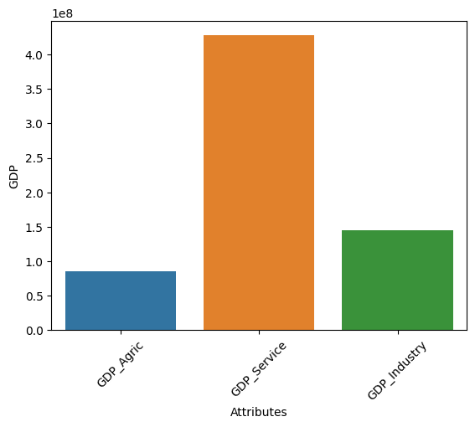
Detailed Proposal & Solution Approach
Results from Data Visualization:

Slide 7
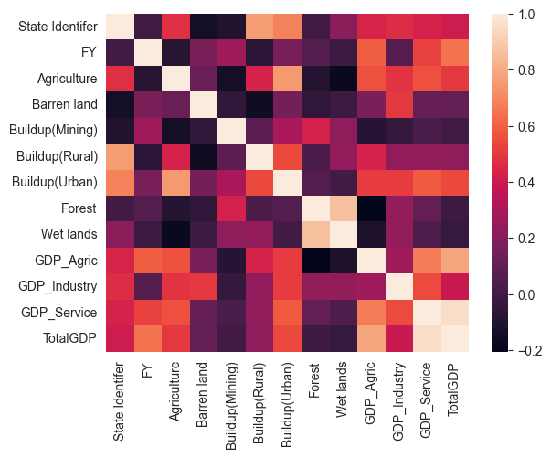
Detailed Proposal & Solution Approach
Results from Data Visualization:

Slide 8
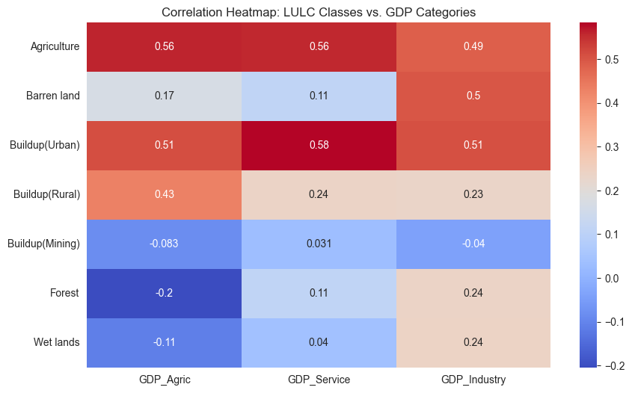
Detailed Proposal & Solution Approach
Results from Data Visualization:

Slide 9
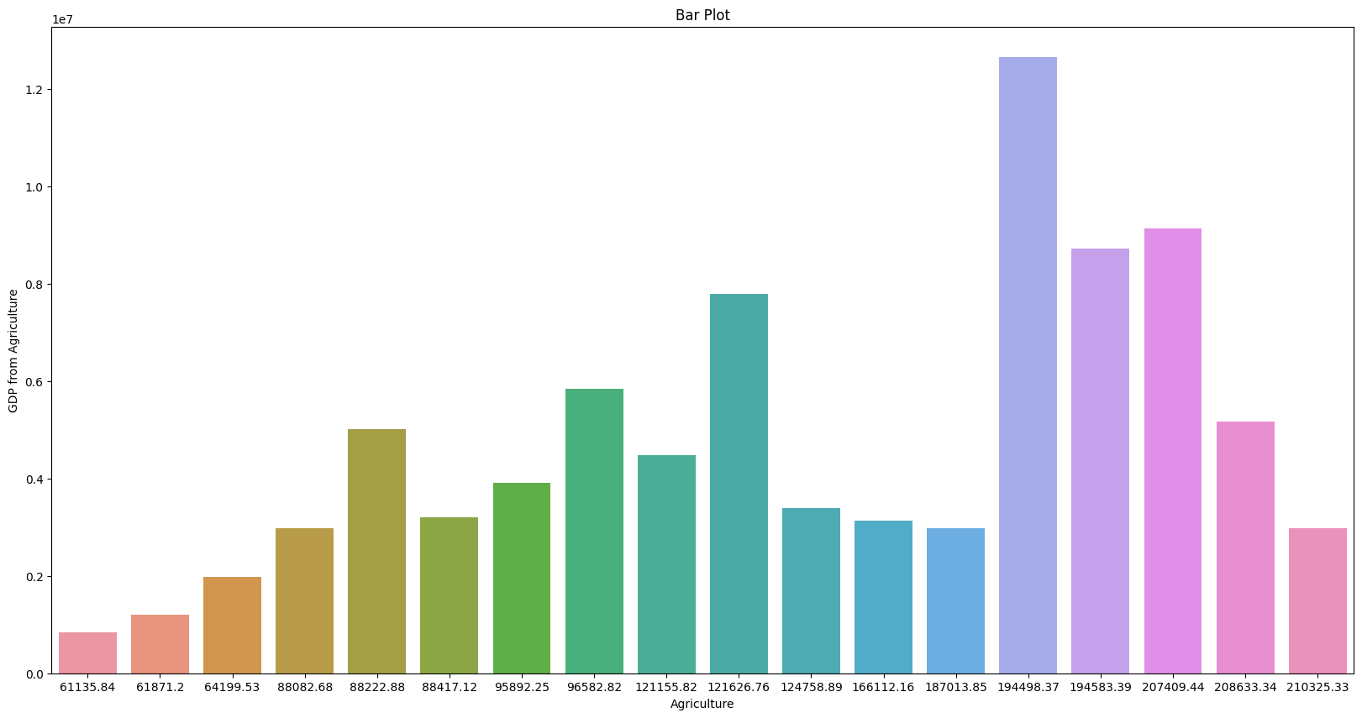
R2 SCORE after model deployment: -0.5595 Visit our source code: https://github.com/kumarprakhar14/Indian-Space-Festival/blob/main/isf.ipynb
Detailed Proposal & Solution Approach
Results from Data Visualization:

Slide 10
Tools and devices used on development
MS Excel
VS Code
Google Colab Notebook
GitHub
Technologies involved/used
Exploratory Data Analysis
Data Visualization
Label Encoding
Imputation
Machine Learning
Linear Regression
References/Acknowledgement
LULC data
https://bhuvan-app1.nrsc.gov.in/thematic/thematic/index.php
GSDP data
https://www.rbi.org.in/Scripts/AnnualPublications.aspx?head=Handbook%20of%20Statistics%20on%20Indian%20States
Dataset prepared
https://drive.google.com/file/d/1YZ-QruD07nJzk3D2bUlT6SfAQTJeogSm/view?usp=sharing

