Slide 1
POWER BI REPORT WALKTHROUGH
Domestic Violence Data Dashboard
A page-by-page tour of every report page and visual in the .pbix file
5
23
4
Report Pages
Visuals
Interactive Slicers
Source file: Data_visualation_pbix_project.pbix

Slide 2
Understanding Domestic Violence
A repeated pattern of behaviour used to gain power and control over an intimate partner or family member — it takes many forms beyond physical violence.
1
Physical Abuse
Hitting, choking, restraining, or any act intended to cause bodily injury or fear of injury.
2
Emotional & Psychological Abuse
Insults, threats, humiliation, and control tactics that erode a victim’s self-worth and independence.
3
Sexual Abuse
Any non-consensual sexual act or coercion, including within intimate or marital relationships.
4
Financial & Economic Abuse
Controlling money, employment, or assets to create dependency and limit a victim’s ability to leave.
5
Stalking, Neglect & Coercive Control
Persistent surveillance, monitoring, or deprivation of care that restricts a victim’s freedom and safety.
Forms of Domestic Violence
Source: WHO (2025), NFHS-5

Slide 3
About This Report
The dashboard is built on a single table, synthetic_domestic_violence_dataset, and is organized into five analytical pages — each built around one guiding question.
1
Victim Demographics
Age, gender, education and economic profile of victims
2
Violence Types & Severity
Most common violence types and incident frequency
3
Reporting & Support Response
How often incidents are reported, and medical assistance
4
Perpetrators & Household
Perpetrator relationships and household context
5
Support Service Utilization
Whether victims access support services, and why
Report Overview
Synthetic Domestic Violence Dataset

Slide 4
DATA-DRIVEN FINDINGS
Key Insights from the Data
What 1,200 case records reveal about victims, reporting, and support access
78%
56%
39%
1,200
Victims are Women
Reported to Police
Used Support Services
Cases Logged
Source: domestic_violence_dummy_dataset.csv — a synthetic, illustrative dataset

Slide 5
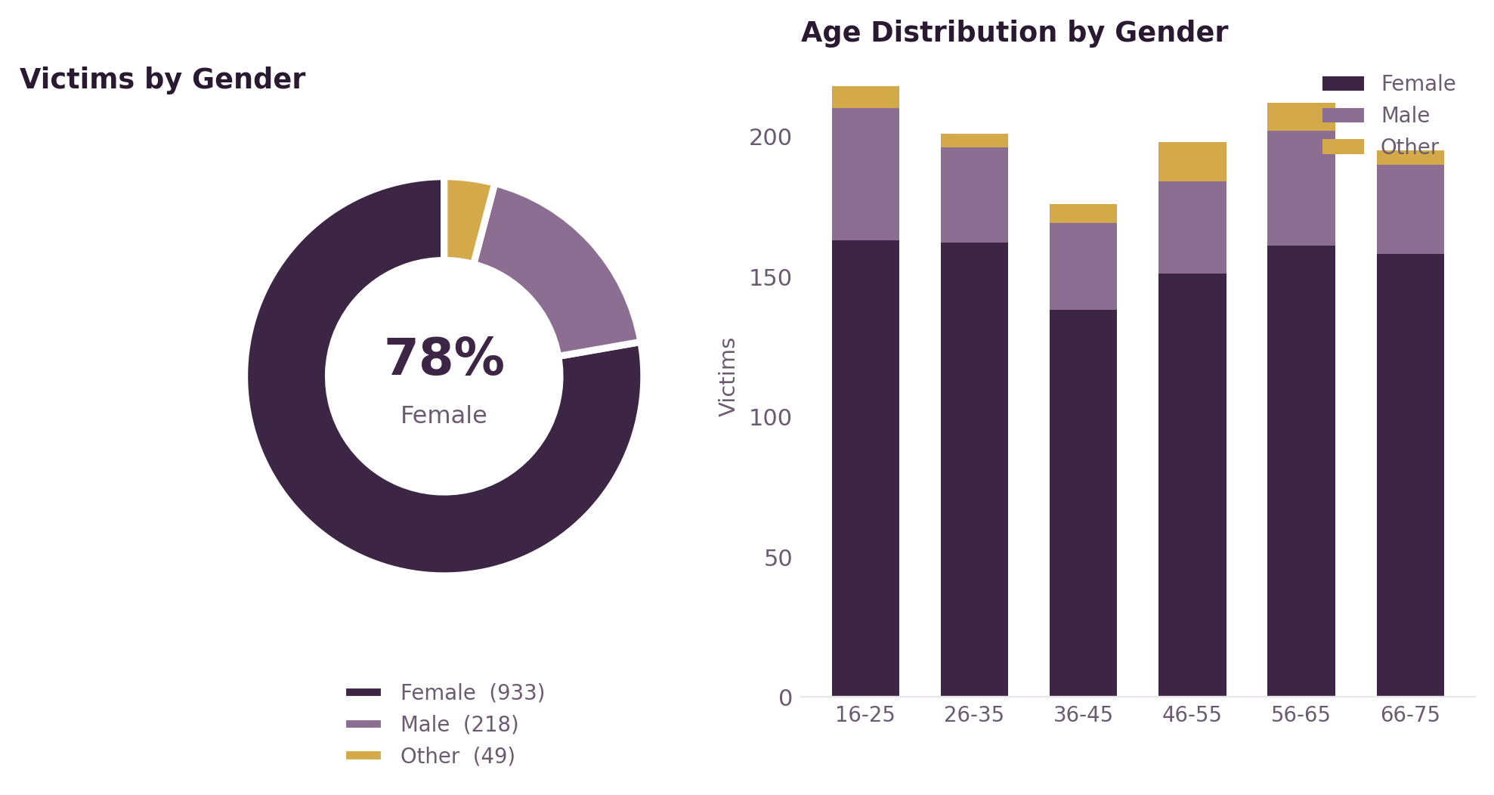
1
Victim Demographics
Who are the victims — in terms of age, gender, education, and economic status?
DATA INSIGHT — 78% OF VICTIMS ARE WOMEN
VISUALS ON THIS PAGE
Donut — Victims by Gender
Gender split of victims (case_id).
Bar — Education by Gender
Education level compared by gender.
Bar — Education by Gender (2)
Detail cut of the same comparison.
Column — Income by Employment
Household income by employment status.
Table — Victim Gender
Reference list of gender categories.
Page 1 of 5 — Victim Demographics
Synthetic Domestic Violence Dataset

Slide 6
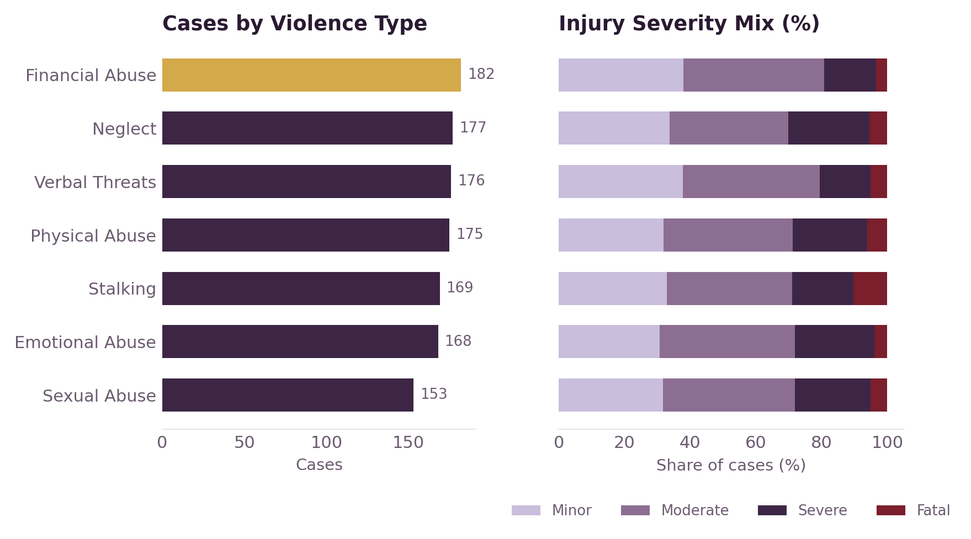
2
Violence Types & Severity
What types of violence occur most often, and how frequent/severe are incidents?
DATA INSIGHT — 24% OF CASES ARE SEVERE OR FATAL
VISUALS ON THIS PAGE
100% Stacked Bar — Violence Type Share
Share of total cases by violence type.
Scatter — Frequency vs Age
Incident frequency vs victim age.
100% Stacked Column — Medical Assistance
Medical aid needed, by violence type.
Card — Total Case Count
#
Headline KPI, filtered by slicer.
Slicer — Violence Type
Filters the whole page.
Page 2 of 5 — Violence Types & Severity
Synthetic Domestic Violence Dataset

Slide 7
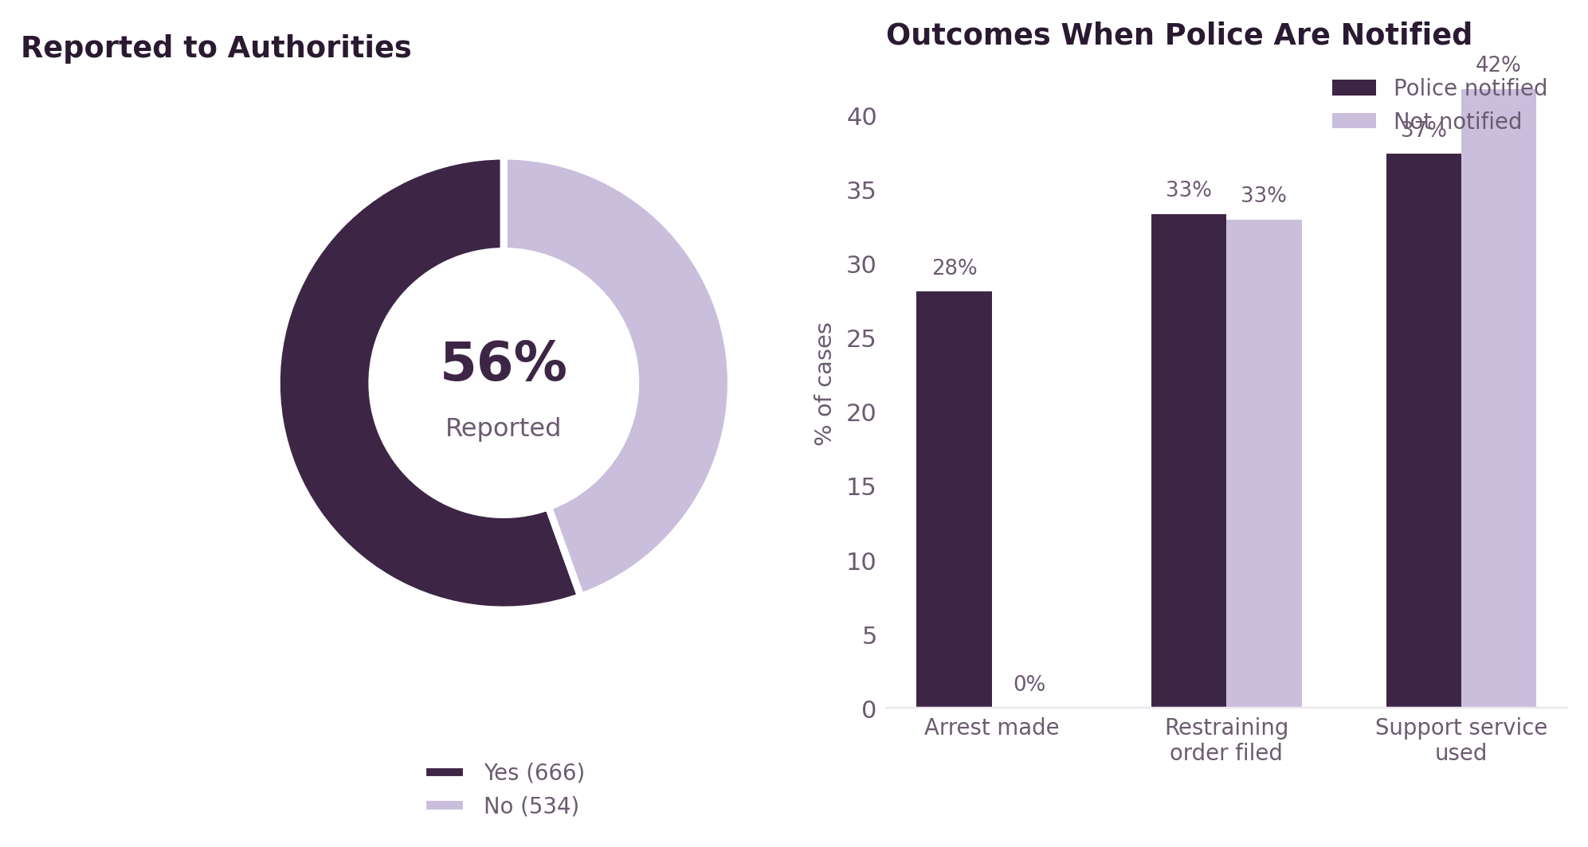
3
Reporting & Support Response
How often is violence reported to authorities, and how does that relate to medical assistance and support use?
DATA INSIGHT — VIRTUALLY NO ARRESTS WITHOUT A POLICE REPORT
VISUALS ON THIS PAGE
Pie — Reported to Authorities
Share of cases reported vs not.
Bar — Cases by Type & Reporting
Reporting behavior by violence type.
Stacked Column — Reporting vs Medical Aid
Reporting crossed with medical need.
Pivot Table — Residence x Reporting
Reporting rates by residence type.
Slicer — Medical Assistance Required
Filters the whole page.
Page 3 of 5 — Reporting & Support Response
Synthetic Domestic Violence Dataset

Slide 8
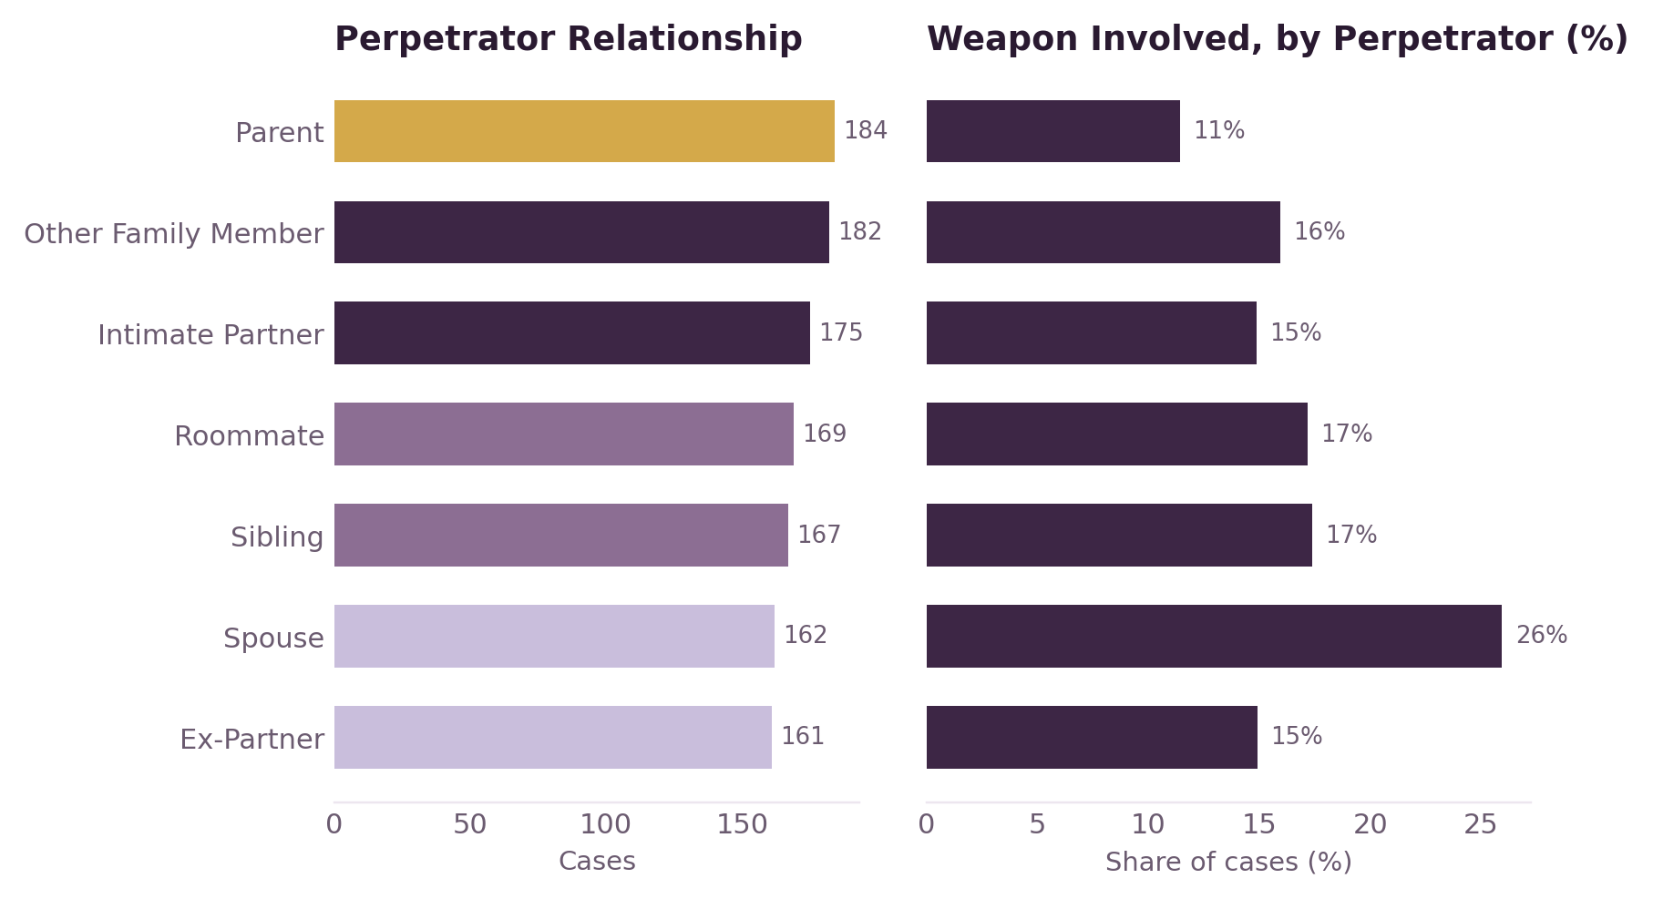
4
Perpetrators & Household Context
Who are the perpetrators, and how does household context (children, residence, income) relate to abuse?
DATA INSIGHT — 1 IN 3 CASES INVOLVE A PARENT OR RELATIVE
VISUALS ON THIS PAGE
Treemap — Perpetrator Relationship
Proportion of each perpetrator type.
Column — Perpetrator by Violence Type
Cross-tab of perpetrator and violence type.
Line — Children by Perpetrator
Avg. children by perpetrator type.
Bar — Children by Residence
Household composition by residence & perpetrator.
Slicer — Perpetrator Relationship
Filters the whole page.
Page 4 of 5 — Perpetrators & Household Context
Synthetic Domestic Violence Dataset

Slide 9
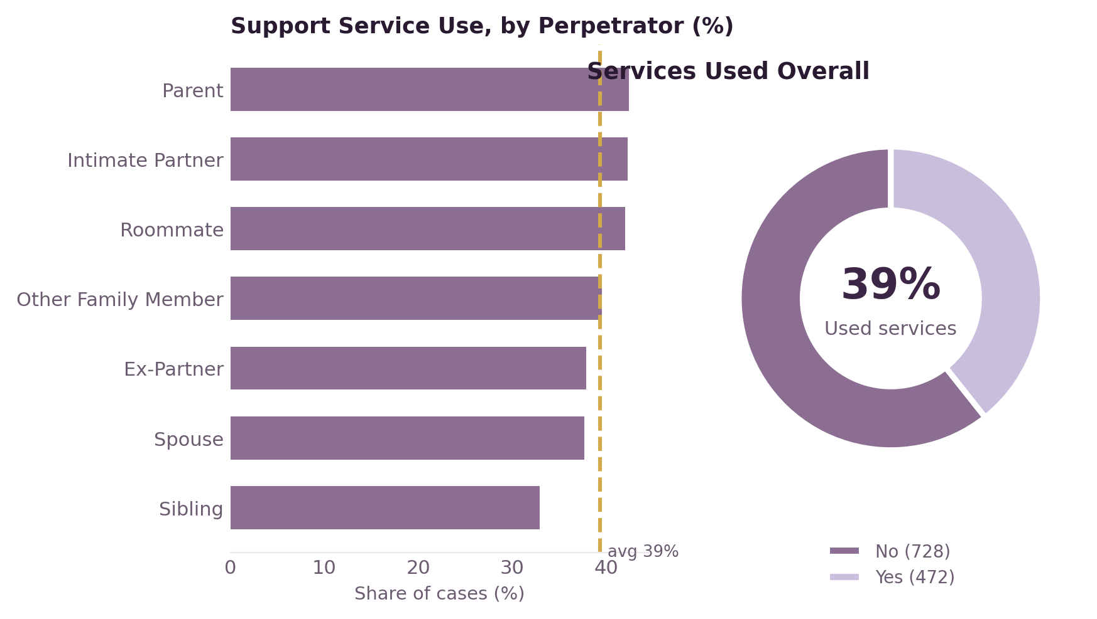
5
Support Service Utilization
Are victims accessing support services, and what factors (income, education, employment) correlate with that?
DATA INSIGHT — ONLY 39% OF VICTIMS USE SUPPORT SERVICES
VISUALS ON THIS PAGE
Bar — Cases by Type & Services Used
Case volume by violence type & service use.
Scatter — Income & Frequency vs Services
Income/frequency related to service uptake.
Bar — Cases by Education & Services
Service usage across education levels.
Slicer — Support Services Used
Filters the whole page.
Gauge — Services Used Indicator
KPI gauge, 1,200 of 2,400 services used.
Page 5 of 5 — Support Service Utilization
Synthetic Domestic Violence Dataset

Slide 10
Report Structure at a Glance
Demographics
Violence Types
Reporting
Perpetrators
Support Services
BY. Pranav(BSc IT) 2402020015
Thank you
Open the .pbix in Power BI Desktop to explore each page interactively.

