Slide 1

DOM

Slide 2
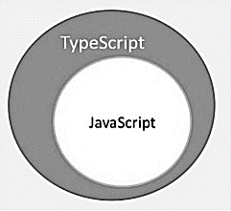
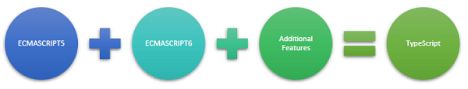
TYPE SCRIPT

Slide 3
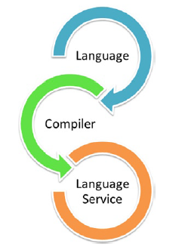

TYPE SCRIPT ARCHITECTURE

Slide 4
Angular | Date | TypeScript | Node.js
16.1.0 (next) |  | >=4.9.3, <=5.1 (support added) | ^16.14.0 || >=18.10.0
16.0.0 | 2023-05-03 | >=4.9.3, <5.1 (support for TS 5) | ^16.14.0 || >=18.10.0
15.2.0 | 2023-02-23 | >= 4.8.2, <5.0 | 14.20.x, 16.13.x, 18.10.x
15.1.0 | 2023-01-10 | >= 4.8.2, 4.9.0 (support added) | 14.20.x, 16.13.x, 18.10.x (no changes)
15.0.0 | 2022-11-17 | >= 4.8.2, < 4.9.0 | 14.20.x, 16.13.x, 18.10.x (support added)
14.2.0 | 2022-08-25 | >= 4.6, 4.8 (support added) | >= 14.15
14.0.0 | 2022-06-02 | >= 4.6, 4.6 and 4.7 (support added) | >= 14.15
13.3 | 2021-11-03 | >= 4.4.2 | >= 12.20.0
13.1 | 2021-12-09 | >= 4.4.2, 4.5 (support added) | 12.20
13.0 | 2021-11-03 | >= 4.4.2 | >= 12.20.0, 16 (support added)
12.0.0 | 2021-05-12 | >= 4.2 | 12
11.1 | 2021-01-20 | 4.1
11.0.0 | 2020-11-11 | >= 4.0 | 12
10.1.0 | 2020-09-02 | 4.0, >= 3.9
10.0.0 | 2020-06-04 | >= 3.9 | 10
9.1.0 | 2020-03-25 | 3.8 | 10.13
9.0.0 | 2020-02-06 | >= 3.6 and 3.7
8.2.0 | 2019-07-31 | 3.5 | 10.16.0
8.0.0 | 2019-05-28 | >= 3.4 | 10
7.2.0 | 2019-01-07 | 3.2 | 8
7.0.0 | 2018-10-18 | 3.1 | 8
6.1.0 | 2018-07-25 | 2.9 | 8
6.0.0 | 2018-05-03 | 2.7 | 8

Slide 5
Fundamentals of Angular
What is Angular?
Angular is a Typescript-based open-source framework for building client-side web applications. Since Typescript is a superset of JavaScript, let us first understand JavaScript briefly. JavaScript runs on the client-side of the web, which can be used to design or program how the web pages behave on the occurrence of an event. Typically, JavaScript is used for interface interactions, slideshows, and other interactive components. JavaScript evolved quickly and has also been used for server-side programming (like in Node.js), game development, etc.
JavaScript deals with dynamic content, which is an important aspect of web development. Dynamic content refers to constantly changing content and it adapts to specific users. For example, JavaScript can be used to determine whether or not to render the mobile version of the website by checking the device, which is accessing the website.
This encouraged web developers to start creating their own custom JavaScript libraries for reducing the number of code lines and implementing complex functionalities easily. jQuery is a fast, small, and feature-rich JavaScript library, which makes things like HTML document traversal and manipulation, event handling, animation, and Ajax much simpler with an easy-to-use API. jQuery became the most popular one because it was easy to use and extremely powerful.
Since jQuery has no real structure, the developer has full freedom to build projects as they see fit. However, the lack of structure also means it’s easier to fall into the trap of “spaghetti code,” which can lead to confusion in larger projects with no clear design direction or code maintainability. For these situations, a framework like Angular can be a big help.

Slide 6
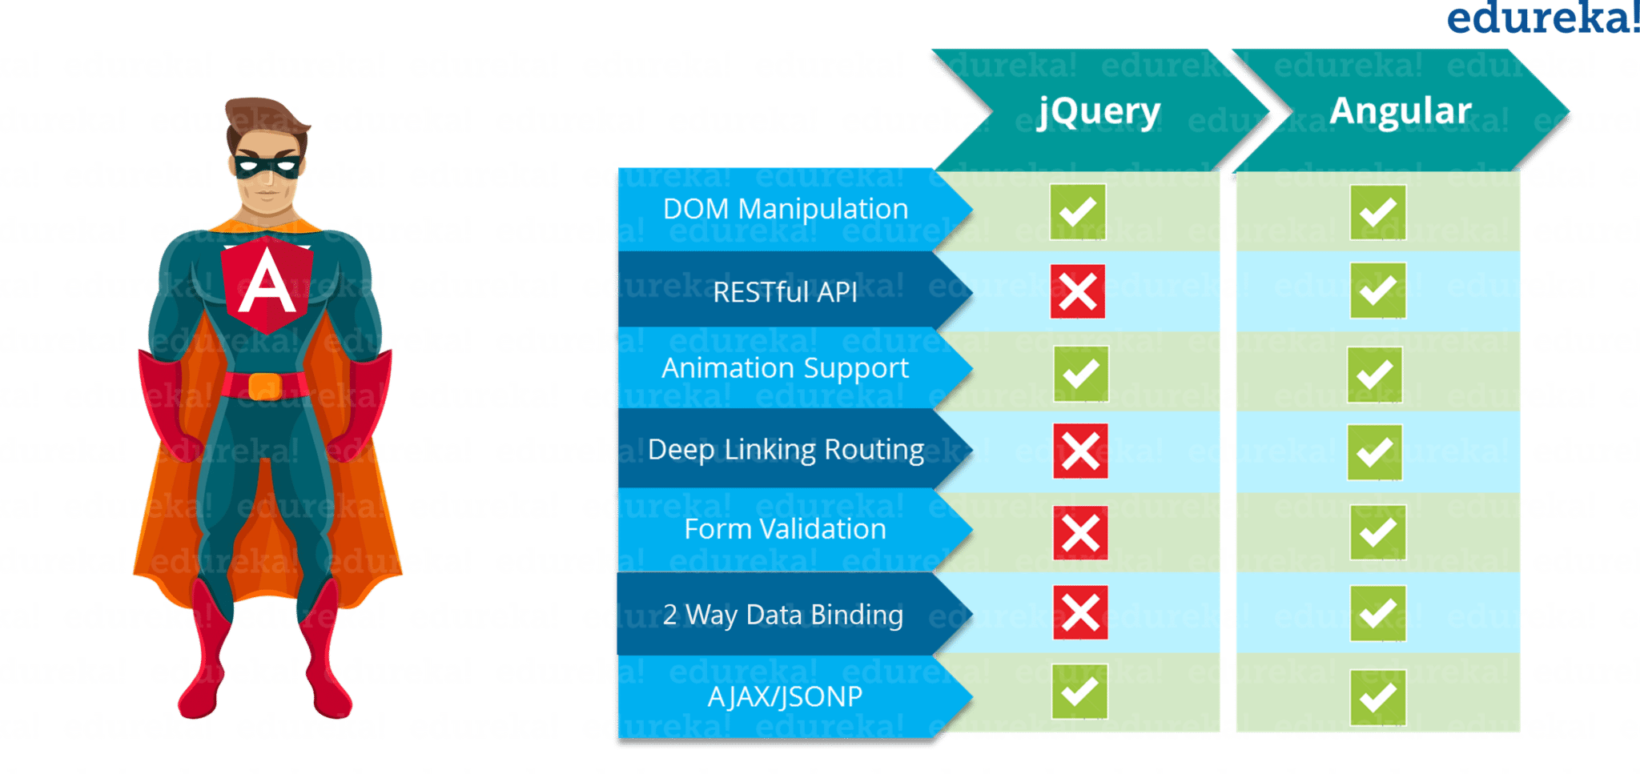
Difference between Angular and jquery

Slide 7
Introduction to angular
Angular is a client-side JavaScript framework that was specifically designed to help developers build SPAs (Single Page Applications) in accordance with best practices for web development. By providing a structured environment for building SPAs, the risk of producing “spaghetti code” is highly reduced. So, you must be wondering what is SPA?
Single-Page Applications (or SPA’s) are applications that are accessed via a web browser like other websites but offer more dynamic interactions resembling native mobile and desktop apps. The most notable difference between a regular website and SPA is the reduced amount of page refreshes. SPAs have a heavier usage of AJAX- a way to communicate with back-end servers without doing a full page refresh to get data loaded into our application. As a result, the process of rendering pages happens mostly on the client-side.

Slide 8
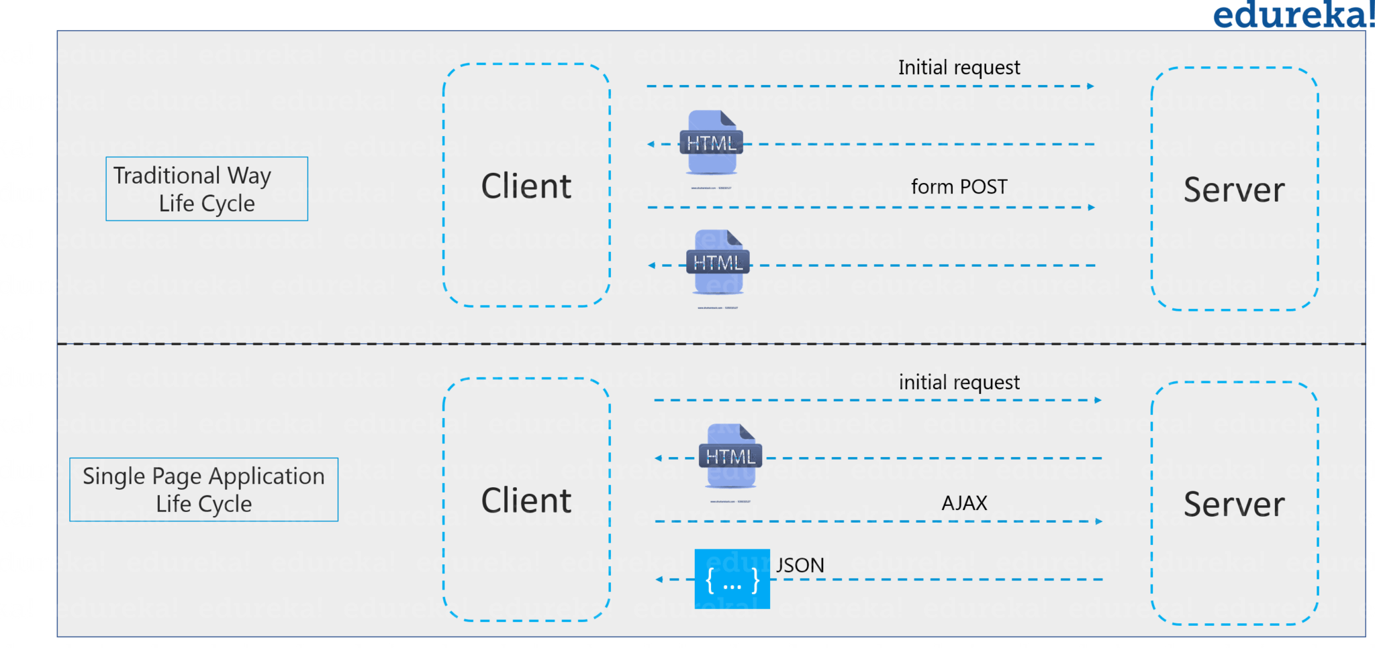
Single page Application VS Non single page application

Slide 9
Angular 15 tutorial
For example, if you go through Gmail, you will notice that while opening mail from the inbox will only fetch the email and display it in place of the e-mail list. The rest of the components like sidebar, navigation bar, etc. are not reloaded. It only refreshes the DOM (Document Object Model) for the required section. So, this reduces the overhead loading of the website.
So, now as we know what is Javascript & Jquery and how angular came into the picture. Moving ahead in Angular 8 Tutorial, we will look through the features of angular and understand how to work with Angular.
Angular is a TypeScript-based open-source front-end web application platform led by the Angular Team at Google and by a community of individuals and corporations. Angular is a complete rewrite from the same team that built AngularJS. But let me tell you that Angular is completely different from AngularJS. Let us understand the differences between Angular and AngularJS.

Slide 10
Differences between Angular and AngularJS
The architecture of an Angular application is different from AngularJS. The main building blocks for Angular are modules, components, templates, metadata, data binding, directives, services, and dependency injection. We will be looking at it in a while.
Angular does not have a concept of “scope” or controllers instead, it uses a hierarchy of components as its main architectural concept.
Angular has a simpler expression syntax, focusing on “[ ]” for property binding, and “( )” for event binding
Mobile development – Desktop development is much easier when mobile performance issues are handled first. Thus, Angular first handles mobile development.
Modularity – Angular follows modularity. Similar functionalities are kept together in same modules. This gives Angular a lighter & faster core.

Slide 11
Features of angular 15
Angular recommends the use of Microsoft’s TypeScript language, which introduces the following features:
Class-based Object-Oriented Programming
Static Typing
TypeScript is a superset of ECMAScript 6 (ES6) and is backward compatible with ECMAScript 5. Angular 8 also includes the benefits of ES5 to ES2015+:
Iterators
For/ Of loops
Reflection
Improved dependency injection – bindings make it possible for dependencies to be named
Dynamic loading
Asynchronous template compilation
Simpler Routing
Replacing controllers and $scope with components and directives – a component is a directive with a template
Support reactive programming using RxJS
Moving ahead in this Angular 15 tutorial, let’s understand the features of Angular.

Slide 12
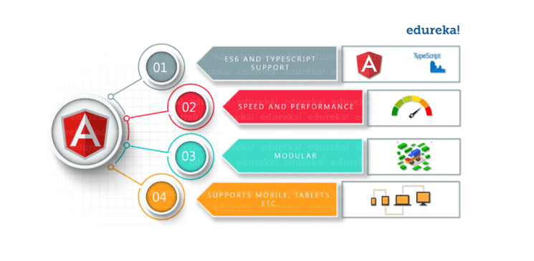
Angular 15 Features

Slide 13
Angular 15 features
Cross-Platform
Progressive web apps: It uses modern web platform capabilities to deliver an app-like experience. It gives high performance, offline, and zero-step installation. So, working with Angular is pretty much easy.
Native: You can build native mobile apps with strategies using Ionic Framework, NativeScript, and React Native.
Desktop: Create desktop-installed apps across Mac, Windows, and Linux using the same Angular methods you’ve learned for the web plus.
Speed and Performance
Code generation: Angular turns your templates into code that’s highly optimized for JavaScript virtual machines, giving you all the benefits of hand-written code with the productivity of a framework.
Universal: You can use any technology with Angular for serving the application like node.js, .NET, PHP and other servers
Code splitting: Angular apps load quickly with the new Component Router, which delivers automatic code-splitting, so users only load code required to render the view they request.
Productivity
Templates: Quickly create UI views with simple and powerful template syntax.

Slide 14
Angular CLI: Command-line tools: You can easily and quickly start building components, adding components, testing them, and then, instantly deploy them using Angular CLI.
IDEs: Get intelligent code completion, instant errors, and other feedback in popular editors and IDEs like Microsoft’s VS Code.
Full Development Story
Testing: With the Jasmine test framework, the Angular CLI downloads and installs everything required for testing your application. When you run ng test command, the app will be built in watch mode and the Karma test runner will be launched. Once that is done, you will see the output in the terminal plus, the chrome browser will open up showing the output in Jasmine HTML Reporter.

Slide 15
What’s new in Angular 15:
TypeScript : Angular 15 requires TypeScript 4.9.5 for web development
Opt-n Ivy Preview: Ivy is the name given to Angular’s next-generation compilation and rendering pipeline. This will help you optionally preview your website to see how it works
Differential Loading: As a part of its build process, Angular 15 CLI will be able to produce both legacy and modern JS bundles i.e ES5 and ES2015+. This implies a differentially-loaded client-side with improved speed and TTI (Time to Interactive) for the present browsers
Backward compatibility of Router: This helps in simplifying the upgrade path for large projects
Opt-in Usage Sharing: With this feature, the Angular team will be able to collect anonymous information with your consent to keep a track of the commands that are used and the time taken to build your projects
Dependency Updates: Angular 8 has updated the dependencies on tools like RxJS, Node, and TypeScript (as mentioned earlier) for better performance and sync with the current environment
Web Worker Building: Web workers allow you to write code that runs separately from the main thread. This improves speed by parallelizing multiple tasks. The developers of Angular 15 have added bundling support for web workers as a result of requests from developers

Slide 16
Building Blocks of Angular
The main building blocks of Angular are:
Modules
Components
Templates
Metadata
Data binding
Directives
Services
Dependency injection

Slide 17
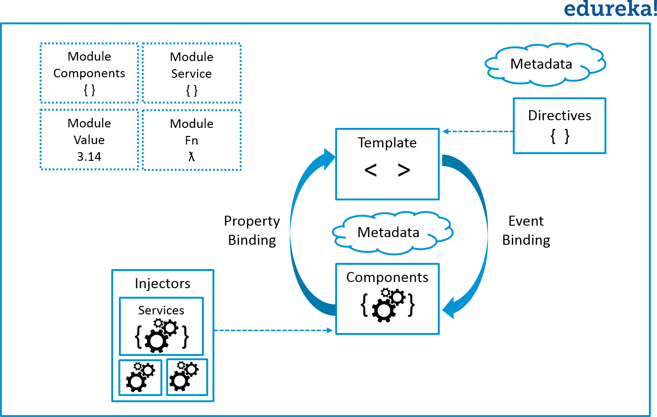
Dependency Injection in angular

Slide 18
Modularity in angular
Modules:
Angular apps are modular and to maintain modularity, we have Angular modules or you can say NgModules. Every Angular app contains at least one Angular module, i.e. the root module. Generally, it is named as AppModule. The root module can be the only module in a small application. While most of the apps have multiple modules. You can say, a module is a cohesive block of code with a related set of capabilities that have a specific application domain or a workflow. Any angular module is a class with @NgModule decorator.
Decorators are functions that modify JavaScript classes. Decorators are basically used for attaching metadata to classes so that, it knows the configuration of those classes and how they should work. NgModule is a decorator function that takes metadata objects whose properties describe the module. The properties are:
declarations: The classes that are related to views and they belong to this module. There are three classes of Angular that can contain view: components, directives, and pipes. We will talk about them in a while.
exports: The classes that should be accessible to the components of other modules.
imports: Modules whose classes are needed by the component of this module.
providers: Services present in one of the modules which are to be used in the other modules or components. Once a service is included in the providers it becomes accessible in all parts of that application
bootstrap: The root component which is the main view of the application. This root module only has this property and it indicates the component that is to be bootstrapped.

Slide 19
Components
A component controls one or more sections on the screen called a view. For example, if you are building a course list application, you can have components like App Component (the bootstrapped component), Course Component, Course Detail Component, etc.
Inside the component, you define a component’s application logic i.e. how does it support the view—inside a class. The class interacts with the view through an API of properties and methods.

Slide 20
Templates
You associate the component’s view with its companion template. A template is nothing but a form of HTML tags that tells Angular about how to render the component. A template looks like regular HTML, except for a few differences.

Slide 21
Metadata
Metadata tells Angular how to process a class. To tell Angular that Course Component is a component, metadata is attached to the class. In TypeScript, you attach metadata by using a decorator. In the below code, you can see metadata attached to the Course Component:

Slide 22
Component + Templates
Here is the @Component decorator, which identifies the class immediately below it as a component class. The @Component decorator takes the required configuration object which Angular needs to create and present the component and its view.
The most important configurations of @Component decorator are:
selector: Selector tells Angular to create and insert an instance of this component where it finds <app-course> tag. For example, if an app’s HTML contains <app-course></app-course>, then Angular inserts an instance of the CourseComponent view between those tags.
templateUrl: It contains the path of this component’s HTML template.
styleUrls: It is the component-specific style sheet.
The metadata in the @Component tells Angular where to get the major building blocks you specify for the component. The template, metadata, and component together describe a view. The architectural takeaway is that you must add metadata to your code so that Angular knows what to do.

Slide 23
Data Binding
If you are not using a framework, you have to push data values into the HTML controls and turn user responses into some actions and value updates. Writing such push/pull logic is tedious, error-prone, and a nightmare to read. Angular supports data binding, a mechanism for coordinating parts of a template with parts of a component. You should add binding markup to the template HTML to tell Angular how to connect both sides.

Slide 24
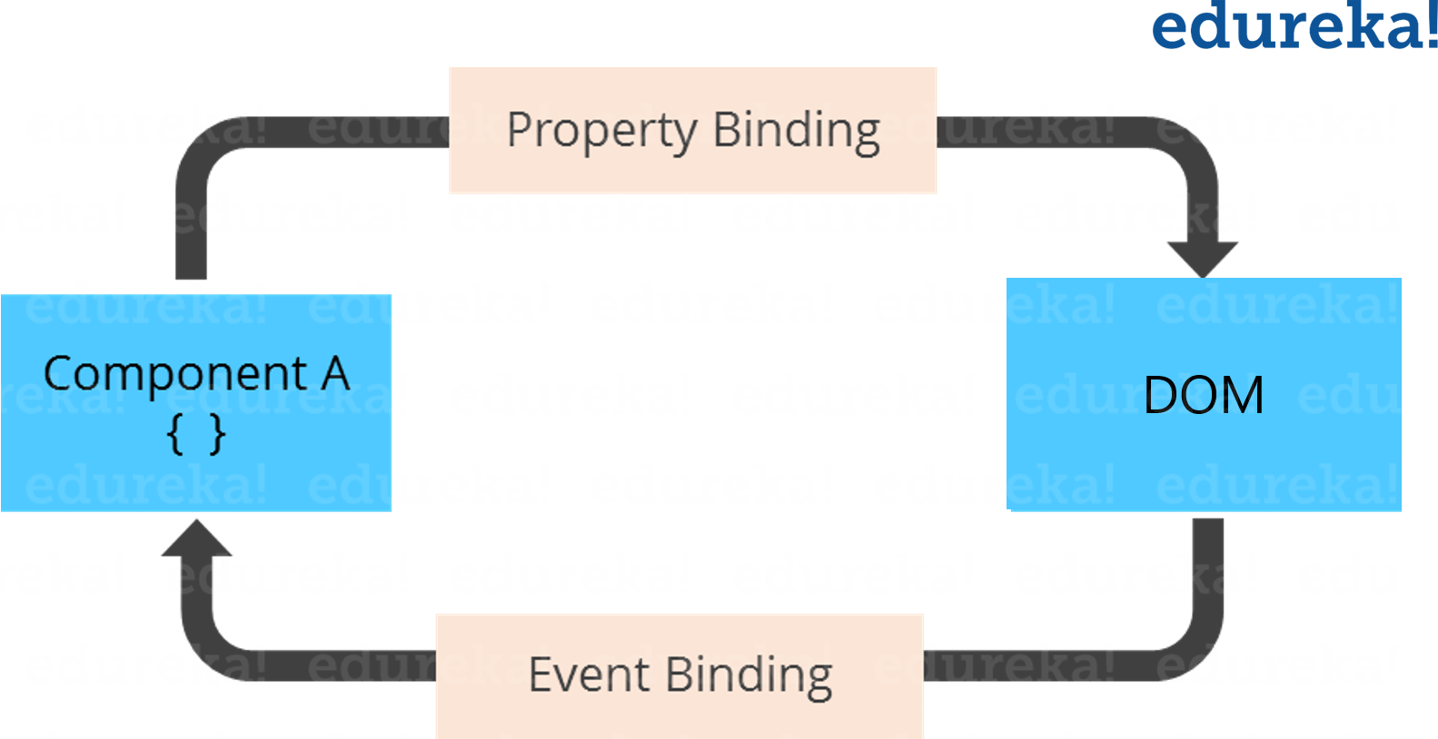
Property and Event Binding

Slide 25
Directives
Angular templates are dynamic. When Angular renders them, it transforms the DOM according to the instructions given by directives. A directive is a class with a @Directive decorator. A component is a directive-with-a-template; a @Component decorator is actually a @Directive decorator extended with template-oriented features.
While a component is technically a directive, components are so distinctive and central to Angular applications that this architectural overview separates components from directives.
Two other kinds of directives exist: structural and attribute directives.
Directive tends to appear within an element tag as attributes do, sometimes by name but more often as the target of an assignment or a binding.
Structural directives alter layout by adding, removing, and replacing elements in DOM.
This example template uses two built-in structural directives:

Slide 26
Services
Service is a broad category encompassing any value, function, or feature that your application needs. A service is typically a class with a well-defined purpose. Anything can be a service. Examples include:

Slide 27
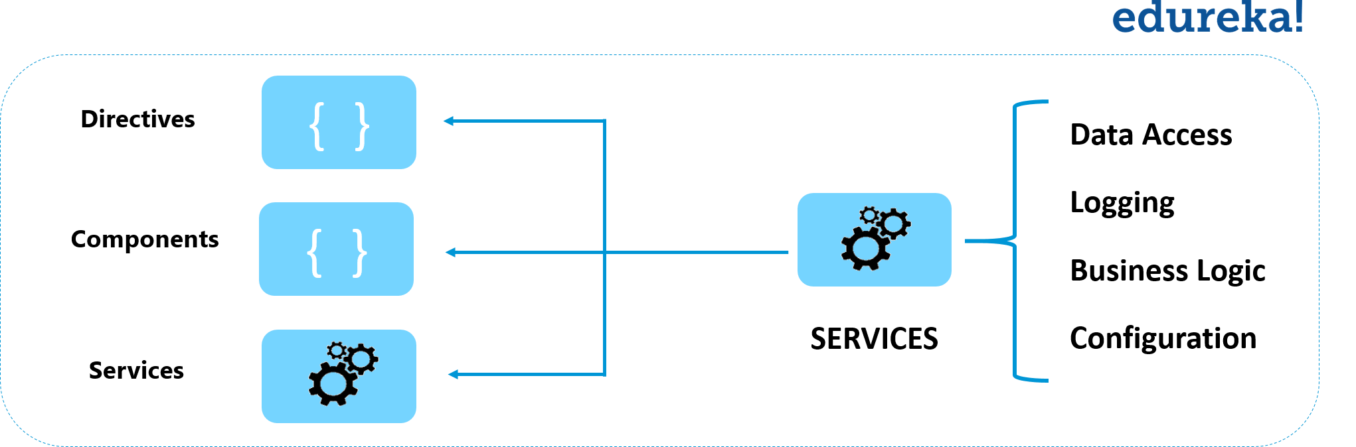
Dependency injection though services

Slide 28
Dependency injection though services
Services are everywhere. Component classes don’t fetch data from the server, validate user input, or log directly to the console. They delegate such tasks to services.
A component’s job is to enable the user experience and nothing more. It mediates between the view (rendered by the template) and the application logic. A good component presents properties and methods for data binding. Angular does help you follow these principles by making it easy to factor your application logic into services and make those services available to components through dependency injection.
So, now let us understand dependency injection, in this Angular 8 Tutorial blog.
Dependency Injection
Dependency injection is a way to supply a new instance of a class with the fully-formed dependencies it requires. Most dependencies are services. Angular uses dependency injection to provide new components with the services they need. Angular can tell which services a component needs by looking at the types of its constructor parameters.
When Angular creates a component, it first asks an injector for the services that the component requires.

Slide 29
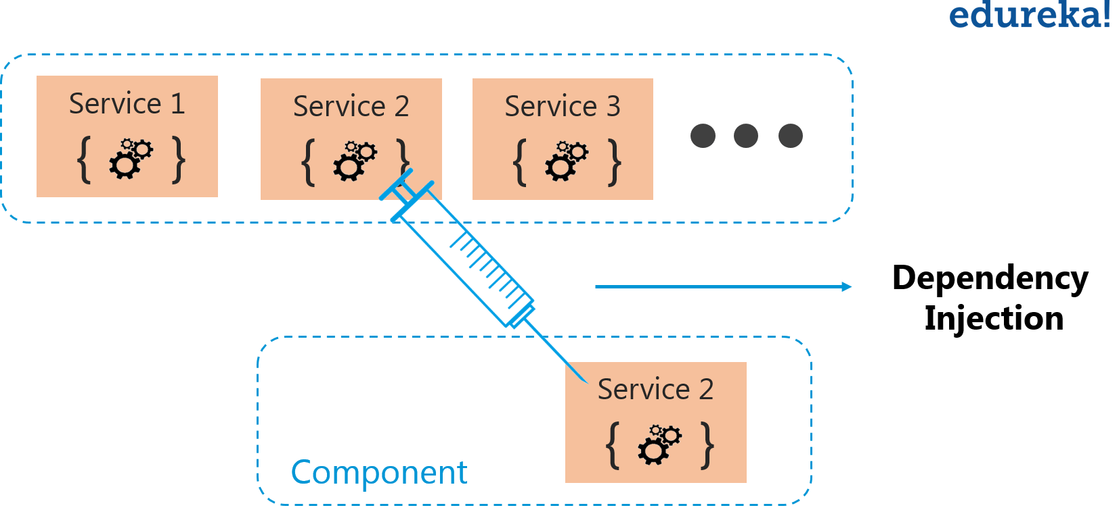
Dependency injection though services

Slide 30
Angular Component Communication
1. Parent to Child: Sharing Data via Input
To share data from parent to child component via @Input Decorator.
@Input links a property of a child component with a value that was given by the parent component.

Slide 31
2. Child to Parent: Sharing Data via ViewChild with AfterViewInit
ViewChild allows a child component to be injected into a parent component.
It will give the parent access to its attributes and functions.
A Child won’t be available to give access until the view has been initialized.
This means we need to implement the AfterViewInit lifecycle hook to receive the data from the child.

Slide 32
3. Child to Parent: Sharing Data via Output() and EventEmitter
Another way to share data is to emit data from the child component which can be listed by the parent component.
This approach is ideal when you want to share data changes that occur on things like button clicks, form entries, and other user events.
For e.g.
In the parent, we create a function to receive the message and set it equal to the message variable.
In the child, we declare a messageEvent variable with the Output decorator and set it equal to a new event emitter.
Then we create a function named sendMessage that calls emit on this event with the message we want to send. Lastly, we create a button to trigger this function.
The parent can now subscribe to this messageEvent that’s outputted by the child component, then run the receive message function whenever this event occurs.

Slide 33
We can share data from parent to child via @Input
We can share data from child to parent via @ViewChild
We can share data from child to parent via @Output for button clicks or Form entries

Slide 34
Angular lifecycle hooks
Here is the complete list of life cycle hooks, which angular invokes during the component life cycle. Angular invokes them when a specific event occurs.
ngOnChanges
ngOnInit
ngDoCheck
ngAfterContentInit
ngAfterContentChecked
ngAfterViewInit
ngAfterViewChecked
ngOnDestroy

Slide 35
The Angular invokes the ngOnChanges life cycle hook whenever any data-bound input property of the component or directive changes. Initializing the Input properties is the first task angular carries during the change detection cycle. And if it detects any change in property, then it raises the ngOnChanges hook. It does so during every change detection cycle. This hook is not raised if change detection does not detect any changes.

Slide 36
ngOnInit
The Angular raises the ngOnInit hook after it creates the component and updates its input properties. It raises it after the ngOnChanges hook.
This hook is fired only once and immediately after its creation (during the first change detection).
This is a perfect place where you want to add any initialization logic for your component. Here you have access to every input property of the component. You can use them in HTTP get requests to get the data from the back-end server or run some initialization logic etc.

Slide 37
ngDoCheck
The Angular invokes the ngDoCheck hook event during every change detection cycle. This hook is invoked even if there is no change in any of the properties.
Angular invoke it after the ngOnChanges & ngOnInit hooks.
ngAfterContentInit
ngAfterContentInit Life cycle hook is called after the Component’s projected content has been fully initialized. Angular also updates the properties decorated with the ContentChild and ContentChildren before raising this hook. This hook is also raised, even if there is no content to project.

Slide 38
ngAfterContentChecked
ngAfterContentChecked Life cycle hook is called during every change detection cycle after Angular finishes checking of component’s projected content. Angular also updates the properties decorated with the ContentChild and ContentChildren before raising this hook. Angular calls this hook even if there is no projected content in the component.
This hook is very similar to the ngAfterContentInit hook. Both are called after the external content is initialized, checked & updated. The only difference is that ngAfterContentChecked is raised after every change detection cycle. While ngAfterContentInit during the first change detection cycle.

Slide 39
ngAfterViewInit
ngAfterViewInit hook is called after the Component’s View & all its child views are fully initialized. Angular also updates the properties decorated with the ViewChild & ViewChildren properties before raising this hook.
The View here refers to the template of the current component and all its child components & directives.
This hook is called during the first change detection cycle, where angular initializes the view for the first time.
At this point, all the lifecycle hook methods & change detection of all child components & directives are processed & Component is entirely ready.

Slide 40
ngAfterViewChecked
The Angular fires this hook after it checks & updates the component’s views and child views. This event is fired after the ngAfterViewInit and after that, during every change detection cycle.
This hook is very similar to the ngAfterViewInit hook. Both are called after all the child components & directives are initialized and updated. The only difference is that ngAfterViewChecked is raised during every change detection cycle. While ngAfterViewInit during the first change detection cycle.
This is a component-only hook.

Slide 41
ngOnDestroy
This hook is called just before the Component/Directive instance is destroyed by Angular
You can Perform any cleanup logic for the Component here. This is where you would like to Unsubscribe Observables and detach event handlers to avoid memory leaks.

Slide 42
The Order of Execution of Life Cycle Hooks
The Angular executes the hooks in the following order
On Component Creation
OnChanges
OnInit
DoCheck
AfterContentInit
AfterContentChecked
AfterViewInit
AfterViewChecked

Slide 43
When the Component with Child Component is created
OnChanges
OnInit
DoCheck
AfterContentInit
AfterContentChecked
Child Component -> OnChanges
Child Component -> OnInit
Child Component -> DoCheck
Child Component -> AfterContentInit
Child Component -> AfterContentChecked
Child Component -> AfterViewInit
Child Component -> AfterViewChecked
AfterViewInit
AfterViewChecked

Slide 44
After The Component is Created
OnChanges
DoCheck
AfterContentChecked
AfterViewChecked
The OnChanges hook fires only if an input property is defined in the component and it changes. Otherwise, it will never fire.

Slide 45
What is Template-driven form?
In Template Driven Forms we specify behaviors/validations using directives and attributes in our template and let it work behind the scenes. All things happen in Templates hence very little code is required in the component class. This is different from the reactive forms, where we define the logic and controls in the component class.
The Template-driven forms
The form is set up using ngForm directive
controls are set up using the ngModel directive
ngModel also provides the two-way data binding
The Validations are configured in the template via directives
Template-driven forms are
Contains little code in the component class
Easier to set up
While they are
Difficult to add controls dynamically
Unit testing is a challenge

Slide 46
ngForm
Once, we have a form with few form elements, the angular automatically converts it into a Template-driven form. This is done by the ngForm directive.
The ngForm directive is what makes the Angular template-driven forms work. But we do not need to add it explicitly. Angular adds it automatically
When we include FormsModule, the Angular is going to look out for any <form> tag in our HTML template. Angular does this via ngForm directive. ngForm directive automatically detects the <form> tag and automatically binds to it. You do not have to do anything on your part to invoke and bind the ngForm directive.
The ngForm does the following
Binds itself to the <Form> directive
Creates a top-level FormGroup instance
CreatesFormControl instance for each of child control, which has ngModel directive.
CreatesFormGroup instance for each of the NgModelGroup directive.
We can export the ngForm instance into a local template variable using ngForm as the key (ex: #contactForm="ngForm"). This allows us to access the many properties and methods of ngForm using the template variable contactForm
<form #contactForm="ngForm">

Slide 47
FormControl
The FormControl is the basic building block of the Angular Forms. It represents a single input field in an Angular form. The Angular Forms Module binds the input element to a FormControl. We use the FormControl instance to track the value, user interaction and validation status of an individual form element. Each individual Form element is a FormControl
We have six form elements in our HTML template. They are firstName, lastname, email, gender, isMarried & country. We need to bind them to FormControl instance. We do this by using the ngModel directive. Add the ngModel directive to each control as shown below.
<input type="text" name="firstname" ngModel>

Slide 48
Submit Form
Now have the template ready, except for the final piece i.e submitting data to the component.
We use the ngSubmit event, to submit the form data to the component class. We use the event binding (parentheses) to bind ngSubmit to OnSubmit method in the component class. When the user clicks on the submit button, the ngSubmit event will fire
<form #contactForm="ngForm" (ngSubmit)="onSubmit(contactForm)">

Slide 49
What are Reactive Forms?
Reactive forms are forms where we define the structure of the form in the component class. i.e. we create the form model with Form Groups, FormBuilder, Form Controls, and FormArrays. We also define the validation rules in the component class. Then, we bind it to the HTML form in the template. This is different from the template-driven forms, where we define the logic and controls in the HTML template.
How to use Reactive Forms
Import ReactiveFormsModule
Create Form Model in component class using FormGroup, FormControl & FormArrays FormBuilder
Create the HTML Form resembling the Form Model.
Bind the HTML Form to the Form Model

Slide 50
Model
In the template-driven approach, we used ngModel & ngModelGroup directive on the HTML elements. The FormsModule automatically creates the FormGroup & FormControl instances from the HTML template. This happens behind the scene.
In the Reactive Forms approach, It is our responsibility to build the Model using FormGroup, FormControl and FormArray. FormBuilder
The FormGroup, FormControl & FormArray are the three building blocks of the Angular Forms. We learned about them in the Angular Forms Tutorial.
FormControl encapsulates the state of a single form element in our form. It stores the value and state of the form element and helps us to interact with them using properties & methods.
FormGroup represents a collection of form controls. It can also contain other FormGroups and FormArrays. In fact, an angular form is a FormGroup.
Let’s create the model for our Form.
First, we need to import FormGroup, FormControl & Validator from the @angular/forms. Open the app.component.ts and the add following import statement.
import { FormGroup, FormControl, Validators } from '@angular/forms'

Slide 51
Creating the Form Model
The FormGroup is created with the following syntax
contactForm = new FormGroup({})
In the above, we have created an instance of a FormGroup and named it as contactForm. The contactForm is top level FormGroup and is the name of our form model.
The FormGroup takes 3 arguments. a collection of a child controls (which can be FormControl, FormArray, or another FormGroup), a validator, and an asynchronous validator. The validators are optional.

Slide 52
Adding the Child Controls
The next step is to add the child controls to the contactForm.
The first argument to FormGroup is the collection of controls. The Controls can be FormControl, FormArray or another FormGroup. It can be done by creating a new instance for FormControl (or FormGroup or FormArray)
contactForm = new FormGroup({
firstname: new FormControl(),
lastname: new FormControl(),
email: new FormControl(),
gender: new FormControl(),
isMarried: new FormControl(),
country: new FormControl()
})

Slide 53
Binding the template to the model
Now we need to associate our model with the above HTML Template. We need to tell angular that we have a model for the form.
This is done using the formGroup directive as shown below.
<form [formGroup]="contactForm">
Next, we need to bind each form field to an instance of the FormControl models. We use the FormControlName directive for this. We add this directive to every form field element in our form. The value is set to the name of the corresponding FormControl instance in the component class.
<input type="text" id="firstname" name="firstname" formControlName="firstname">
<input type="text" id="lastname" name="lastname" formControlName="lastname">

Slide 54
Submit form
We submit the form data to the component using the Angular directive named ngSubmit. Note that we already have a submit button in our form. The ngSubmit directive binds itself to the click event of the submit button. We are using event binding (parentheses) to bind ngSubmit to OnSubmit method. When the user clicks on the submit button ngSubmit invokes the OnSubmit method on the Component class
<form [formGroup]="contactForm" (ngSubmit)="onSubmit()">

Slide 55
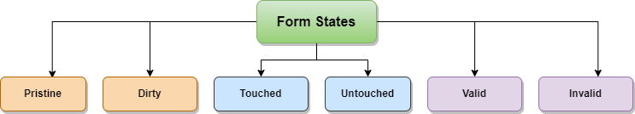
Form States | True when?
Pristine | The user has not modified the form control
Dirty | The user has modified the form control
Touched | The user has interacted with the form control, e.g., by clicking or focusing on it.
Untouched | The form control has not been interacted with by the user.
Valid | The form control's value meets the validation rules defined in the application.
Invalid | The form control's value does not meet the validation rules defined in the application.

Slide 56
What is Angular Routing
Routing allows you to move from one part of the application to another part or one View to another View.
In Angular, Routing is handled by the Angular Router Module.
Angular Router
The Router is a separate module in Angular. It is in its own library package, @angular/router. The Angular Router provides the necessary service providers and directives for navigating through application views.
Using Angular Router you can
Navigate to a specific view by typing a URL in the address bar
Pass optional parameters (query parameters) to the View
Bind the clickable elements to the View and load the view when the user performs application tasks
Handles back and forward buttons of the browser
Allows you to load the view dynamically

Slide 57
Components of Angular Router
Router
An Angular Router is a service (Angular Router API) that enables navigation from one component to the next component as users perform application tasks like clicking on menus links, and buttons, or clicking on the back/forward button on the browser. We can access the router object and use its methods like navigate() or navigateByUrl(), to navigate to a route

Slide 58
Route
Route tells the Angular Router which view to display when a user clicks a link or pastes a URL into the browser address bar. Every Route consists of a path and a component it is mapped to. The Router object parses and builds the final URL using the Route
Routes
Routes is an array of Route objects our application supports

Slide 59
Route
Route tells the Angular Router which view to display when a user clicks a link or pastes a URL into the browser address bar. Every Route consists of a path and a component it is mapped to. The Router object parses and builds the final URL using the Route
Routes
Routes is an array of Route objects our application supports

Slide 60
RouterLinkActive
RouterLinkActive is a directive for adding or removing classes from an HTML element that is bound to a RouterLink. Using this directive, we can toggle CSS classes for active RouterLinks based on the current RouterState
ActivatedRoute
The ActivatedRoute is an object that represents the currently activated route associated with the loaded Component.

Slide 61
How to configure Angular Router
To Configure the Router in Angular, you need to follow these steps
Set the <base href>
Define routes for the view
Register the Router Service with Routes
Map HTML Element actions to Route
Choose where you want to display the view

Slide 62
Define the routes
Next, create an array of route objects. Each route maps the path (URL Segment) to the component
const appRoutes={ path: 'product', component: ProductComponent }
Where
path: The URL path segment of the route. We will use this value to refer to this route elsewhere in the app
component: The component to be loaded.
This route tells angular to render ProductComponent when the user navigates to the URL “/product”

Slide 63
Register the Routes
Import the Angular Router from @angular/router library in the root module of the application
import { RouterModule } from '@angular/router';
Then, install the routes using the RouterModule.forRoot method, passing the routes as the argument in the imports array
imports: [RouterModule.forRoot(appRoutes)],

Slide 64
Map Action to Routes
Next, we need to bind the click event of the link, image, or button to a route. This is done using the routerlink directive
<li><a [routerLink]="['product']">Product</a></li>
Choose where you want to display
Finally, we need to tell the angular where to display the view. This is done using the RouterOutlet directive as shown. We will add the following directive to the root component.
<router-outlet></router-outlet>

Slide 65
Default Route
{ path: '', redirectTo: 'home', pathMatch: 'full' },
The path is empty, indicating the default route. The default route is redirected to the home path using the RedirectTo argument. This route means that, when you navigate to the root of your application /, you are redirected to the home path (/home), which in turn displays the HomeComponent.
Note, that we have pathMatch argument set to ‘full’. The pathMatch tells the Router how to match the URL.

Slide 66
What are Angular Route Parameters?
There are many scenarios, where you need to pass parameters to the route. For example, to navigate to the product detail view, we need to pass the id of the Product, so that component can retrieve it and display it to the user. This is where we use the Route Parameters (or Angular Route Params)
The Route Parameters are a dynamic part of the Route and essential in determining the route.

Slide 67
For example, consider the following route
{ path: 'product/‘, component: ProductComponent }
The above route match only if the URL is /product
To retrieve the product details, our URL should look something like
/product/1 /product/2

Slide 68
Defining the Route
Our first task is to create a Route with a dynamic Parameter. We know how to define Route from the Routing & Navigation tutorial
We can define parameters by adding a forward slash followed colon and a placeholder (id) as shown below
{ path: 'product/:id', component: ProductDetailComponent }
Where id is the dynamic part of the Route.
Now above path matches the URLs /product/1 , /product/2, etc.

Slide 69
Defining the Navigation
We, now need to provide both path and the route parameter routerLink directive.
This is done by adding the id of the product as the second element to the routerLink parameters array as shown below
<a [routerLink]="['/Product', ‘2’]">{{product.name}} </a>
Which translates to the URL /product/2
<a [routerLink]="['/Product', product.productID]">{{product.name}} </a>

Slide 70
You can also use the navigate method of the router object
3 4 5 6 7 | goProduct() { this.router.navigate( ['/products'. product.productID] } ); }

Slide 71
Retrieve the parameter in the component
Finally, our component needs to extract the route parameter from the URL
This is done via the ActivatedRoute service from the angular router module to get the parameter value
ActviatedRoute
The ActivatedRoute is a service, which keeps track of the currently activated route associated with the loaded Component.
To use ActivatedRoute, we need to import it into our component
import { ActivatedRoute } from '@angular/router';

Slide 72
There are two properties that ActviatedRoute routes provide, which contain the Route Parameter.
ParamMap
Params
Params
The Angular ActviatedRoute also maintains the Route Parameters in the Params array. The Params array is a list of parameter values, indexed by name.

Slide 73
Reading the Route Parameters
Subscribing to the paramMap or params observable property of the ActivatedRoute
Eg
this.paramSub=this.ar.params.subscribe
(params=>{
this.id=+params['id'];
});

Slide 74
What is Route Guard?
Why is it Required?
Type of Angular Route Guard?
How to Implement CanActivateGuard?
What is Route Guard?
In the traditional web application, we were checking users' access and permission using Authentication and Authorization on the server side. If the user doesn’t have sufficient access or permission, we were redirecting a user to the login page with an appropriate error message.
Now a question comes to mind; how we will achieve this in Angular? I mean how will restrict a user to access a certain area of the application without login/permission?
That’s one of the scenarios where Route Guard comes into the picture.
Route Guards help us to prevent users to access a certain area of the application that is not permitted or has access to.

Slide 75
Type of Route Guard?
Four types of Route guards are available in Angular. In this article, we will cover the “CanActivate” Route guard and the rest will cover in subsequent articles.
CanActivate
CanActivateChild
CanDeactivate
CanLoad
Please note that all Route guards have interfaces that need to be implemented in the component class.
eg. “CanActivate” is an interface that has a method called “canActivate”
Please see the below screen to get a better understanding,

Slide 76
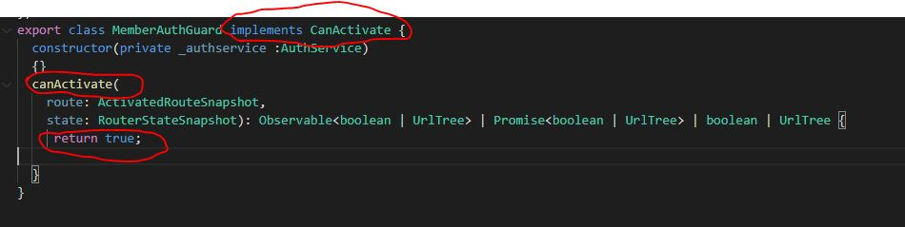
Suppose we have multiple Route guards applied to a specific route then all route guards should return true to navigate. If any route guard returns false then the navigation will be canceled.
Let's see below the screen to understand,

Slide 77
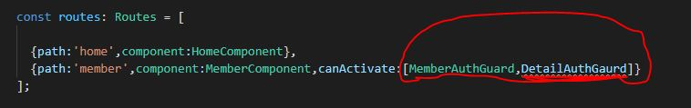
In the above screen, we have two route guards,
MemberAuthGaurd
DetailsAuthGuard
So both route guards should return true. In case any of the route guards return false then “member” navigation will not work.
Now we will implement “CanActivateGaurd”
How to Implement a CanActivateGuard?
First, we will see the syntax/command used to create a route guard.
Syntax
ng g g “name of the guard”

Slide 78
How To Implement Lazy Loading In Angular
What is Lazy Loading in Angular?
When Lazy Loading is useful?
How to Lazy Load a Component in Angular?
What is Lazy Loading in Angular?
Lazy loading in Angular refers to the ability to load components as needed, rather than loading all components at once during the initial application load.
Lazy loading modules helps us decrease the start-up time as Application does not need to load everything at start-up and modules that are lazily loaded will only be loaded when the user navigates to their routes.
The following image represents the resulting build artifacts between default loading vs Lazy loading of some of the features:

Slide 79
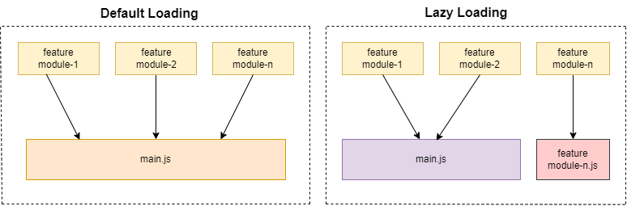

Slide 80
Using Lazy loading, some of the feature modules (feature-n) are separated into different chunks, and these are only loaded if the user navigates to that specific route.
When Lazy Loading is useful?
When NgModule launches the angular application, it loads all the components and modules which are declared within, due to this application start up time will be increased and this will impact on the performance of our application.
Lazy loading is useful in Angular when an application has many components, and not all of them are needed for the initial load of the application.

Slide 81
By only loading the necessary components as they are needed, lazy loading can help improve the performance of an Angular application in several ways:
Reducing the initial load time of the application by loading only the necessary components.
Reducing the overall size of the main.js file by splitting the application bundle into smaller chunks.
Increase the modularity of the applications.
Improving the user experience by loading the components which are needed for the initial views only.
It’s allowing developers to break up the application into smaller, more manageable chunks, making the development, and maintenance easier.

Slide 82
How to Lazy Load a Component in Angular?
To implement lazy loading in an Angular application, we can use the Angular Router module, which allows us to specify a component to load lazily by using the "loadChildren" property in the route configuration.
Here's an example demonstration of how we can implement lazy loading for a component.
Step 1 - Create a new module and a component
Create a new module you want to load lazily, in this case, "AdminModule" and created component called "Home" inside admin module.

Slide 83
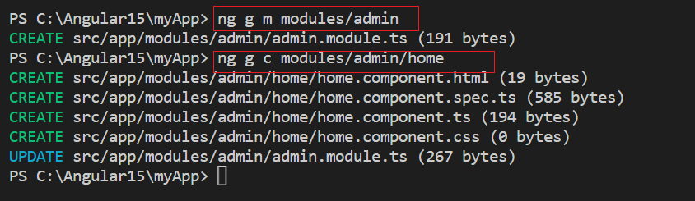

Slide 84
Step 2 - Define and Import Router module in Lazy Load module
In the "AdminModule" module, import the component you want to load lazily and add it to the "declarations" and "imports" arrays of the module. When registering routes in sub-modules and lazy loaded submodules then we need to use forChild(routes) as follows.

Slide 85
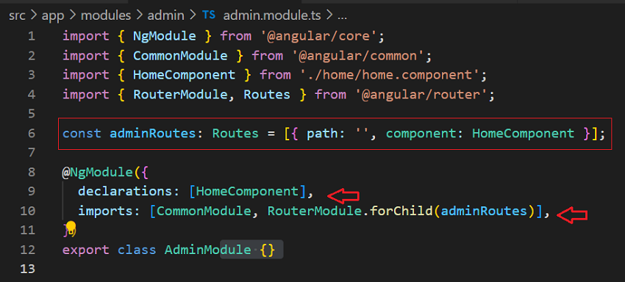

Slide 86
In the declarations, add the component that you want to load lazily.
Step 3 - Import the Angular Router module and configure the route
In the routing module of your application, import the Angular Router module and configure the route for the " AdminModule" component to be loaded lazily.

Slide 87
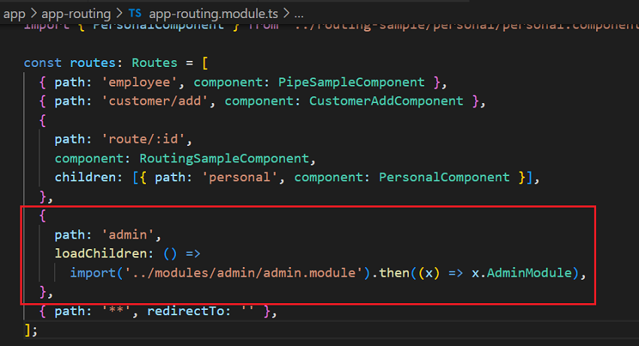

Slide 88
tep 4 - Verify lazy loading in Browser
Angular will load the module and component on demand when a specific route is activated in the browser. We can verify from the Network tab that a module is indeed being lazy loaded.

Slide 89
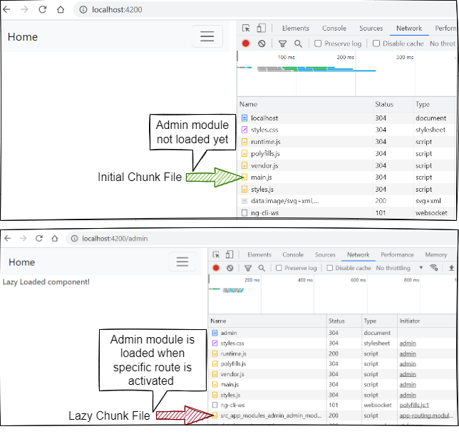

Slide 90
Using Angular HttpClient
The HttpClient is a separate model in Angular and is available under the @angular/common/http package. The following steps show you how to use the HttpClient in an Angular app.
What is Observable?
The Angular HTTPClient makes use of observable. Hence it is important to understand the basics of it
Observable help us to manage async data. You can think of Observables as an array of items, which arrive asynchronously over time.
The observables implement the observer design pattern, where observables maintain a list of dependents. We call these dependents as observers. The observable notifies them automatically of any state changes, usually by calling one of their methods.

Slide 91
Observer subscribes to an Observable. The observer reacts when the value of the Observable changes. An Observable can have multiple subscribers and all the subscribers are notified when the state of the Observable changes.
When an Observer subscribes to an observable, it needs to pass (optional) the three callbacks. next(), error() & complete(). The observable invokes the next() callback, when it receives an value. When the observable completes it invokes the complete() callback. And when the error occurs it invokes the error() callback with details of error and subscriber finishes.
The Observables are used extensively in Angular. The new HTTPClient Module and Event system are all Observable based.
The Observables are proposed feature for the next version of Javascript. The Angular uses a Third-party library called Reactive Extensions or RxJs to implement the Observables.

Slide 92
Observables Operators
Operators are methods that operate on an Observable and return a new observable. Each Operator modifies the value it receives. These operators are applied one after the other in a chain.
The RxJs provides several Operators, which allows you to filter, select, transform, combine and compose Observables. Examples of Operators are map, filter, take, merge, etc

Slide 93
How to use RxJs
The RxJs is a very large library. Hence Angular exposes a stripped-down version of Observables. You can import it using the following import statement
import { Observable } from 'rxjs';

Slide 94
HTTP GET
The HttpClient.get sends the HTTP Get Request to the API endpoint and parses the returned result to the desired type. By default, the body of the response is parsed as JSON. If you want any other type, then you need to specify explicitly using the observe & responseType options.
Syntax

Slide 95
get(url: string,
options: {
headers?: HttpHeaders | { [header: string]: string | string[]; };
params?: HttpParams | { [param: string]: string | string[]; };
observe?: "body|events|response|";
responseType: "arraybuffer|json|blob|text";
reportProgress?: boolean;
withCredentials?: boolean;}
): Observable<>

Slide 96
HTTP Post
The HttpClient.post() sends the HTTP POST request to the endpoint. Similar to the get(), we need to subscribe to the post() method to send the request. The post method parsed the body of the response as JSON and returns it. This is the default behavior. If you want any other type, then you need to specify explicitly using the observe & responseType options.

Slide 97
3 4 5 6 7 8 9 10 11 12 13 | post(url: string, body: any, options: { headers?: HttpHeaders | { [header: string]: string | string[]; }; observe?: "body|events|response|"; params?: HttpParams | { [param: string]: string | string[]; }; reportProgress?: boolean; responseType: "arraybuffer|json|blob|text"; withCredentials?: boolean; } ): Observable

Slide 98
HTTP PUT
The HttpClient.put() sends the HTTP PUT request to the endpoint. The syntax and usage are very similar to the HTTP POST method.
1 2 3 4 5 6 7 8 9 10 11 12 13 | put(url: string, body: any, options: { headers?: HttpHeaders | { [header: string]: string | string[]; }; observe?: "body|events|response|"; params?: HttpParams | { [param: string]: string | string[]; }; reportProgress?: boolean; responseType: "arraybuffer|json|blob|text"; withCredentials?: boolean; } ): Observable

Slide 99
HTTP DELETE
The HttpClient.delete() sends the HTTP DELETE request to the endpoint. The syntax and usage are very similar to the HTTP GET method.

Slide 100
delete(url: string,
options: {
headers?: HttpHeaders | { [header: string]: string | string[]; };
params?: HttpParams | { [param: string]: string | string[]; };
observe?: "body|events|response|";
responseType: "arraybuffer|json|blob|text";
reportProgress?: boolean;
withCredentials?: boolean;}
): Observable<>

Slide 101
JSON Server is an npm package that allows you to create REST JSON web service, backed by a simple database. It is created for front end developers and helps to perform all CRUD operations without a proper backend prototype or structure. A valid json file will suffice. It runs on port no 3000
npm install –g Json-server
json-server –watch db.json

