Slide 1
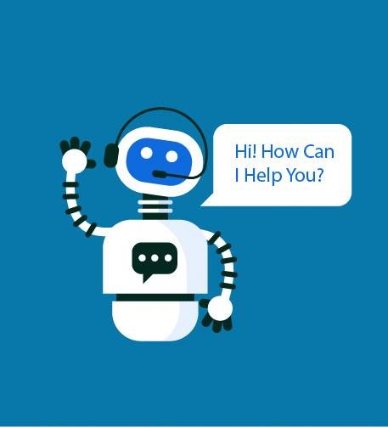
CHATBOT
Group : 2
Mentor : Bhanupriya, Harshal Raut

Slide 2
Team Members
Hariharan
Perumal
Rooba Dharshini
Sangeethraj
Shashank
Thakur Aashish Singh
Kumar Prince

Slide 3
Business Objective
The aim of this project is to build a chatbot for a food delivery app client.

Slide 4
CHATBOT
A chatbot is a computer program that simulates and processes human conversation (either written or spoken), allowing humans to interact with digital devices as if they were communicating with a real person.

Slide 5
Types of Chatbots
Rule based Chatbot
AI Chatbot
Rule based Chatbot
With this type of bot, communication is through pre-set rules. User input must conform to these pre-defined rules in order to get an answer. Often with such bots only buttons are used.
Since no artificial intelligence is used here, an open conversation with this type of bot is not possible or very limited.
AI Chatbot
NLP chatbots learn languages in a similar way that children learn a language. After having learned a number of examples, they are able to make connections between questions that are asked in different ways.
In this way, the bot understands what the question is about without being precisely programmed for it and an appropriate answer can be given. In a conversation form, this is also called Conversational AI.

Slide 6
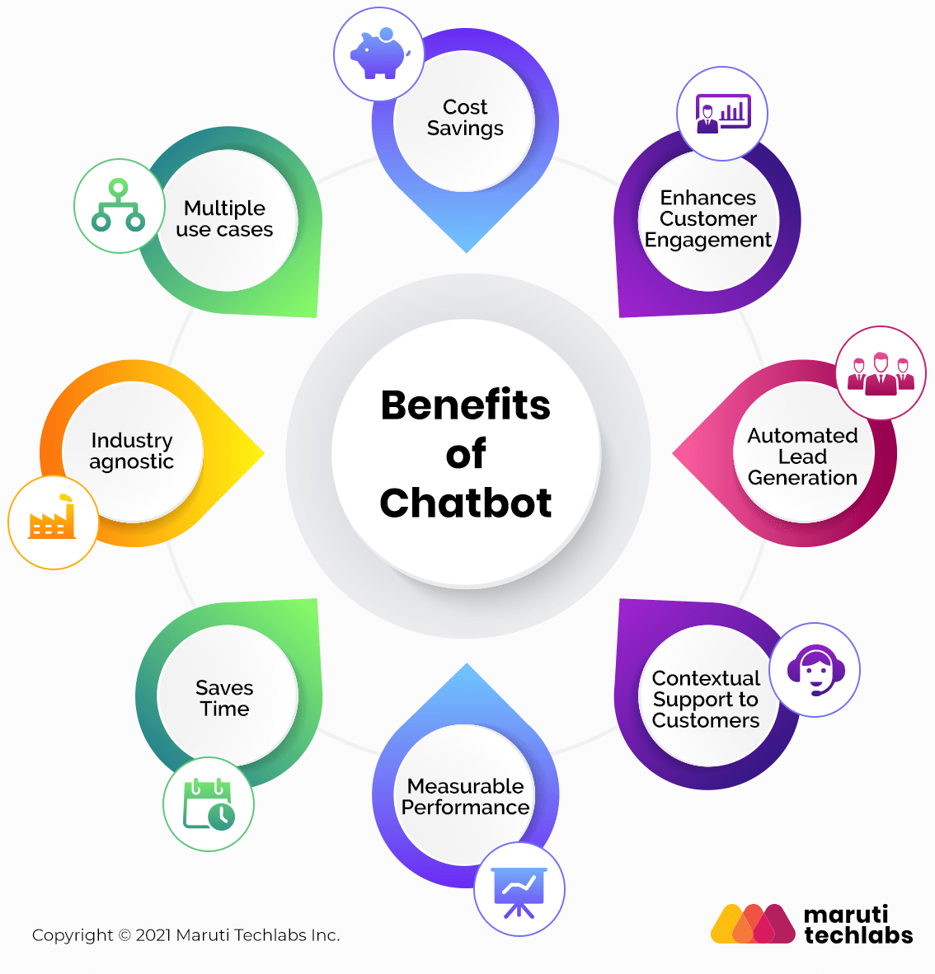

Slide 7
Project Architecture / Project Flow
Data Collection
Data Exploration
Data Processing
Model Building
Model Evaluation
Model Deployment

Slide 8
Data Collection
We referred many food delivery chatbots in the industry.
We worked on our own dataset to provide best results.
Dataset is created in Json format where we provide tags, patterns and responses.

Slide 9
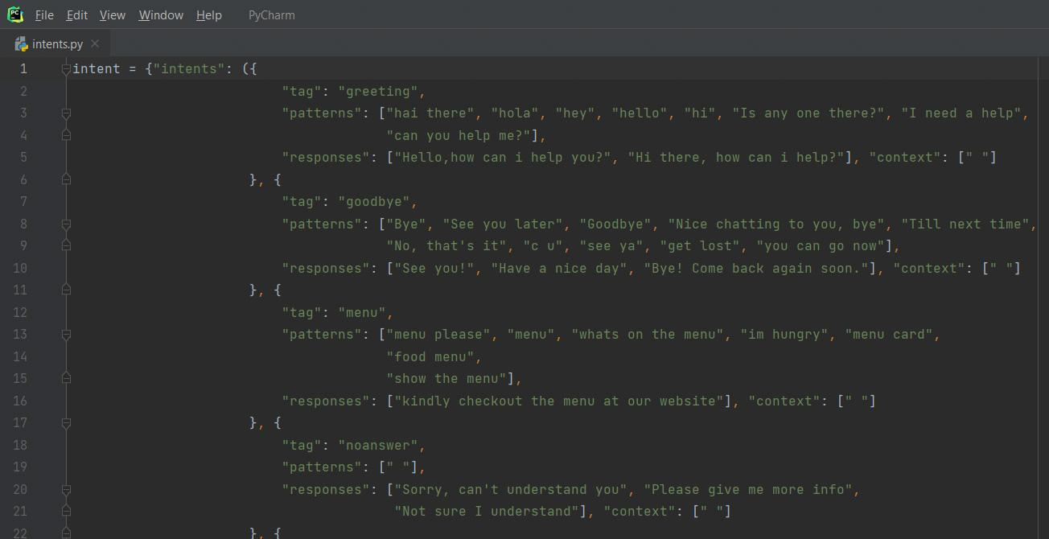
Dataset looks like

Slide 10
Data Pre-processing:
In NLP projects, Data pre-processing includes Tokenization, stemming/ lemmatization, stopwords and lower the words.
Tokenization:
Tokenization is a process which involves breaking down the entire raw text(sentence) into small units(words) which can be used for processing purpose.
Lemmatization:
Lemmatizing is the process of converting a word into its lemma form and then creating a pickle file to store the Python objects which we will use while predicting.
The library to import for lemmatization is WordNetLemmatizer().

Slide 11
Lower the words:
In text pre-processing, We always have to lower the words in order to avoid the repetition of same words with upper and lower cases.
Bag of Words:
It is responsible for creating the document matrix.
CountVectorizer() is the function used.

Slide 12
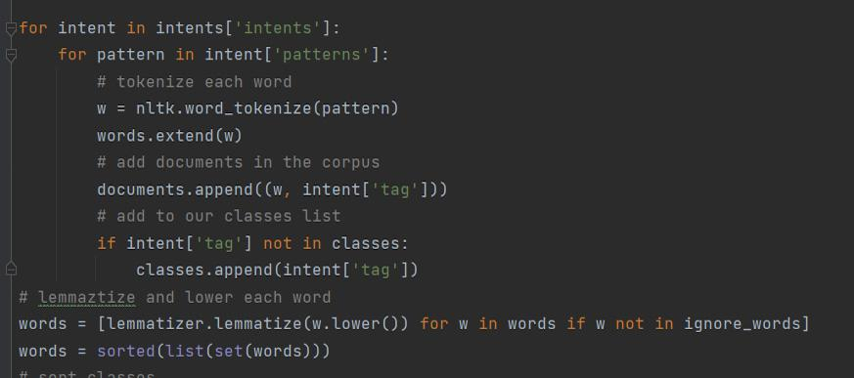
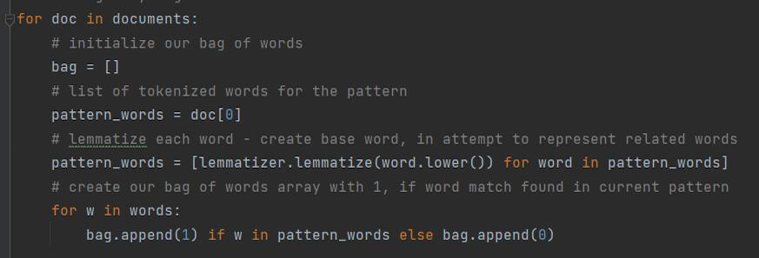
Code for preprocessing

Slide 13
Model Building
Here, we use the deep neural network for model building.
we built a deep neural network that has 3 layers. First layer 128 neurons, second layer 64 neurons and third layer as a output layer.
Here we use stochastic gradient descent with Nesterov accelerated gradient as a optimizer.

Slide 14
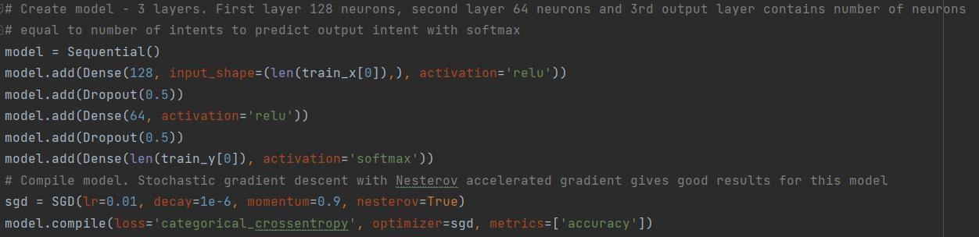
Code for Model Building

Slide 15
Model Deployment:
Here we deploy the model using Flask web based GUI.
We also have HTML and CSS file for front end.
Here we load the trained model and using flask framework we get the response from the user and to predict the response first we have predict the class and predict the response.

Slide 16
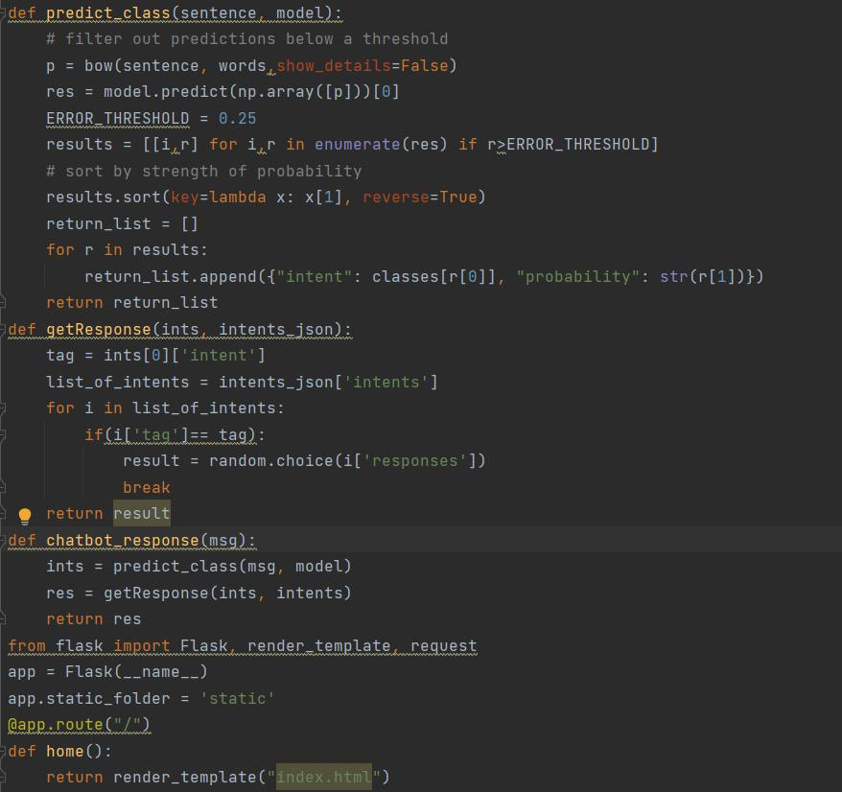
Code for Deployment

Slide 17
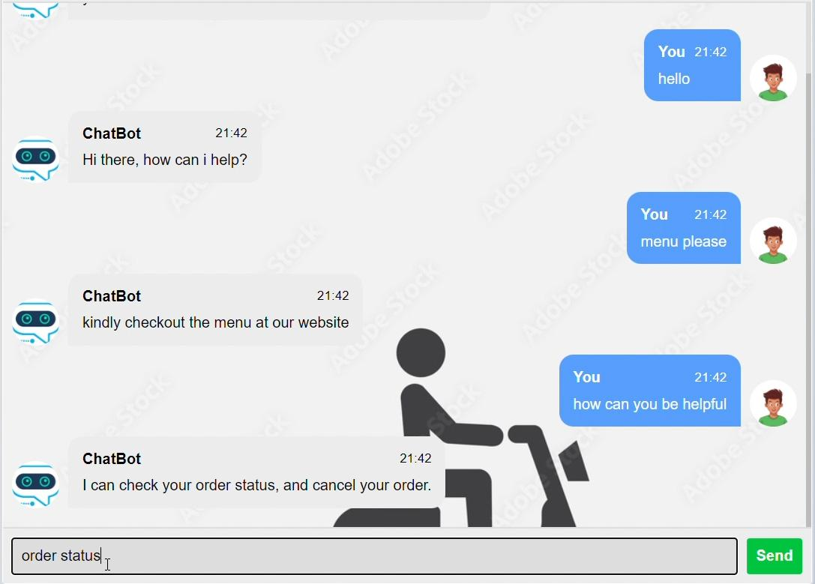
Output

