Slide 1

This project & presentation is for partial fulfilment of Front-End-Engineering-II Session 2022-2023 BY G-30 PURAB VATS (2210990692) PRANAV KUMAR(2210990667) PRITAM KUMAR(2210990683) Supervisor Mr. Rajender Kumar Institute of Engineering & Technology Department of computer Science and Engineering Chitkara University, Punjab, India

Slide 2
OUTLINE
INTRODUCTION
Project Snippets
SPECIAL FEATURES
REFERENCES
PRESENTATION ENDING

Slide 3
Introduction
Welcome to FitnessTracker, your ultimate destination for achieving your health and fitness goals!
At FitnessTracker, we believe that fitness is not just about hitting the gym, but it's a holistic approach that encompasses nutrition, exercise, and overall wellness. That's why we've curated a comprehensive platform that provides you with all the tools and resources you need to succeed.

Slide 4
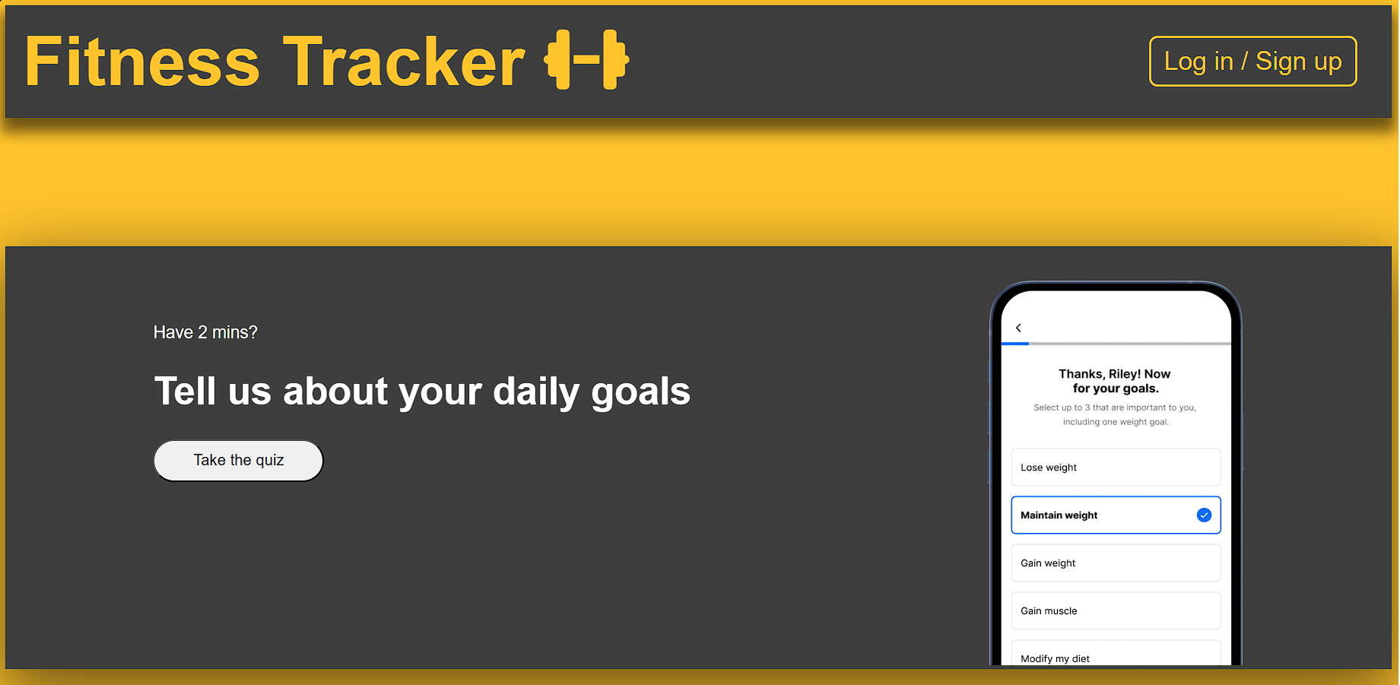
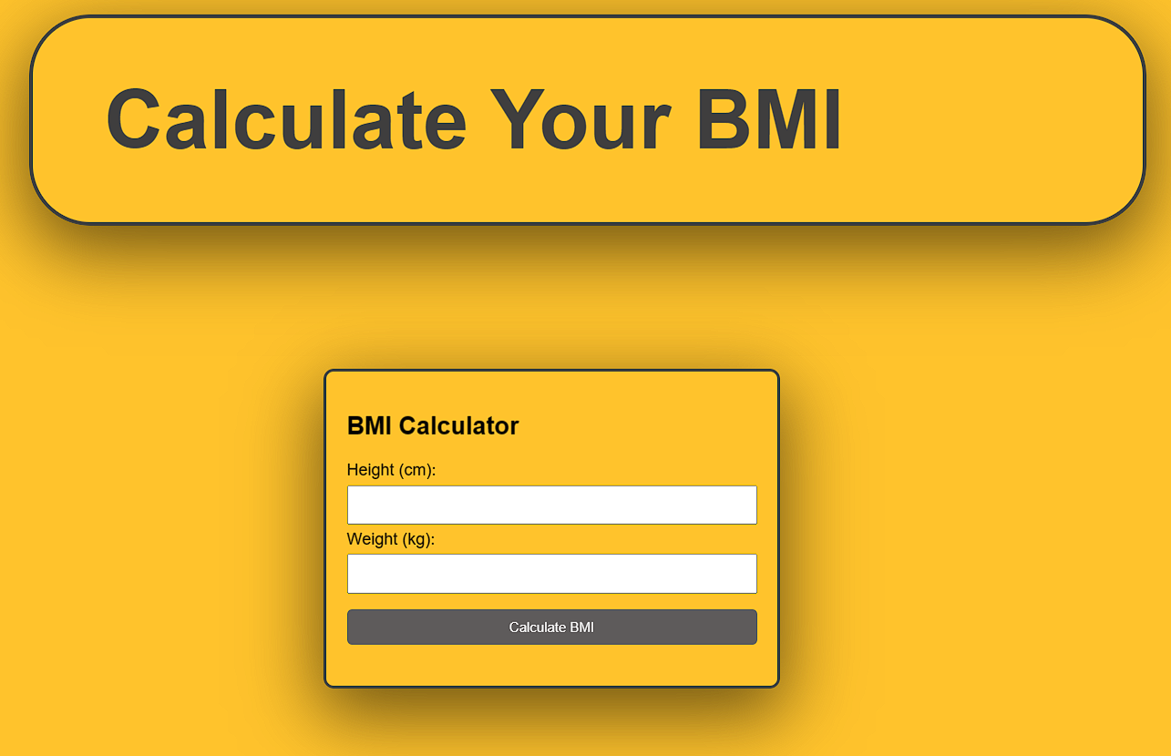
PROJECT SNI PPETS

Slide 5
SPECIAL FEATURES
We have added a quiz for daily goals of a an individual.
We have also added a BMI calculator using Javascript in which user can calculates his/her BMI and through that user cam go to our Diet and Exercise plan and check according to their BMI.
There is also a daily task page where user can add their daily tasks to perform.

Slide 6
CONTRI BUTI ON
Purab – Contributed in HTML,CSS and JavaScript
Pranav – Contributed in JavaScript and PPT
Pritam – Contributed in HTML and PPT

Slide 7


