Slide 1

Forecasting Blood Glucose Level
Advanced model for proactive diabetes management.
TEAM 3: PRANJAL JAIN, PRIYANSHU KUMAR,PREM JANJRUKIA, SAMHITHA SEELAM, SENIYAL JASANI

Slide 2
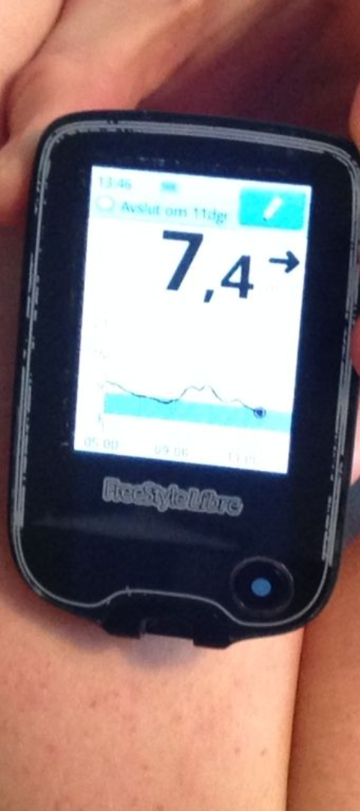
Problem Statement
1
Continuous Management
2
Invasive Methods
Snapshot insights are limiting.
Traditional monitoring is invasive.
3
Predictive Models
Need for forecasting glucose levels.
Vision
To revolutionize glucose monitoring with non-invasive, real-time predictive models.

Slide 3
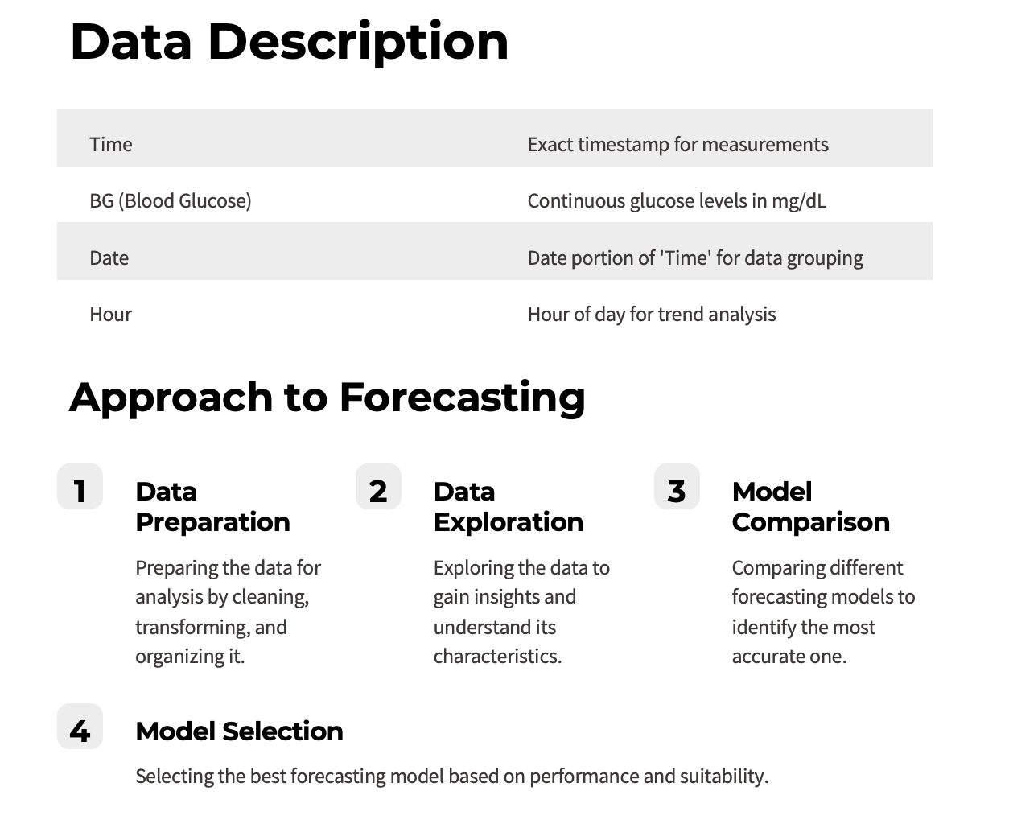
Data Description
Time
Exact timestamp for measurements
BG (Blood Glucose)
Continuous glucose levels in mg/dL
Date
Date portion of 'Time' for data grouping
Hour
Hour of day for trend analysis
Approach to Forecasting
1
Data Preparation
2
Data Exploration
3
Model Comparison
Preparing the data for analysis by cleaning, transforming, and organizing it.
Exploring the data to gain insights and understand its characteristics.
Comparing different forecasting models to identify the most accurate one.
4
Model Selection
Selecting the best forecasting model based on performance and suitability.

Slide 4
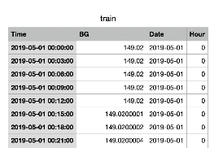
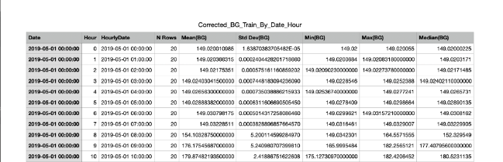
Original Dataset
Dataset after aggregating on hourly basis
Data Preparation
1
Data Aggregation
Aggregating data on an hourly basis from minute-level measurements.
2
Data Cleanliness
The dataset has been thoroughly cleaned and is consistent in its format and structure.
3
Column Selection
The target variable for forecasting is the Mean(BG) mean blood glucose level. The time variable used for analysis is the HourlyDate, representing the hour of the measurement.

Slide 5
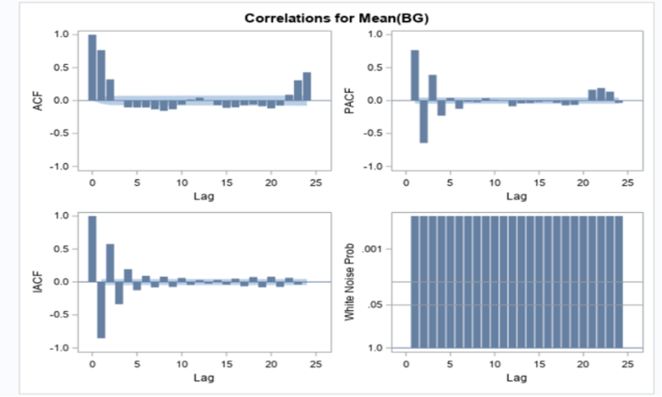
Data Exploration
Correlation and Decomposition
1

Slide 6
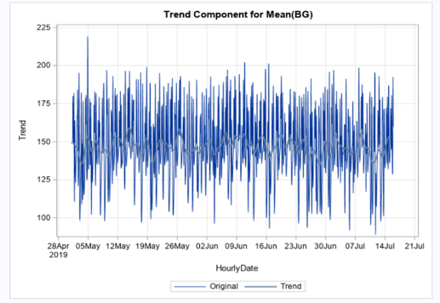
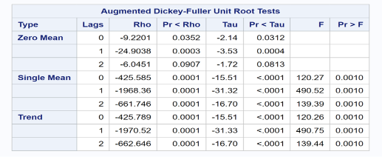
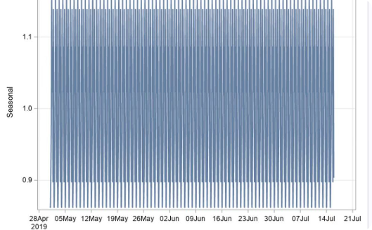
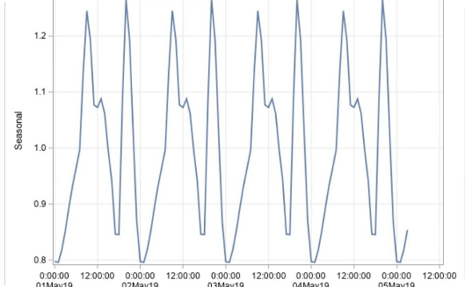
Trend
ADF Test
Seasonal Component
Truncated Seasonal component (for better picture/clarity

Slide 7
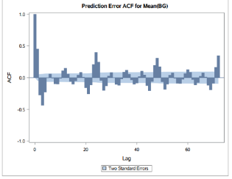
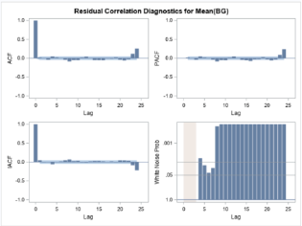
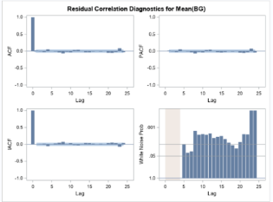
Comparing Forecasting Models
Simple Exponential Smoothing Models
ARIMA Models: Comparing (2,0,1)
SARIMA (2,0,1)(1,0,0)
NO.
MODEL
AIC
SBC
1
SARIMA (3,0,1) (1,0,1)
13168.52
13207.09
2
SARIMA (2,0,1) (1,0,0)
13335.395548
13362.939483
3
SARIMA (4,0,0) (2,0,0)
13318.01
13356.57
4
SARIMA (3,0,2) (1,0,1)
13167.08
13211.15

Slide 8
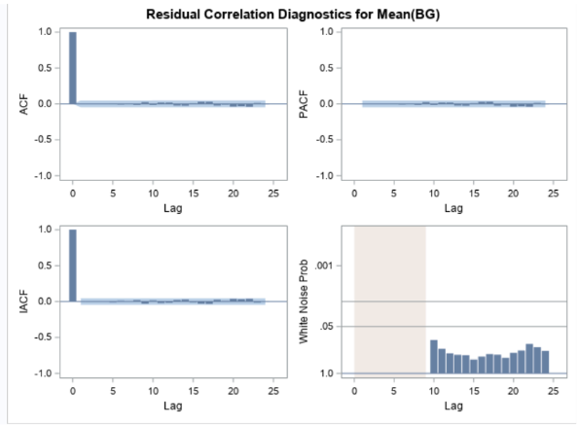
Final Model
MODEL
AIC
SBC
SARIMA (4,0,2) (2,0,1)
13143.971
13199.058

Slide 9
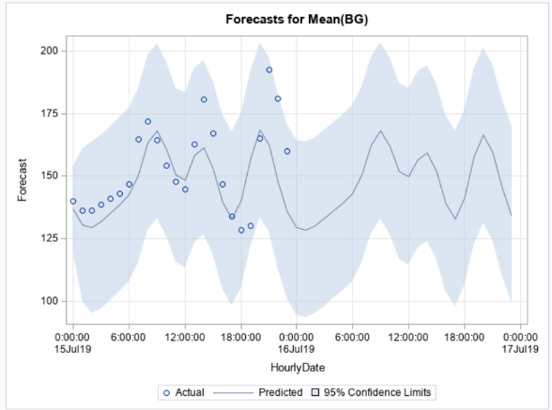
Model Insights
Confidence Intervals
Narrow intervals indicate precision.
Actual Data Coverage
Actuals within confidence intervals.
Trend Capture
Predicted values follow actual trend.
Residual Analysis
Randomly distributed residuals.

Slide 10
Business Case and Recommendation
Business Case
Business Recommendation
Implementing modeling techniques for diabetes management provides valuable insights into patient data, enabling better decision-making and improved outcomes.
We recommend integrating the diabetes modeling system into the existing healthcare infrastructure to benefit both the business and the patients.
Insights
Benefits for Business and Patients
Modeling techniques can identify patterns and trends in blood glucose levels, helping healthcare providers understand patient behaviors and potential risk factors.
Enhanced decision-making based on data-driven insights
Improved patient outcomes through personalized care
By leveraging these insights, businesses can develop personalized treatment plans, optimize resources, and improve patient satisfaction.
Cost savings through efficient resource allocation
Reduced hospital readmissions and complications
The implementation of modeling techniques can lead to cost savings by reducing hospital readmissions and complications related to diabetes management.

