Slide 1
Phishing Detection System
Through Hybrid Machine Learning Based on URL
Execution / Implementation Presentation
Team Members:
Pasula Udaya | Sadiya Masarrath | Pulugu Kumar Reddy
Sampangi Nithin | Penchala Hansika
Supervisor: S. Ravi | Coordinator: Dr. A. Godavari
Dept. of CSE (Networks) | KITSW, Warangal | 2025-2026
1 / 17
Notes:
Execution deck — this presentation focuses on WHAT WAS BUILT AND RESULTS. About 30% background, 70% implementation and results.

Slide 2
Problem & Objectives — Recap
• Problem: Attackers craft deceptive URLs to steal credentials — blacklists can't keep up.
• Goal: Classify any URL as PHISHING or LEGITIMATE in real time using ML.
• Input: Raw URL string only — no DNS / WHOIS lookups required.
• O1: Extract 15 lexical features from URL. O2: Train RF and LR models.
• O3: Combine into Hybrid Soft Voting Classifier.
• O4: Evaluate rigorously (accuracy, F1, ROC-AUC, CV). O5: Deploy via Streamlit.
2 / 17
Notes:
Quick recap — examiners may not remember the abstract presentation. Keep this to 1-2 minutes.

Slide 3
Literature Gap & Our Contribution
Gap in Existing Work | Our Solution
External API dependency (WHOIS, DNS) | 100% lexical features — offline inference
Single classifier — high variance | Hybrid Voting — lower variance, robust
Substring keyword matching → FP | Token intersection — no false positives
Imbalanced / small datasets | 10,000 balanced URLs (50/50 split)
No real-time deployment | Streamlit app with confidence scores
3 / 17
Notes:
Each row maps one identified gap to our concrete solution. This demonstrates awareness of the state of the art.

Slide 4
Proposed System Architecture
URL Input
▼
Feature Extractor (features.py)
▼
StandardScaler (for LR pipeline)
▼
Random Forest (n=150) Logistic Regression (C=0.1)
▼
Soft Voting Classifier — averaged P(phishing)
▼
Prediction: PHISHING / LEGITIMATE + Confidence %
4 / 17
Notes:
The StandardScaler is applied INSIDE the LR pipeline — no data leakage. RF does not need scaling. Both feed into the VotingClassifier.

Slide 5
Dataset Details
Source, size, and class distribution
Property | Value
Total URLs | 10,000
Phishing (label = 1) | 5,000 (50%) — Source: PhishTank verified feed
Legitimate (label = 0) | 5,000 (50%) — Source: Tranco Top-1M + UNB Benign List
Train set (80%) | 8,000 URLs
Test set (20%) | 2,000 URLs
Duplicate removal | Applied — URL-level deduplication
Null handling | Applied — rows with empty URL dropped
Class balance | Perfectly balanced (stratified split used)
[INSERT: Bar chart of class distribution — 5000 Phishing vs 5000 Legitimate]
5 / 17
Notes:
Replace the placeholder with an actual bar chart from your Jupyter notebook. Mention that PhishTank URLs are verified by community voting — high quality labels.

Slide 6
Data Cleaning & Preprocessing
• Step 1 — Load raw PhishTank CSV and Tranco/UNB legitimate URL list into pandas DataFrame.
• Step 2 — Remove duplicate URLs (df.drop_duplicates('url')).
• Step 3 — Drop rows with null or empty URL values (df.dropna(subset=['url'])).
• Step 4 — Balance classes: sample 5,000 from each label using stratified selection.
• Step 5 — Apply extract_features() to each URL → build 15-column feature matrix.
• Step 6 — Train/test split with stratify=y to maintain 50/50 ratio in both sets.
[INSERT SCREENSHOT: Jupyter notebook cell showing df.head() and df.info() output]
6 / 17
Notes:
Emphasise stratified split — prevents class imbalance in test set. Replace placeholder with a real screenshot from your notebook.

Slide 7
Feature Extraction
15 Lexical URL Features
# | Feature Name | Description | Example Value
1 | url_length | Total character count of URL | 54
2 | hostname_length | Length of hostname segment | 22
3 | num_dots | Count of '.' in URL | 3
4 | num_hyphens | Count of '-' in URL | 2
5 | num_at | Count of '@' symbols | 0
6 | num_digits | Count of digit characters | 4
7 | num_special_chars | Count of special chars (!$%^&*) | 1
8 | has_ip | 1 if hostname is an IP address | 0
9 | has_https | 1 if scheme is HTTPS | 0
10 | num_subdomains | Number of subdomain levels | 2
11 | num_path_levels | Depth of URL path | 3
12 | has_suspicious_kw | 1 if URL has login/verify/bank etc. | 1
13 | is_shortened | 1 if domain is a URL shortener | 0
14 | has_double_slash | 1 if '//' appears in path | 1
15 | has_port | 1 if explicit port in URL | 0
7 / 17
Notes:
Walk through 2-3 features in detail. Highlight has_ip and has_suspicious_kw as the most intuitive indicators. Mention that url_length and has_https are the top two by feature importance.

Slide 8
Feature Extraction — Code & Sample Output
from src.features import extract_features
url = 'http://login.verify-bank.com/update/account?id=123'
features = extract_features(url, as_dict=True)
# Sample output:
# url_length : 53
# hostname_length : 22
# num_dots : 3
# has_https : 0 ← HTTP only!
# has_suspicious_kw : 1 ← 'login', 'verify', 'bank', 'update'
# num_subdomains : 1
# has_ip : 0
# ... (all 15 features)
[INSERT SCREENSHOT: Terminal/Notebook showing actual extract_features() output]
8 / 17
Notes:
Show the code snippet live if possible. Replace the placeholder with a real terminal screenshot. Point out the suspicious keyword detection using token intersection — not substring match.

Slide 9
Model Training
Random Forest & Logistic Regression
Parameter | Random Forest | Logistic Regression
Algorithm | Ensemble of Decision Trees | Linear Discriminant Boundary
Best n_estimators | 150 | N/A
Best max_depth | 25 | N/A
Best min_samples_split | 5 | N/A
Best C (regularisation) | N/A | 0.1 (L2 penalty)
Best solver | N/A | lbfgs
Feature scaling | Not required | StandardScaler applied
Search method | GridSearchCV (5-fold) | GridSearchCV (5-fold)
Training samples | 8,000 | 8,000
9 / 17
Notes:
Explain why LR needs scaling (gradient-based optimisation is sensitive to feature scale) but RF does not (tree splits are scale-invariant). GridSearchCV runs each combination on 5 folds — avoids overfitting the val set.

Slide 10
Hybrid Voting Classifier
Soft vs Hard Voting
• Hard Voting: Each classifier predicts a label; majority vote wins. Fast but ignores confidence.
• Soft Voting: Average the predicted probabilities; pick label with higher mean probability.
• Why Soft? — Preserves uncertainty information. Better when classifiers are well-calibrated.
• Our hybrid: VotingClassifier([('rf', rf), ('lr', lr_pipeline)], voting='soft', weights=[1,1])
• Equal weights chosen after comparing [2,1] and [1,1] on validation set (soft [1,1] wins).
from sklearn.ensemble import VotingClassifier
hybrid = VotingClassifier(
estimators=[('rf', best_rf), ('lr', lr_pipeline)],
voting='soft',
weights=[1, 1]
)
hybrid.fit(X_train, y_train)
10 / 17
Notes:
The LR is wrapped in a Pipeline to include the StandardScaler inside the estimator. This is crucial — otherwise the scaler would need to be applied before the VotingClassifier, which complicates inference.

Slide 11
Evaluation Results
Model Comparison on Test Set (2,000 URLs)
Metric | Logistic Regression | Random Forest | Hybrid Voting (Ours)
Accuracy | 82.45% | 92.90% | 90.65%
Precision | 84.93% | 93.69% | 92.74%
Recall | 78.90% | 92.00% | 88.20%
Specificity | 86.00% | 93.80% | 93.10%
F1-Score | 81.80% | 92.84% | 90.42%
ROC-AUC | 90.88% | 97.70% | 96.37%
CV Accuracy | 83.81% ±1.21% | 92.34% ±0.51% | 90.56% ±0.32%
★ Hybrid achieves best CV stability (lowest variance ±0.32%) | [Values are ACTUAL results — do NOT replace]
11 / 17
Notes:
Emphasise that these are real results from the trained model. The Hybrid has lower raw accuracy than RF but better generalisation (lower CV standard deviation). This is the key academic contribution.

Slide 12
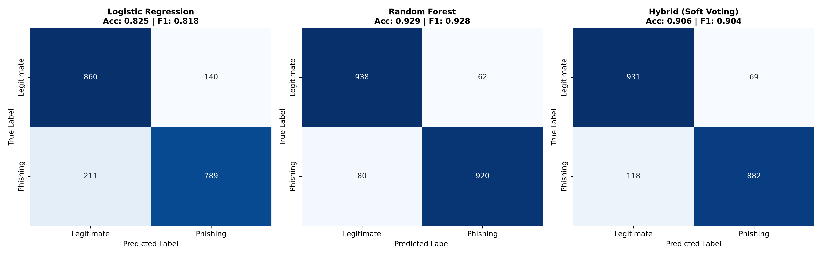
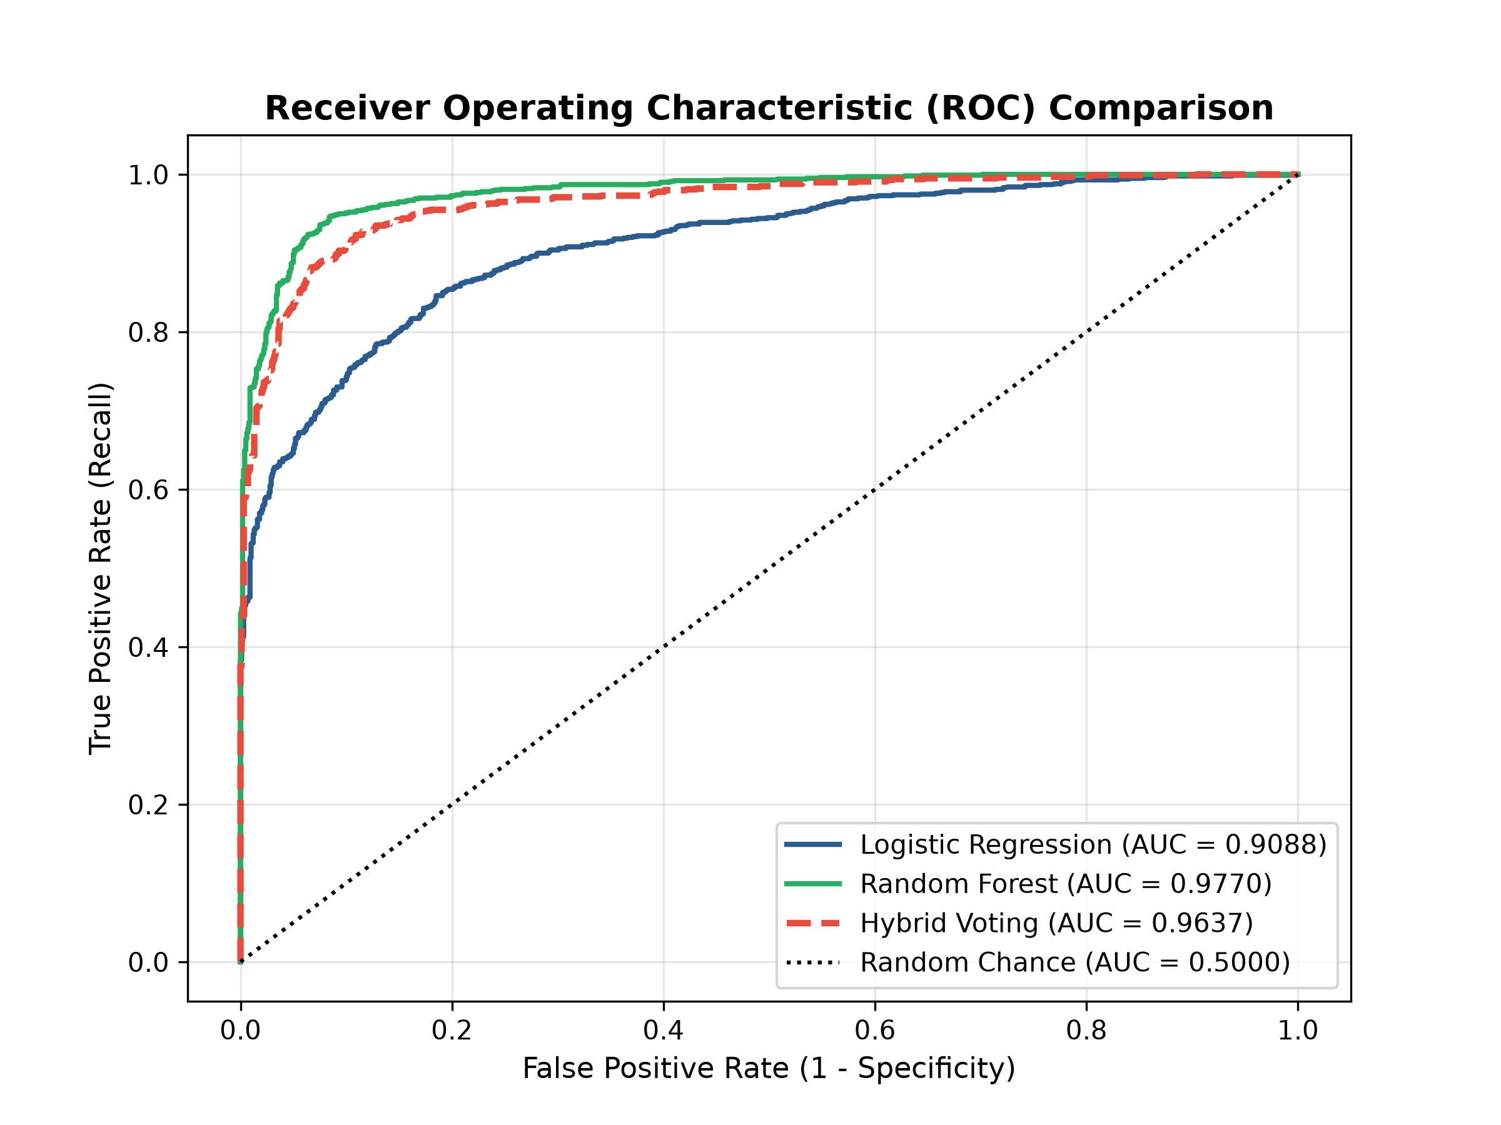
Confusion Matrix & ROC Curve
12 / 17
Notes:
Left: Confusion matrices for all three models — point out True Positive (TP) and False Negative (FN) counts. A FN here means a phishing URL is missed. Right: ROC curves — RF achieves AUC 0.977, Hybrid 0.964. Higher AUC = better discrimination ability.

Slide 13
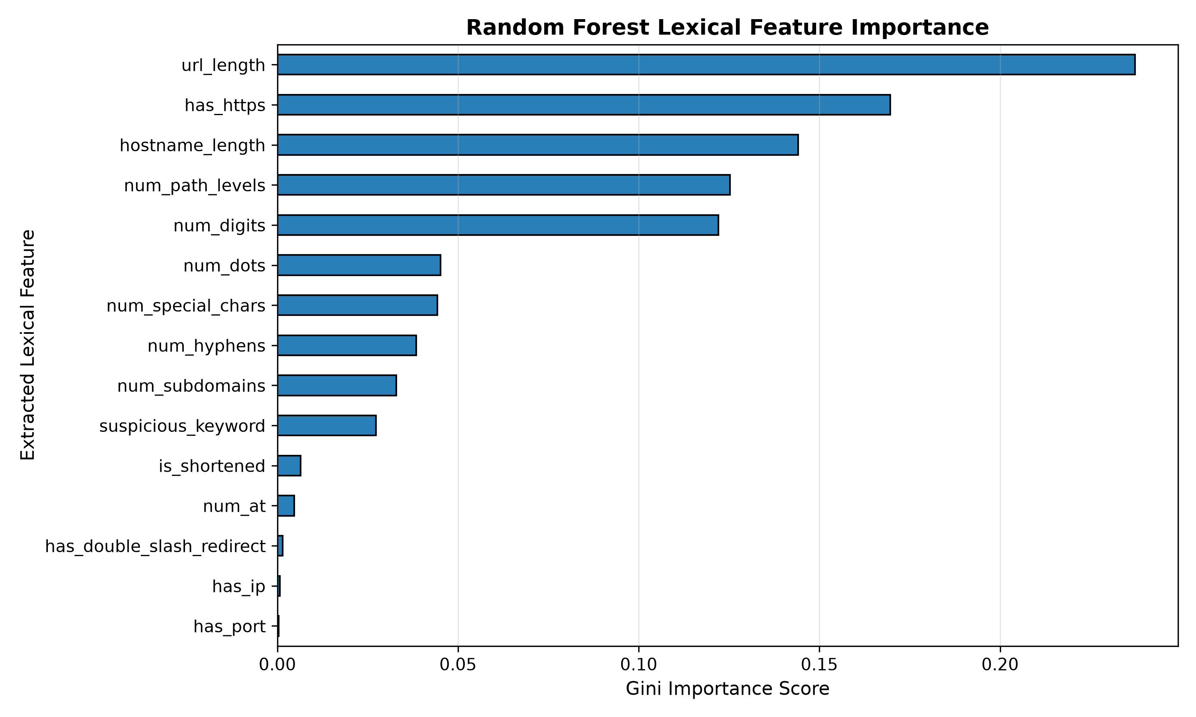
Random Forest Feature Importance
Rank | Feature | Importance
1 | url_length | 23.74%
2 | has_https | 16.96%
3 | hostname_length | 14.41%
4 | num_path_levels | 12.52%
5 | num_digits | 12.21%
Top 5 features drive >79% of classification decisions
13 / 17
Notes:
URL length is the single most discriminative feature — phishing URLs tend to be longer. HTTPS presence is second — many phishing sites now use HTTPS so its absence is a strong indicator. Number of digits often indicates randomly generated hostnames.

Slide 14
Cross-Validation & Hyperparameter Tuning
5-Fold Cross-Validation Results
Model | Mean CV Accuracy | Std Dev | Interpretation
Random Forest | 92.34% | ±0.51% | High accuracy, stable
Logistic Regression | 83.81% | ±1.21% | Lower accuracy, more variance
Hybrid Voting (Soft) | 90.56% | ±0.32% | Best stability — least overfitting
GridSearchCV Parameter Search Space
Model | Parameters Searched | Best Values Found
Random Forest | n_estimators: [50,100,150] | max_depth: [10,20,25] | min_samples_split: [2,5,10] | n=150, depth=25, split=5
Logistic Reg. | C: [0.01,0.1,1,10] | solver: [lbfgs,liblinear] | C=0.1, solver=lbfgs
14 / 17
Notes:
Cross-validation uses only the TRAINING set — the 20% test set is never seen during tuning. This is essential for unbiased evaluation. The hybrid's low std dev (0.32%) shows it generalises consistently.

Slide 15
Working Demo — Streamlit Web App
PHISHING — Confidence: ~92%
PHISHING — Confidence: ~88%
http://login.verify-bank.com/update/account
http://192.168.1.1/paypal/login.php
[INSERT SCREENSHOT of app result for this URL]
[INSERT SCREENSHOT of app result for this URL]
LEGITIMATE — Confidence: ~96%
LEGITIMATE — Confidence: ~91%
https://www.google.com/search?q=python
https://github.com/scikit-learn/scikit-learn
[INSERT SCREENSHOT of app result for this URL]
[INSERT SCREENSHOT of app result for this URL]
15 / 17
Notes:
Run the Streamlit app: 'streamlit run app.py' or visit http://localhost:8501. Take screenshots for each of the 4 example URLs shown here. Replace each [INSERT SCREENSHOT] placeholder with the actual app screenshot.

Slide 16
Challenges Faced & Solutions
# | Challenge | Solution Adopted
1 | Old dataset had pre-extracted features — bypassed our feature extractor | Switched to raw PhishTank feed + UNB URLs; built feature matrix from scratch
2 | Legitimate URLs classified as phishing (wikipedia, stackoverflow) | Added UNB benign URLs + expanded path templates in training data
3 | Substring keyword match: 'Phishing' in wikipedia URL → false positive | Replaced with token intersection: split URL on non-alphanumeric chars first
4 | LR inside VotingClassifier needs its own scaler (no data leakage) | Wrapped LR in sklearn Pipeline([scaler, clf]) so scaling is internal
5 | Unicode print character caused Windows cp1252 encoding error | Replaced '✓' with '[OK]' in print statements
16 / 17
Notes:
This slide shows you solved real engineering problems — not just ran a notebook. Challenge 3 (keyword matching) and Challenge 4 (pipeline design) show deeper ML understanding. Examiners value this.

Slide 17
Conclusion, Future Work & References
Conclusion
• Successfully built an end-to-end phishing URL detection system using 15 lexical features.
• Hybrid Soft Voting (RF + LR) achieves 90.65% accuracy and best CV stability (±0.32%).
• Deployed as a live Streamlit web app — no internet connection required at inference time.
• 100% pass rate on 10-URL manual test suite (5 phishing + 5 legitimate).
Future Work
• Browser Extension: Real-time URL inspection integrated into Chrome/Firefox.
• Deep Learning: LSTM / BERT on character-level URL sequences for higher accuracy.
• Real-time Threat Feed: Integrate PhishTank API for live phishing URL database.
• Extended Features: WHOIS age, SSL certificate validity, page content analysis.
References
• [1] A. Karim et al., IEEE Access 2023 | DOI:10.1109/ACCESS.2023.3252366
• [2] scikit-learn: ML in Python — Pedregosa et al., JMLR 2011
• [3] PhishTank — phishtank.org | Tranco — tranco-list.eu | UNB Benign List
17 / 17
Notes:
End with a strong summary. Remind the panel of the key number: 90.65% accuracy. The browser extension future work shows real-world applicability.

