Slide 1
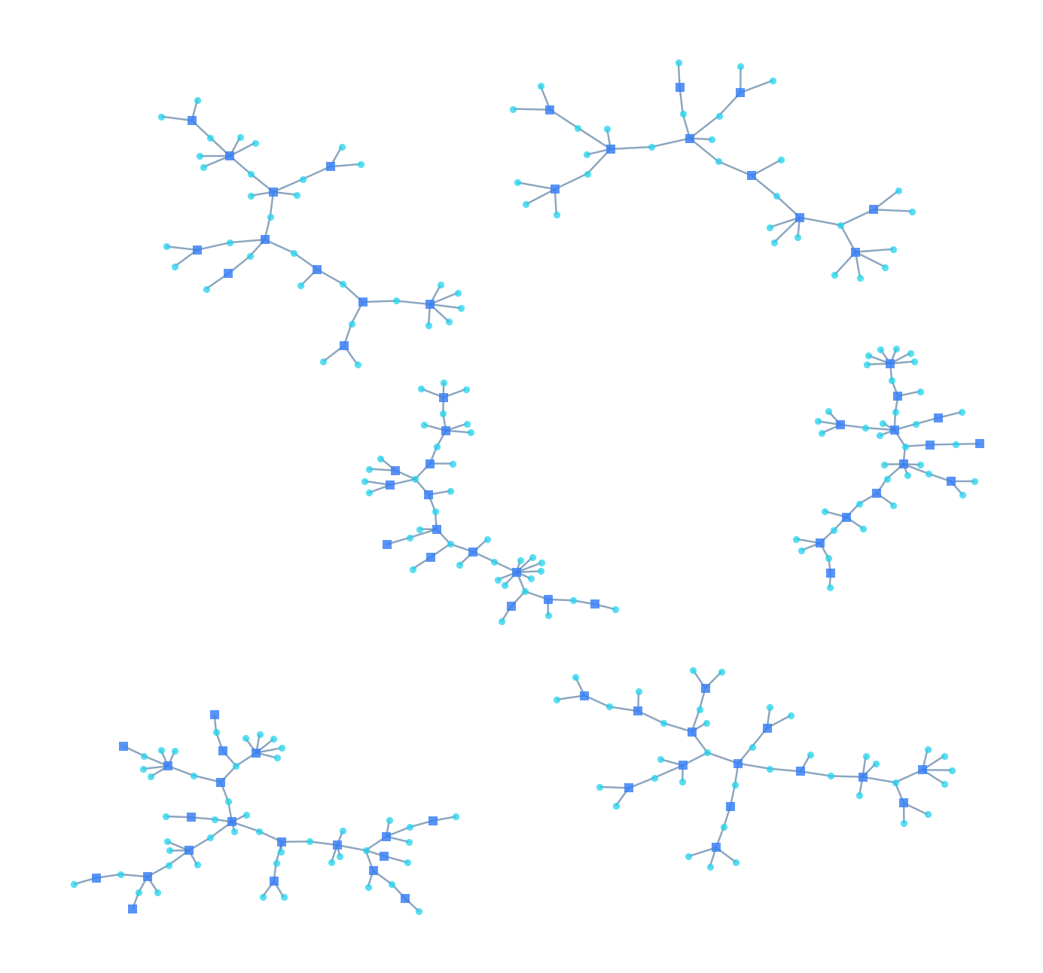
TRANSORG AGENTIQ DATATHON 2026
Track 1 — FinTech & BFSI · UPI Fraud Ring & Merchant Analytics
DataVortex
UPI Fraud & Identity Intelligence
“Turning UPI Data Chaos into Fraud Intelligence.”
TEAM DATAVORTEX
Rishuraj Kumar
12400878
Amit Kumar
12400871
Satyam Saurabh
12310274
Live dashboard ↗ GitHub repository ↗
Background: the largest connected components of the real DataVortex transaction network
DataVortex · UPI Fraud & Identity Intelligence · TransOrg AgentIQ Datathon 2026
1 / 12
Notes:
Title. Team and links. Background art: the six largest connected components of the real transaction network (agg_network_edges).

Slide 2
THE PROBLEM
The Hardest Problem Wasn't Fraud. It Was Trusting the Data.
5,341
1,310
0 / 2,607
customer IDs shared by different entities
merchant IDs shared by different businesses
chargeback user_id matches linked transaction
UPI transaction data is fragmented and noisy
WITHOUT VALIDATION
WITH DATAVORTEX
Currency symbols inside numbers, sign-corrupted amounts, 5–7 timestamp formats per date field
Raw UPI data
Same raw UPI data
Identity records collide
One customer ID can belong to several different people; user IDs arrive in five formats
Data-quality problems
DataVortex
rescue · validate · test hypotheses before reporting
Merchant IDs collide and categories disagree
Transaction MCC matches the merchant master only 10.12% of the time
Identity & merchant ambiguity
Chargebacks carry noisy denormalized fields
The complaint's own user_id never matches its linked transaction
A wrong foundation gives confident, wrong answers
Unreliable risk signals
Validated intelligence
Dispute and risk analytics built on unvalidated joins point at the wrong entities
DataVortex · UPI Fraud & Identity Intelligence · TransOrg AgentIQ Datathon 2026
2 / 12
Notes:
The three headline numbers are the data-trust evidence: collision counts from dim_users/dim_merchants (5,341 customer IDs, 1,310 merchant IDs), and audit_facts for the chargeback key disagreement (0 of 2,607) and MCC agreement (10.12% vs 9.76% expected).

Slide 3
THE DATA
Before Analytics, We Had to Rescue the Data
UPI Transactions
KYC Records
Merchant Master
Chargebacks
track1_upi_transactions.csv
track1_kyc_records.csv
track1_merchants_master.csv
track1_chargebacks.json
20,400
36,400
6,210
2,884
raw rows
raw rows
raw rows
raw rows
8 columns
12 columns
11 columns
13 fields
↓ Data rescue pipeline — every defect is measured before it is repaired, and flagged rather than hidden
Duplicate records
Identifier collisions
Malformed IDs
400 transaction · 84 complaint · 278 KYC · 12 merchant rows, byte-identical
5,341 customer IDs and 1,310 merchant IDs shared by different entities
User IDs in five formats; 116 malformed chargeback txn_ids
Missing UTRs
Inconsistent timestamps
Amount sign corruption
1,000 transactions — flagged, never fabricated
5–7 formats per date field; 1,000 date-only timestamps
429 negative amounts, none with a matching positive twin
KYC / PAN issues
Category inconsistencies
Noisy chargeback fields
687 PANs repaired from OCR look-alikes; 1,454 truncated, left unrepaired
82 category spellings; transaction MCC agrees with the master 10.12% of the time
Complaint user_id and merchant_id never match the linked transaction
DataVortex · UPI Fraud & Identity Intelligence · TransOrg AgentIQ Datathon 2026
3 / 12
Notes:
Raw row and column counts: README §4 and recon_rows. Issue evidence: audit_facts, agg_data_quality, dim_users pan_status, README §4.

Slide 4
DATA ENGINEERING
Data Rescue → Validated Analytical Model
RAW DATA
1 Exact deduplication
2 ID normalization
3 Amount parsing & sign repair
4 Timestamp normalization
5 Canonicalization
CLEAN ANALYTICAL MODEL
10 UNKNOWN routing
9 FK validation
8 Collision resolution
7 Chargeback normalization
6 KYC repair
PARQUET STAR SCHEMA
ENGINEERING PRINCIPLE
DIM_USERS
DIM_MERCHANTS
DIM_DATE
Unmatched ≠ deleted
28,920 + UNKNOWN
4,343 + UNKNOWN
spans both fact tables
Records that don't join go to an explicit UNKNOWN member and stay in every total.
FACT_TRANSACTIONS
FACT_CHARGEBACKS
20,000 rows · one per txn_id
2,800 rows · linked via txn_id
13,522
transactions without a KYC match
BRIDGE_IDENTITY_COLLISION
10,369
transactions without a merchant-master match
16,578 candidate rows — every colliding identity record preserved and inspectable
193
complaints with no linkable transaction
DataVortex · UPI Fraud & Identity Intelligence · TransOrg AgentIQ Datathon 2026
4 / 12
Notes:
Cleaning modules: src/cleaning (duplicates, ids, amounts, timestamps, statuses, kyc, merchants, chargebacks, validation) and src/transformation/star_schema.py. Row counts: star schema and agg_data_quality (13,522 / 10,369 UNKNOWN-routed transactions, 193 unlinked complaints).

Slide 5
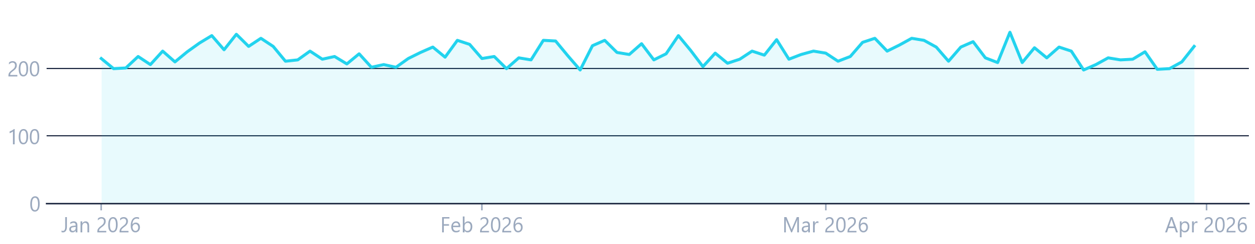
CORE KPIS
What the Clean Data Reveals
Computed on the cleaned star schema; 16 of 16 KPIs are re-validated by an independent route.
20,000
₹249.77M
₹12,489
12.26%
Unique transactions
Transaction value
Average transaction value
Chargeback rate
400 duplicate rows collapsed
₹249,772,508.82 exactly
per transaction
2,451 disputed ÷ 20,000
2,800
2,451
Transaction outcomes
KYC status
77.43%
8.10%
Chargeback complaints
Disputed transactions
85.27%
9.78%
4.96%
completion
rejection
unique complaint IDs (2,884 raw)
151 carry 2+ complaints
success
failed
pending
of 28,920 resolved identities
TRANSACTIONS PER DAY · 1 JAN – 31 MAR 2026
90 days · 198–254 per day
No significant trend (p = 0.977).
Chargebacks are customer disputes, not confirmed fraud. The rate counts distinct disputed transactions, not complaints.
DataVortex · UPI Fraud & Identity Intelligence · TransOrg AgentIQ Datathon 2026
5 / 12
Notes:
kpi_headline.parquet; 2,451 distinct disputed transactions from fact_chargebacks; daily series from agg_daily; trend p-value from agg_forecast_diagnostics.

Slide 6
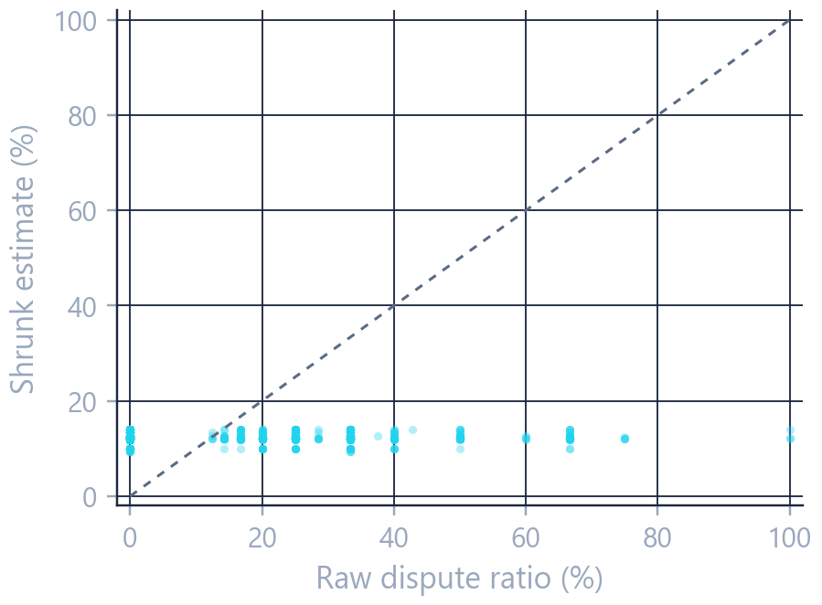
MERCHANT & USER RISK
Risk Signals That Survive Small Samples
Merchant dispute rates are stabilised before anyone ranks on them.
Raw dispute rate
RAW VS SHRUNK DISPUTE RATE · 3,451 ELIGIBLE MERCHANTS
1
304
merchants show a 100% raw dispute ratio — almost all with one transaction
Dotted line = no shrinkage.
Raw ratios spread from 0 to 100%; shrunk estimates collapse near the shared rate.
Minimum evidence · ≥ 3 transactions
2
4,600 / 8,051
below the floor: flagged and kept, never ranked on rate · 100%-ratio merchants fall from 304 to 3
Empirical-Bayes shrinkage
3
17.16 → 0.69 pp
spread (SD) of dispute rates across 3,451 eligible merchants, raw vs shrunk toward the category mean
Stable signal
RISK INDICATOR SCORE
4
χ²/df = 0.969
p = 0.904 — no detectable merchant-level dispute propensity, so merchants are ranked by exposure
0–100 review priority from 4 observable components × 25 points
Not a fraud probability — the data has no fraud label. Dispute counts use distinct disputed transactions, not complaints, which overstated dispersion.
DataVortex · UPI Fraud & Identity Intelligence · TransOrg AgentIQ Datathon 2026
6 / 12
Notes:
agg_merchant (floor, raw/shrunk rates), hypothesis register (overdispersion chi2/df 0.9688, p 0.904), risk_indicators.py (4 x 25 points, disclaimer).

Slide 7
IDENTITY INTELLIGENCE
Identity Collisions Are a Signal — Not a Verdict
KYC RECORDS · REPEATED user_id
WHAT A COLLISION LOOKS LIKE
6,288
one user_id
repeated IDs across 13,768 rows
947 same entity
5,341 different entities
KYC record A1
KYC record A2
KYC record B
MERCHANT MASTER · REPEATED merchant_id
Entity A
same person · conflicting rows → resolved to one record
Entity B
different name, PAN, DOB, city
1,412
repeated IDs across 3,279 rows
102 same entity
1,310 different entities
Collision ≠ fraud
4,422 customer IDs carry more than one distinct valid PAN · 0 PANs shared across IDs
A shared ID is a data-quality finding. Every candidate is kept (16,578 bridge rows), the ID is flagged low-confidence, and different people are never merged.
Repeated-ID counts from the forensic audit of the raw files; PAN counts from the cleaned layer.
DataVortex · UPI Fraud & Identity Intelligence · TransOrg AgentIQ Datathon 2026
7 / 12
Notes:
Repeated-ID counts: Stage 1 forensic audit of the raw files (docs/01_forensic_audit.md). PAN figures: audit_facts on the cleaned layer. Bridge rows: bridge_identity_collision.

Slide 8
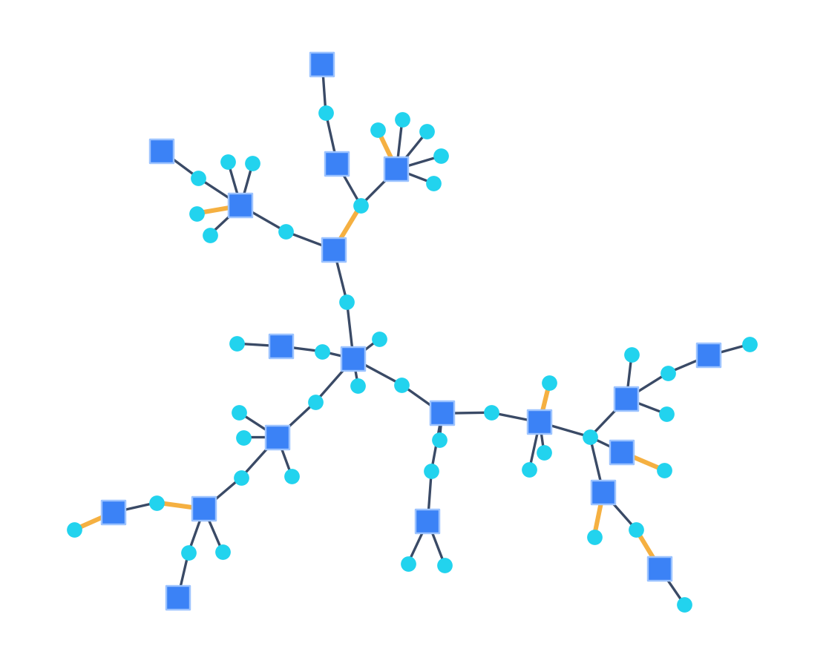
NETWORK ANALYSIS
Testing the Fraud-Ring Hypothesis
Customers and merchants as one graph: a coordinated ring would appear as dense clusters and closed loops.
20,000
LARGEST CONNECTED COMPONENT
distinct customer–merchant pairs
customer (45)
5,929
merchant (20)
connected components
disputed transaction (9)
65 / 64
65 nodes · 64 edges
nodes and edges in the largest component
A tree — no closed loop of any length.
0
A coordinated ring would have to close one.
four-cycles
Bipartite
The available data provides no statistically or structurally supported evidence for the tested fraud-ring hypothesis.
and acyclic — a forest
20,000 transactions · mean degree 1.12 customers / 2.48 merchants · 0 repeat pairs · 0 shared full Aadhaar, PAN or settlement account
Money moving outside this dataset is not observed.
DataVortex · UPI Fraud & Identity Intelligence · TransOrg AgentIQ Datathon 2026
8 / 12
Notes:
agg_network_summary; audit_facts (shared full Aadhaar / PAN / settlement accounts); chart: largest component from agg_network_edges (45 customers, 20 merchants, 64 transactions, 9 disputed).

Slide 9
HYPOTHESIS TESTING
Let the Data Challenge the Hypothesis
The seven insights suggested by the dataset notes, each tested on the cleaned data.
HYPOTHESIS
RESULT
EVIDENCE
Certain merchant categories have disproportionately high chargebacks
NOT SUPPORTED
χ² = 5.24, df = 11, p = 0.92
Some users appear repeatedly in disputes
NOT SUPPORTED
39 observed vs 33.9 expected, z = +0.87
Merchants show sudden spikes followed by disputes
NOT SUPPORTED
variance/mean = 0.901 · max merchant-day = 3
Missing UTRs correlate with failure or dispute
NOT SUPPORTED
χ² = 0.117, p = 0.73
Unverified or rejected KYC users show higher dispute risk
BORDERLINE
omnibus p = 0.047 · min adjusted pairwise p = 0.053
Delayed reporting indicates account takeover
CONTRADICTED
takeover disputes reported 1.16 days earlier (5.45 d vs 6.62 d), p = 0.014
Duplicates inflate revenue and dispute metrics
QUANTIFIED
₹5,186,378 (2.0%) · 84 duplicate complaints
“Not supported” means this data did not show the effect — not that the effect cannot exist.
DataVortex · UPI Fraud & Identity Intelligence · TransOrg AgentIQ Datathon 2026
9 / 12
Notes:
agg_hypothesis_register.parquet: statistics, p-values and readings (takeover 1.16 days earlier; duplicates Rs 5,186,378 = 2.0%).

Slide 10
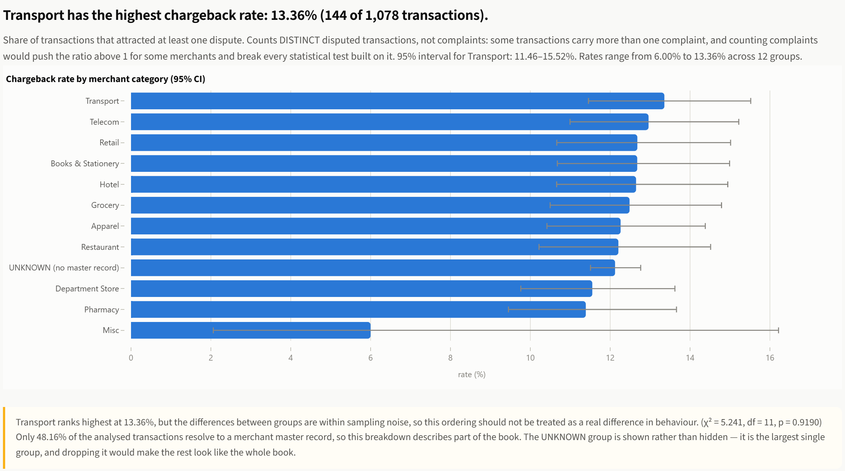
AI INVESTIGATOR
Ask Questions. Get Explainable Answers.
The planner turns a question into a typed intent; every number comes from the query engine.
Rule-based planner
No LLM
No API key
No external network calls
66 / 66 evaluation questions pass
ASK
LIVE ANSWER FROM THE DEPLOYED APP
“What happened to transaction value over time?”
a question typed into the app in plain English
“Which merchant categories have the highest dispute rates?”
₹2,775,250 per day
Line chart · 1 Jan – 31 Mar 2026
INTERPRET
“chargebacks per 1000 transactions”
rule-based planner → typed intent: measure · dimension · grain · window
122.55 per 1,000
Distinct disputed transactions — the 12.26% basis
QUERY
validated against the semantic registry — 23 metrics · 15 dimensions
“What is our profit margin?”
Refused
No fee, commission, cost or margin field exists
EXPLAIN
narrative + caveats + provenance, with the chart chosen by rule
“Which customers committed fraud?”
Caveat returned with the answer: the ranking is within sampling noise (χ² = 5.241, df = 11, p = 0.919).
Refused
Same question in, same answer out — every step is deterministic.
Horizontal bars with 95% intervals · chart chosen by explicit rules
The data carries no confirmed fraud labels
DataVortex · UPI Fraud & Identity Intelligence · TransOrg AgentIQ Datathon 2026
10 / 12
Notes:
Centre: screenshot of the deployed dashboard answering a typed question. Right: answers produced by the real planner/executor. Registry: 23 metrics, 15 dimensions (semantic.py). Evaluation matrix: 66/66 (docs/agent_test_matrix.md). No LLM, no API key, no network calls (.env.example, README).

Slide 11
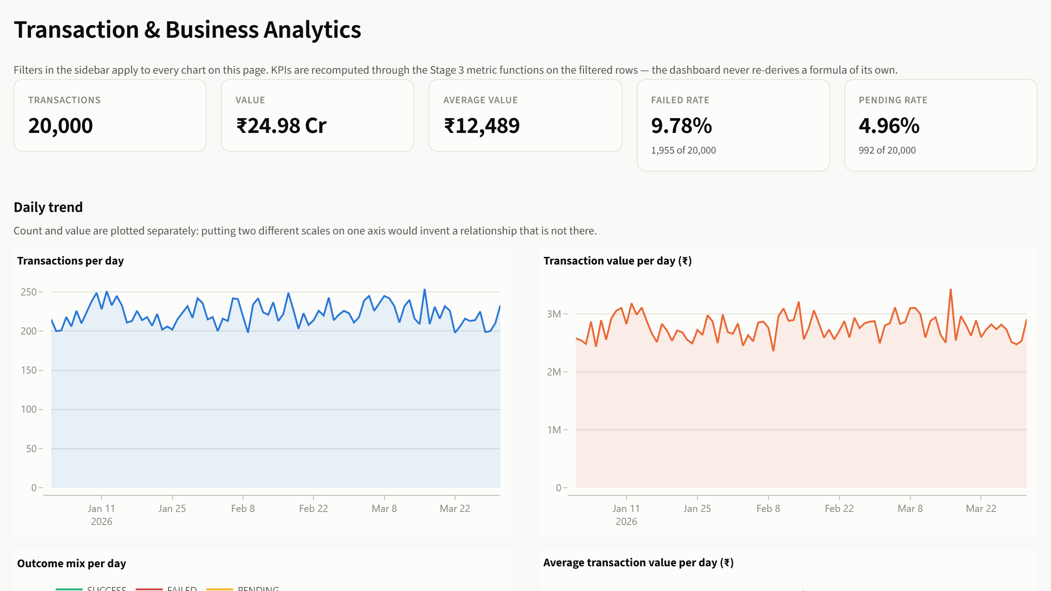
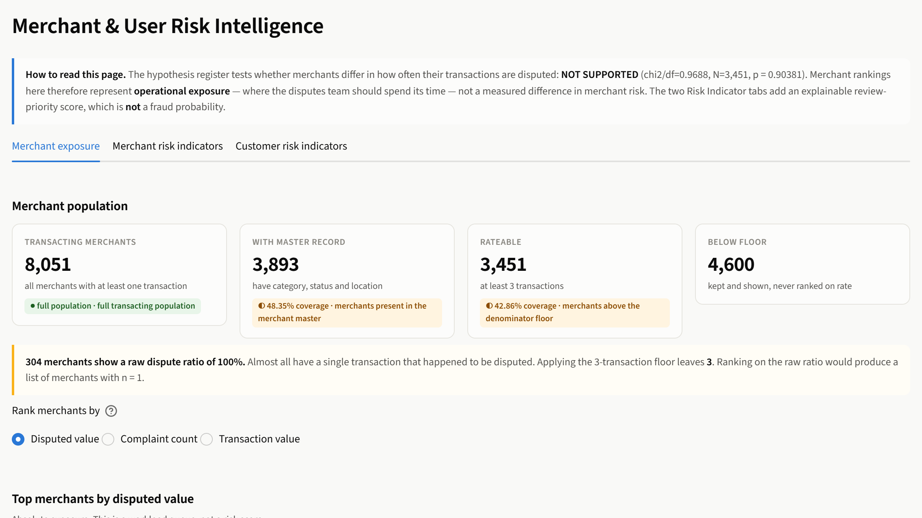
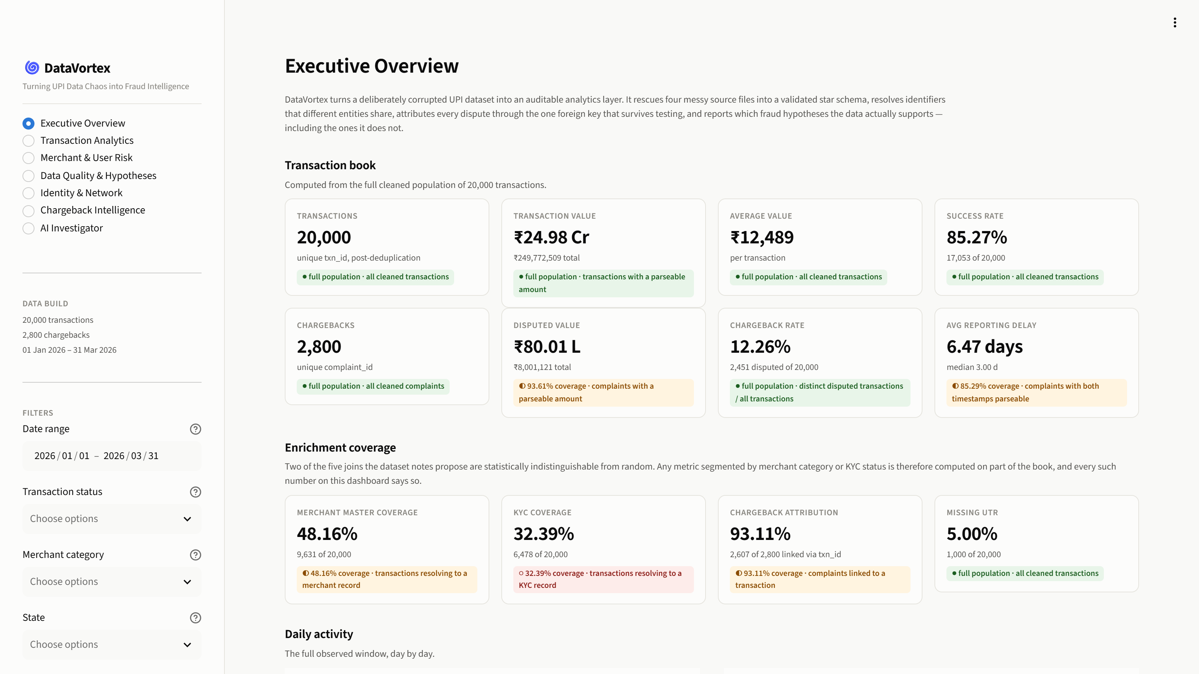
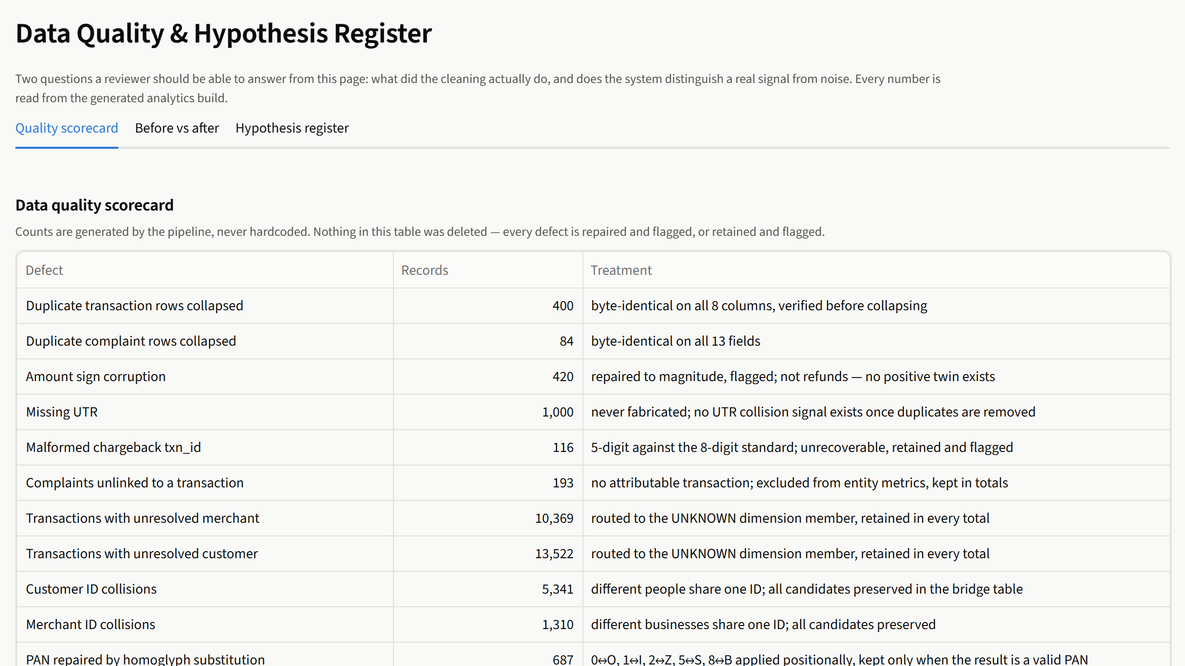
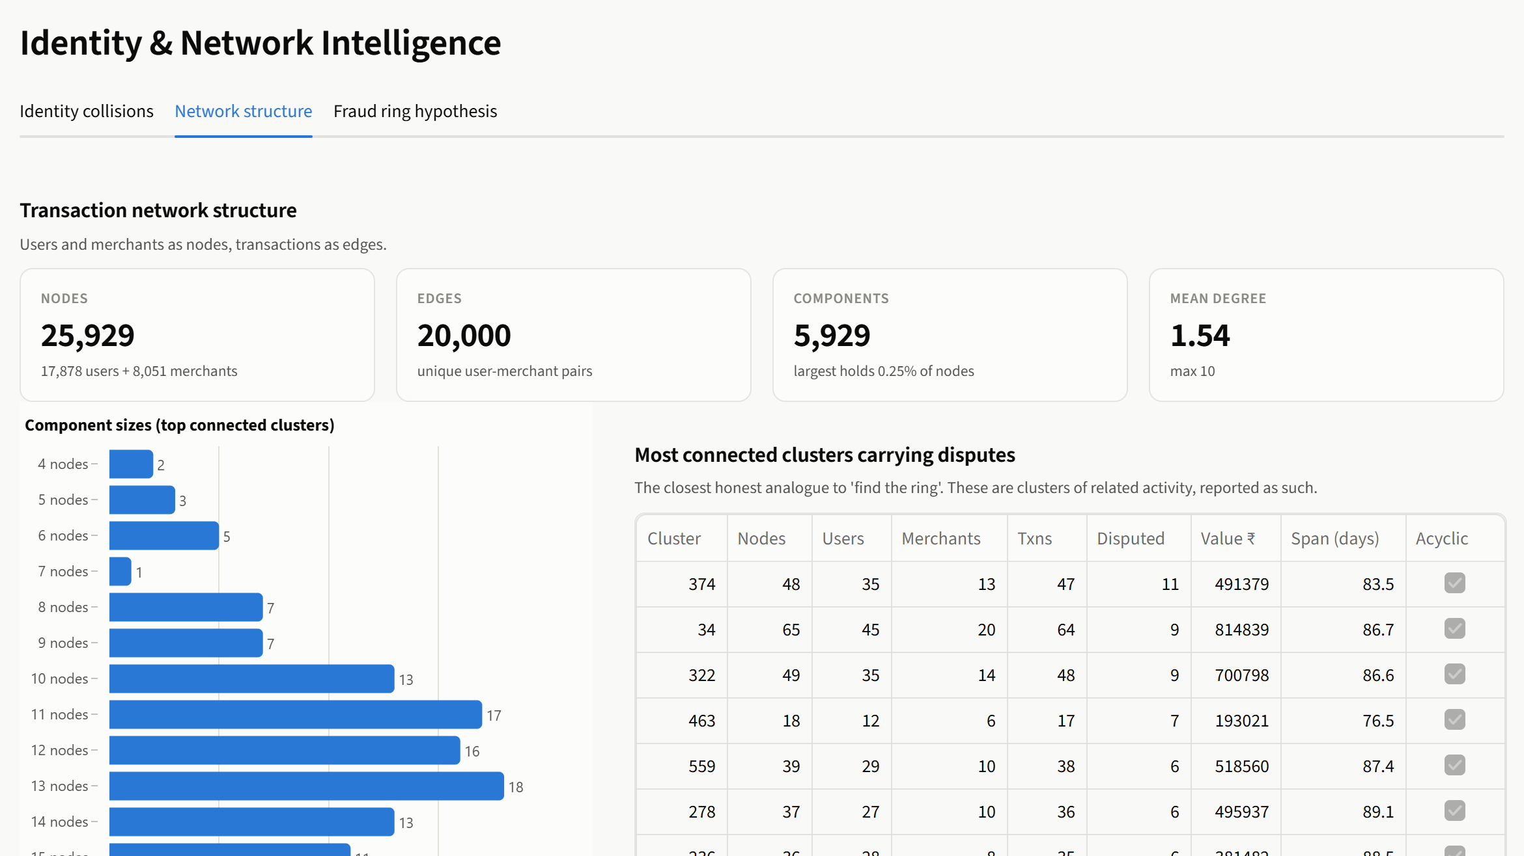
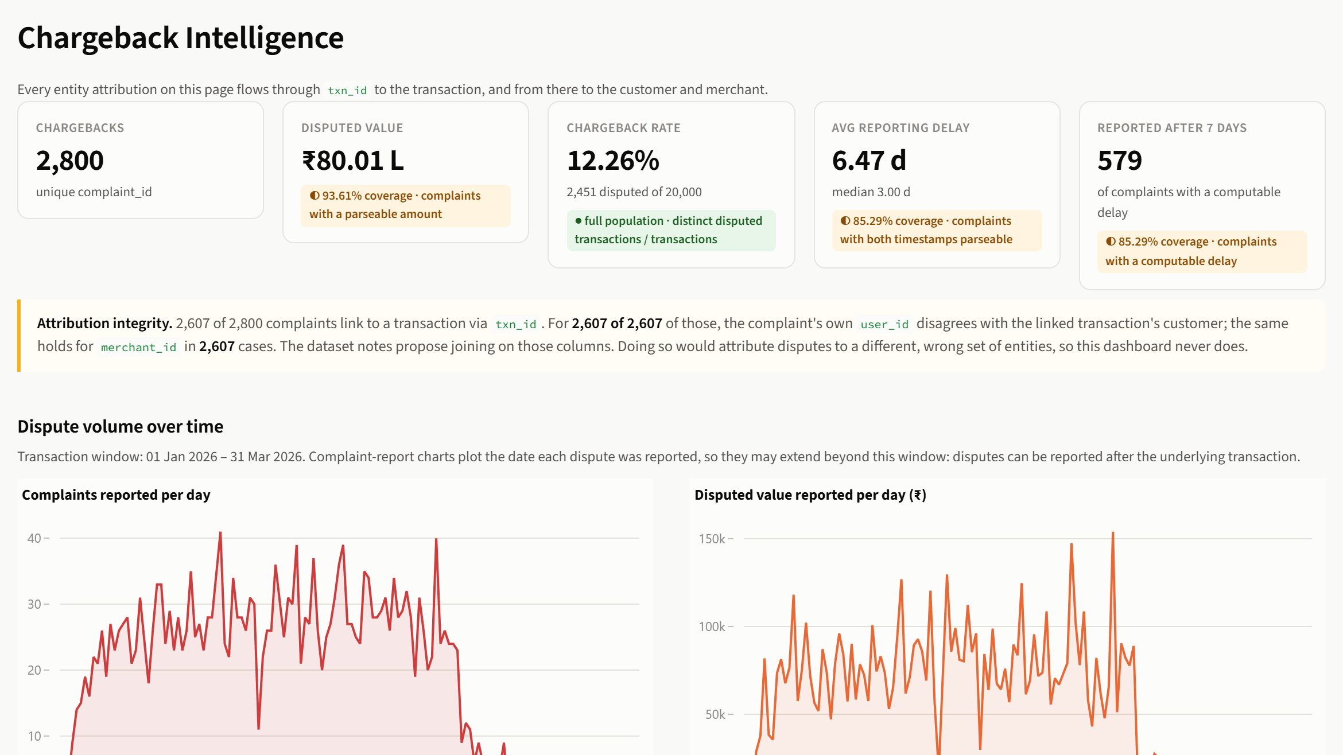
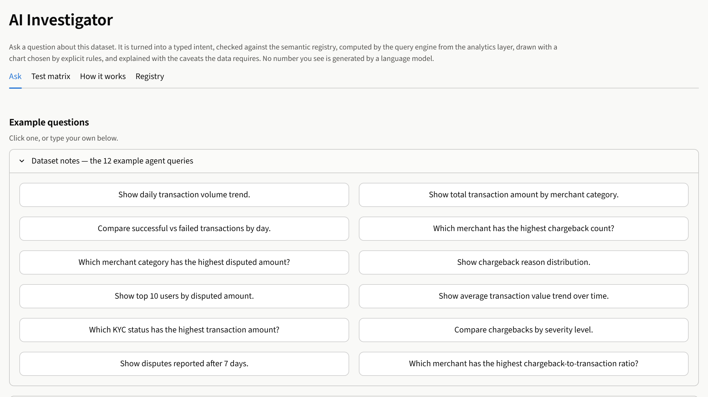
THE PRODUCT
From Analysis to Investigation
1 · Executive Overview
›
2 · Transaction Analytics
›
3 · Merchant & User Risk
›
4 · Data Quality & Hypotheses
›
5 · Identity & Network
›
6 · Chargeback Intelligence
›
7 · AI Investigator
kumarrishuraj-datavortex-appdashboard-vsor4k.streamlit.app
1 · Executive Overview
2 · Transaction Analytics
3 · Merchant & User Risk
4 · Data Quality & Hypotheses
5 · Identity & Network
6 · Chargeback Intelligence
7 · AI Investigator
Live dashboard https://kumarrishuraj-datavortex-appdashboard-vsor4k.streamlit.app/ GitHub https://github.com/kumarrishuraj/datavortex
DataVortex · UPI Fraud & Identity Intelligence · TransOrg AgentIQ Datathon 2026
11 / 12
Notes:
One investigation path across seven pages of the deployed app. Screenshots captured from the live deployment; Identity & Network shown on its Network structure tab so no customer-level rows appear.

Slide 12
CONCLUSION
DataVortex: A Defensible Fraud-Intelligence Foundation
✓
Rescues noisy UPI data before any analytics runs
✓
Preserves unmatched records under UNKNOWN
DataVortex does not manufacture fraud signals.
It builds the data foundation required to investigate them responsibly.
✓
Separates identity collisions from fraud conclusions
✓
Tests every suggested insight with defensible statistics
✓
Explains every answer, with privacy-safe masking throughout
TEAM DATAVORTEX
Delivers it as an interactive decision-support dashboard
Rishuraj Kumar
12400878
✓
Amit Kumar
12400871
Built with Python · pandas · PyArrow/Parquet · NetworkX · Streamlit · Plotly
Satyam Saurabh
12310274
Live dashboard ↗ GitHub ↗
DataVortex · UPI Fraud & Identity Intelligence · TransOrg AgentIQ Datathon 2026
12 / 12
Notes:
Summary of the verified project. Technologies from requirements.txt.

