Slide 1

Guidelines
Kindly use the given template for submitting your prototype(Make a copy of the template)
One team is only required to submit one project.
Follow this template while preparing your presentation.
You are welcome to add as many POCs and design concepts to support your project.
The project should be feasible and the team members should be capable enough, to come up with the fully functioning prototype of the same idea, if required.

Slide 2

Team Details
Team name: [ TO BE FILLED BY TEAM ]
Team leader: [ TO BE FILLED BY TEAM ]
Team members: [ TO BE FILLED BY TEAM ]
Problem statement: Unilog AI Product Intelligence — turn minimal, messy product data into a commerce-ready 252-column catalogue record.
Submission: a working, tested system, not a mockup — 1,000 products enriched end to end, 136/136 tests passing.

Slide 3
Brief about your solution
Problem → Solution
THE PROBLEM
OUR SOLUTION
Supplier feeds give 6 columns — and lie in 3 of them.
'-- Unbranded --' is a sentinel, not a brand. Treating it as data corrupts 799 of 1,000 rows.
'Appliance Dealers Cooperative' is a buying co-op, not a manufacturer.
No voltage, no dimensions, no material, no certifications.
Commerce needs 252 validated columns.
Doing it by hand does not scale. Doing it with a raw LLM hallucinates and cannot be audited.
An evidence-grounded enrichment pipeline.
Deterministic core, AI only where it genuinely helps, evidence attached to every value.
One rule shapes the whole design:
A value is published only if it comes from the input, an approved vocabulary, manufacturer evidence, or a deterministic transformation.
Anything else is left blank, flagged, and sent to a human.
1,000
products enriched
7.7 s
wall clock
0
failures
252
output columns
136/136
tests passing

Slide 4
1 · How the solution enriches minimal product information
From 6 messy columns to a validated 252-column record
INPUT · WHAT THE FEED GIVES US
OUTPUT · EXCERPT OF 252 COLUMNS
WDTS7024RZ
WDTS7024RZ Dishwasher SS - Display Only
E1_Brand -- Unbranded --
Unilog_Brand -- No Unilog Brand --
DIB_Brand -- No DIB Brand --
Part_Manuf Appliance Dealers Cooperative
Classpath → Kitchen Appliances>Built-In Dishwashers
Product Name → Dishwasher
Material → Stainless Steel (SS via LOV synonym)
INVOICE_DESC → DISHWASHER BLTLN SST SST 120V 10A 41DBA
BRAND_NAME → blank, flagged (no evidence offline)
HOW · SEVEN DETERMINISTIC MOVES
1 Detect placeholders before anything else
2 Resolve entities — 6-stage cascade, margin tests
3 Classify — 36 leaves, explainable keyword scoring
4 Retrieve category-scoped vocabulary shortlist
5 Extract attributes — LOV → regex → dimension chain
6 Normalise — 50.25 → 50-1/4, inches → in
7 Generate copy from a verified fact sheet only
94.7%
classified to a real category
87.5%
brand resolved
100%
of rows get 5 description fields
751
RAG documents indexed

Slide 5
2 · How the solution ensures accuracy and trust
Five independent layers — every one measurable
Rule-based validation
8 check groups: schema · character limits · casing · UOM approval · vocabulary · required fields · evidence · consistency
94.7% of rows pass with zero errors
Controlled vocabulary
An unapproved value is an ERROR. The self-correction loop clears it rather than publishing it.
100% LOV compliance
Evidence / provenance
Every value stores source + transformation + confidence + validation status. Fully auditable.
100% evidence coverage
Confidence scoring
Six weighted components; validation failure is a multiplicative gate, not a subtraction.
mean 72.7%, banded HIGH→UNKNOWN
Human review
Low confidence or unresolved evidence routes out with a specific, actionable reason — never a generic bucket.
467 rows queued (46.7%)
AI validation is deliberately NOT used here: a verdict must be reproducible, and a sampled model cannot guarantee the same record yields the same answer.

Slide 6
3 · What makes it scalable for enterprise catalogs
Large catalogues · new manufacturers · new formats · continuous updates
LARGE CATALOGUES
NEW MANUFACTURERS
130 rows/s offline, 0 failures
Extraction cached by (category, description) — colour/length variant families cost one extraction, not N
Per-row isolation: a malformed row is a FAILED record, never a dead batch
Thread pool engages when research or LLM I/O is live
Masters are mined from the feed itself — co-occurrence recovered Diablo→Freud, Carlon→Thomas & Betts with no configuration
Part-number prefix learning generalises to unbranded siblings
Distributor detection via brand fan-out, so co-ops are never published as the manufacturer
DIFFERENT DOCUMENT FORMATS
CONTINUOUS UPDATES
CSV · XLSX · DOCX ingestion with header sniffing, merged-cell handling and multi-row header detection
Output schema is READ from the delivery template — a revised 252-column spec needs no code change
Reference workbooks discovered by filename pattern, not hard-coded
12 independently toggleable stages — re-run only what changed
Content-addressed prompt cache survives restarts
Every human override is stored with provenance: a labelled pair for threshold tuning and synonym mining

Slide 7
Opportunities · Differentiation · USP
Why this is not another LLM wrapper
TYPICAL APPROACH
OUR APPROACH
Input → LLM → Output
Hallucinates specifications that were never stated
No audit trail — cannot answer 'why does it say this?'
No vocabulary control; free-text values break filtering
Accuracy looks high until it meets unseen data
The model is caged inside deterministic stages
The description generator never sees raw text — only resolved entities and extracted attributes
It is structurally incapable of inventing a fact
Unknown → blank + flagged, never a plausible guess
Runs and reports honestly with no API key
USP — THREE THINGS NOBODY ELSE IS DOING
Provable fidelity
Honest by construction
Offline-first, AI-optional
Reproduces both labelled rows character-for-character across all 10 description fields — including a 390-character long description. Asserted in tests, not eyeballed.
Reports which reference tier is live (official / derived / seed / computed) and refuses to overstate it. Blank-and-flagged beats a confident guess.
Every AI stage has a deterministic fallback, so all reported metrics are reproducible with no key and no network.

Slide 8
Features offered by the solution
INGEST & CLEAN
RESOLVE & CLASSIFY
EXTRACT & NORMALISE
Input profiling: fill rates, duplicates, encoding damage
Placeholder-sentinel detection (799 rows protected)
Mojibake repair, whitespace and casing normalisation
6-stage entity cascade with ambiguity margin tests
Distributor / buying-co-op detection
36 taxonomy leaves, explainable keyword scoring
Corpus part-number prefix learning
323 controlled values, 68 approved UOM
Exact fraction ladder to 1/64 (50.25 → 50-1/4)
Ordered dimension chains (5"x.045"x7/8")
AI & RETRIEVAL
GENERATE & VALIDATE
TRUST & OPERATE
RAG: 7 collections, 751 documents
Adaptive category-scoped shortlist — never the whole vocabulary
3 guarded LLM call sites, each with a fallback
6 description fields from a verified fact sheet
8 validation check groups + self-correction loop
Character limits, casing, UOM and vocabulary enforcement
Evidence graph — every value traced end to end
Confidence bands + human review queue with overrides
CSV / XLSX export, 15 REST endpoints, 7-page dashboard

Slide 9
Process flow · one row, end to end
12 toggleable stages · per-row isolation · two possible exits
one catalogue row, end to end · green = deterministic amber = AI-assisted with fallback red = human
Profile
& clean
Resolve
entities
Parse
product
Classify
category
Retrieve
LOV
Extract
attributes
continues below ↴
Normalise
fractions · UOM
Research
manufacturer
Generate
descriptions
Validate
+ self-correct
Score
confidence
Route
Nothing is guessed: an unresolved field is left blank and flagged.
PUBLISH · 533 rows
252-column delivery record
HUMAN REVIEW · 467 rows
specific, actionable reason each

Slide 10
AI · RAG · enrichment pipeline
Where the model is allowed to act — and what stops it inventing facts
the model may STRUCTURE information — it may never ADD it
Raw row
6 columns, 3 placeholders
1 Product parser
VERIFIED FACT SHEET
resolved entities + extracted attributes only
fires when the row is opaque
RAG COLLECTIONS
manufacturer + brand
global LOV
UOM standards
guidelines
examples
fittings · faucets
GUARD every returned token must
appear in the source text
Description generator
never sees raw text
2 Taxonomy tie-break
fires on ambiguity — 53 of 1,000 rows
GUARD must pick a supplied id or
'none'; confidence capped at 0.72
Validate → self-correct
confidence → review
751 documents · filter BEFORE rank
3 LOV rescue
Result: the generator is structurally incapable of inventing a fact.
fires when a value misses the vocabulary
GUARD only an exact alias inside the
same attribute is applied

Slide 11
System architecture
Interface → orchestration → agents → knowledge, with evidence throughout
every AI stage has a deterministic fallback — the system runs and reports honestly with no API key
React + Tailwind dashboard
7 pages
FastAPI
15 endpoints
CLI
run · demo · benchmark
Export
CSV · XLSX · review queue
INTERFACE
Two-pass corpus-aware orchestrator · 12 toggleable stages · per-row isolation · extraction cache
ORCHESTRATION
Product
Parser
Manufacturer
Resolver
Brand
Resolver
Taxonomy
Agent
Attribute
Agent
Research
Agent
Description
Agent
Validation
Agent
AGENTS
RAG retrieval
7 collections · 751 docs
Reference registry
official → derived → seed
Normalisation
fractions · UOM · casing
LLM client
strict JSON · cache · offline
KNOWLEDGE
TRACE
EVIDENCE · every value carries source + transformation + confidence + validation status

Slide 12
Technologies used in the solution
Backend
Python 3.13 · FastAPI · Pydantic · pandas
Entity matching
RapidFuzz token-set similarity with margin tests
Retrieval / RAG
scikit-learn TF-IDF, word + character n-grams (FAISS/Chroma seam documented)
Data I/O
openpyxl · XlsxWriter · python-docx (merged cells, multi-row headers)
AI layer
Provider-agnostic client — Anthropic / OpenAI · strict JSON schemas · local repair · prompt-hash cache · offline mode
Research
httpx behind a source-hierarchy gate (Tavily / Serper pluggable)
Frontend
React 18 · Vite · Tailwind CSS · Recharts
Quality
pytest — 136 tests, all passing
Delivery
Docker + docker-compose · CLI · 15 REST endpoints
Deliberate choice: TF-IDF with character n-grams beats sentence embeddings on short controlled vocabulary ('Kitchen Aid' / 'KitchenAid'), needs no model download, and is exactly reproducible in any environment.

Slide 13
Estimated implementation cost
The architecture is cheap by design — deterministic first, AI last
$0
to run the current build
~$1–2
per 1,000 rows with LLM on
free tier
search API covers a pilot
1 vCPU
no GPU, no model hosting
WHY IT COSTS SO LITTLE
SCALING ESTIMATE
Everything measured in this deck ran with no API key and no network — the deterministic core does the work.
The model is a tie-breaker, not the classifier: it is consulted on 53 of 1,000 rows (~5%).
Extraction is cached by (category, description); variant families cost one extraction, not N.
Prompts are content-addressed and cached on disk across restarts.
TF-IDF retrieval needs no embedding API and no GPU.
100k products, deterministic only: ~10 minutes, $0.
100k products with LLM tie-break on ~5%: roughly $100–200 in tokens, one-off.
Re-runs are near-free: cache hits and stage toggles mean only what changed is recomputed.
Infrastructure: a single container. No vector DB, no GPU, no model hosting required at this scale.
Token figures are public list-price estimates for the stated volume, not measured spend — the current build has made zero paid API calls.

Slide 14
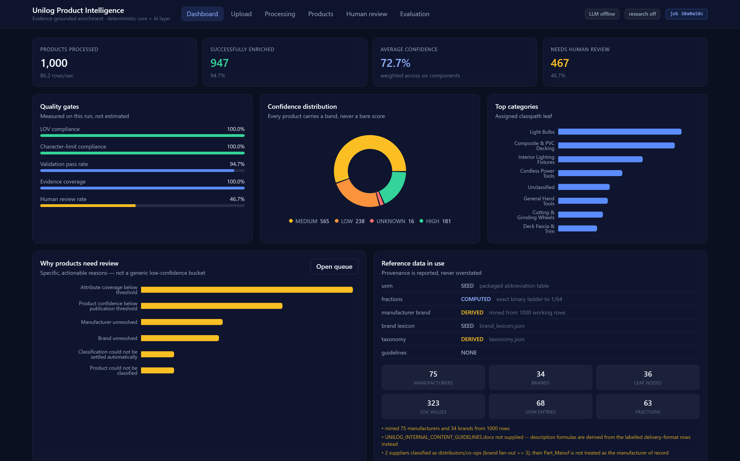
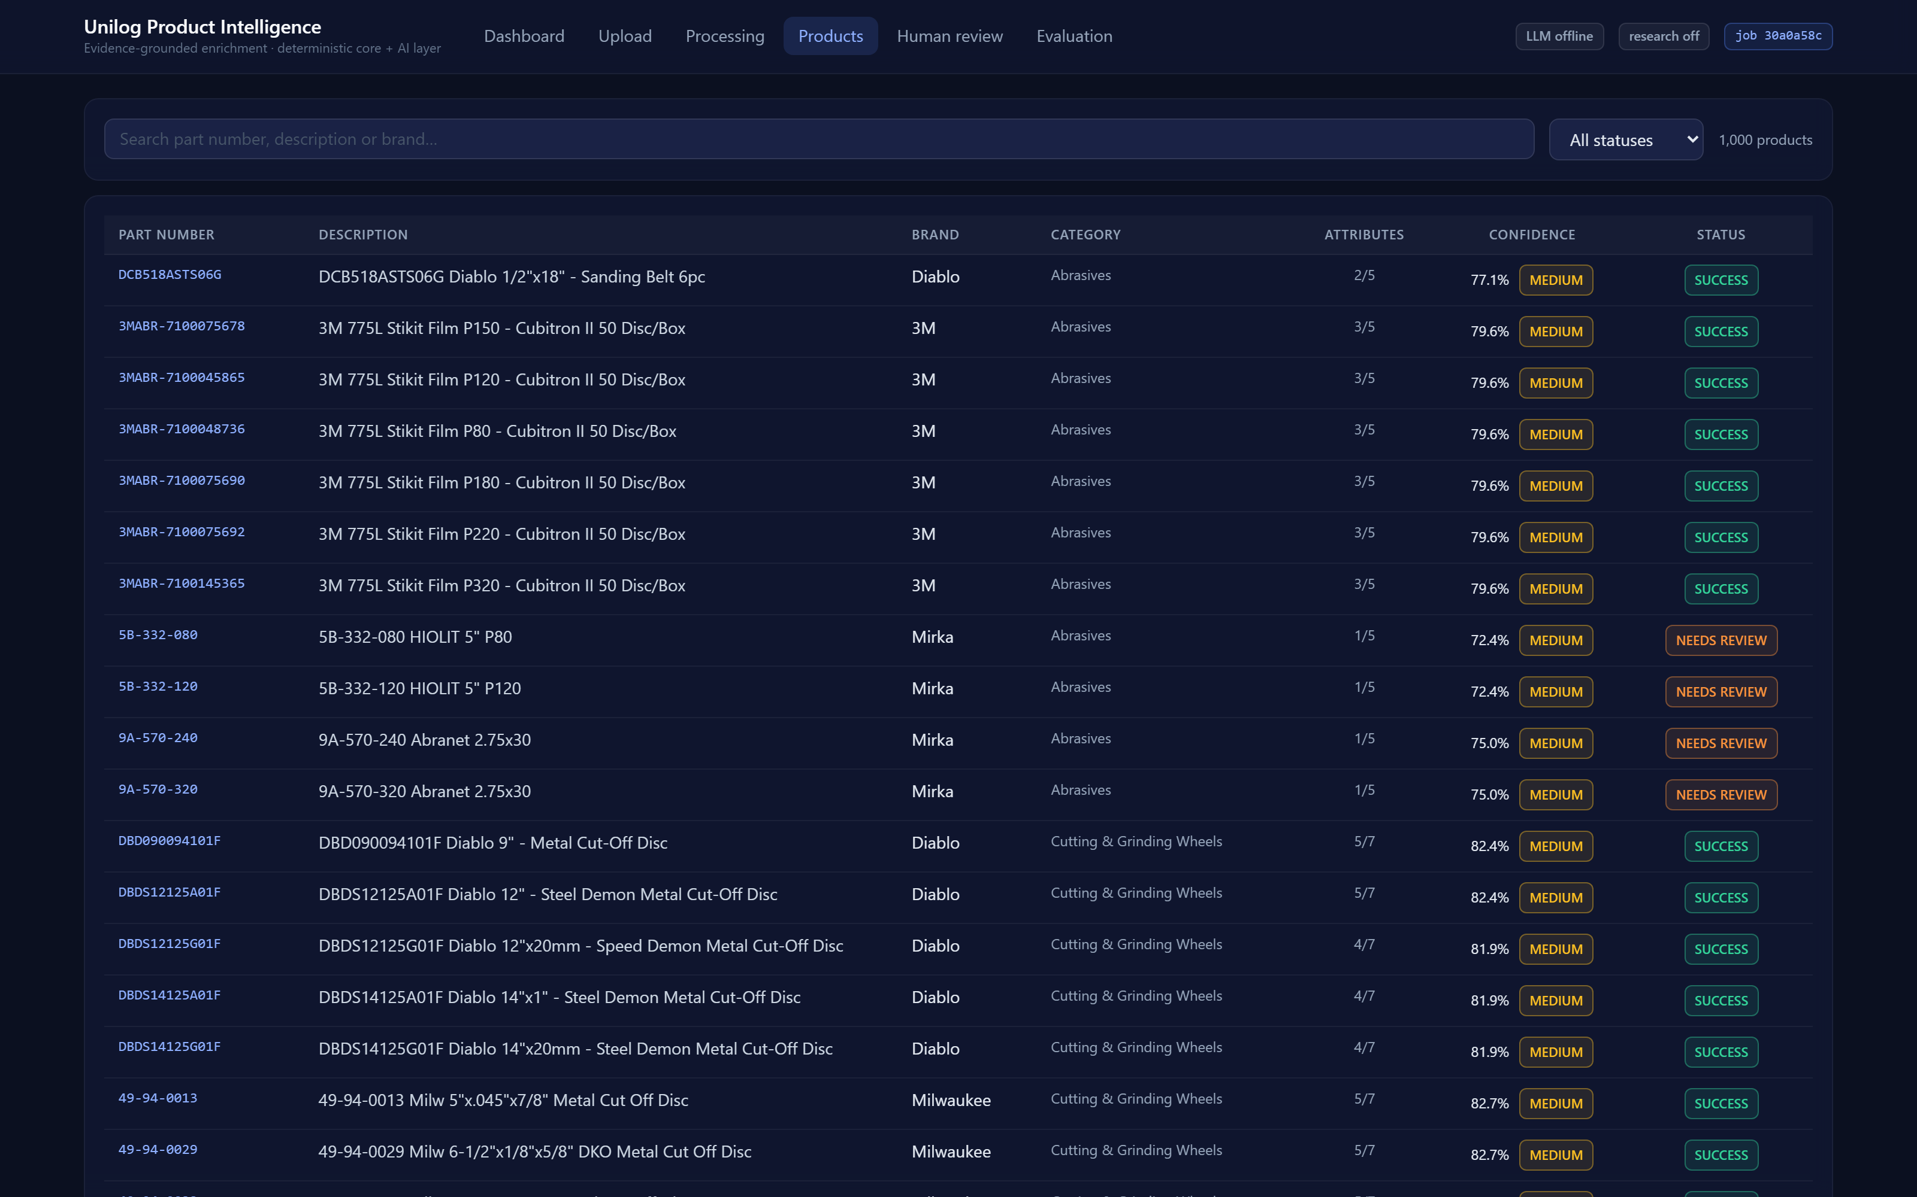
Snapshots of the MVP
Real screenshots of the running system — captured from this build, enriching 1,000 products
Dashboard — live quality gates, confidence bands, provenance
Products — searchable, per-row confidence
Left: quality gates, confidence distribution and live reference provenance for the full run. Right: every product with its confidence band and attribute fill, searchable and filterable.

Slide 15
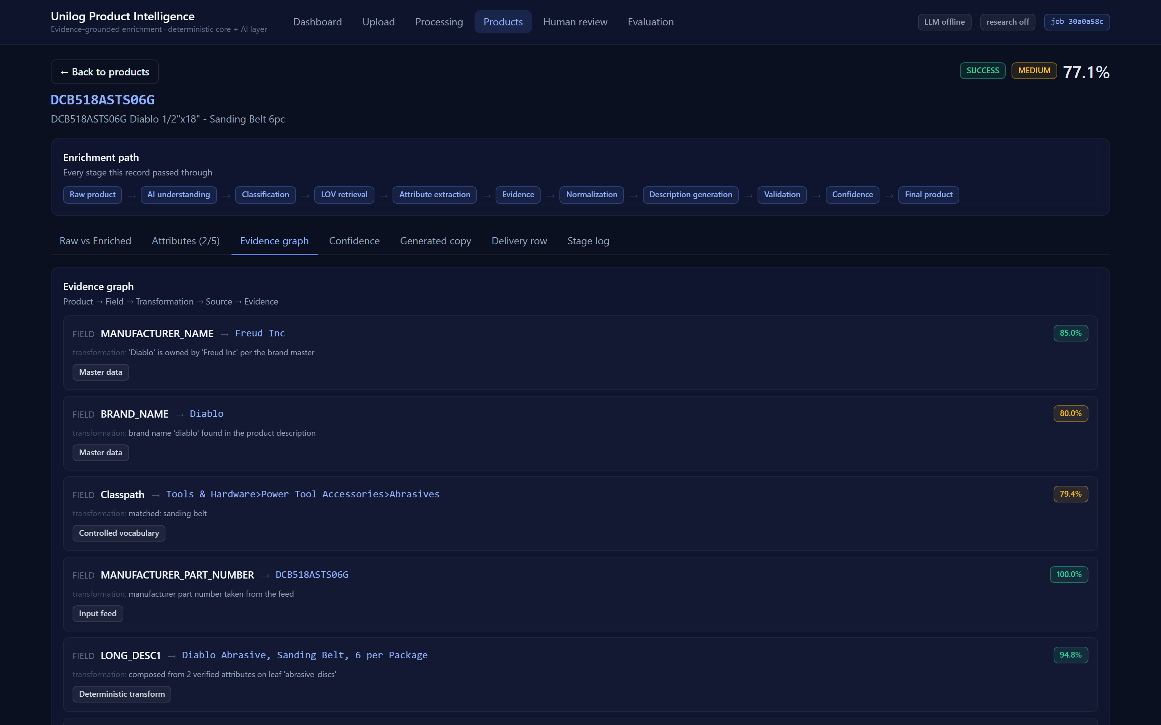
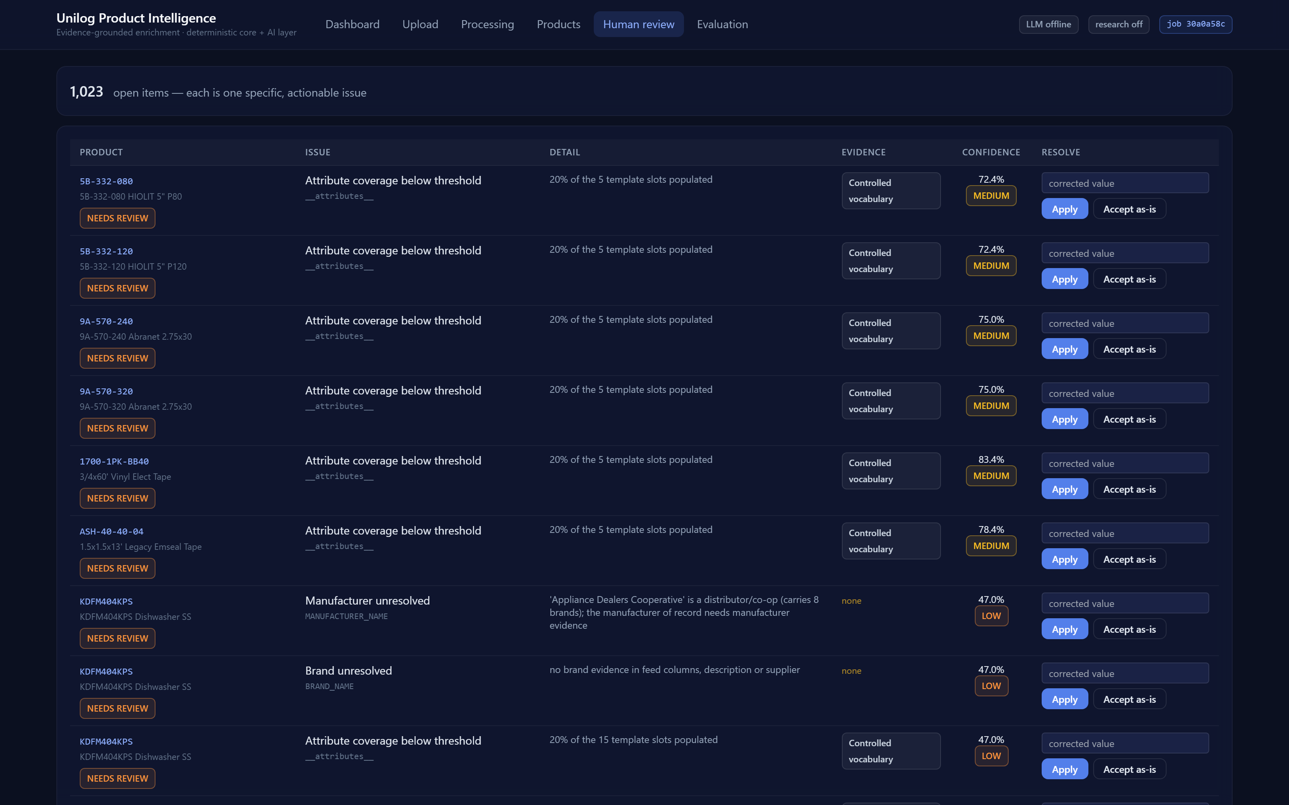
MVP · explainability and human-in-the-loop
Every value answers 'why does it say this?' in one click
Evidence graph — every value traced to its source
Human review — one row per actionable issue
Evidence graph: MANUFACTURER_NAME → Freud Inc · transformation: 'Diablo' is owned by 'Freud Inc' per the brand master · source: master data · confidence 85%
Review queue: one row per specific issue, with the nearest approved value suggested and an inline override that writes back with full provenance.

Slide 16
Results · measured, not estimated
Full 1,000-row run, no API key, no network — reproducible by anyone who clones the repo
1,000
products enriched
7.7 s
wall clock · 130 rows/s
0
processing failures
136/136
tests passing
94.7%
classified to a real category
100%
LOV compliance
100%
evidence coverage
100%
character-limit compliance
87.5%
brand resolved
94.7%
rows with zero validation errors
72.7%
mean confidence
751
RAG documents indexed
AGAINST THE LABELLED DELIVERY-FORMAT ROWS
100% on Dept / Class / Fine, Classpath, Product Name, part number and every attribute label · overall quality score 82.9%
The description engine reproduces all 10 derivable fields character-for-character, including a 390-character long description.

Slide 17
Future development · and what we are honest about today
Known limits stated plainly, with the fix for each
HONEST LIMITATIONS
NEXT
BRAND_NAME and ATTRIBUTE_VALUE score 0% against the labelled rows — because those facts are not in the input. The gold row has them because a human opened the manufacturer's website.
Offline the system refuses to invent them and flags the record. That is the no-hallucination rule working, and why review sits at 46.7% rather than a suspiciously low number.
The official Unilog reference pack was not supplied with the dataset, so masters are mined from the feed and every surface reports which tier is live.
The LLM path is wired, guarded and stub-tested, but has not yet run against a live model — the contract is proven, the quality is not.
1 Load the official reference pack — highest value, zero code change. Flips provenance to 'official' and unlocks the Faucets/Fittings categories.
2 Enable manufacturer research with a search key — closes the brand and attribute-value gap, roughly doubling populated columns.
3 Swap TF-IDF for embeddings once the full 161k-row vocabulary lands and semantic recall matters more than exactness.
4 Persist jobs in Postgres and move execution to a worker queue.
5 Learn from reviewer overrides — every correction is already stored with provenance, so each is a labelled training pair for threshold tuning and synonym mining.

Slide 18
Links
Repository · demo video · working prototype
Working prototype: https://unilog-product-intelligence.onrender.com
GitHub public repository: https://github.com/kumarrishuraj/unilog-ai-product-intelligence
Demo video (3 minutes): [ TO BE FILLED BY TEAM ]
The prototype is live and offline-first — it needs no API key. Render's free tier sleeps after 15 minutes idle, so the first request may take ~50 s to wake it.
RUN IT LOCALLY
pip install -r requirements.txt
python scripts/run_pipeline.py --input data/raw/sample_1000_input.csv --format both
python evaluation/benchmark.py --labelled data/raw/delivery_format_labelled.csv
cd frontend && npm install && npm run build && cd ..
uvicorn backend.api.main:app --port 8000 → http://127.0.0.1:8000
Walk one product through all eleven stages with its evidence: python scripts/demo.py --mpn 49-94-0013

Slide 19


