Slide 1

BLUESTOCK
Mutual Fund Analytics
Capstone Project
Prepared by: Ritik Kumar
B.Tech Chemical Engineering · Delhi Technological University
Organization: Bluestock Fintech | Project ID: bluestock_mf_capstone
Python
Pandas
NumPy
SQLite
Power BI
Data Analytics · Financial Modeling · Business Intelligence · Dashboard Development
Notes:
1

Slide 2






EXECUTIVE SUMMARY
Mutual Fund Analytics Capstone Project · Bluestock Fintech
Objective
Problem
Solution
Build an end-to-end Mutual Fund Analytics Platform transforming raw data into actionable investment insights
Fund data scattered across sources; no unified view of performance, risk, or investor behavior for decision-making
Integrated Python pipeline + SQLite database + Power BI dashboard covering all analytics dimensions
Tech Stack
Analytics
Key Outcome
Python · Pandas · NumPy · SQLite · Power BI · Matplotlib · Seaborn
CAGR, Sharpe, Sortino, Alpha, Beta, Tracking Error, VaR, CVaR — full performance & risk metric suite
4-page interactive Power BI dashboard; top-performing funds identified; SIP continuity & investor patterns revealed
Notes:
2

Slide 3
PROBLEM STATEMENT & OBJECTIVES
Challenges · Goals · Business Impact
CHALLENGES
PROJECT OBJECTIVES
Fund data scattered across multiple disparate sources
01
Analyze fund performance across categories & fund houses
No unified performance & risk evaluation framework
02
Measure risk with Sharpe, Sortino, VaR, and CVaR
Traditional methods lack speed and comprehensiveness
03
Compare funds against benchmark indices (Alpha / Beta)
Investor behavior patterns difficult to analyze at scale
04
Understand investor behavior via demographics & SIP analysis
Missing benchmark comparison and alpha measurement tools
05
Deliver interactive Power BI dashboards for decision-making
Notes:
3

Slide 4






PROJECT ARCHITECTURE
End-to-End Analytics Pipeline
Raw Data
Data Cleaning
SQLite DB
EDA
Analytics
Power BI
Insights
CSV Datasets
5 core files
Pandas
Dedup · Validate
Fact-Dimension
Schema Design
Distribution
Trend Analysis
Performance
& Risk Metrics
4-Page Interactive
Dashboard
Business
Recommendations
1
2
3
4
5
6
7
Integrated data pipeline: from raw CSV ingestion to executive-ready interactive dashboards
11
4
8+
5
Datasets
Integrated
Dashboard
Pages
Performance
Metrics
Risk
Indicators
Notes:
4

Slide 5
DATASET OVERVIEW
11 Integrated Datasets · Comprehensive Mutual Fund Data Ecosystem
Dataset | Description | Key Columns
fund_master_clean | Master scheme info & metadata | amfi_code, fund_house, category, expense_ratio
nav_history_clean | Historical NAV records | amfi_code, date, nav
investor_transactions | SIP & lump-sum transactions | investor_id, date, type, amount, state
scheme_performance | Return metrics per fund | return_1yr, return_3yr, return_5yr, aum_crore
benchmark_indices | Index benchmark values | date, index_name, close_value
alpha_beta | Risk vs benchmark | amfi_code, alpha, beta
var_cvar_report | Downside risk measures | amfi_code, VaR_95, CVaR_95
sip_continuity | SIP gap & continuity | investor_id, avg_gap_days, at_risk
Notes:
5

Slide 6
DATA CLEANING & DATABASE DESIGN
Preprocessing Steps · Schema Architecture · Data Quality
DATA PREPROCESSING STEPS
SQLITE DATABASE SCHEMA
Fact-Dimension Architecture · AMFI Code as Primary Key
01
Duplicate Removal
Eliminated duplicate records across all datasets using Pandas drop_duplicates()
DIM
FACT
fund_master_clean
nav_history_clean
02
Missing Values
Handled NaN values via forward-fill, drop, or mean imputation by column
FACT
FACT
03
Date Standardization
investor_transactions
scheme_performance
Converted all date fields to consistent datetime64 format for time-series analysis
Type Validation
Primary Key: AMFI Code links all tables
04
Ensured correct data types: numeric NAV/amounts, string codes, category fields
Cleaned Output Files:
fund_master_clean.csv
05
AMFI Code Validation
nav_history_clean.csv
Cross-validated AMFI codes across fund_master, NAV, and performance datasets
investor_transactions_clean.csv
scheme_performance_clean.csv
Notes:
6

Slide 7
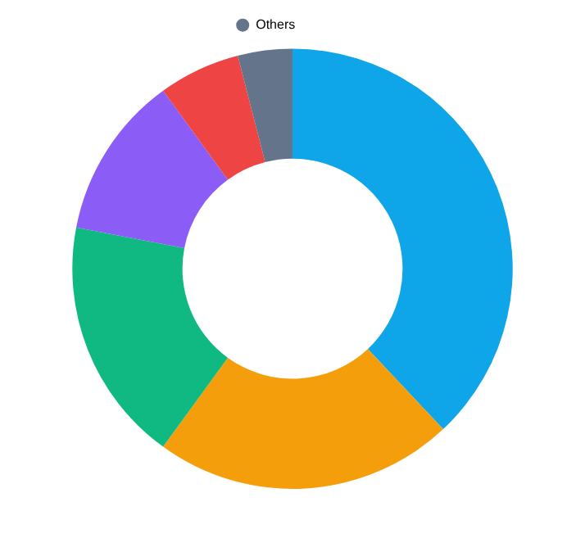
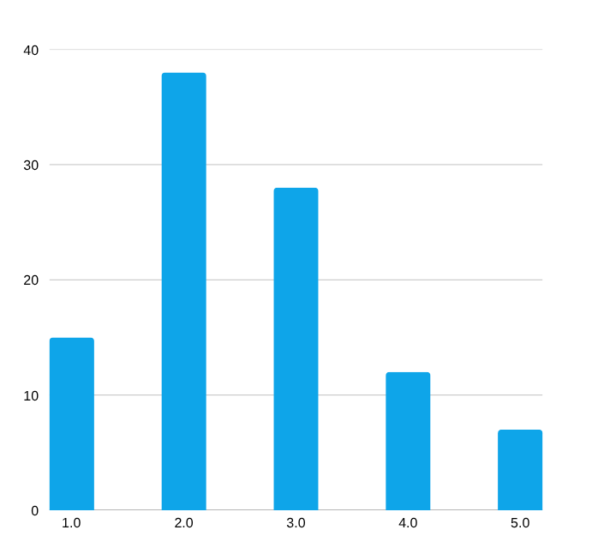
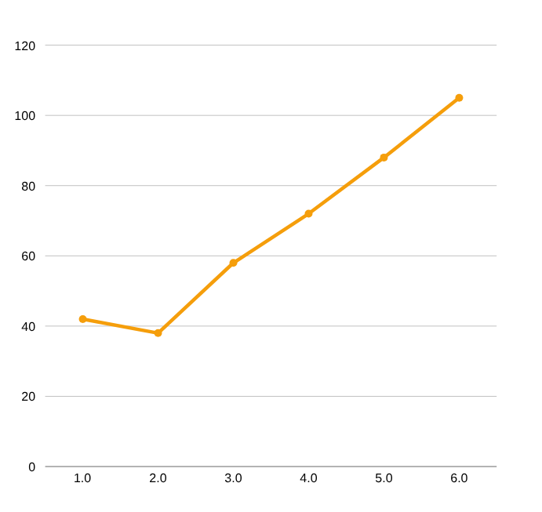
EXPLORATORY DATA ANALYSIS
Category Distribution · Demographics · Geography · SIP Trends
KEY OBSERVATIONS
Equity funds dominate at ~38% of all schemes; strong investor preference for growth-oriented products
SIP inflows grew ~150% from 2019–2024, signaling a structural shift toward systematic investing
26–35 age cohort is the largest investor segment (38%), indicating young urban investor participation
Geographic concentration: Tier-1 cities (Delhi, Mumbai, Bengaluru) account for majority of AUM
Notes:
7

Slide 8
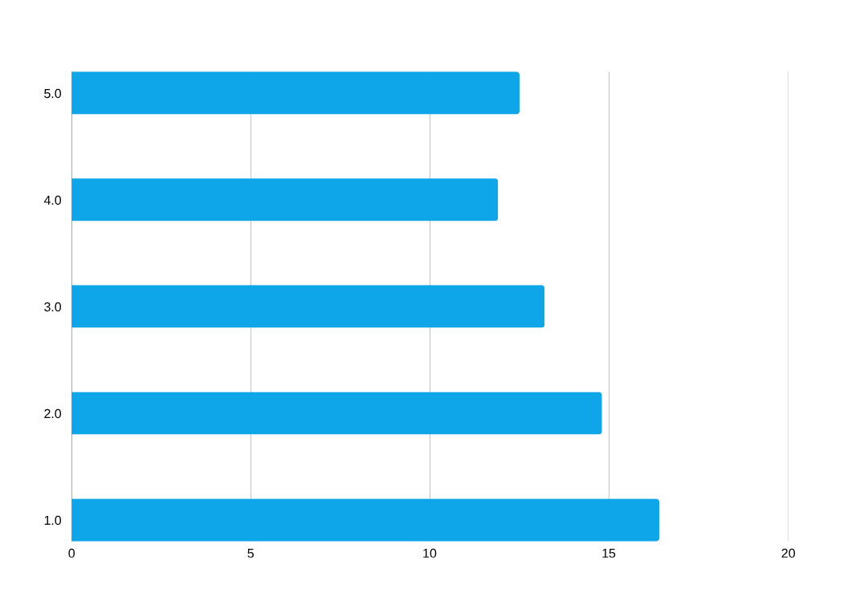
PERFORMANCE ANALYTICS
14.2%
1.38
CAGR · Sharpe · Sortino · Alpha · Beta · Tracking Error
CAGR
Sharpe Ratio
0.87
2.1%
5-Year Top Funds
Best Risk-Adj. Fund
Beta
Tracking Error
+3.4%
1.92
Market Sensitivity
Avg Benchmark Dev.
Alpha
Sortino Ratio
📌 Key Insight: Funds with Sharpe Ratio > 1.2 consistently outperformed peers on risk-adjusted basis. Positive alpha funds demonstrated superior stock selection ability beyond index returns.
Excess vs Benchmark
Downside Adjusted
Notes:
8

Slide 9
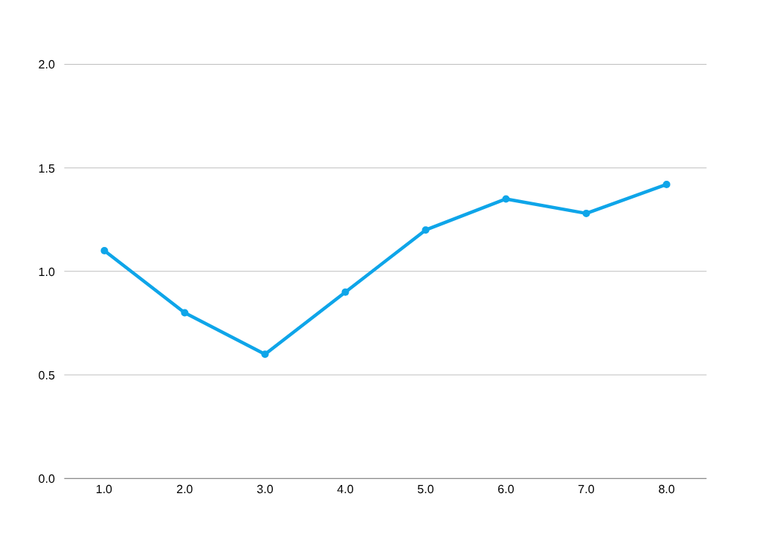
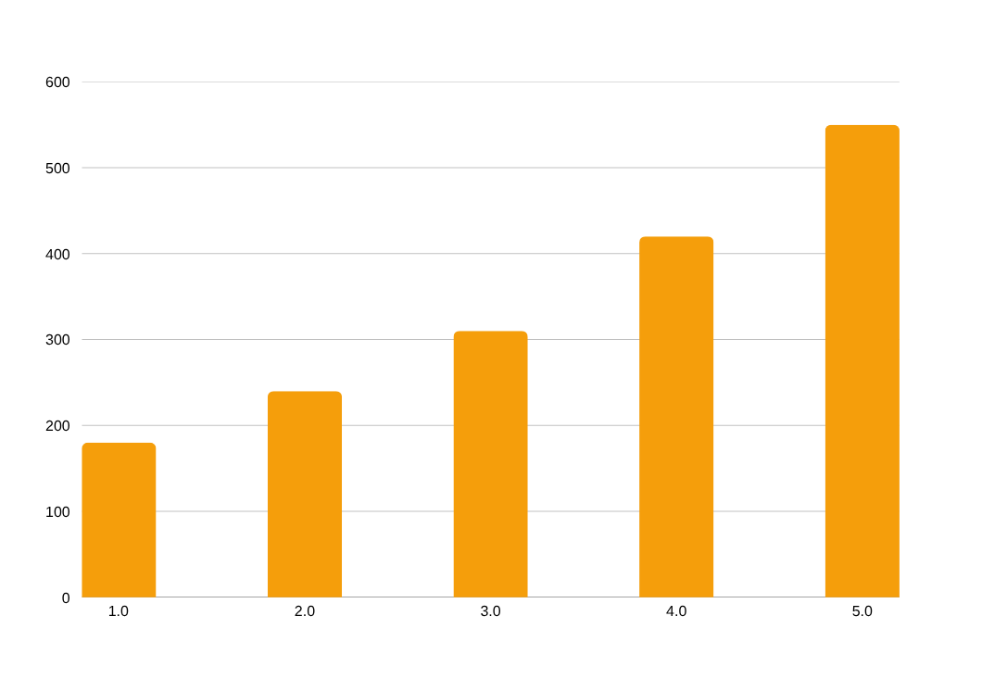
RISK ANALYTICS
VaR · CVaR · Rolling Sharpe · Cohort Analysis · SIP Continuity
VaR (95%)
CVaR (95%)
At-Risk SIPs
SIP Retention
−4.8%
−6.2%
18%
82%
Max 1-Day Loss
Avg Tail Loss
Irregular Contributors
Continuity Rate
Notes:
9

Slide 10



POWER BI DASHBOARD
4-Page Interactive Analytics Platform
Page 1
Industry Overview
Page 2
Fund Performance
AUM distribution across fund categories
CAGR and annualized return rankings
Fund house market share analysis
Sharpe & Sortino ratio comparison
NAV trend by scheme type
Alpha/Beta scatter plots
Expense ratio benchmarking
Top 10 fund leaderboard
Page 3
Investor Analytics
Page 4
SIP & Market Trends
Age & gender demographic distribution
SIP inflow trends over time
Geographic heat map by state
Benchmark index performance overlay
City-tier investment breakdown
Category-wise SIP participation
Transaction type analysis
Investor continuity scoring
Notes:
10

Slide 11







KEY FINDINGS
Performance · Risk · Investor Behavior · Market Insights
PERFORMANCE
SIP GROWTH
ALPHA FUNDS
TRACKING ERROR
Funds with Sharpe Ratio > 1.2 consistently delivered superior risk-adjusted returns vs peers
SIP inflows grew ~150% from 2019–2024, reflecting strong retail participation in mutual funds
Select funds generated positive alpha (3–5%), outperforming benchmark indices over 5-year periods
Tracking error varied 1.5%–4% across index funds, highlighting benchmark-following efficiency gaps
DEMOGRAPHICS
COHORT GROWTH
SIP RISK
RISK-RETURN
26–35 age group dominates (38% of investors); Tier-1 cities contribute majority of total AUM
Newer investor cohorts (2021–2023) contributed significantly to overall investment growth
18% of SIP investors identified as at-risk due to irregular contributions and high gap days
Higher-return funds exhibited higher VaR (4–8%), confirming the fundamental risk-return tradeoff
Notes:
11

Slide 12
RECOMMENDATIONS
Investment · Business · Data-Driven Decision Making
01
Prioritize Risk-Adjusted Performance
02
Maintain SIP Discipline
Evaluate funds using Sharpe & Sortino Ratios rather than raw returns alone to ensure quality risk compensation.
Consistent SIP investing reduces market timing risk; target uninterrupted SIP streaks to maximize compounding benefits.
03
Monitor Benchmark Performance
04
Diversify Across Categories
Prefer funds with positive alpha and low tracking error; these demonstrate genuine benchmark-beating ability.
Spread investments across equity, hybrid, and debt to reduce concentration risk and portfolio volatility.
05
Consider Expense Ratios
06
Enhance Investor Engagement
Lower TER funds can outperform higher-TER alternatives over long periods due to compounded cost savings.
Use demographic & transaction analytics to design targeted retention programs for at-risk SIP investors.
Notes:
12

Slide 13



LIMITATIONS & FUTURE SCOPE
Current Constraints · Planned Enhancements
CURRENT LIMITATIONS
FUTURE ENHANCEMENTS
No Sector Allocation Data
ML Recommendation Engine
Portfolio holdings and HHI concentration analysis not feasible with current datasets
Personalized fund suggestions using collaborative filtering & user profile clustering
Historical Data Only
Insights are backward-looking; future performance prediction requires ML models
Real-Time NAV API
Live AMFI API integration for real-time NAV tracking and portfolio valuation
Limited Benchmark Coverage
Benchmark comparisons restricted to indices available in the provided dataset
Portfolio Optimization
Rule-Based Recommendations
Markowitz efficient frontier, risk parity, and Black-Litterman portfolio models
Fund recommendation engine uses static rules; no ML or personalized preference modeling
Advanced Investor Segmentation
No Real-Time Integration
Platform operates on static files; live NAV feeds and market data not yet integrated
Behavioral clustering using K-Means and DBSCAN for targeted engagement
Notes:
13

Slide 14
PROJECT IMPACT & SKILLS DEMONSTRATED
Technical Competencies · Business Value · Portfolio Showcase
Python
Programming
Pandas / NumPy
Data Wrangling
90%
88%
SQLite / SQL
Database
Power BI
Visualization
82%
85%
Financial Analytics
Domain Knowledge
Data Visualization
Communication
80%
87%
PROJECT VALUE: End-to-end analytics solution integrating data engineering, statistical modeling, financial domain expertise, and executive-grade visualization — demonstrating full-stack business intelligence capability suitable for internship, analyst, or BI roles.
Notes:
14

Slide 15
Thank You
Ritik Kumar
B.Tech Chemical Engineering, Class of 2027
Delhi Technological University · CGPA: 8.69 · GATE 2026 AIR 508
Organization: Bluestock Fintech · Project: bluestock_mf_capstone
Portfolio: ritspective.lovable.app
Mutual Fund Analytics Capstone · Bluestock Fintech · 2024–25
Notes:
15

