Slide 1

R.R.
INSTITUTE OF MODERN TECHNOLOGY
Department Of Computer Science And Technology-2nd Year
Session -2022-23
Covid-19 Awareness
Under The Guidance Of-
MRS. DEEPSIKHA MAM

Slide 2



MEET OUR TEAM….
PRIYANSHU KUMAR
PRACHI TIWARI
FRONT-END DEVELOPER
FRONT-END DEVELOPER

Slide 3
WHAT COVID-19 AWARENESS IS !
Covid-19 awareness is a website that aimed to access the level of awareness and preparation to fight against covid-19.This website will be used to help us encourage people to prevent the further spread of covid and any other diseases.
This website can be used for booking slot for corona vaccine for different age group of people,downloading corona vaccine certificate, performing different types of activities started by Indian Government like quiz, donations for helping people.
This website contains symptoms of covid,myths and facts regarding covid,preacutions and safety and important information about covid like emergency contact,whatsapp,telegram .

Slide 4
Technology using to build
HTML
CSS
CSS-FLEXBOX
CSS-ANIMATION
CSS-TRANSITION
BOOTSTRAP
TAILWIND CSS

Slide 5
WHAT HTML IS?
HTML stands for Hyper Text Markup Language.
HTML is the standard markup language for creating Web pages.
HTML describes the structure of a Web page.
HTML consists of a series of elements.
HTML elements tell the browser how to display the content.
HTML elements label pieces of content such as "this is a heading", "this is a paragraph", "this is a link", etc.

Slide 6
WHAT CSS IS ?
CSS stands for Cascading Style Sheets
CSS describes how HTML elements are to be displayed on screen, paper, or in other media
CSS saves a lot of work. It can control the layout of multiple web pages all at once
External stylesheets are stored in CSS files

Slide 7
WHAT css- FLAXBOX IS ?
The flax box property is a shorthand for the flex-Grow,
flex-Shrink and flex – basis properties.
These items have default growth , shrink ,and a 100px
basis.
A flax container expands items to fill available free space
or shrinks them to prevent overflow.
Most importantly , the flax box layout is direction –
agnostic opposed to the regular layouts (block which is
vertically based and inline which is horizontally - based).

Slide 8
WHAT css- animation IS ?
CSS animation is a proposed module for CSS that allows
the animation of HTML documents.
CSS animations make it possible to animate transitions
from one CSS configuration to another.
CSS animation deepens visual understanding much more
than traditionals.
CSS animation is used to create an illusion of movement in a
sequence.

Slide 9
WHAT css- transition IS ?
CSS transition allows you to change the property values
smoothly,over a given duration.
The transition effect will start when the specified CSS
property changes value.
CSS transitions provide a way to control animation speed
when changing CSS properties.
CSS transition are generally best for simple from-to
movements.

Slide 10
WHAT bootstrap IS ?
BOOTSTRAP is a free and open CSS framework
directed at responsive, mobile-friendly front-end web
development.
It contains HTML,CSS and JavaScript-based design
templates for typography,forms,buttons and
navigations.
BOOTSTRAP provides a collection of syntax for
template designs.

Slide 11
WHAT tailwind-css IS ?
Tailwind-CSS can be used for make website in the
fastest and the easiest way.
Tailwind-CSS is basically a utility-first CSS framework
for rapidly building custom user interfaces.
It provides minimum number of code in CSS files.
It makes the website more responsive.
it provides no more silly names for CSS classes and
id’s.

Slide 12
COVID-19 AWARENESS OVERVIEW
“
”

Slide 13
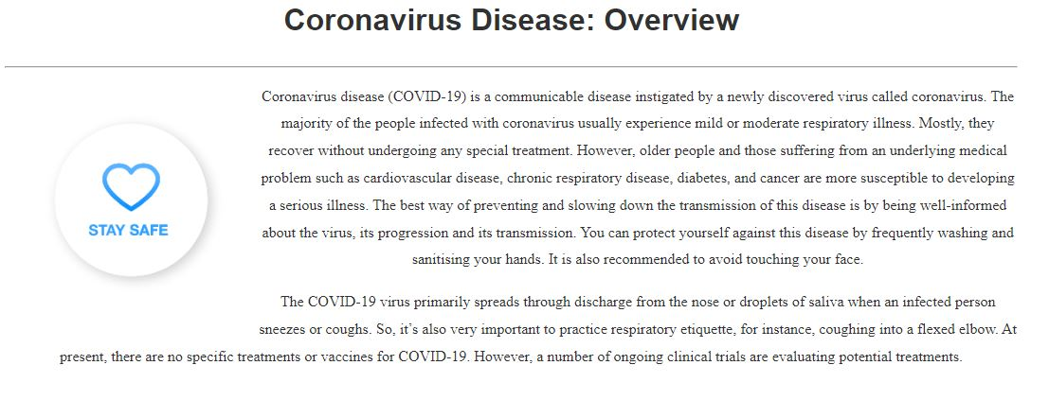
Covid-19 overview….

Slide 14
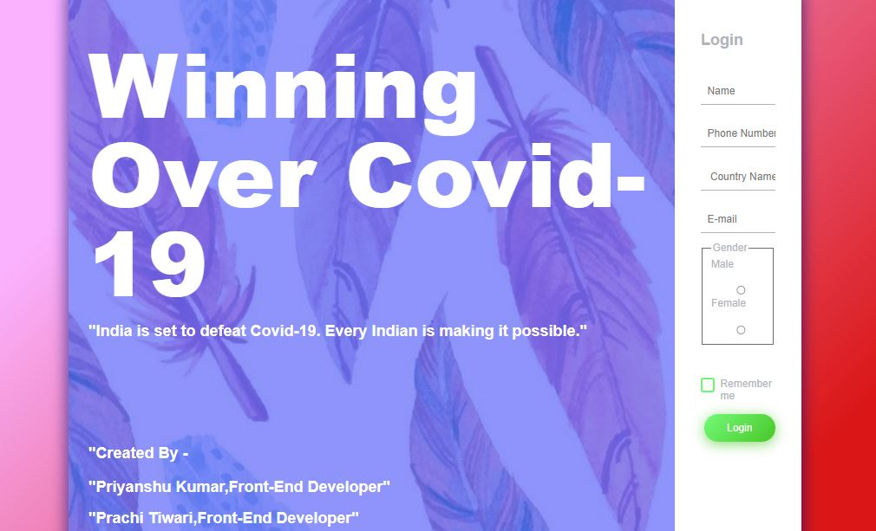
…..log-in page…….

Slide 15
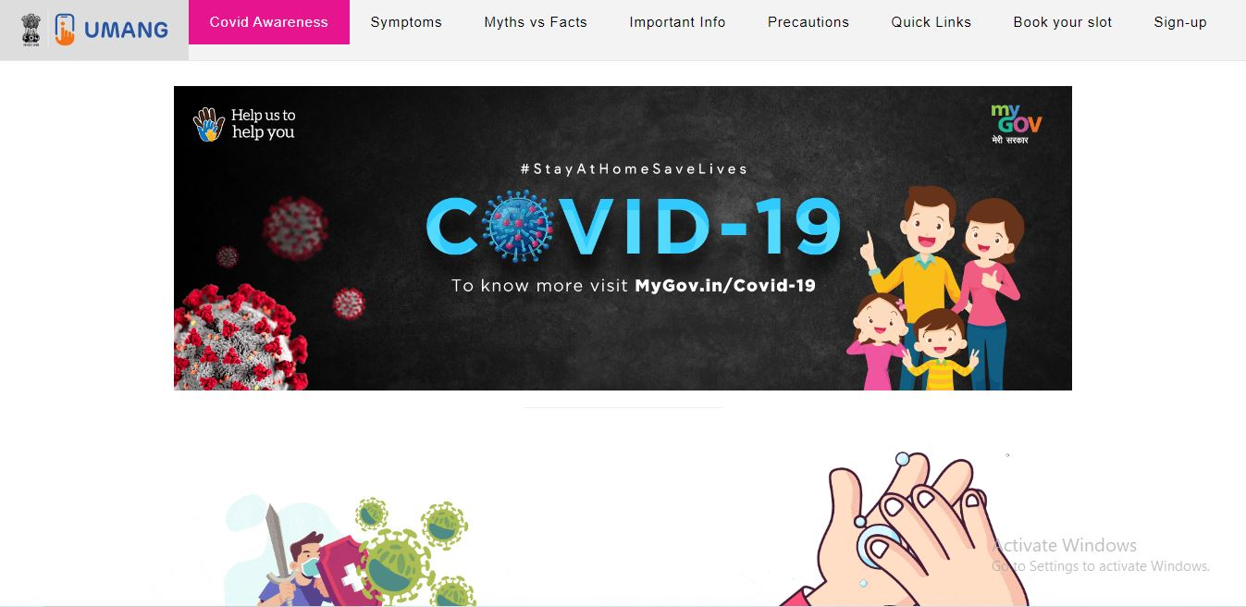
……home page……..

Slide 16
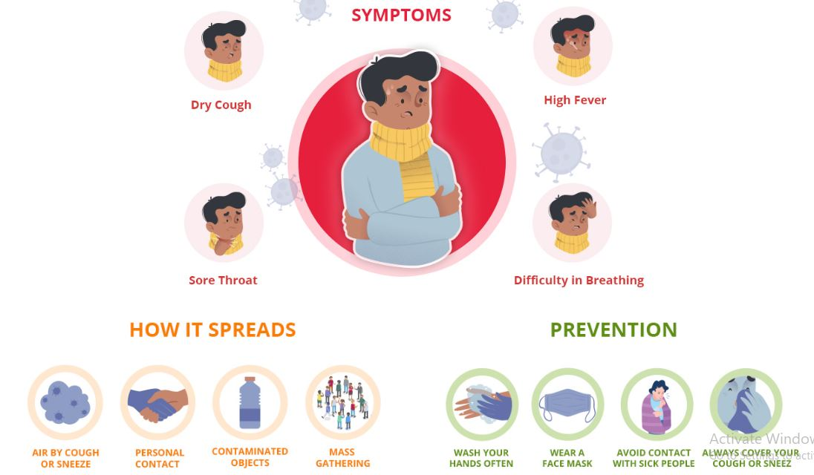
…..symptoms of corona…..

Slide 17
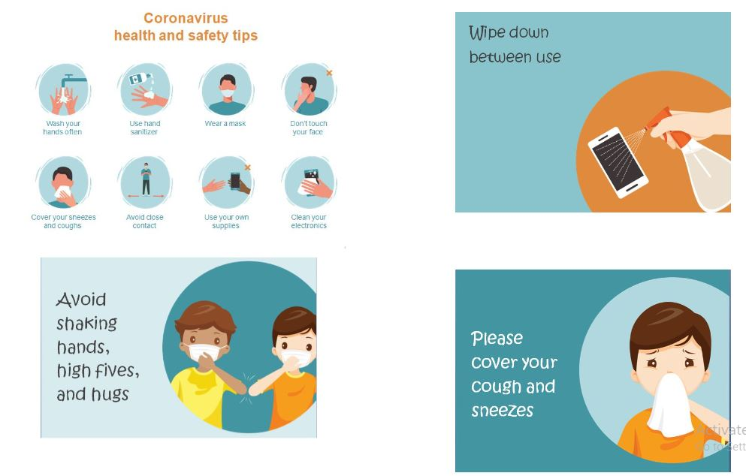
…..safety tips…..

Slide 18
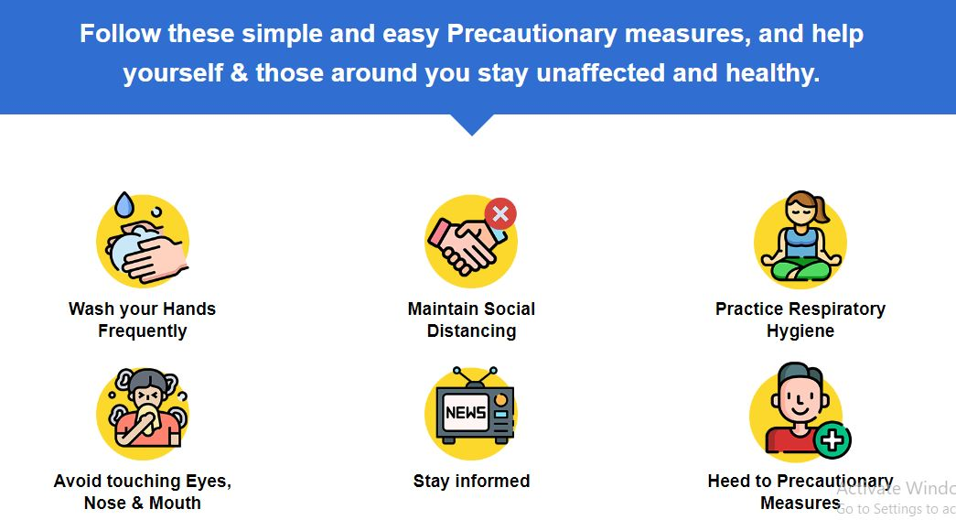
…..precautionary measure…

Slide 19

….. Important information….

Slide 20
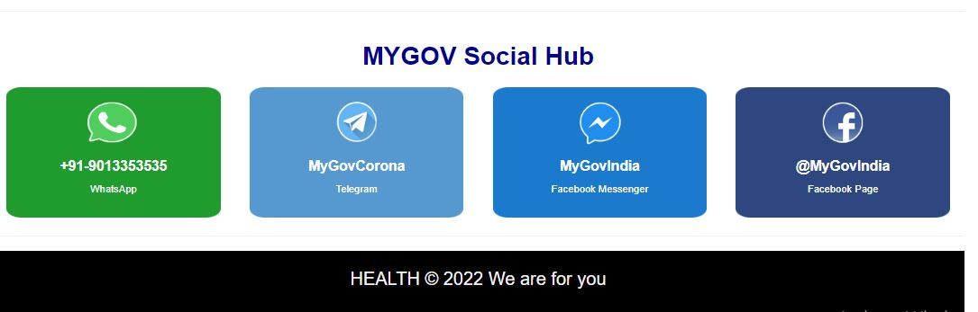
….. Social hub….

Slide 21


….activities….

Slide 22
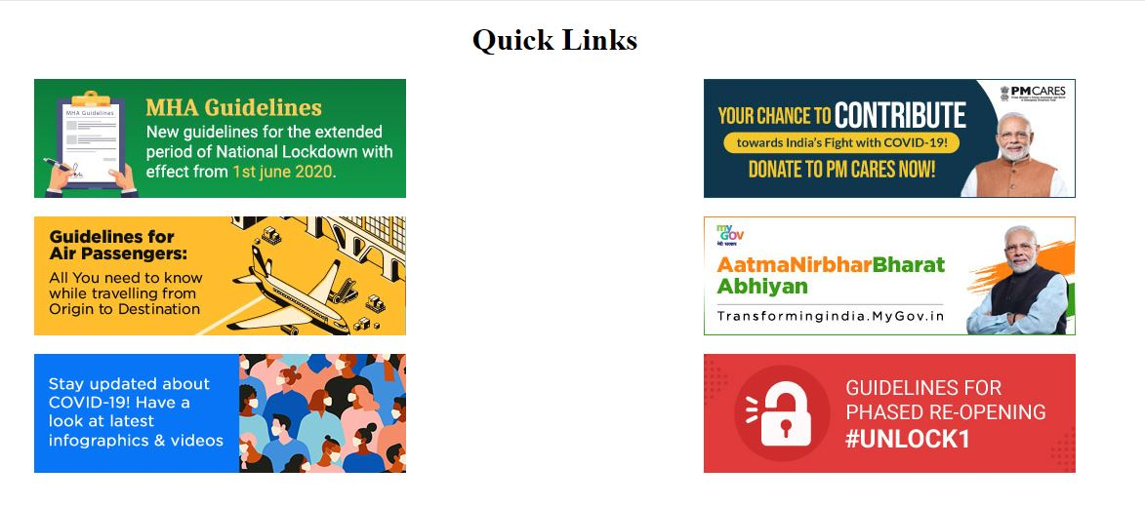
….. Important links….

Slide 23
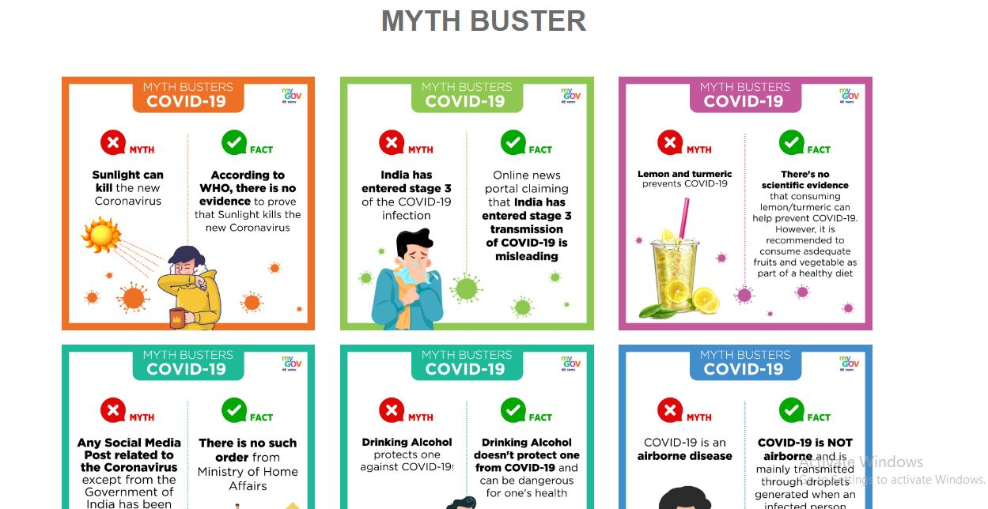
…… myth vs myth buster….

Slide 24
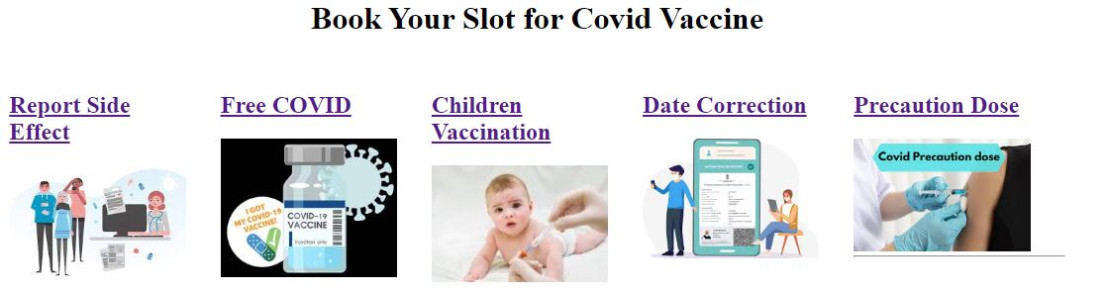
book your slot for vaccine…

Slide 25
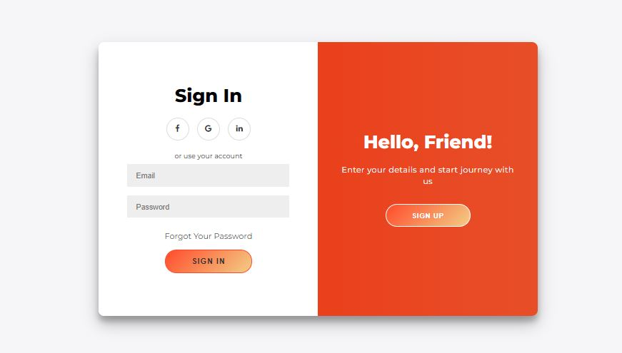
……sign-in & sign-up…..

Slide 26
….future work…..
In this project, we are only telling information related to CORONA virus’s safety measures , precaution , myths and various important news .
In future this website will also keep the information about safety measures , precautions and various information about dangerous diseases likely to come in future.

Slide 27
Thank you
PRIYANSHU KUMAR
kumarrpriyanshu1@gmail.com
PRACHI TIWARI
sandhyatiwari4295@gmail.com

