Slide 1
CLASSIFICATION & PREDICTION OF AGE AND GENDER USING CNN
NAME:- M.L.SAI KUMAR
ROLL NO:- 121822501005
GUIDE:- K.YASUDHA

Slide 2
INTRODUCTION
In this project, I am using CNN for gender classification & ResNet50 architecture to predict age.
CNN is a Neural Network algorithm that extracts the deep features from the image and specifies the desired output at the final layers.
Gender prediction is accurate in all the test data presented to the model. Our model successfully executed with approximately 91% in gender model and mean absolute error of approx 5 in age model.

Slide 3
FUNCTIONAL REQUIREMENTS
Functional requirements can define specific behaviours, features, and use cases of the product.
The project will keep a log of changes as well as the failures of predicting the images or the framework.
The project will have a website hosted in the localhost as well the internet. We just need to upload an image and the underlying models will predict and classify.

Slide 4
NONFUNCTIONAL REQUIREMENTS
Non-functional requirements assess system properties and constraints such as performance, scalability, and security. In short they describe how the system should perform it.
The interface between a user and the automated system shall have a maximum response time of 15 seconds unless noted by an exception.
The project can predict from any type of image like jpg, jpeg, png, gif etc.

Slide 5
HARDWARE REQUIREMENTS
SYSTEM: Intel i5 or more.
RAM: 4GB or more
HARD DISK: 200GB or more
MOUSE/KEYBOARD: Any

Slide 6
SOFTWARE REQUIREMENTS
OPERATING SYSTEM: Windows 7 or more
IDE: Visual Studio Code
FRONT END: Django
BACK END Keras, Ktrain
LIBRARIES: Numpy, Tensorflow, Pillow, Scipy, Math, Matplotlib
HOSTING: Amazon AWS/Heroku

Slide 7
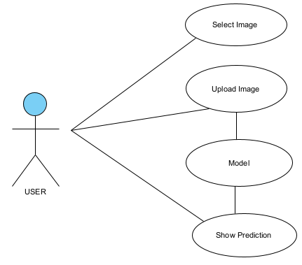
UML DIAGRAM
Use Case Diagram

Slide 8
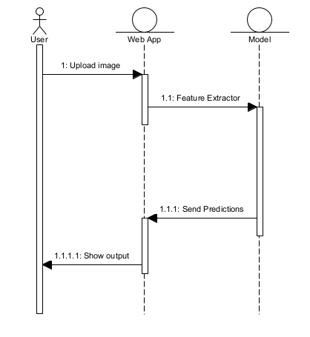
UML DIAGRAM
Sequence Diagram

Slide 9
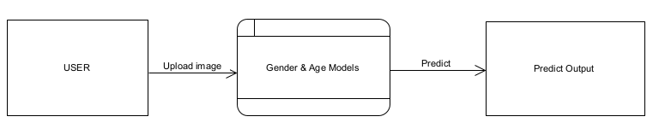
DATA FLOW DIAGRAM

Slide 10
DATASET FOR GENDER PREDICTION
IMDB-WIKI DATASET, the largest dataset for faces in the internet.
It has more than 200000 images.
Divided into three labels(Train, Validation and Test)
Each label is divided into two classes i.e. Male and Female.

Slide 11
DATASET FOR AGE PREDICTION
UTK-Face DATASET, the largest dataset for faces in the internet.
It has more than 20000 images with age ranging from 01-116.
The label of each image is embedded in the filename as : [age]_[gender]_[race]_[date].jpg
Age is extracted using Python RegEx.

Slide 12
MODEL FOR GENDER PREDICTION
Sequential model of Keras, in which each layer has exactly one input and one output.
Train Datagen generates many images from a single image which will help us in training and improving the accuracy.
We used class mode as binary as it has two classes 0-female and 1-male.
Used 5 Conv layers and 2 Fully connected layers.

Slide 13
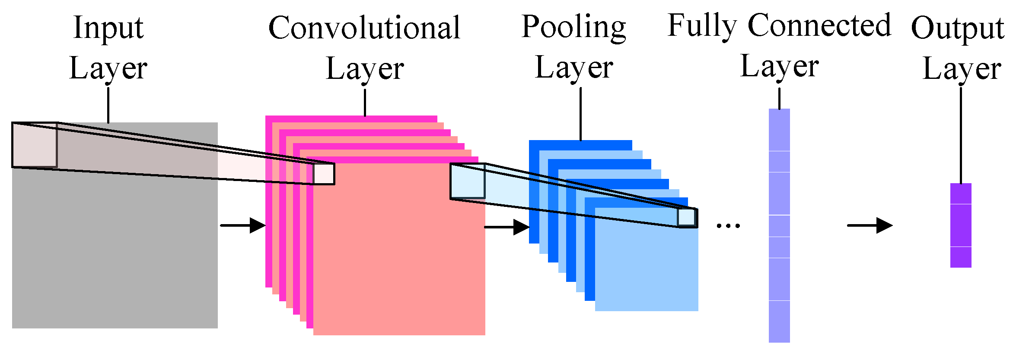
CONVOLUTIONAL NEURAL NETWORK

Slide 14
CONVOLUTIONAL NEURAL NETWORK
The input layer contains the image data.
The Conv layer is the feature extractor which will extract features from the image.
The pooling layer is used to reduce the spatial volume of the input image.
The FC layer is used to classify images between different category by training.
The output layer is used to generate the output based on the number of classes desired by the network.

Slide 15
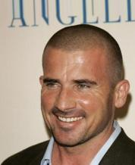
TRAINING THE MODEL- GENDER
STEP-1:- We will Import all the required modules.
STEP-2:- We will convert a single image into multiple images.

Slide 16
TRAINING THE MODEL- GENDER
STEP-3:- Loading Train data and validation data from the OS/drive/Github.
STEP-4:- We will wrap the model with keras sequential model with 5 Conv layers and 2 FC layers. We will train it for 50 epoch and in each epoch the batch size is 256.
exa:- Epoch 3/50 256/256 [==============================] - 2599s 10s/step - loss: 0.4556 - accuracy: 0.7879

Slide 17
TRAINING THE MODEL- GENDER
STEP-5:- We will save the model as JSON and weights as h5 file.
STEP-6:- We will use the saved machine learning model in Django for predictions.

Slide 18
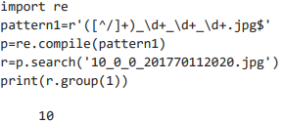
TRAINING THE MODEL- AGE
STEP-1:- We will import all the required ktrain modules.
STEP-2:- We will clone the dataset in Google Colab from Github.
STEP-3:- We will use Python RegEx to extract age from the image file name.

Slide 19
TRAINING THE MODEL- AGE
STEP-4:- We will wrap the learner with ResNet50 model along with train data and test data and the pre-processor.
STEP-5:- We will train the model for a required number of epoch.
STEP-6:- We will save the model as JSON file and weights as h5 file.
STEP-7:- We will use the saved model in Django for predictions.

Slide 20
MODEL FOR AGE PREDICTION
ResNet50 model of CNN, a 50 layer residual network which has 48 Conv layers and 1 MaxPool layer and 1 AveragePool layer.
We wrap the model in the learner by using Ktrain API along with the train data and test data.
We use regression as true so Ktrain will use the representing age as numerical rather than a class.
ResNet50 is mainly used here to improve the accuracy and reduce computational depth.

Slide 21
THE FRONTEND- DJANGO FRAMEWORK
A high level python web framework.
Deployed the machine learning models into web application using the Django framework.
HTML, CSS, JS and Bootstrap are used for the designing the webpage.
Microsoft Visual studio code is used as the code editor.

Slide 22
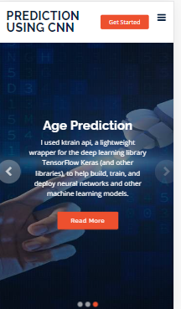
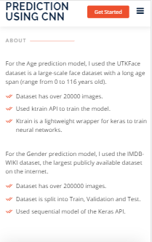
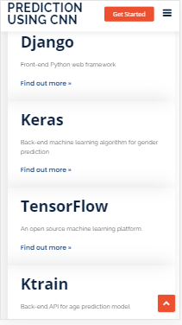
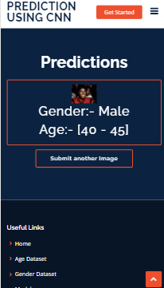
Mobile View

Slide 23
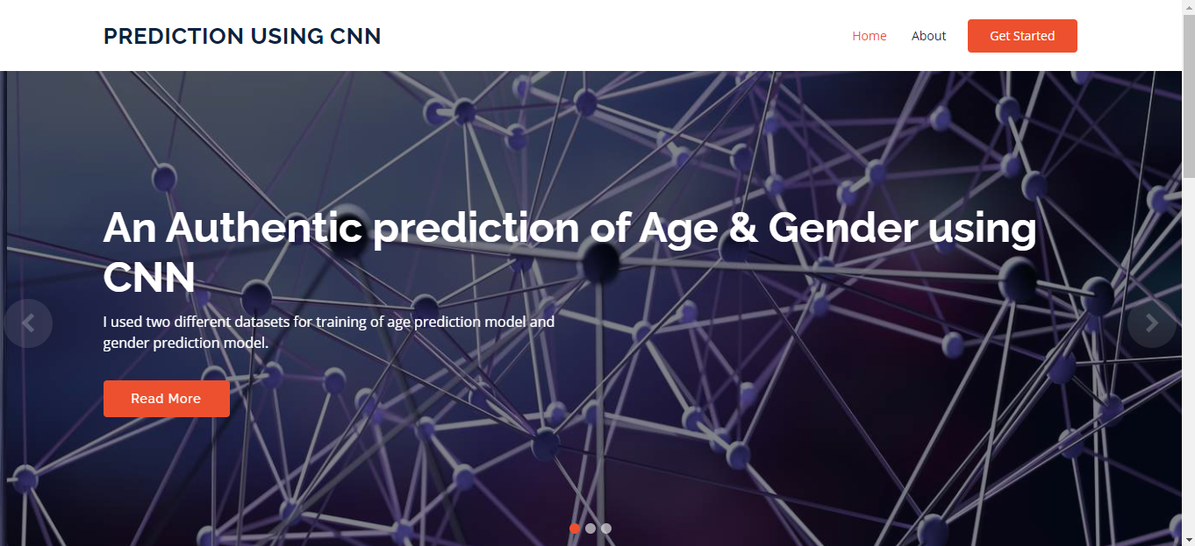
SCREENSHOTS
Home Page
.

Slide 24
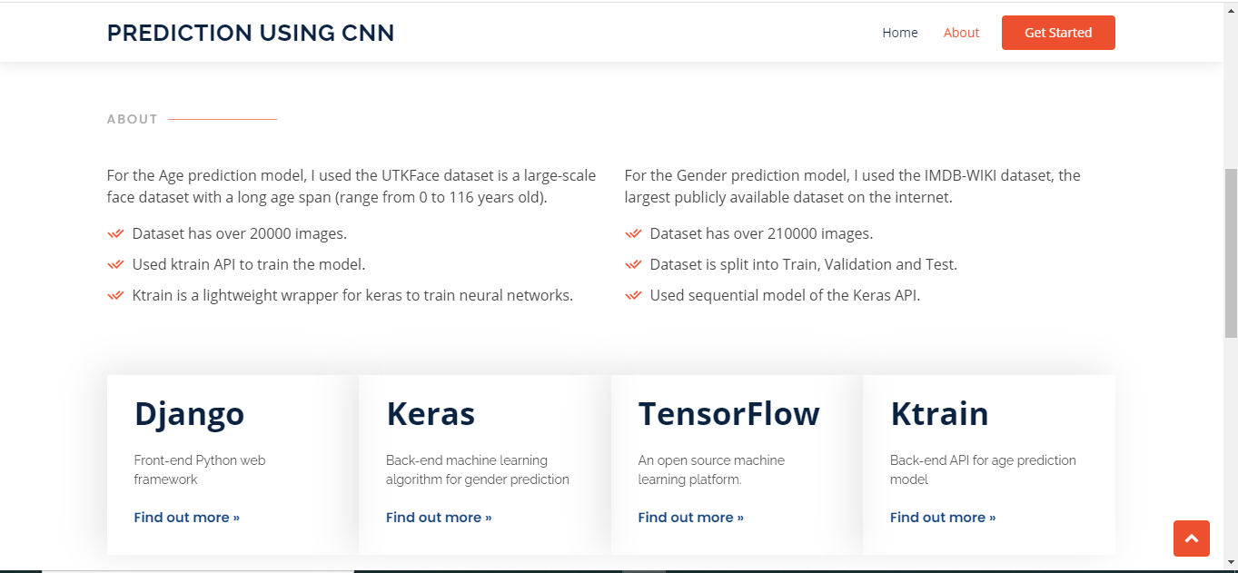
SCREENSHOTS
About
.

Slide 25
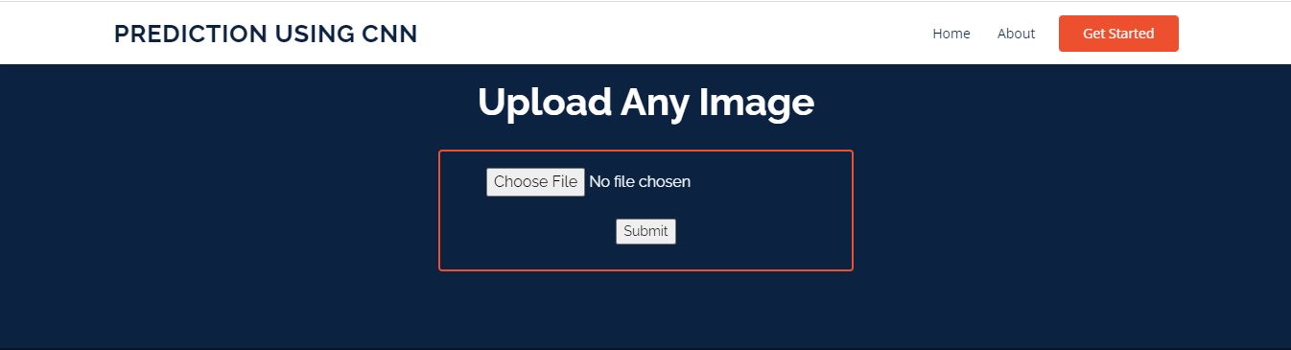
SCREENSHOTS
Get Started
.

Slide 26
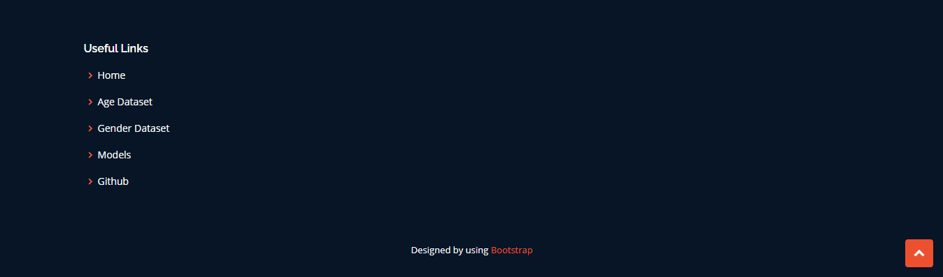
SCREENSHOTS
Footer
.

Slide 27
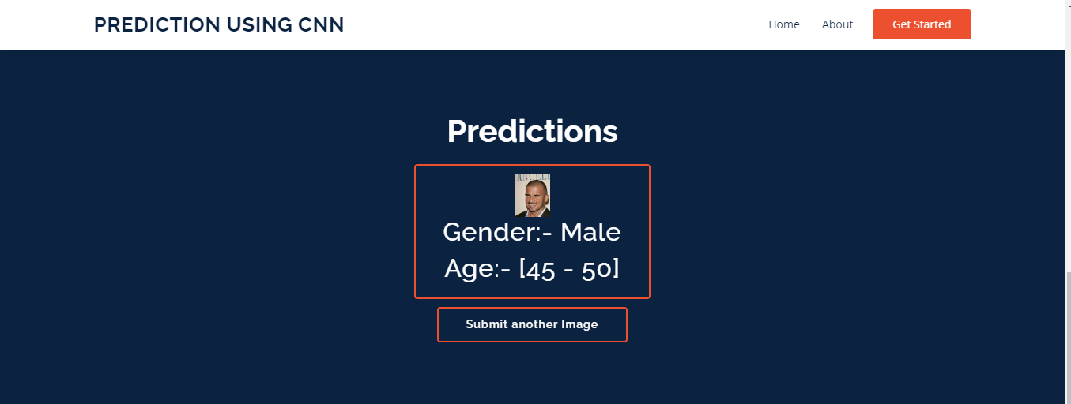
SCREENSHOTS
Result

Slide 28
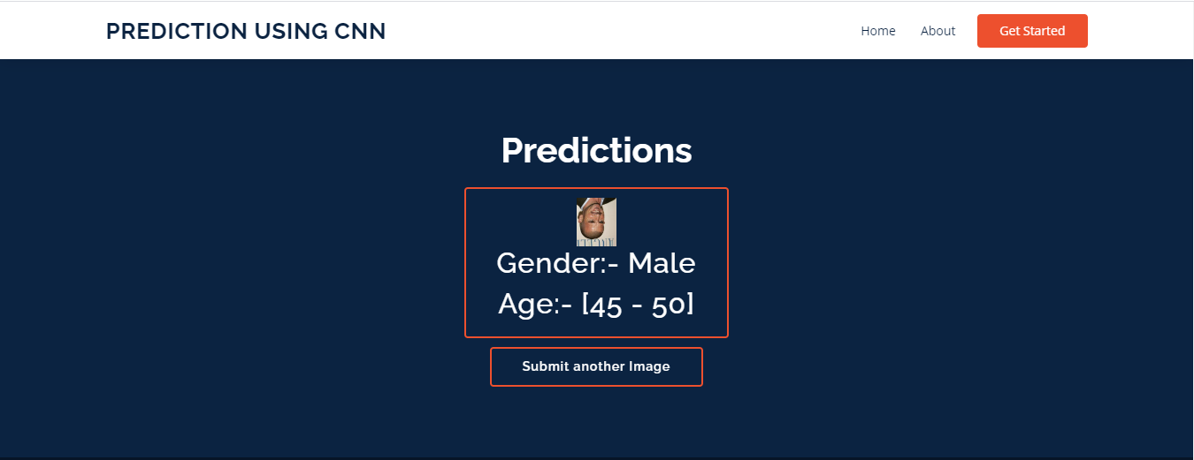
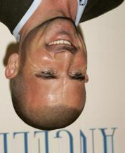
SCREENSHOTS
Result

Slide 29
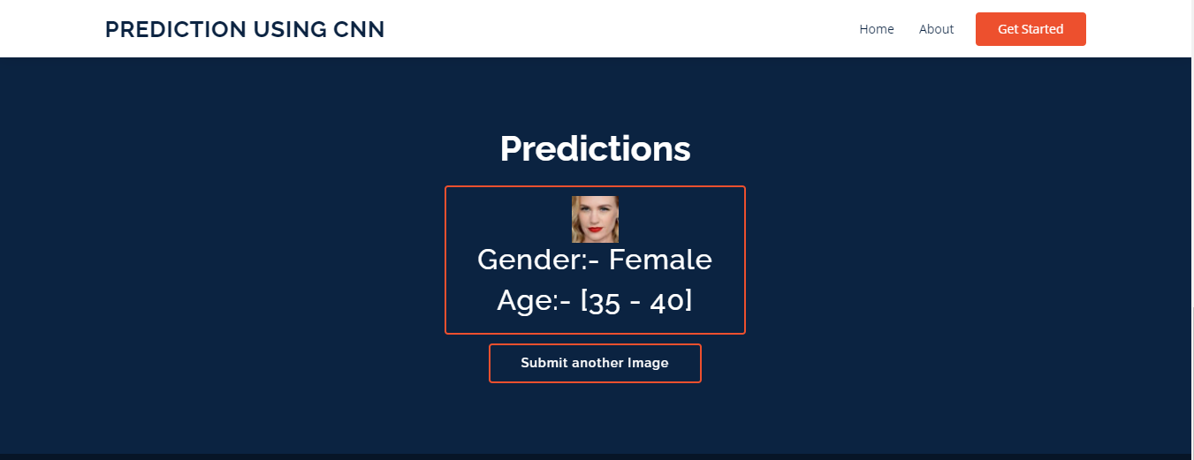
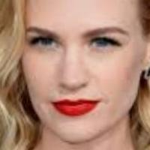
SCREENSHOTS
Result

Slide 30
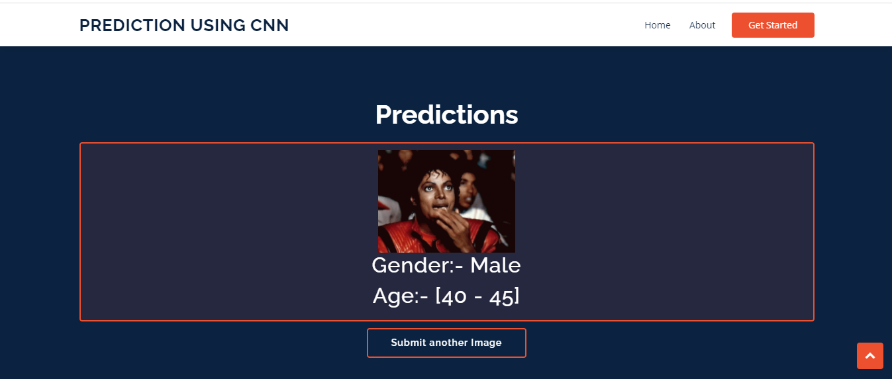
SCREENSHOTS
Result

Slide 31
CONCLUSION
Two important conclusions can be made from our results.
First, CNN can be used to provide improved age and gender classification results, even considering the much smaller size of contemporary unconstrained image sets labelled for age and gender.
Second, the simplicity of our model implies that more elaborate systems using more training data may well be capable of substantially improving results beyond those reported in this project.

Slide 32
BIBLIOGRAPHY
http://keras.io/
http://www.tensorflow.org/guide/keras/sequential_model
http://github.com/amaiya/ktrain
http://docs.djangoproject.com/en/3.2/
http://www.vitoshacademy.com/python-django-how-to-add-css-to-django-application/

Slide 33
Thank You

