Slide 1



calender-1
View in Power BI
Last data refresh:
3/21/2022 2:02:45 AM UTC
Downloaded at:
4/6/2022 2:58:10 AM UTC

Slide 2
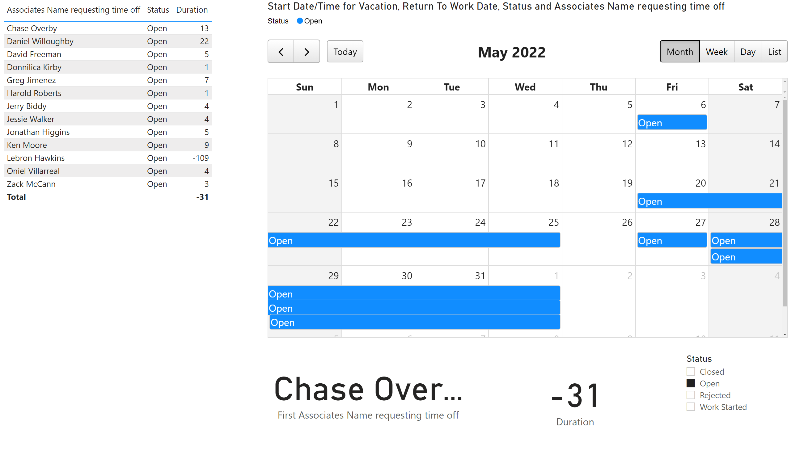
Page 2
Notes:
calendarVisual74934D05B71F4C31B0F79D925EE89638
No alt text provided
slicer
No alt text provided
card
No alt text provided
card
No alt text provided
tableEx
No alt text provided

