Slide 1

AI-Powered Enterprise Knowledge Assistant using Retrieval-Augmented Generation (RAG) and Natural Language Processing
DSA0308 – Natural Language Processing
Presented by
B Rajesh -192472165
C Sandeep - 192472368
V Nagendra - 192425091
Supervisor
Dr. T. Kumaragurubaran

Slide 2


Abstract
AI-Powered Enterprise Knowledge Assistant enables users to access enterprise information quickly using Natural Language Processing (NLP).
Retrieval-Augmented Generation (RAG) retrieves relevant documents before generating responses, ensuring accurate and reliable answers.
Large Language Models (LLMs) generate context-aware responses while minimizing hallucinations through document-grounded information.
The system supports intelligent document search, question answering, and knowledge summarization across enterprise repositories.
The proposed solution improves employee productivity, decision-making, and overall enterprise knowledge management efficiency.

Slide 3
Introduction
Modern enterprises generate vast amounts of structured and unstructured data, making information retrieval challenging and time-consuming.
Traditional keyword-based search systems often fail to understand user intent, leading to inaccurate and inefficient search results.
Natural Language Processing (NLP) enables the system to understand user queries in natural language and identify their context.
Retrieval-Augmented Generation (RAG) combines document retrieval with Large Language Models (LLMs) to generate accurate, context-aware responses.
The AI-Powered Enterprise Knowledge Assistant improves knowledge access, employee productivity, and organizational decision-making through intelligent information retrieval.

Slide 4

Objectives
To develop an AI-powered enterprise knowledge assistant for intelligent information retrieval.
To implement Natural Language Processing (NLP) for understanding user queries in natural language.
To integrate Retrieval-Augmented Generation (RAG) for accurate, context-aware, and reliable response generation.
To enable document search, question answering, and knowledge summarization from enterprise repositories.
To improve employee productivity, decision-making, and enterprise knowledge management efficiency.

Slide 5
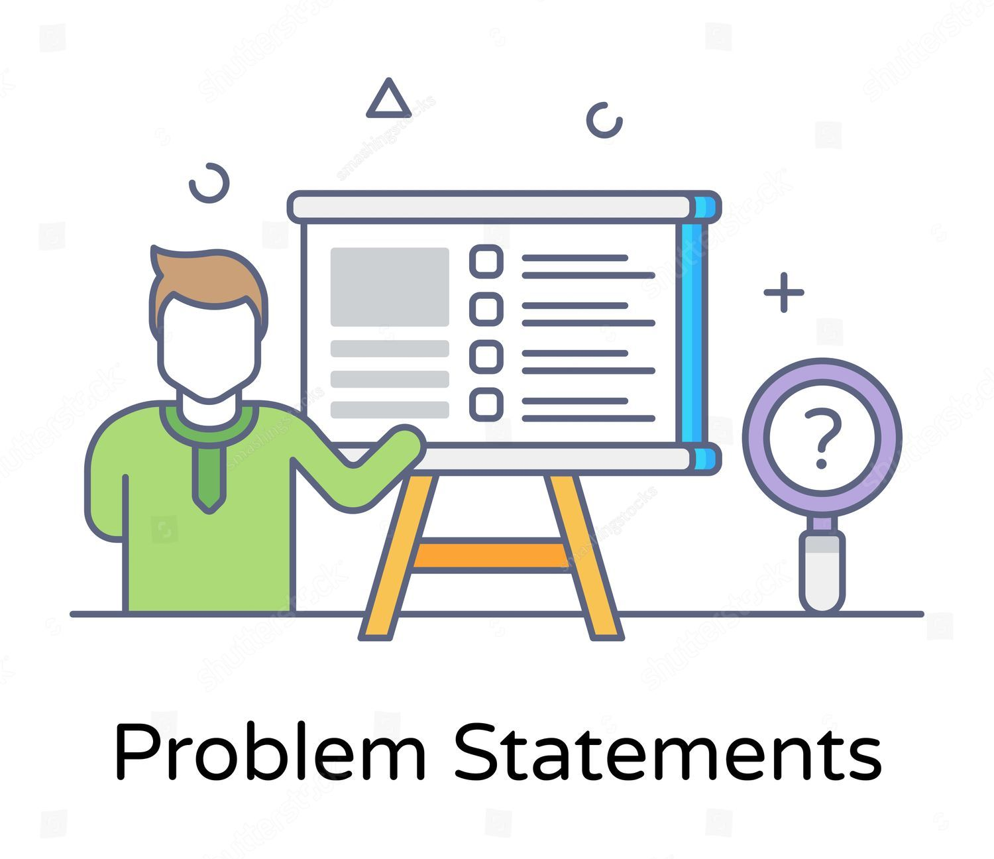
Problem Statement
Enterprises store large volumes of structured and unstructured data, making information retrieval difficult and time-consuming.
Traditional keyword-based search systems fail to understand the context and intent behind user queries.
Employees spend excessive time searching across multiple documents, manuals, and knowledge repositories.
Existing AI systems may generate inaccurate or hallucinated responses without using verified enterprise data.
An intelligent, context-aware knowledge assistant is needed to provide fast, accurate, and reliable access to enterprise information.

Slide 6
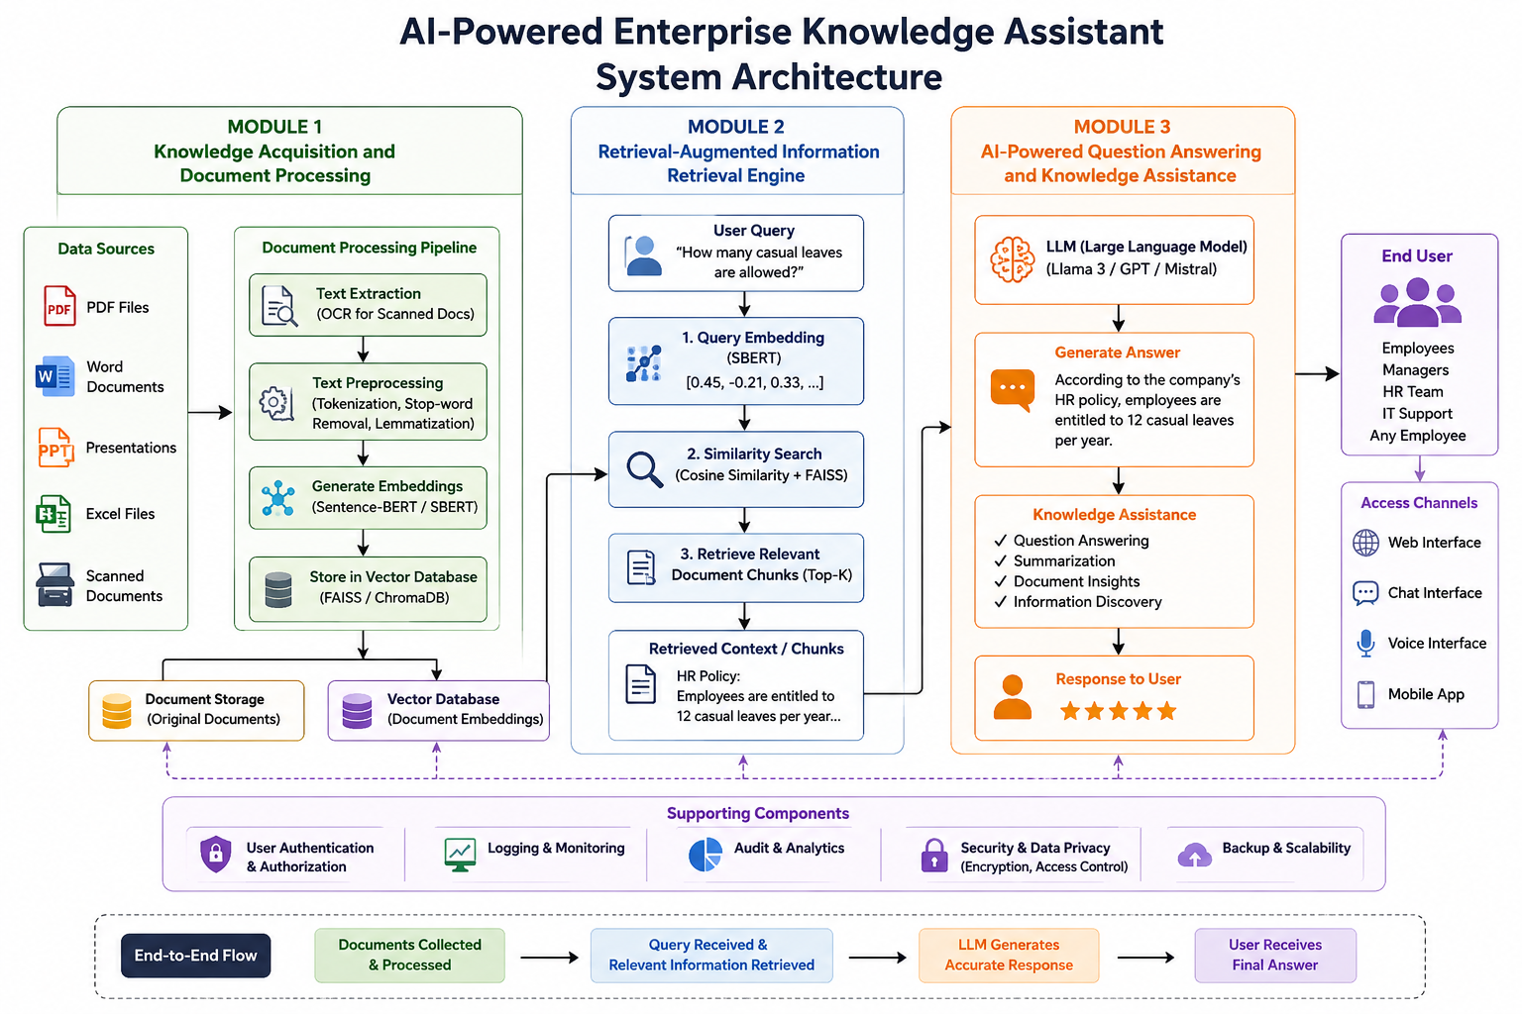

Slide 7
Literature Review
Author / Year | Title of the Paper | Method / Algorithm Used | Key Findings
Gao, Y. et al. (2023) | Retrieval-Augmented Generation for Large Language Models: A Survey | RAG, LLM | Improved answer accuracy and reduced hallucinations.
Chen, X. et al. (2024) | Enterprise Knowledge Management using Large Language Models | NLP, LLM | Enhanced enterprise knowledge retrieval and decision-making.
Wang, H. et al. (2024) | Intelligent Question Answering using RAG | RAG, Vector Search | Delivered context-aware and reliable responses.
Kumar, R. et al. (2025) | AI-Based Enterprise Knowledge Assistant | NLP, RAG, Transformer | Improved document search and employee productivity.

Slide 8
Modules
Module 1 : Knowledge Acquisition and Document Processing
Module 2 : Retrieval-Augmented Information Retrieval Engine
Module 3: AI-Powered Question Answering and Knowledge Assistance

Slide 9
Module 1 : Knowledge Acquisition and Document Processing
Collects enterprise documents such as PDFs, Word files, reports, manuals, and company policies.
Extracts text from digital and scanned documents using text extraction or OCR.
Preprocesses the text using tokenization, stop-word removal, and lemmatization.
Converts document content into embeddings using models such as Sentence-BERT (SBERT).
Stores documents and embeddings in document storage and a vector database for later retrieval.

Slide 10
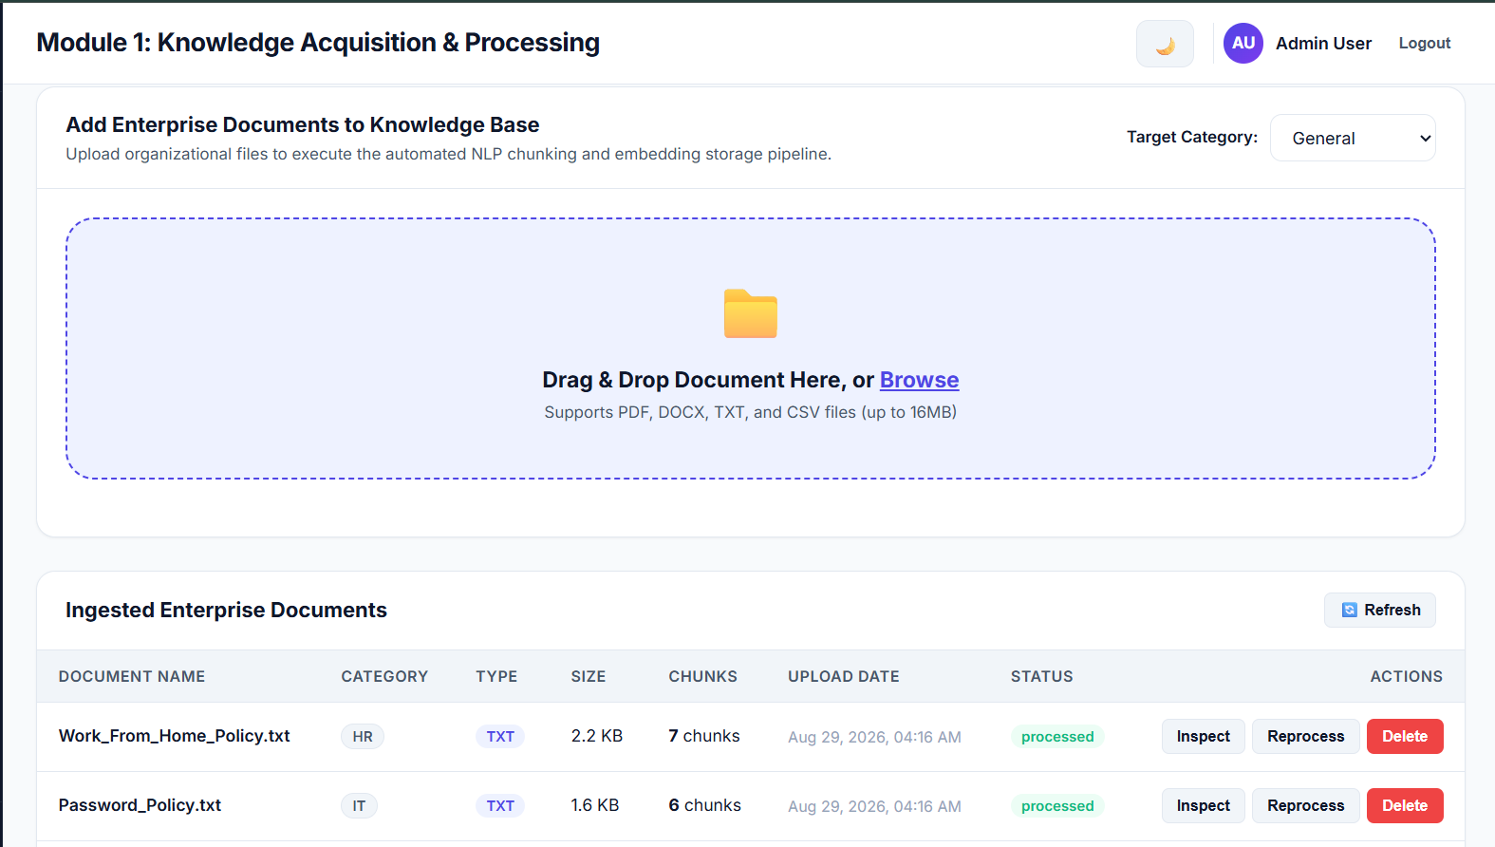

Slide 11
Module 2: Retrieval-Augmented Information Retrieval Engine
Accepts the user's natural-language query and converts it into a semantic embedding.
Searches the vector database to find information related to the user's query.
Uses similarity search such as Cosine Similarity and FAISS to identify relevant content.
RAG retrieves the most relevant document chunks from the enterprise knowledge base.
Passes the retrieved information to the LLM to generate a reliable and context-aware response.

Slide 12
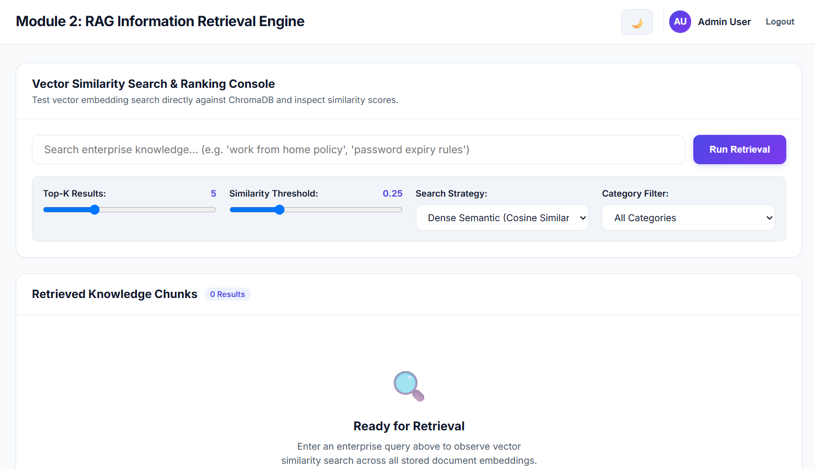

Slide 13
Module 3: AI-Powered Question Answering and Knowledge Assistance
Uses a Large Language Model (LLM) to understand the user's question and retrieved information.
Generates clear and context-aware answers based on the retrieved enterprise data.
Reduces hallucinations by grounding responses in the organization's documents.
Supports knowledge assistance such as question answering, document summarization, and information discovery.
Improves employee productivity by providing quick and reliable access to organizational knowledge.

Slide 14
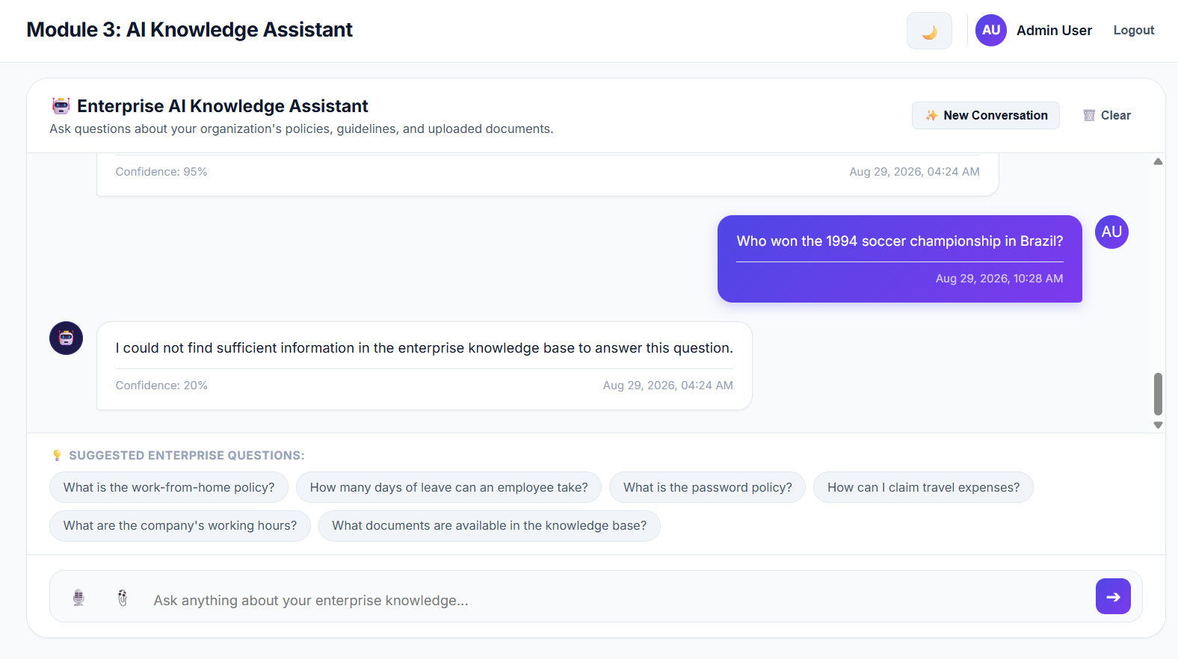

Slide 15
Result
The system successfully collects and processes enterprise documents and converts their content into searchable knowledge.
RAG retrieves the most relevant information from the enterprise knowledge base based on the user's natural-language query.
The LLM generates accurate, context-aware responses using the retrieved organizational information.
The system supports question answering, document search, summarization, and knowledge discovery.
Overall, the proposed system reduces information-search time, improves employee productivity, and provides efficient enterprise knowledge management.

Slide 16
Conclusion
The AI-Powered Enterprise Knowledge Assistant provides an intelligent way to access and manage enterprise information.
NLP helps the system understand user queries, while RAG retrieves relevant information from organizational documents.
LLMs generate accurate and context-aware answers based on the retrieved enterprise knowledge.
The system reduces manual document searching and information retrieval time, making knowledge access faster and easier.
Overall, the solution improves employee productivity, decision-making, collaboration, and enterprise knowledge management.

Slide 17
Future Scope
Multilingual Support: Extend the assistant to understand and respond in multiple languages for diverse employees.
Voice-Based Interaction: Add speech recognition and voice responses for hands-free and natural communication.
Advanced Document Support: Support more formats such as images, spreadsheets, presentations, and scanned documents.
Improved AI and RAG: Use advanced LLMs, better retrieval techniques, and hybrid search to improve accuracy and reduce hallucinations.
Enterprise Integration: Integrate with platforms such as email, HR systems, CRM, ERP, and internal communication tools for centralized knowledge access.

Slide 18
References
Gao, Y., et al. (2023). Retrieval-Augmented Generation for Large Language Models: A Survey. arXiv preprint arXiv:2312.10997.
Chen, X., et al. (2024). Enterprise Knowledge Management using Large Language Models. Proceedings of the IEEE International Conference on Artificial Intelligence and Knowledge Engineering.
Wang, H., et al. (2024). Intelligent Question Answering using Retrieval-Augmented Generation. Proceedings of the International Conference on Natural Language Processing and Information Retrieval.
Kumar, R., et al. (2025). AI-Based Enterprise Knowledge Assistant using NLP and Retrieval-Augmented Generation. International Journal of Computer Science and Information Technology (IJCSIT).
Peng, B., Zhu, Y., Liu, Y., Bo, X., Shi, H., Hong, C., Yan, Z., & Tang, S. (2024). Graph Retrieval-Augmented Generation: A Survey. arXiv:2408.08921.

Slide 19


