Slide 1
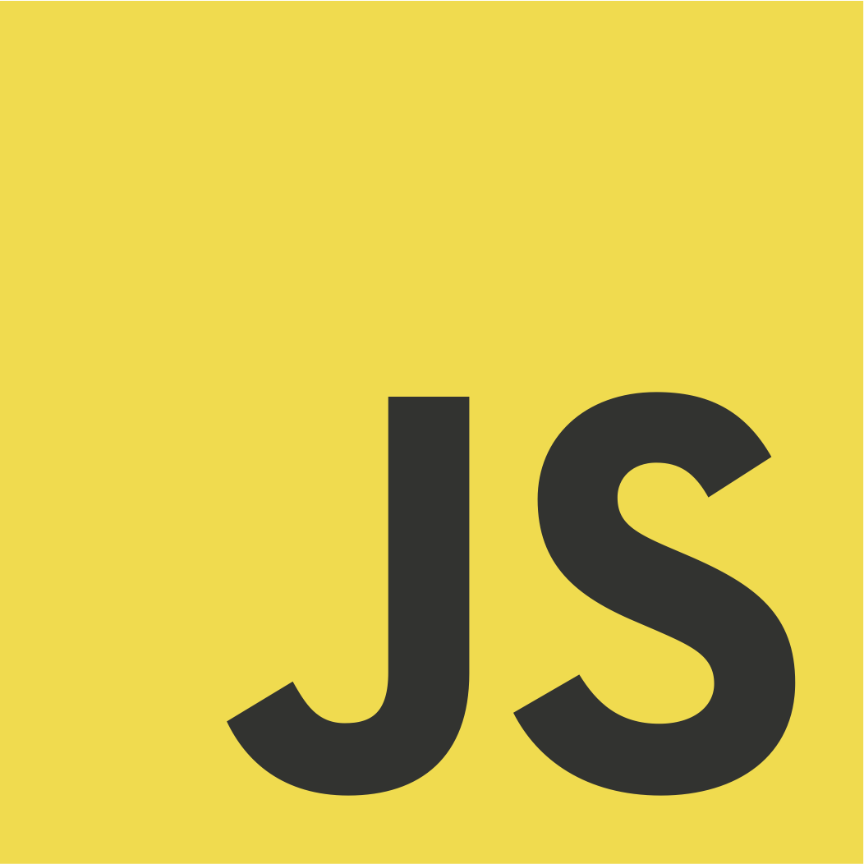
JavaScript

Slide 2
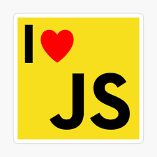
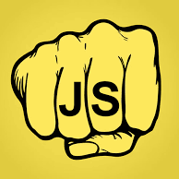
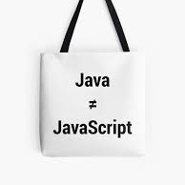

Slide 3
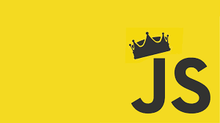
Most Famous Programming Language

Slide 4
Let’s Start with Fundamentals

Slide 5
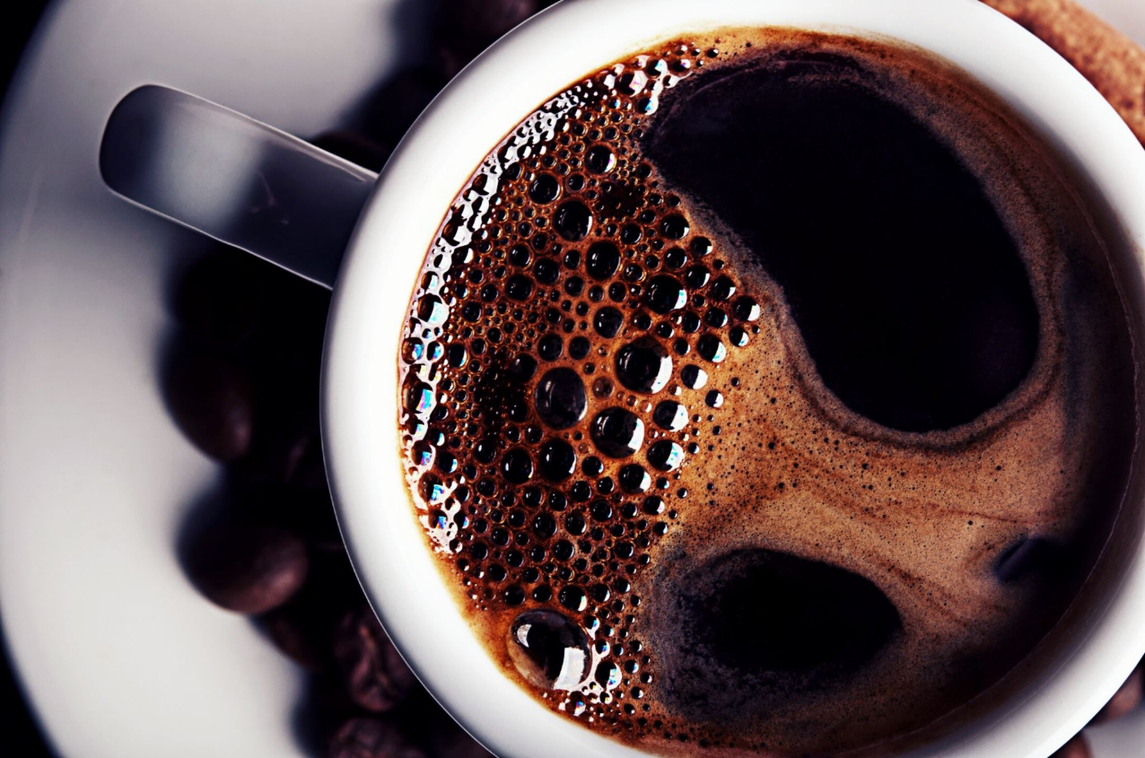
Mocha -> LiveScript -> JavaScript
(1995 => 1996 =>Till Date)

Slide 6
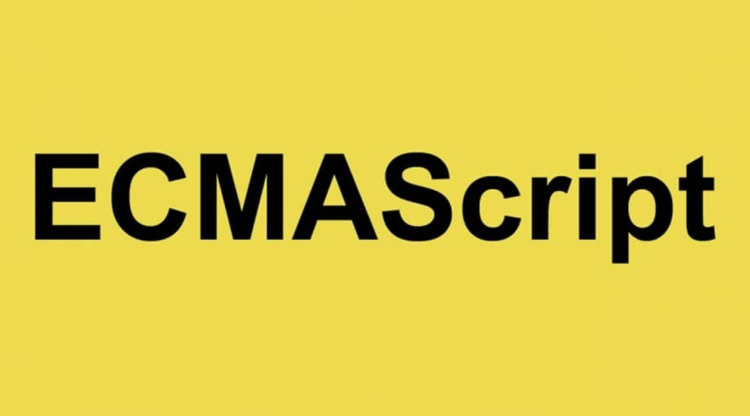
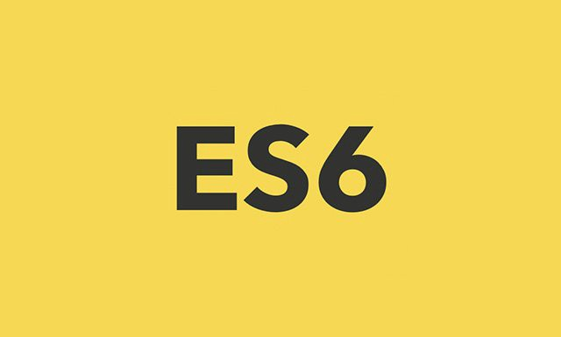

Slide 7
Basics of Programming Language
Values
Operations
Variables
Decisions
Loops
Functions

