Slide 1
NeuroSync
Work, in sync with how you think.
An inclusive work companion for neurodivergent employees (ADHD & dyslexia)
Accenture HumanEdge Hackathon — Final Jury, 2026

Slide 2

THE HUMAN STORY
Meet Aanya — a talented analyst with ADHD and dyslexia.
Monday, 9 AM: 38 unread emails, 4 chat threads, 6 tickets. One email hides three tasks and a Thursday deadline in paragraph three.
An hour later — she still hasn’t started. It isn’t her ability; her workday was built for a brain that isn’t hers.
Photo: CIPHR Connect, CC BY 2.0

Slide 3
THE PROBLEM
A hidden ‘cognitive tax’
Turning workplace text into started, finished work costs employees with ADHD and dyslexia far more energy —
not because of capability, but because mainstream tools assume one way of processing information.
Missed priorities
Tasks & deadlines buried in long emails, chats, tickets.
Cognitive overload
Constant re-reading and context-switching drains focus.
Emotional burnout
Masking the struggle leads to absence and attrition.
Lost productivity
Wasted talent — for the person and the business.
51% of neurodivergent employees have taken time off due to their condition.
Source: Neurodiversity in the Workplace — mydisabilityjobs.com (City & Guilds Neurodiversity Index, 2025)
NeuroSync · Work, in sync with how you think
3

Slide 4

WHO IT’S FOR — AND WHY IT MATTERS
A specific audience, a connected problem
15–20%
of people are neurodivergent (ADHD, autism, dyslexia, dyspraxia).
~1 in 2
people with ADHD also have dyslexia — ONE connected problem, not two.
28% ↑ revenue
Accenture: disability-inclusion leaders averaged ~28% higher revenue & 2× net income (4 yrs).
Our user: Accenture employees with ADHD and/or dyslexia.
Source: Accenture, ‘Getting to Equal: The Disability Inclusion Advantage’ (2018)
NeuroSync · Work, in sync with how you think
4

Slide 5
WHAT MAKES NEUROSYNC DIFFERENT?
Why not just use ChatGPT or Copilot?
Generic AI gives everyone the same answer. NeuroSync does three things they don’t do together:
1
2
3
Personalisation
Adaptive output
The SAME email becomes time-boxed steps (ADHD) or short, plain, dyslexia-friendly text — from a one-time profile.
Understanding AND doing
Not just ‘I get it’
We attack task initiation & overwhelm — micro-steps, focus mode, a one-tap reset — so understanding turns into action.
Built for your brain
& your firewall
Calm, sensory-aware by default, running on enterprise data in-tenant — not a public chatbot.
NeuroSync · Work, in sync with how you think
5

Slide 6
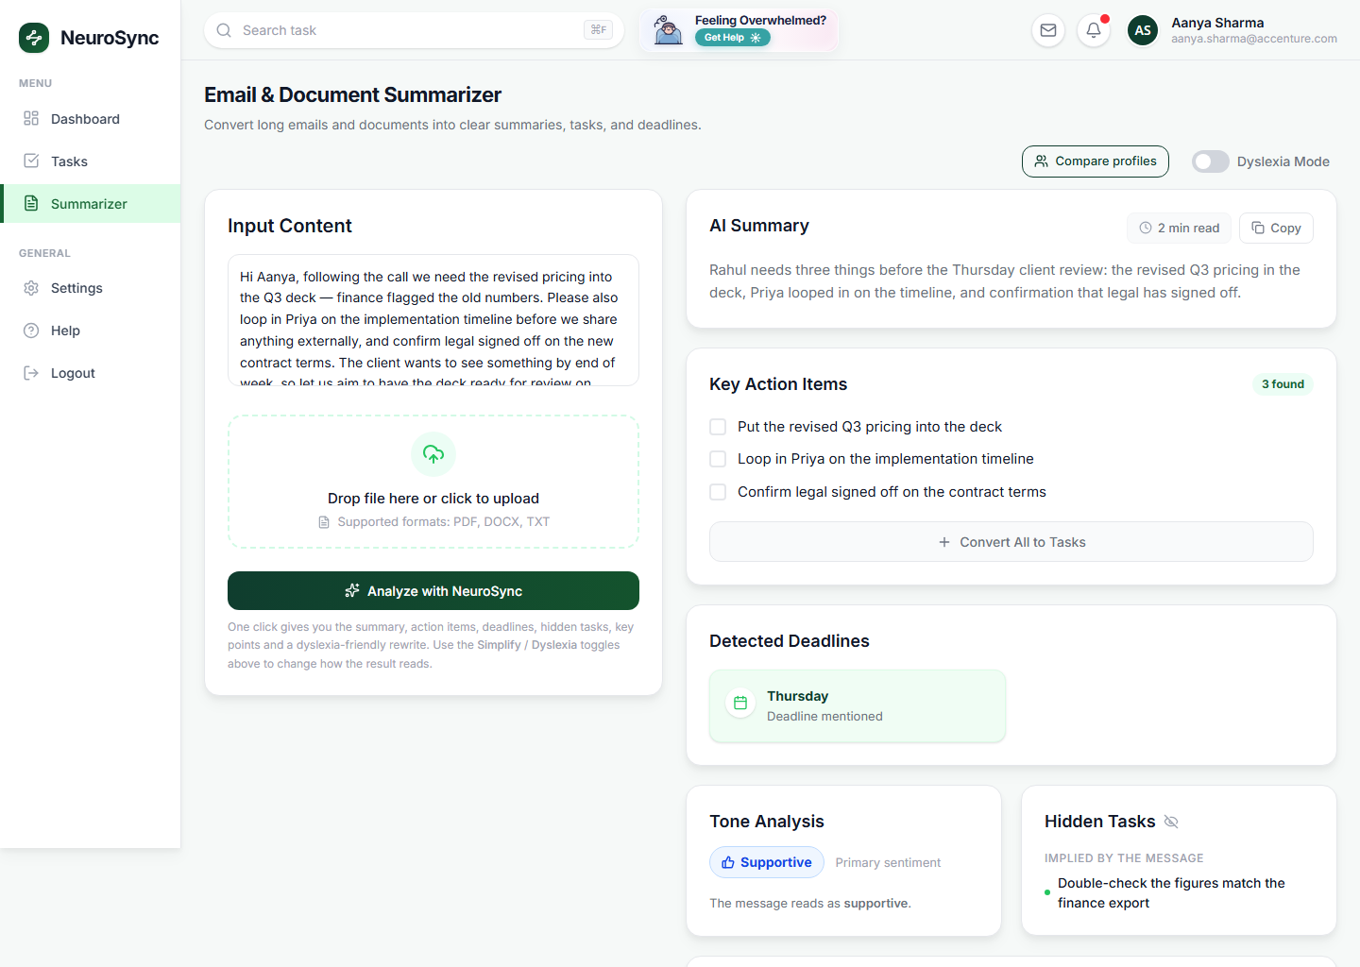
HOW IT WORKS
From chaos to the next clear step — in the real product
1
Email / Outlook or any text
2
AI summary + action items
3
Adaptive breakdown (your profile)
4
Prioritise
5
Focus timer
6
Execute
Real screenshot — the Summarizer turning a messy email into summary, action items & a deadline.
NeuroSync · Work, in sync with how you think
6

Slide 7
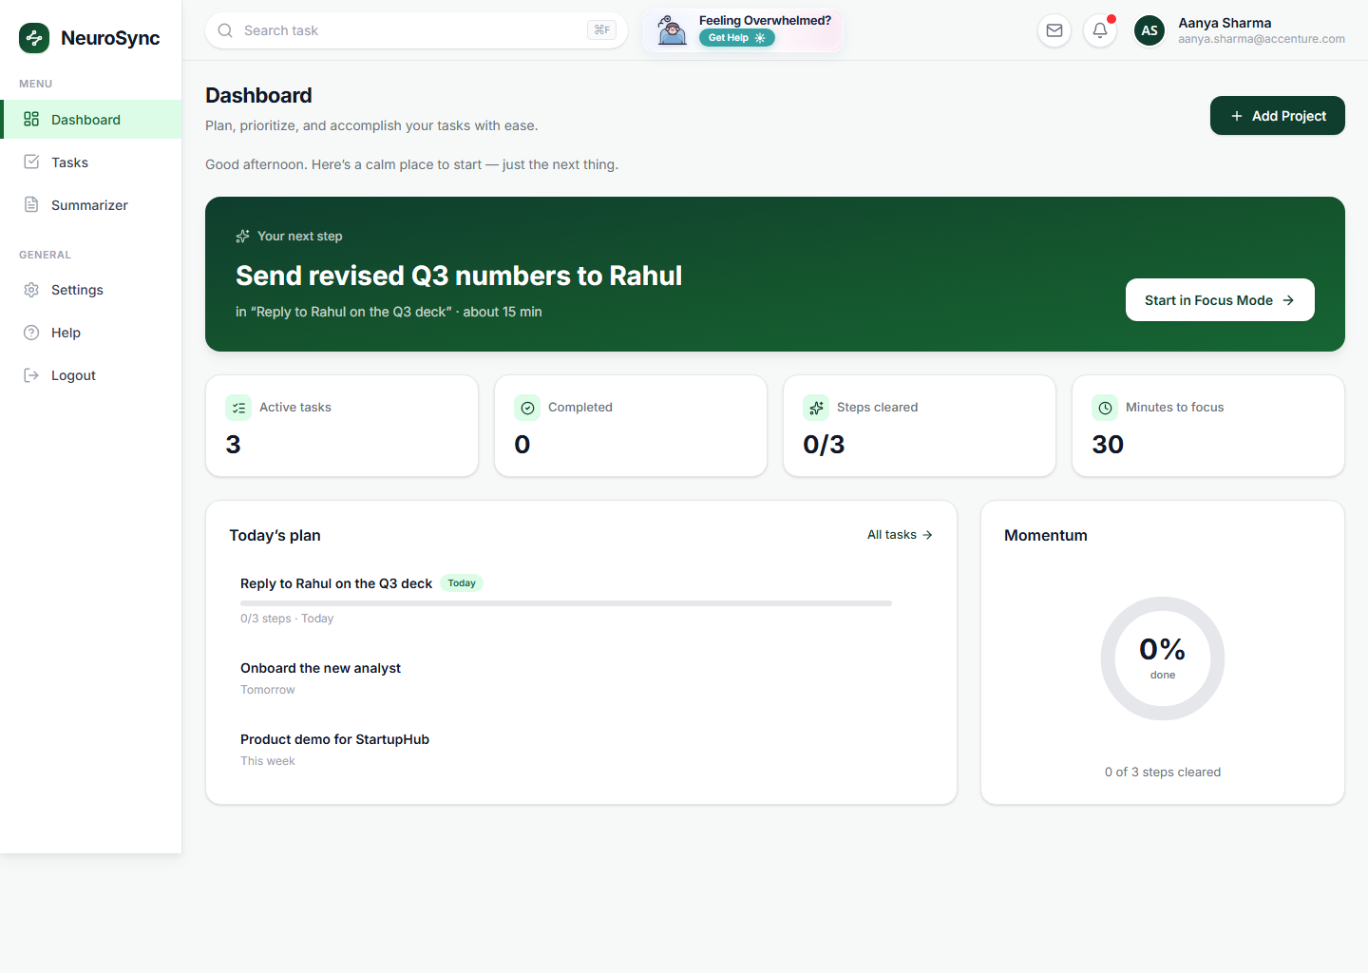
SEE IT WORK
Live demo — real AI, in seconds
1 Calm dashboard — one clear next step
2 Email → summary, tasks, hidden deadline
Then: convert to micro-steps with time estimates → Focus Mode strips all but the next step. We’ll show, not tell.
NeuroSync · Work, in sync with how you think
7

Slide 8

From 38 unread emails to one clear next step.
Same inbox, same deadlines — now understood, broken down, and started. No masking, no asking for help. That’s the point of NeuroSync.
Photo: StockSnap, CC0

Slide 9
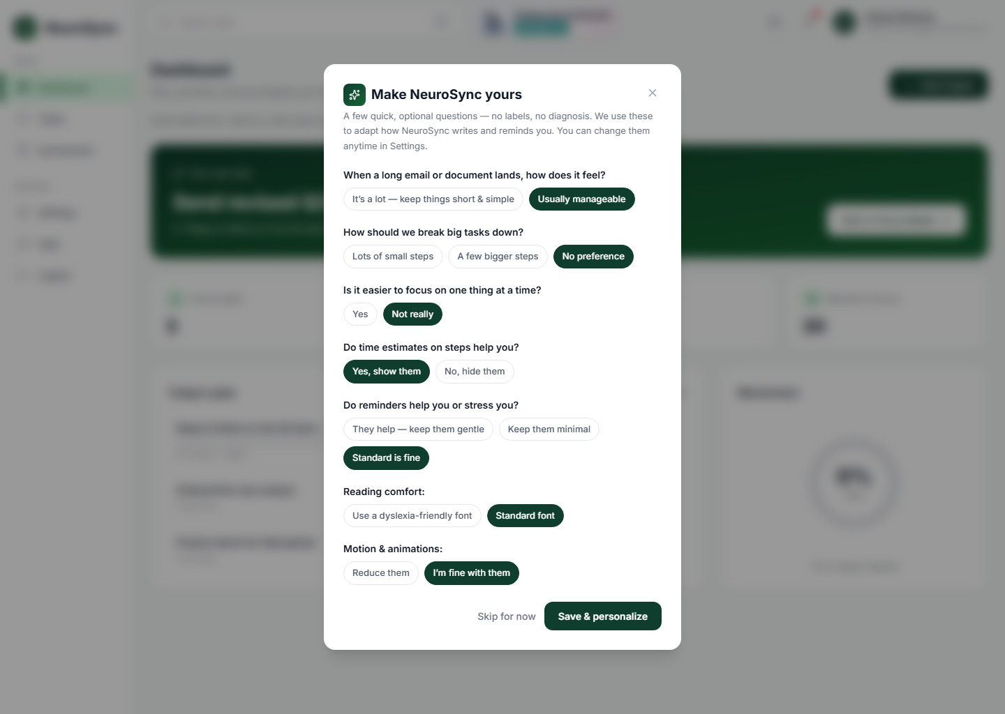
PERSONALISATION — THE CORE OF NEUROSYNC
Built for your brain, not the average one
A one-time profile
You answer a few opt-in questions; you can change them anytime in Settings.
Same email → your version
ADHD: time-boxed micro-steps + focus timer. Dyslexia: short, plain, bulleted rewrite.
Learns over time
Behaviour-aware tuning — if steps run over, NeuroSync adjusts future time estimates.
Real screenshot — the one-time, opt-in profile (no labels, no diagnosis).
NeuroSync · Work, in sync with how you think
9

Slide 10
AI ARCHITECTURE & INTEGRATIONS
Real today — and enterprise-ready
Frontend
React + Vite + Tailwind — calm, accessible UI (dyslexia font, high contrast, reduced motion)
Integrations
Outlook (Microsoft Graph)
Live
Backend
ASP.NET Core API + SQL — Tasks, Projects, Summarizer, per-user personalization (all live)
Microsoft Teams
Planned
AI layer
Azure OpenAI (GPT-5.5), hosted in-tenant — behind a provider-agnostic, swappable interface
Azure DevOps / Jira
Planned
More accessibility profiles
Cloud-agnostic & swappable. Changing AI provider is a config change, not a rewrite. Data stays in-tenant.
Planned
NeuroSync · Work, in sync with how you think
10

Slide 11
ETHICS & INCLUSION
Responsible and inclusive by design
No diagnosis, no labels
Support is an opt-in choice — never an assumption about anyone.
Human-in-the-loop
The AI suggests; the person edits and approves. Nothing auto-acts.
Privacy by design
Enterprise data stays within enterprise governance, in-tenant.
Sourced nudges
Wellbeing prompts use recognised, published techniques.
Inclusive by default
Calm UI, dyslexia font, high contrast, reduced motion — for everyone.
Transparent output
The original source is always one click away to verify.
NeuroSync · Work, in sync with how you think
11

Slide 12
FUTURE ROADMAP
From prototype to pilot to scale
NOW — working
NEXT — 1–3 months
LATER — scale
• AI summariser + adaptive task breakdown
• Per-user personalization profile
• Projects, due dates, focus mode + timers
• Outlook email → task (Microsoft Graph)
• Azure OpenAI (GPT-5.5) in-tenant; guest demo
• Validated pilot with a neurodiversity ERG
• Behaviour-aware learning (auto time tuning)
• Teams + Azure DevOps / Jira connectors
• Agentic reminders before login; escalation
• Emergency handling (on leave → reassign / notify)
• Supervisor profile + escalation workflows
• More language & low-vision / screen-reader modes
• Privacy-safe manager insights
NeuroSync · Work, in sync with how you think
12

Slide 13
Aanya doesn’t need to be fixed.
Her workday does.
NeuroSync levels the playing field — quietly, respectfully, and at scale.
Our ask: help us pilot NeuroSync with a neurodiversity employee resource group.
NeuroSync · Work, in sync with how you think. Thank you — questions welcome.

Slide 14
APPENDIX
Sources & references (clickable)
1. Accenture — ‘Getting to Equal: The Disability Inclusion Advantage’ (2018)
Leaders averaged ~28% higher revenue, 2× net income, 30% higher economic profit margin (4 yrs).
2. Accenture / Disability:IN / AAPD — ‘The Disability Inclusion Imperative’ (2023)
Leaders saw 1.6× revenue, 2.6× net income, 2× economic profit vs. peers (5 yrs).
3. Neurodiversity in the Workplace — mydisabilityjobs.com (2025)
51% of neurodivergent employees have taken time off; ADHD/dyslexia comorbidity (City & Guilds Index).
4. Accenture 2018 — full research report (PDF)
Primary source for the 28% / 2× / 30% figures.
Image credits: Aanya (stress) — CIPHR Connect, CC BY 2.0 · Aanya (calm) — StockSnap, CC0 · Team — StockSnap, CC0
Other images are real screenshots of the NeuroSync product. Tier-1 sources prioritised; figures verified against primary sources.
NeuroSync · Work, in sync with how you think
14

