Slide 1

NBA PLAYER AND SEASON ANALYSIS
1997-2023

Slide 2
TABLE OF CONTENTS
1. Brief Introduction to NBA and Game Refresher
2. Player Analysis
3. Team Analysis
4. Overview of seasons
5. Conclusion

Slide 3
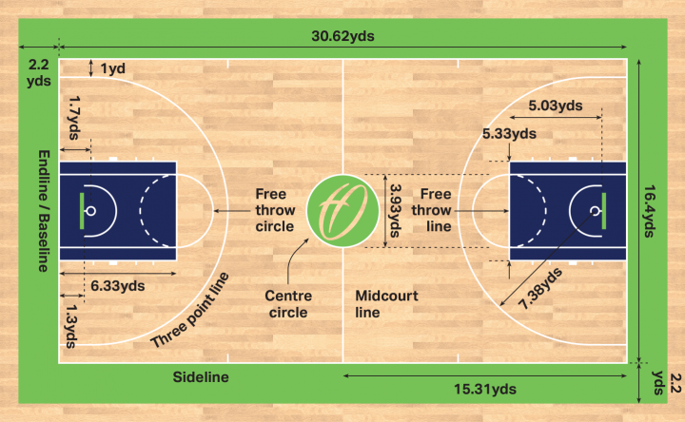
GAME REFRESHER
Each NBA Season:
Total 30 teams participates
Every team plays 82 games per season in regular matches and 15-28 games in playoffs
Total 27 seasons so far

Slide 4
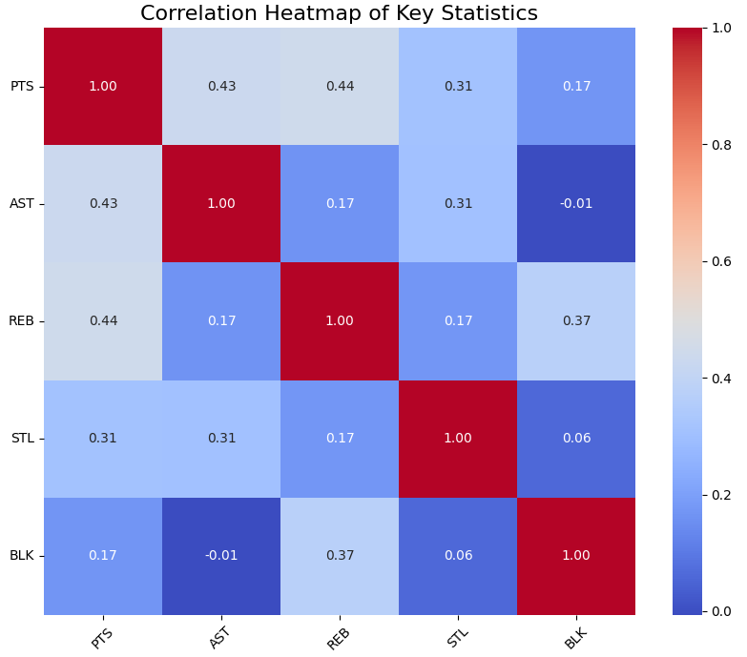
PLAYER ANALYSIS

Slide 5
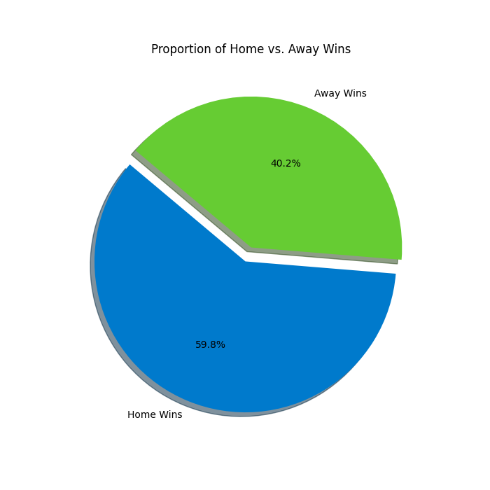
TEAM ANALYSIS
SIGNIFICANCE OF PLAYING IN HOME CITY

Slide 6
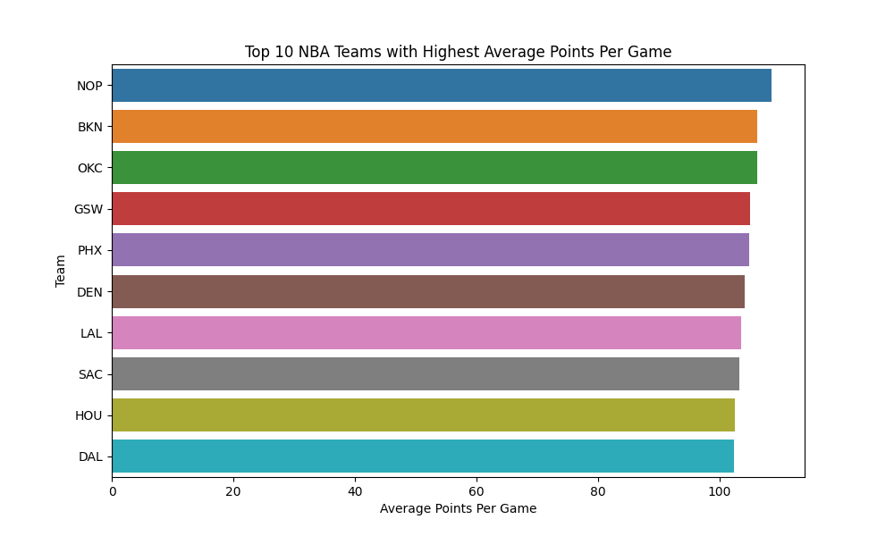
TEAM ANALYSIS

Slide 7
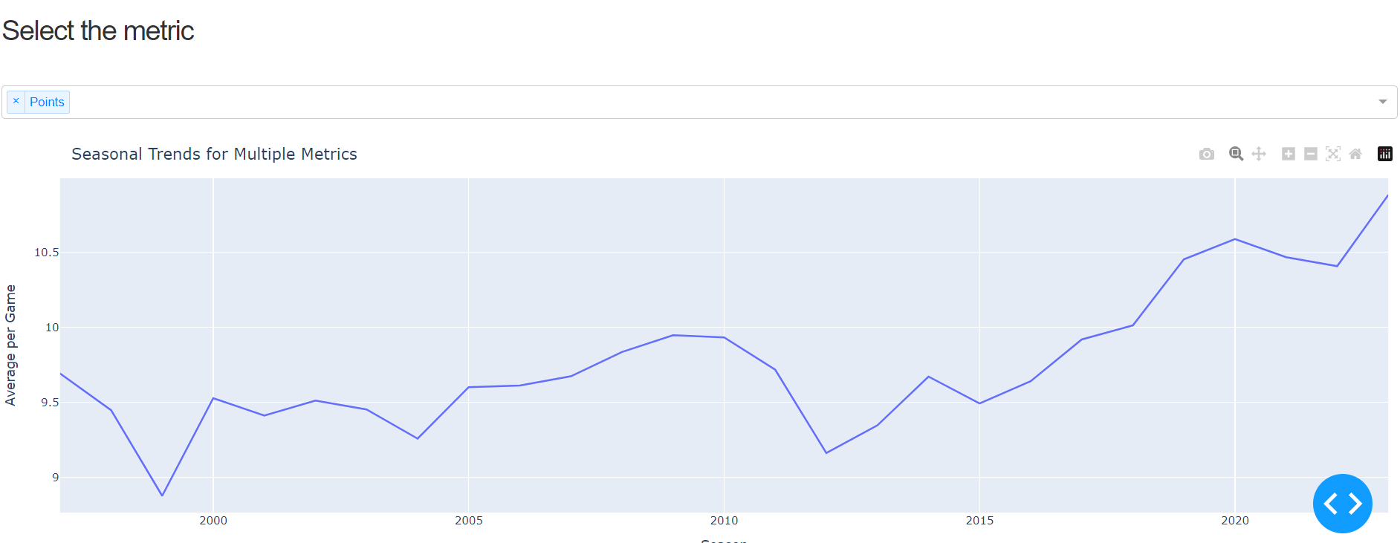
OVERALL TREND ANALYSIS

Slide 8
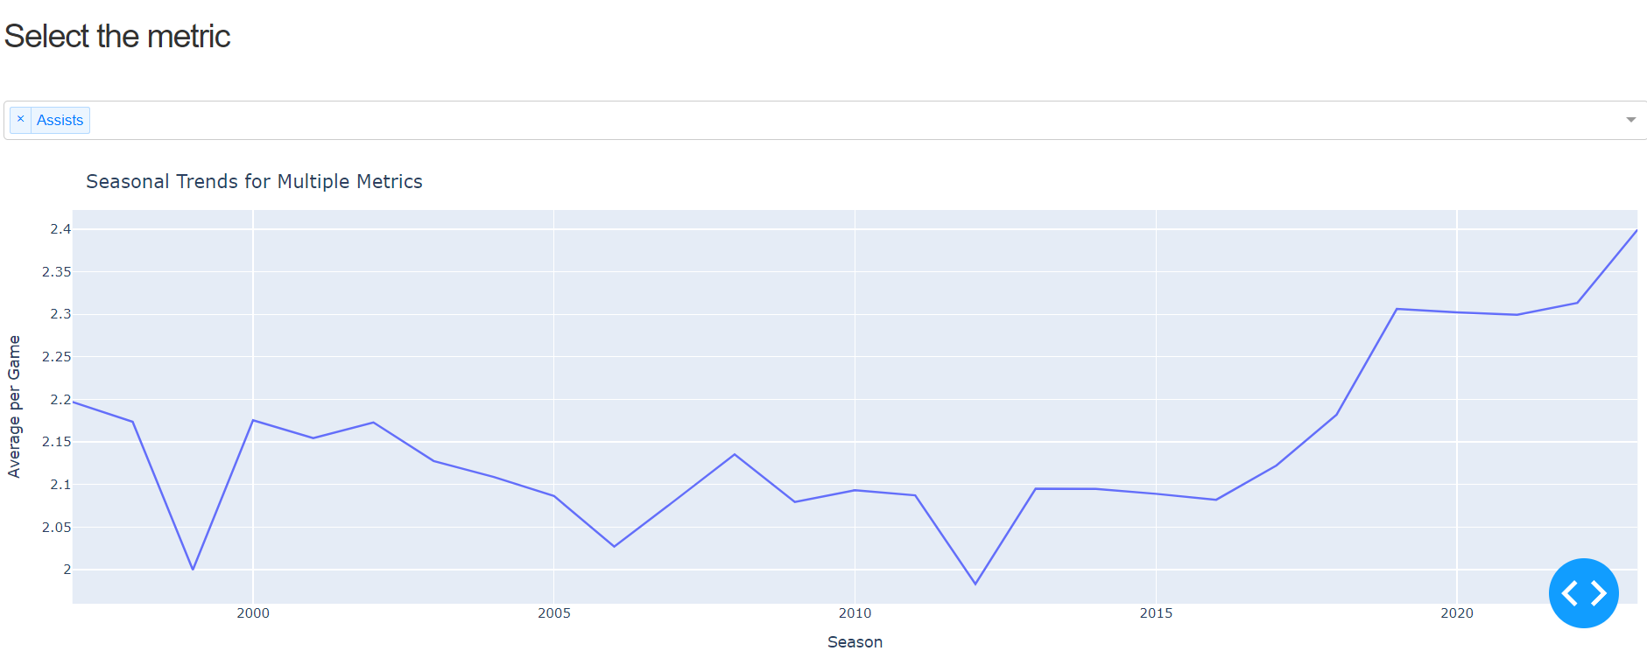
OVERALL TREND ANALYSIS

Slide 9
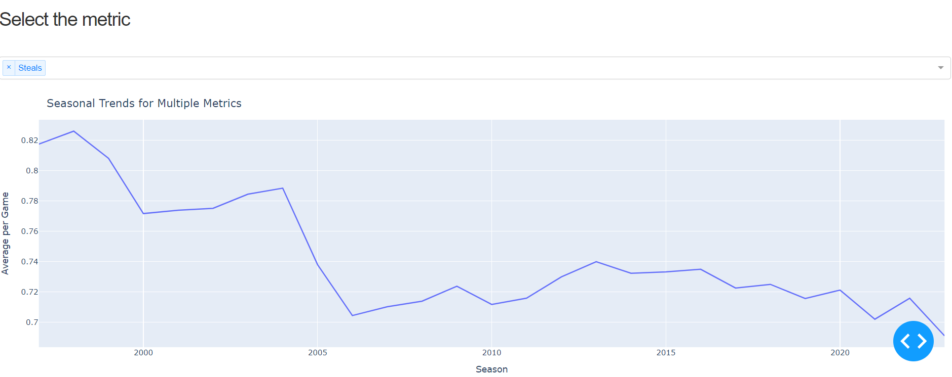
OVERALL TREND ANALYSIS

Slide 10
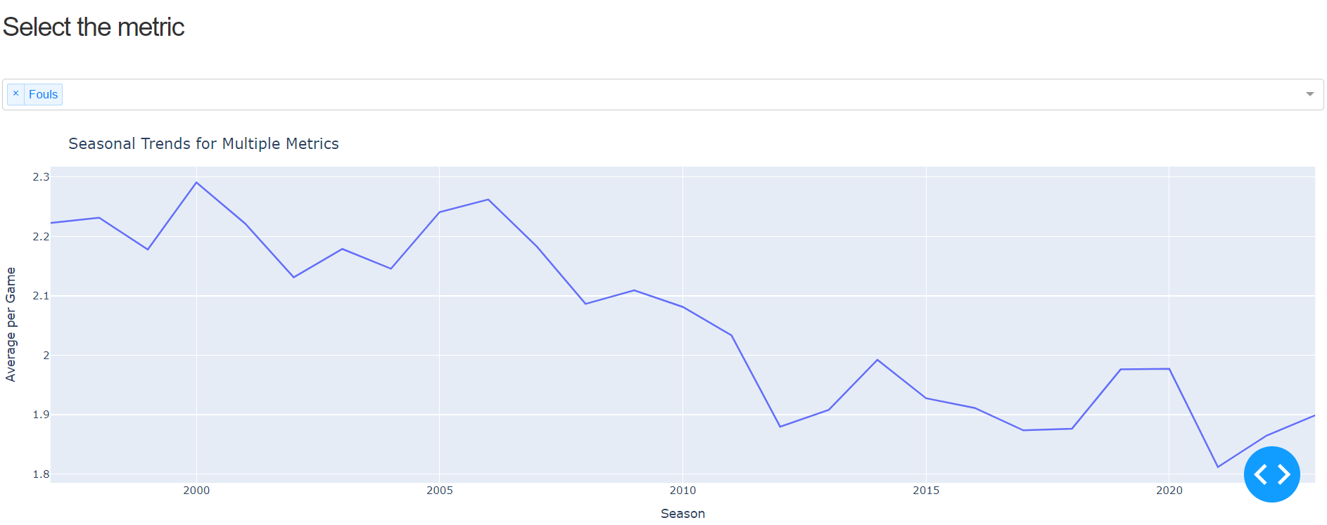
OVERALL TREND ANALYSIS

Slide 11
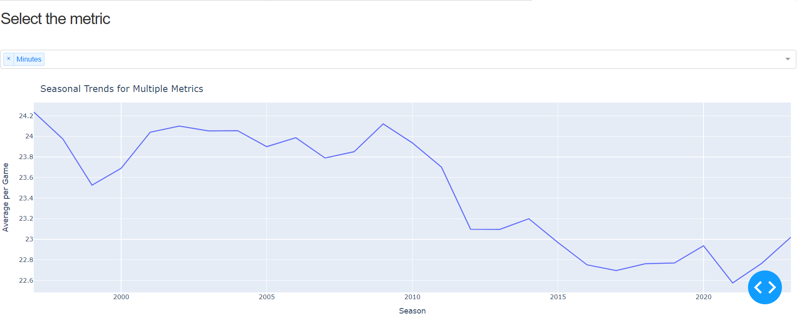
OVERALL TREND ANALYSIS

Slide 12
CONCLUSION
Game has become more competitive over the years
Strict rules against fouls
Points per game has increased
Player performance over the years has increased

