Slide 1


Slide 2
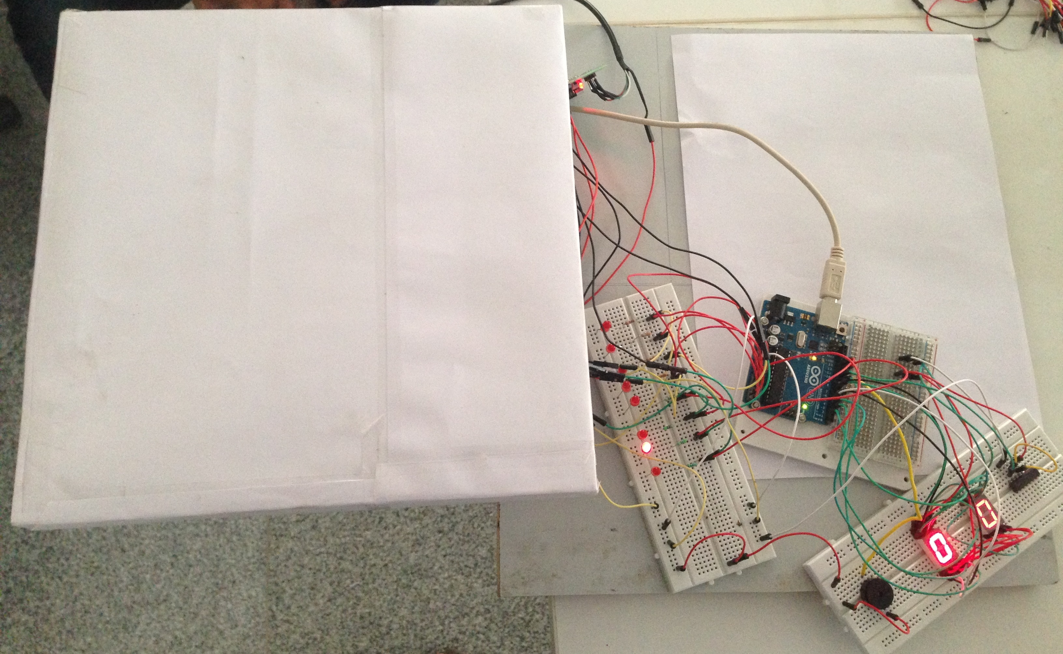
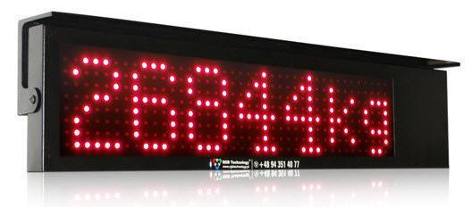
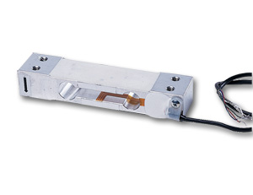

Weight measuring device
Aditya Naidu Rishabh Bhadauria Simran Dokania Shivam Kumar Sneha A. Ujjwal Jain
International Institute of Information Technology, Bangalore
Introduction
The main objective of the project is to use the weigh sensor and measure the weight of the object placed and then display the weight using the light emitting diodes and seven segment display. The daily life application of this is at the airports. When the luggage exceeds a particular threshold value, the buzzer beeps.
For example , if the weight was 26844 units then the display would be:
Results
The input from the load sensor goes to the LEDs and in turn goes to the arduino. We have used eight LEDs and these eight Leds represent input in the binary form. For example, 6 in binary represents 1kg and the maximum weight that it can sense is 40 kgs and in that case all the LEDs glow. The output from the arduino is given to the seven segment LEDs and this is how the weight is displayed. We can set a particular weight as the limit and if the object kept on the sensor exceeds that particular threshold value, the piezo buzzer beeps.
Conclusions and future work
Working on the project was a highly enriching and a great learning experience. Apart from learning about the weight sensor, we also learnt about various other sensors like motion sensor, temperature sensor, depth sensor etc, and how they work. In the aspects of our future work, we can work on improving the limit of weight sensor so that it can be used for industrial purposes to measure humongous weights. Also, we might work on increasing the sensitivity of a sensor so that it can measure small weights too.
Materials and methods
We used the weigh sensor and an arduino kit.
A weigh sensor is a sensor that converts a load or force acting on it into an electronic signal. This electronic signal can be a voltage change, current change or frequency change depending on the type of load cell and circuitry used. It is based on the principle of change of resistance in response to an applied load.
References
1. http://www.oomlout.com/oom.php/products/ardx/circ-06/
2. https://www.sparkfun.com/products/10245
3. http://www.loadstarsensors.com/what-is-a-load-cell.html
Acknowledgements
We take this opportunity to thank our Director Prof.Sadagopan for exposing us to the iMTech curriculum which involves such innovative projects. We express our gratitude to Prof. Madhav Rao who introduced us to electronics subject at such an early stage. We would like to thank our classmates and Nandeep Sir making this journey of the project so memorable.
Notes:
Copyright Colin Purrington (http://colinpurrington.com/tips/academic/posterdesign).

