Slide 1
Terry Brown
Genomes
Third Edition
Chapter 1:
Genomes, Transcriptomes,
and Proteomes
Copyright © Garland Science 2007

Slide 2
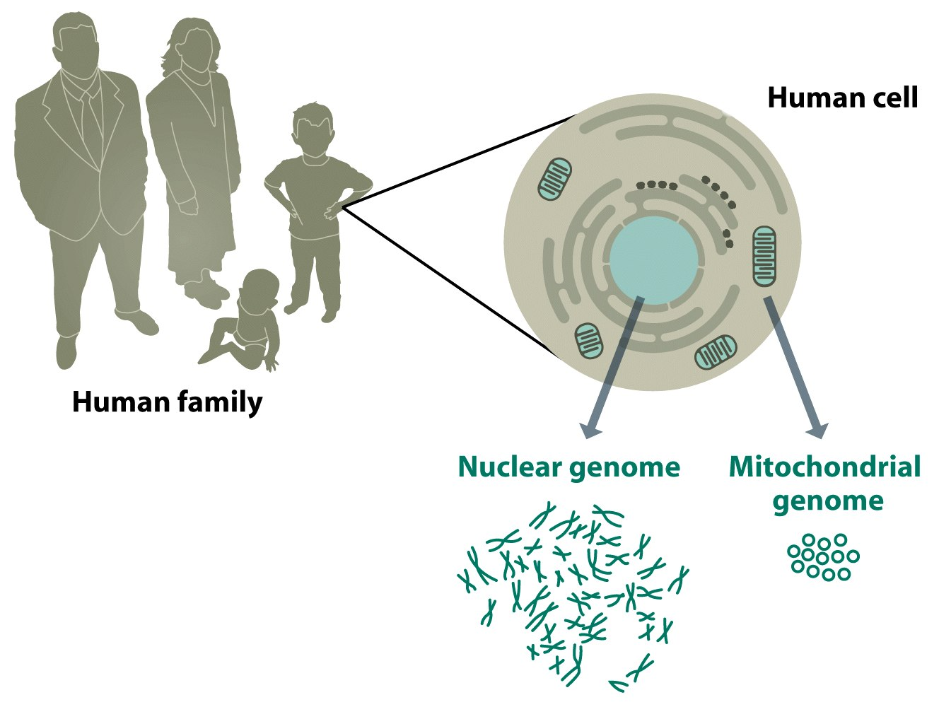
Figure 1.1 Genomes 3 (© Garland Science 2007)

Slide 3
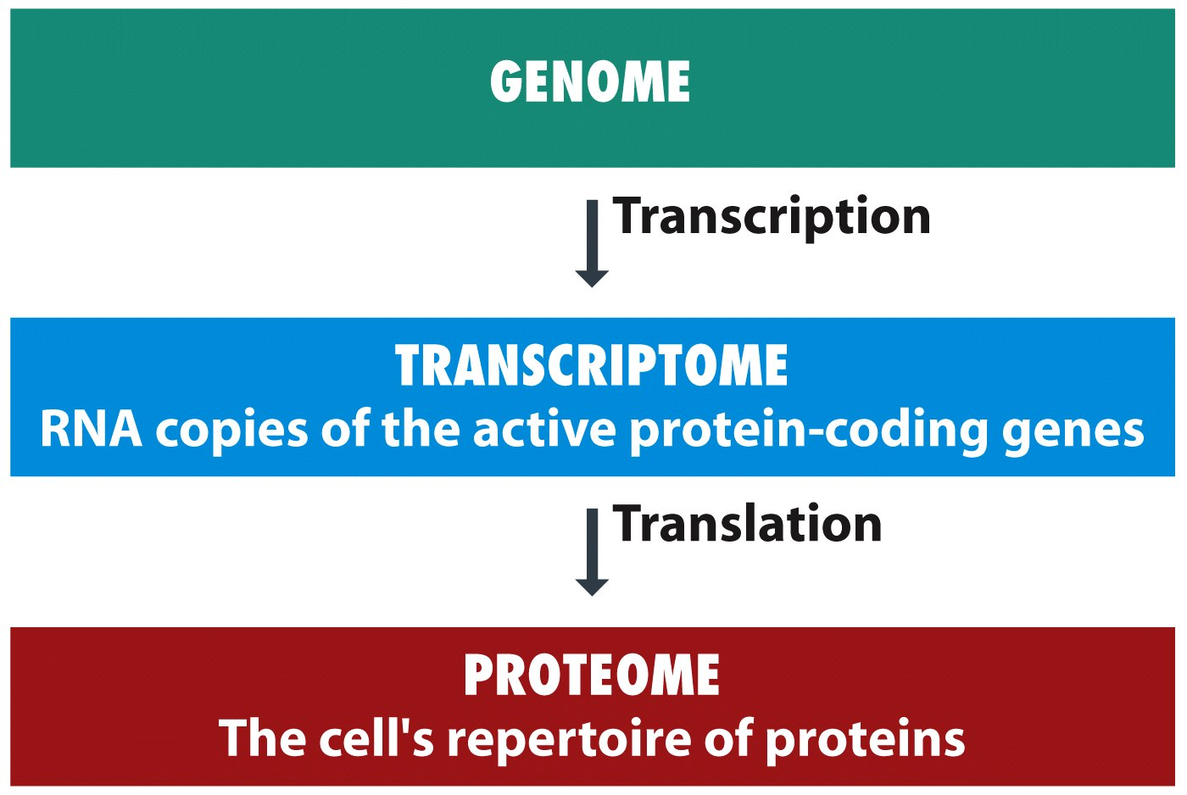
Figure 1.2 Genomes 3 (© Garland Science 2007)

Slide 4
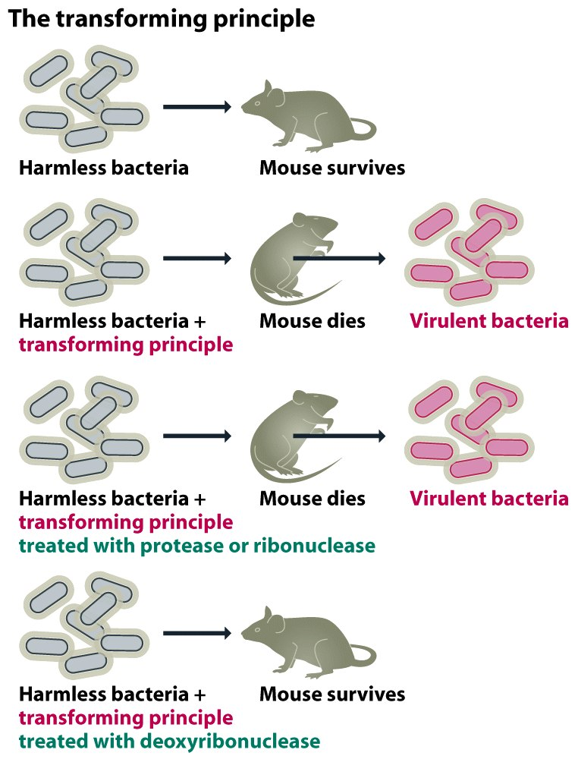
Figure 1.3a Genomes 3 (© Garland Science 2007)

Slide 5
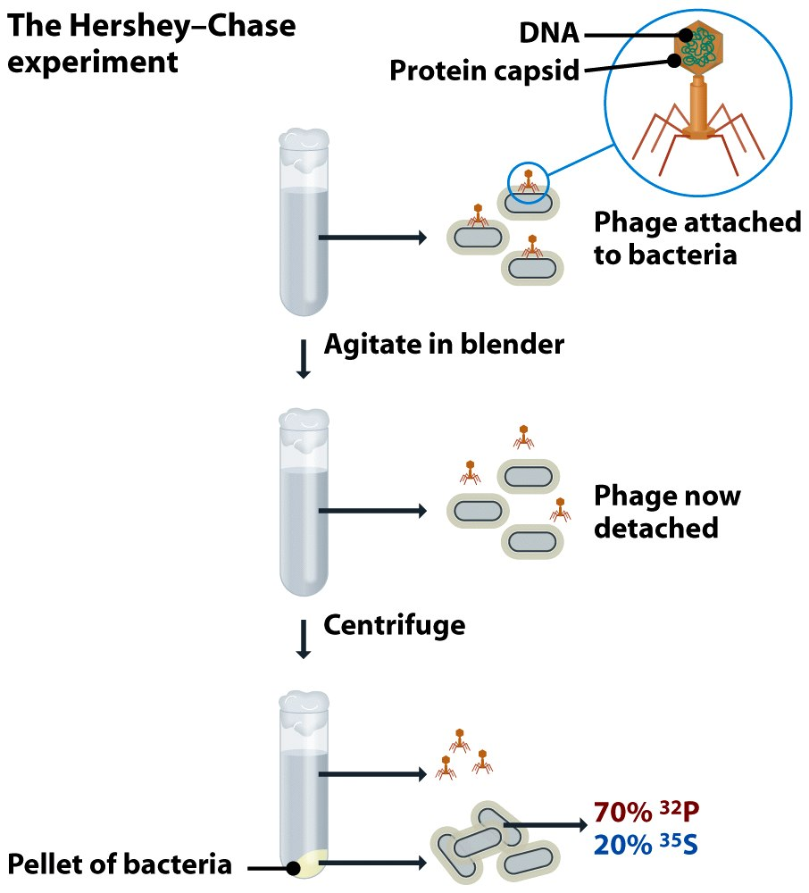
Figure 1.3b Genomes 3 (© Garland Science 2007)

Slide 6
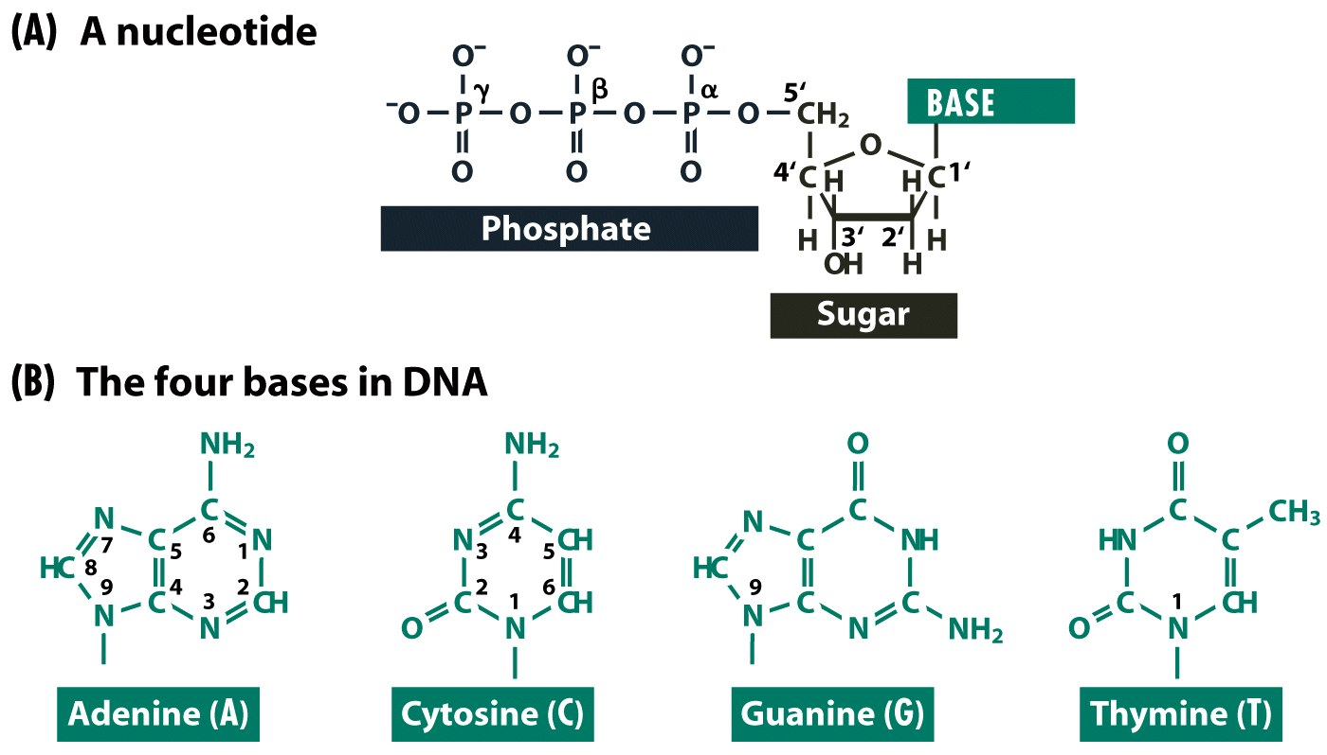
Figure 1.4 Genomes 3 (© Garland Science 2007)

Slide 7
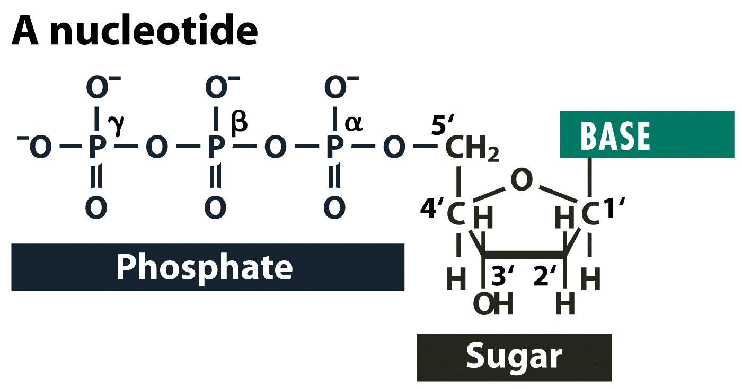
Figure 1.4a Genomes 3 (© Garland Science 2007)

Slide 8
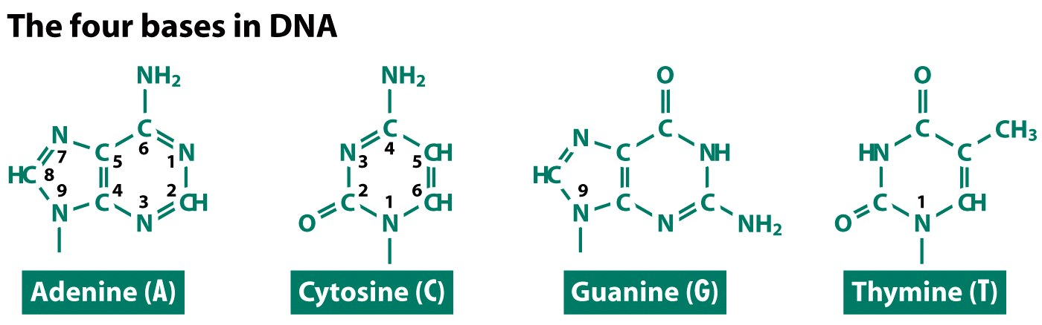
Figure 1.4b Genomes 3 (© Garland Science 2007)

Slide 9
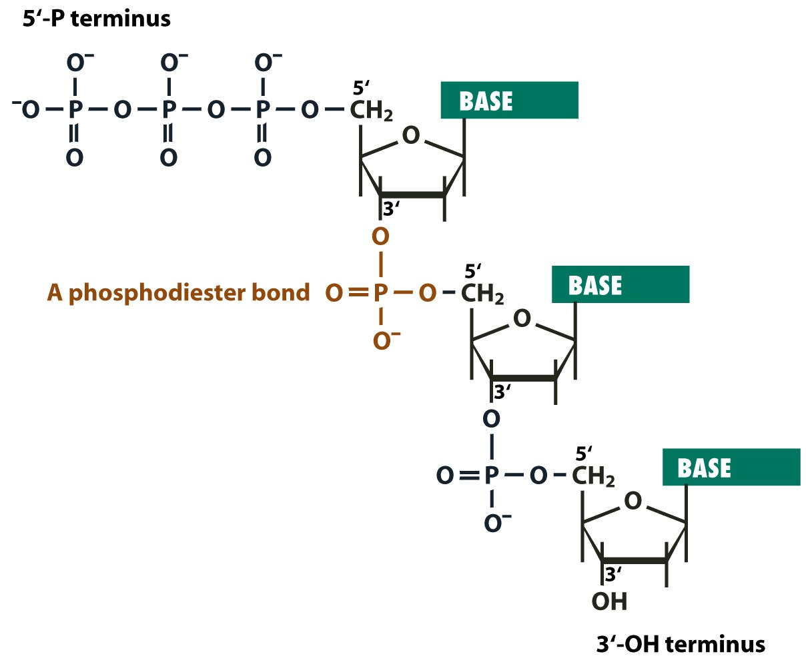
Figure 1.5 Genomes 3 (© Garland Science 2007)

Slide 10
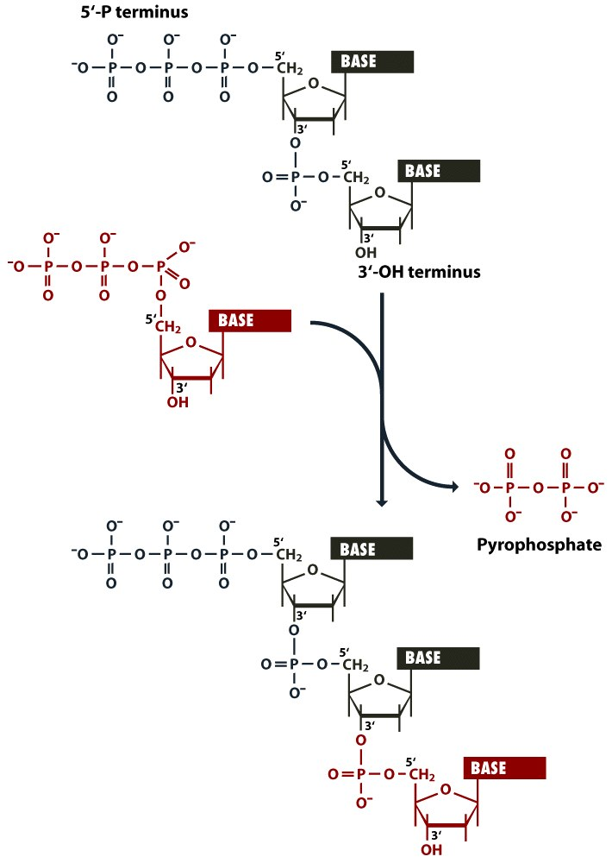
Figure 1.6 Genomes 3 (© Garland Science 2007)

Slide 11
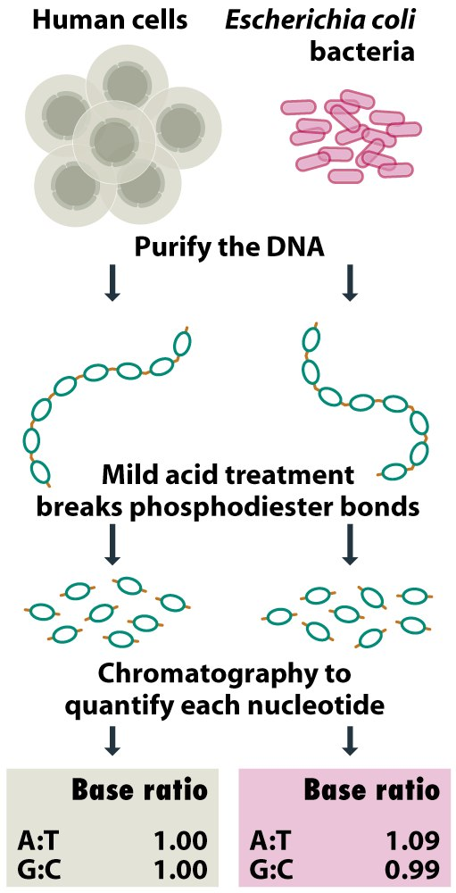
Figure 1.7 Genomes 3 (© Garland Science 2007)

Slide 12
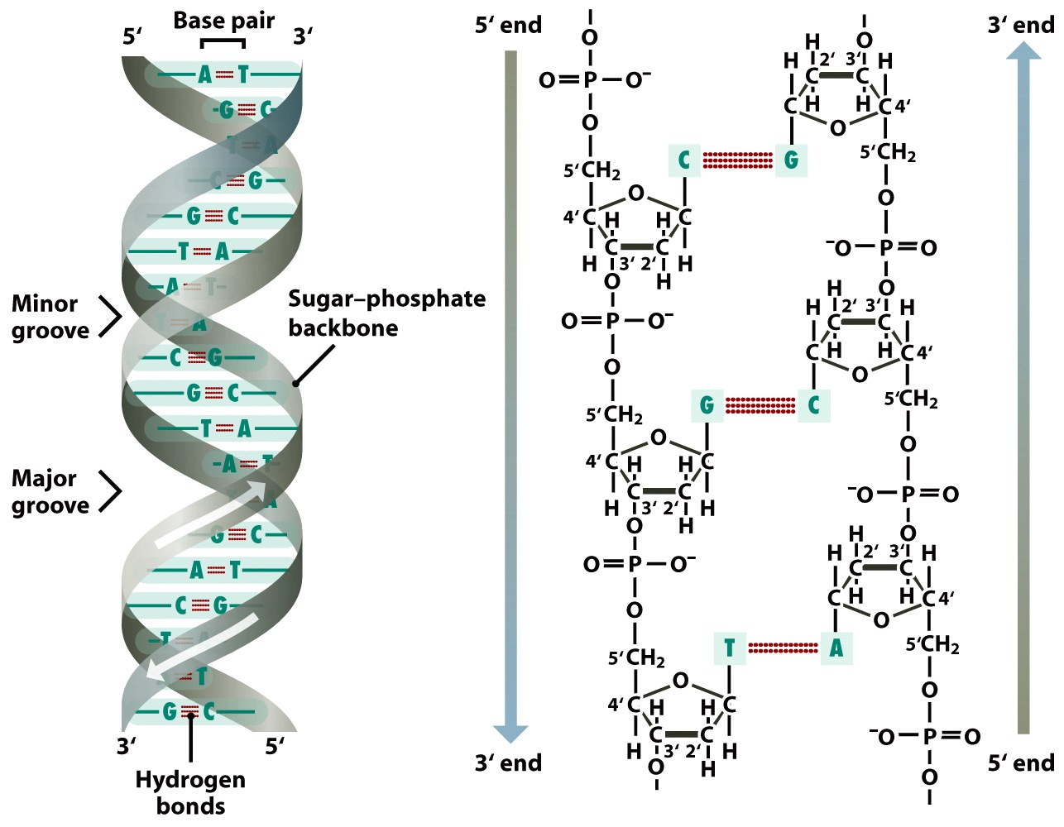
Figure 1.8a Genomes 3 (© Garland Science 2007)

Slide 13
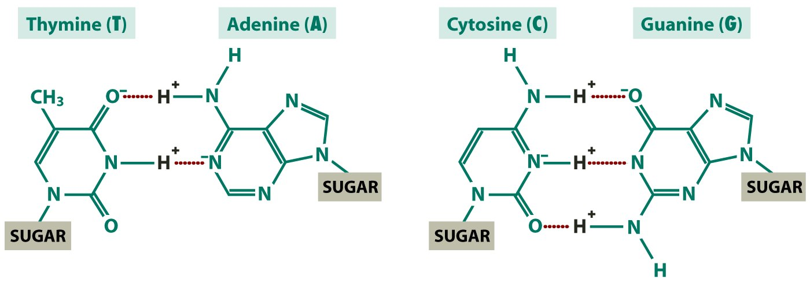
Figure 1.8b Genomes 3 (© Garland Science 2007)

Slide 14
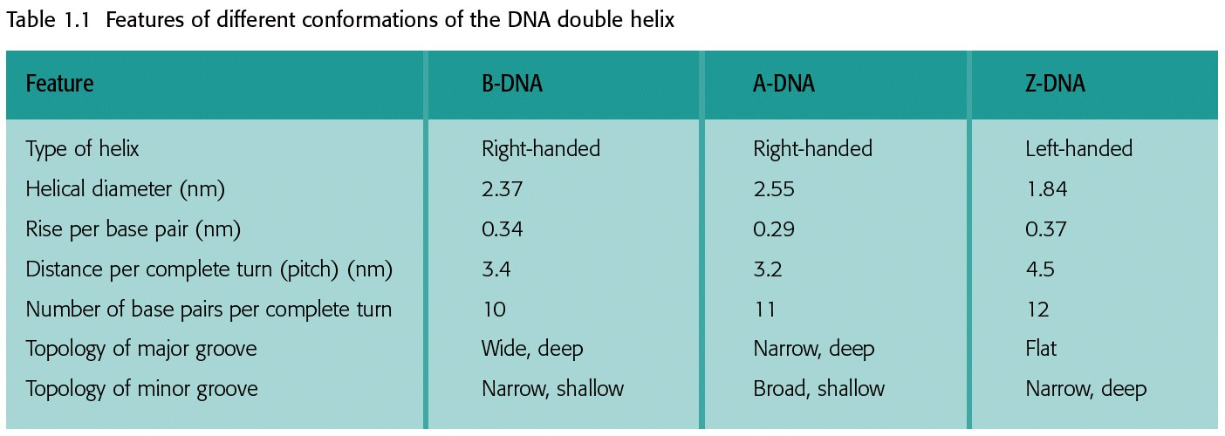
Table 1.1 Genomes 3 (© Garland Science 2007)

Slide 15
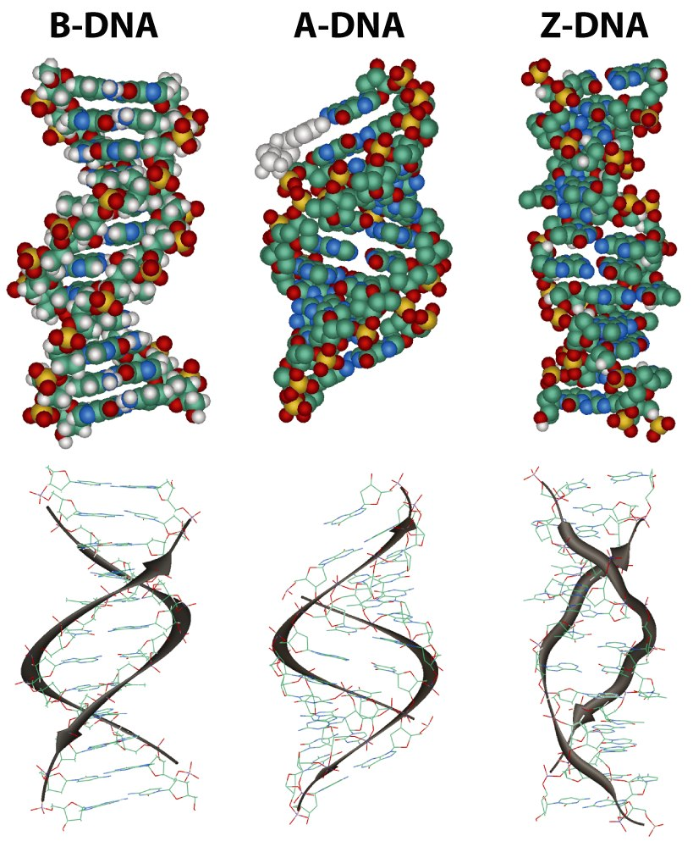
Figure 1.9 Genomes 3 (© Garland Science 2007)

Slide 16
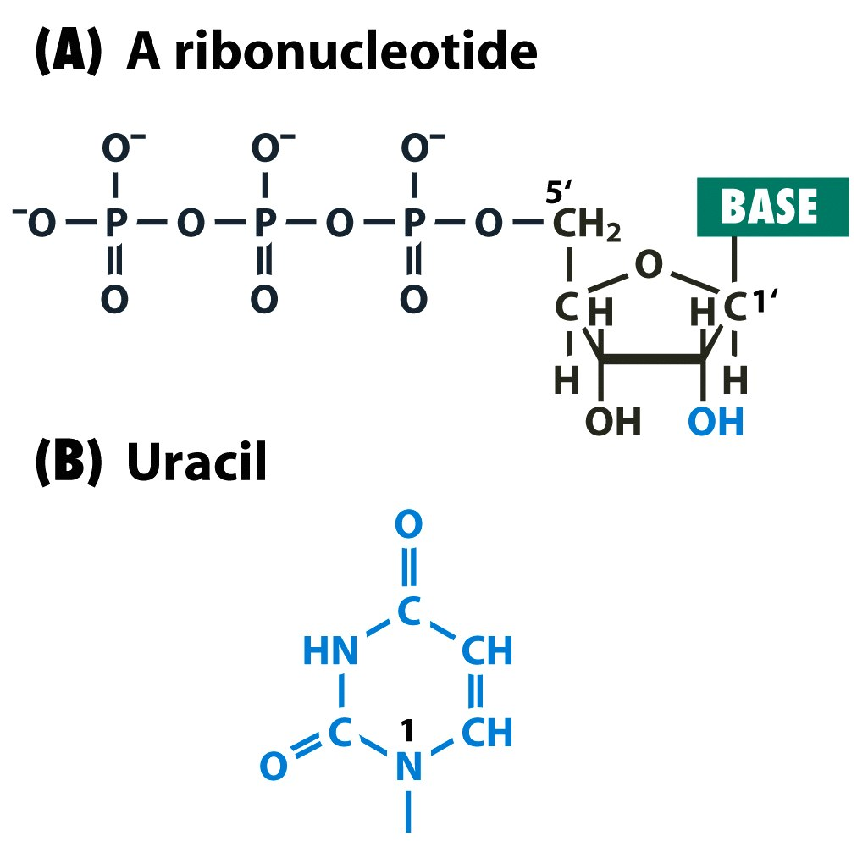
Figure 1.10 Genomes 3 (© Garland Science 2007)

Slide 17
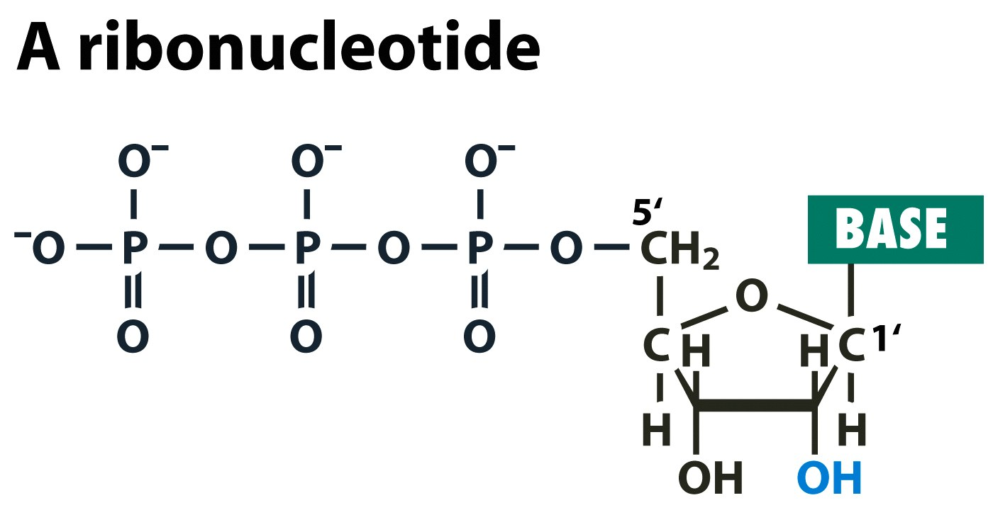
Figure 1.10a Genomes 3 (© Garland Science 2007)

Slide 18
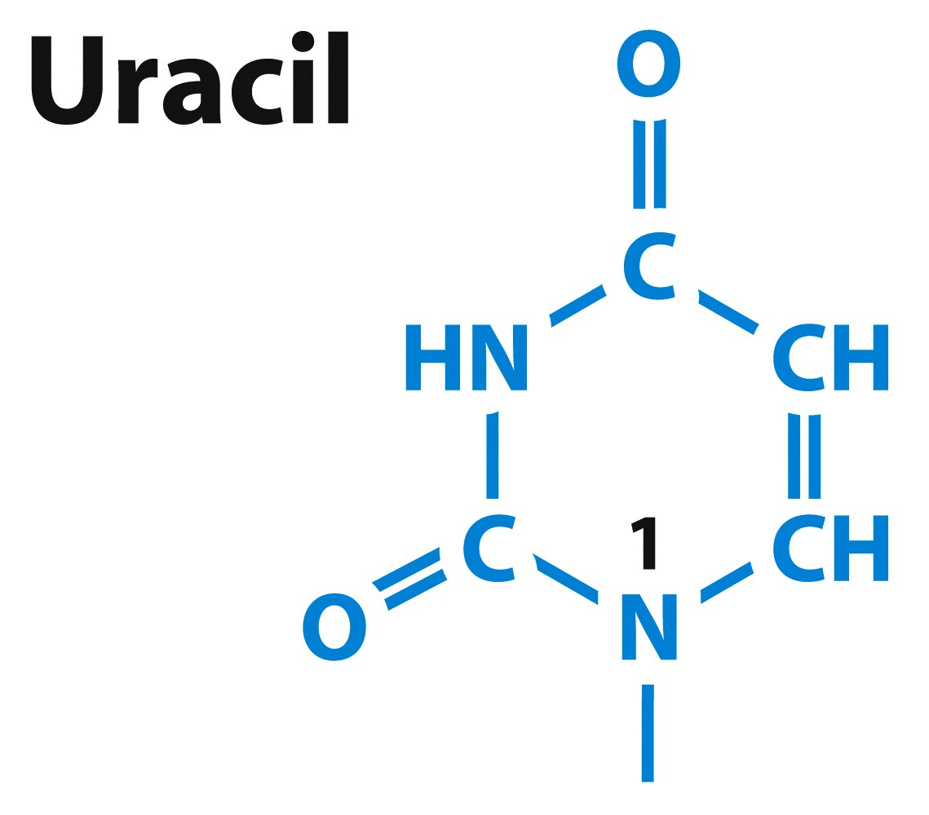
Figure 1.10b Genomes 3 (© Garland Science 2007)

Slide 19
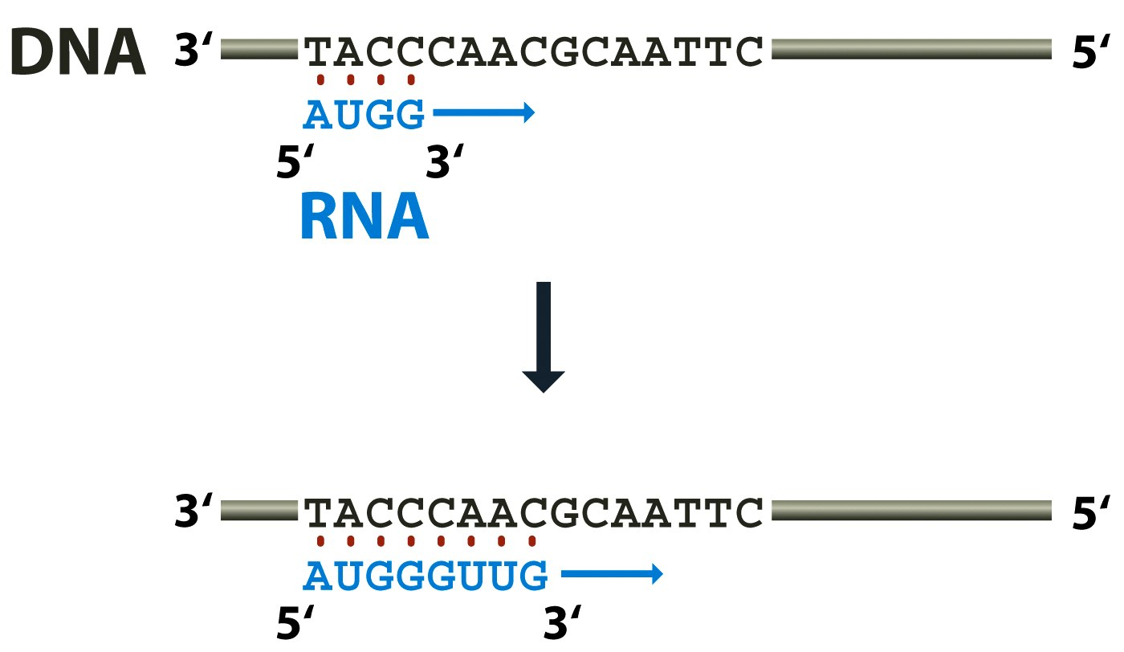
Figure 1.11 Genomes 3 (© Garland Science 2007)

Slide 20
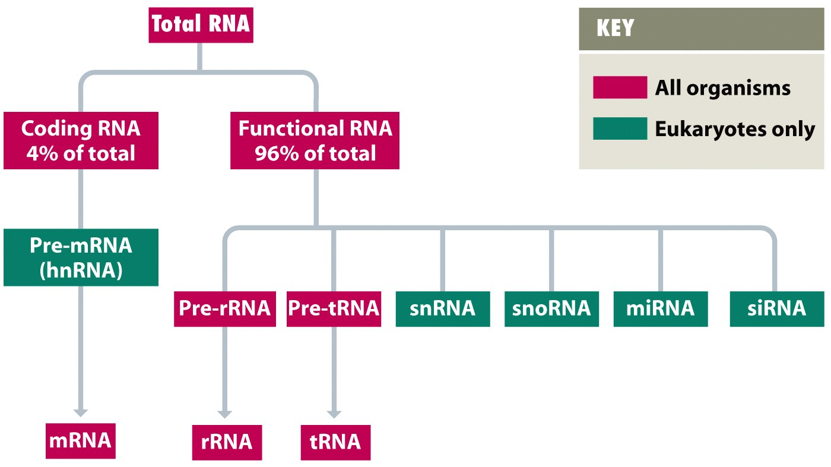
Figure 1.12 Genomes 3 (© Garland Science 2007)

Slide 21
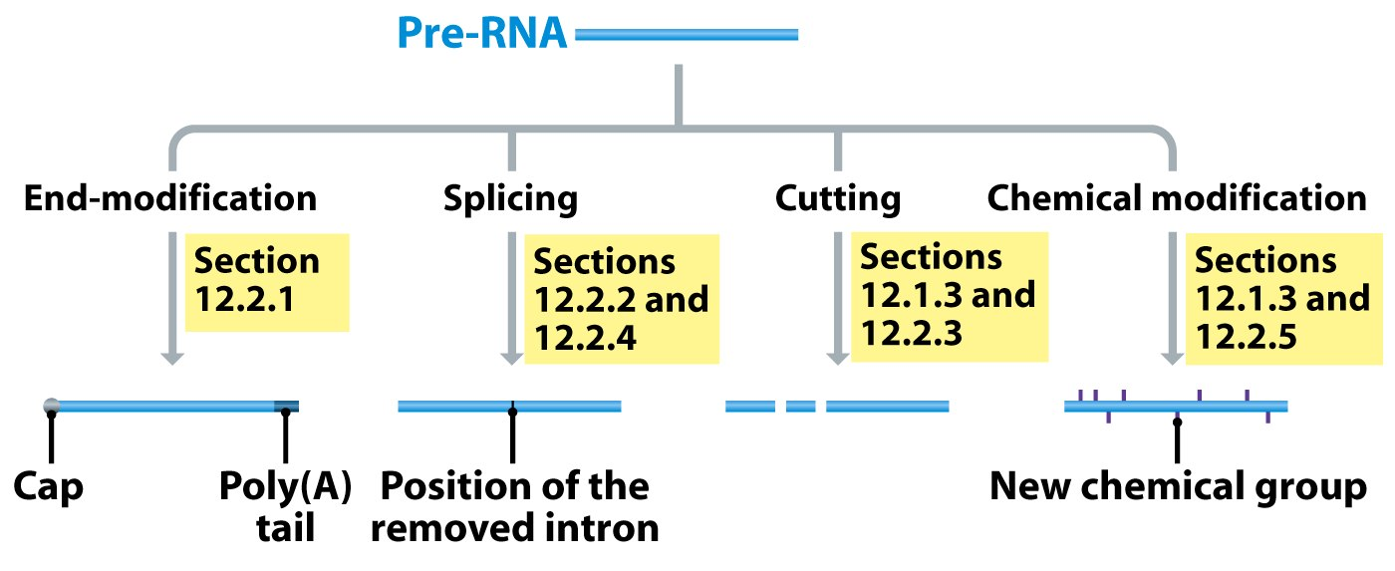
Figure 1.13 Genomes 3 (© Garland Science 2007)

Slide 22
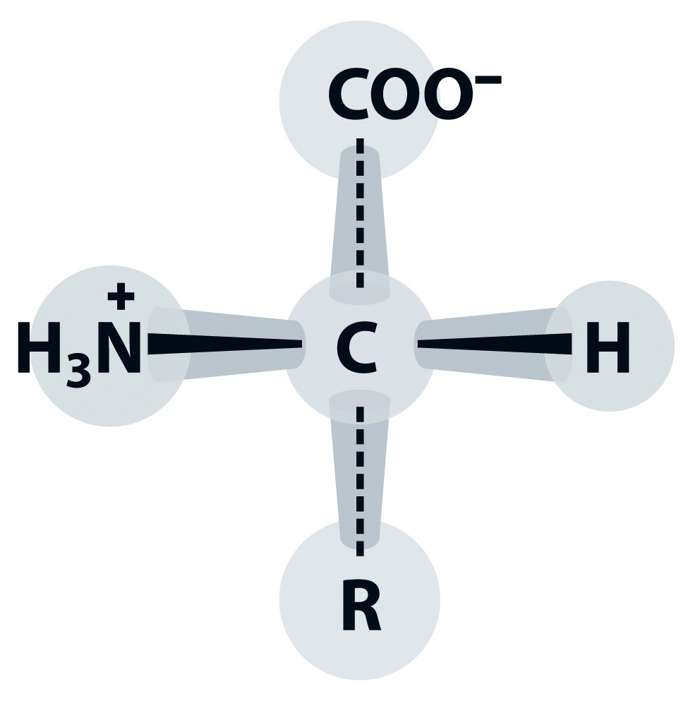
Figure 1.14 Genomes 3 (© Garland Science 2007)

Slide 23
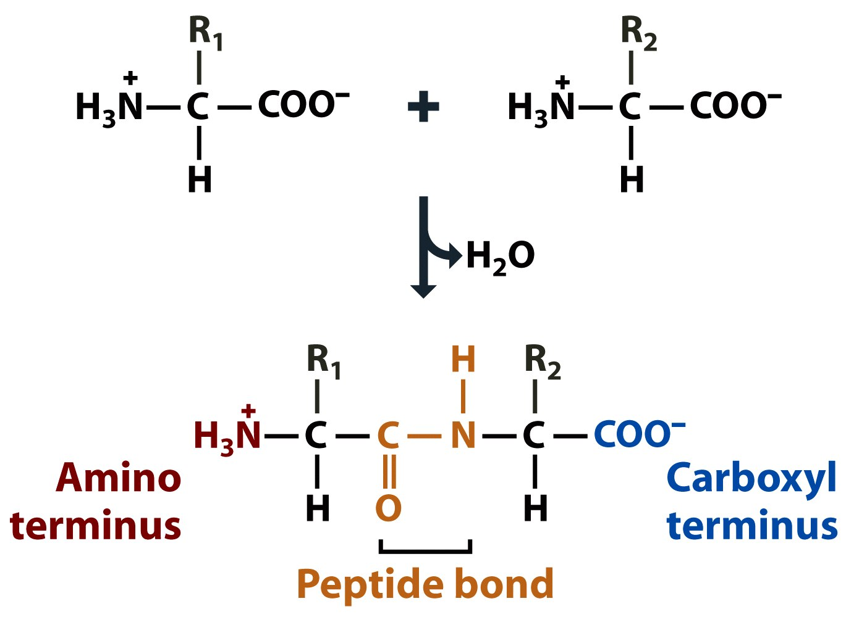
Figure 1.15 Genomes 3 (© Garland Science 2007)

Slide 24
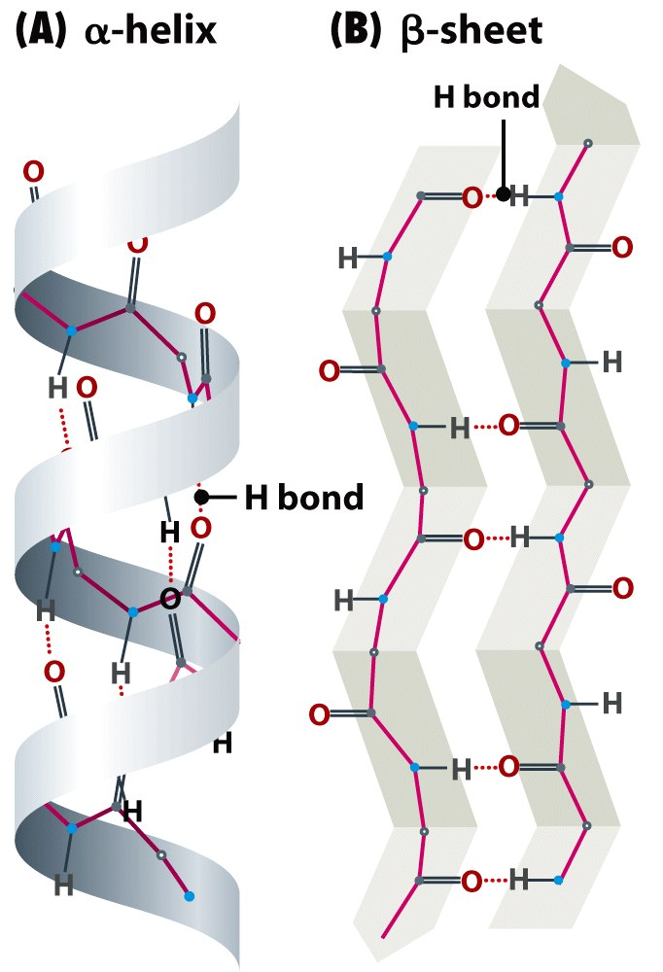
Figure 1.16 Genomes 3 (© Garland Science 2007)

Slide 25
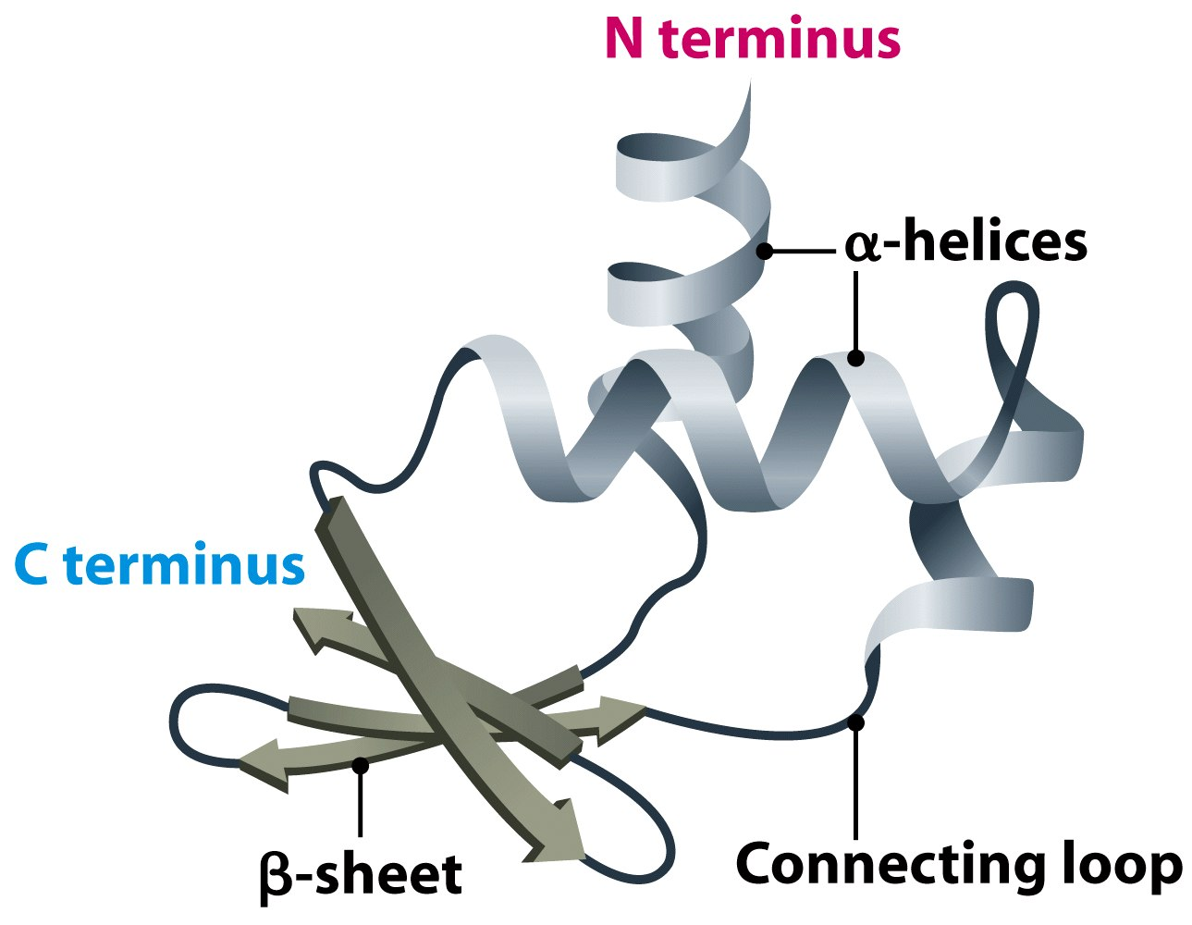
Figure 1.17 Genomes 3 (© Garland Science 2007)

Slide 26
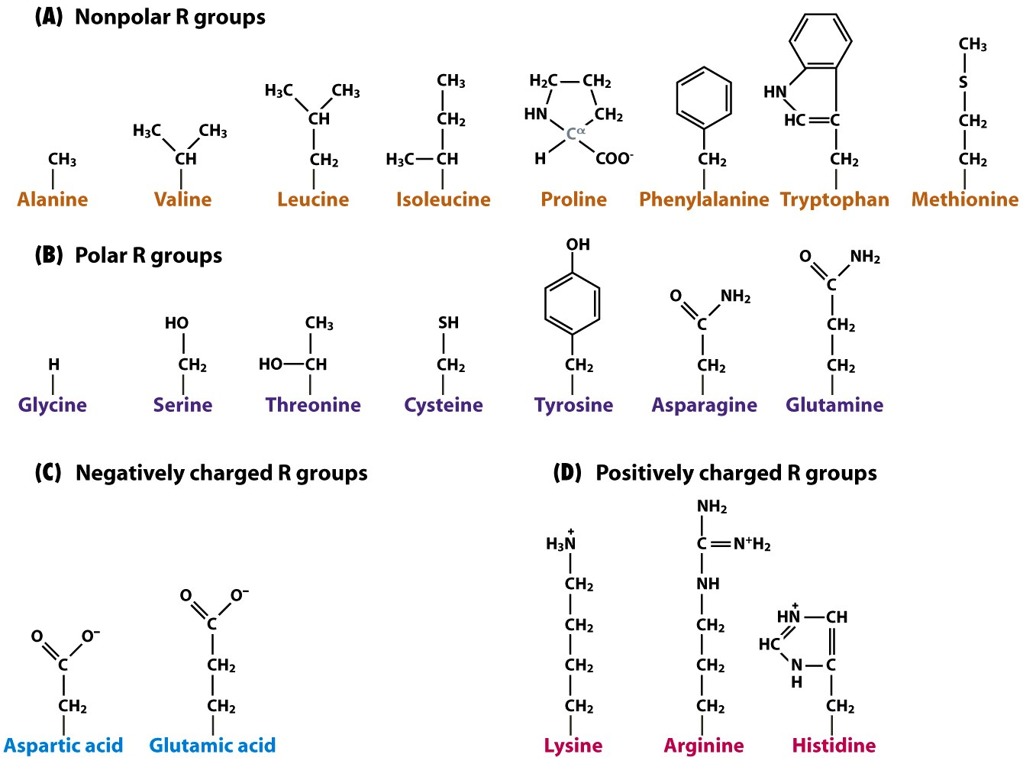
Figure 1.18 Genomes 3 (© Garland Science 2007)

Slide 27
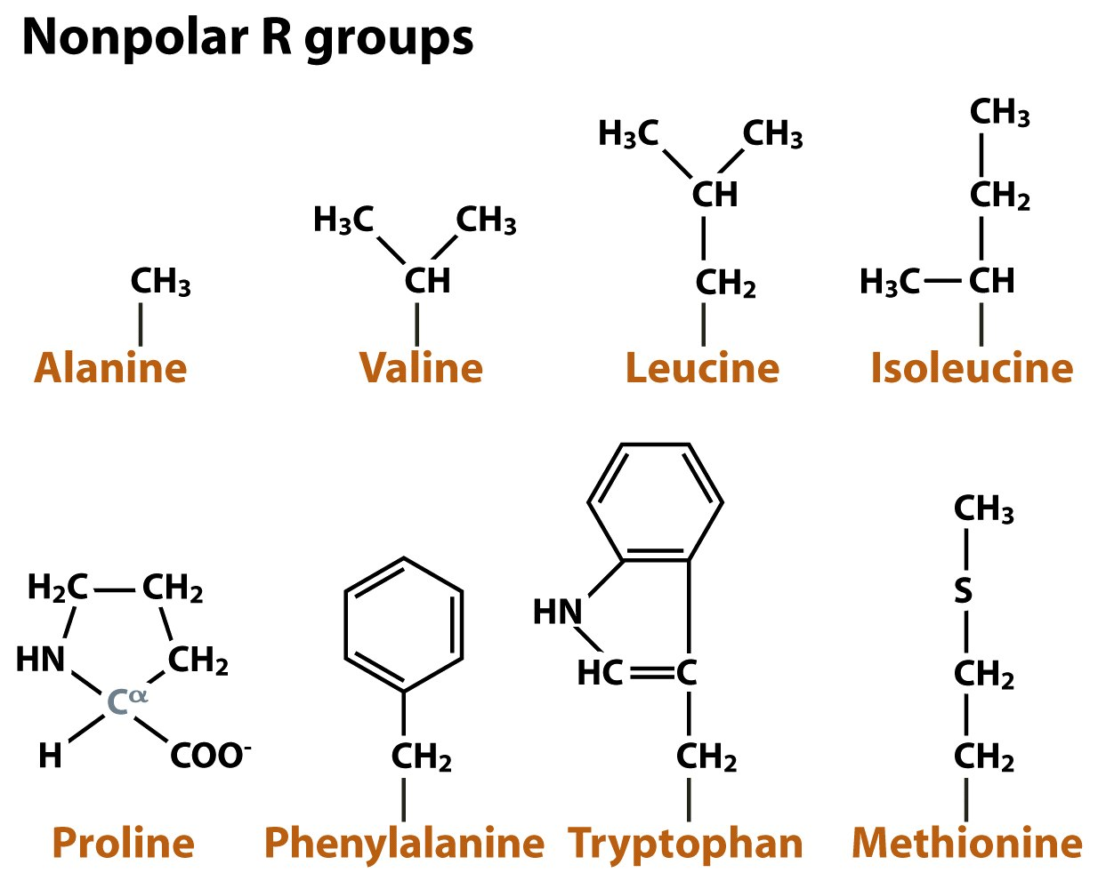
Figure 1.18a Genomes 3 (© Garland Science 2007)

Slide 28
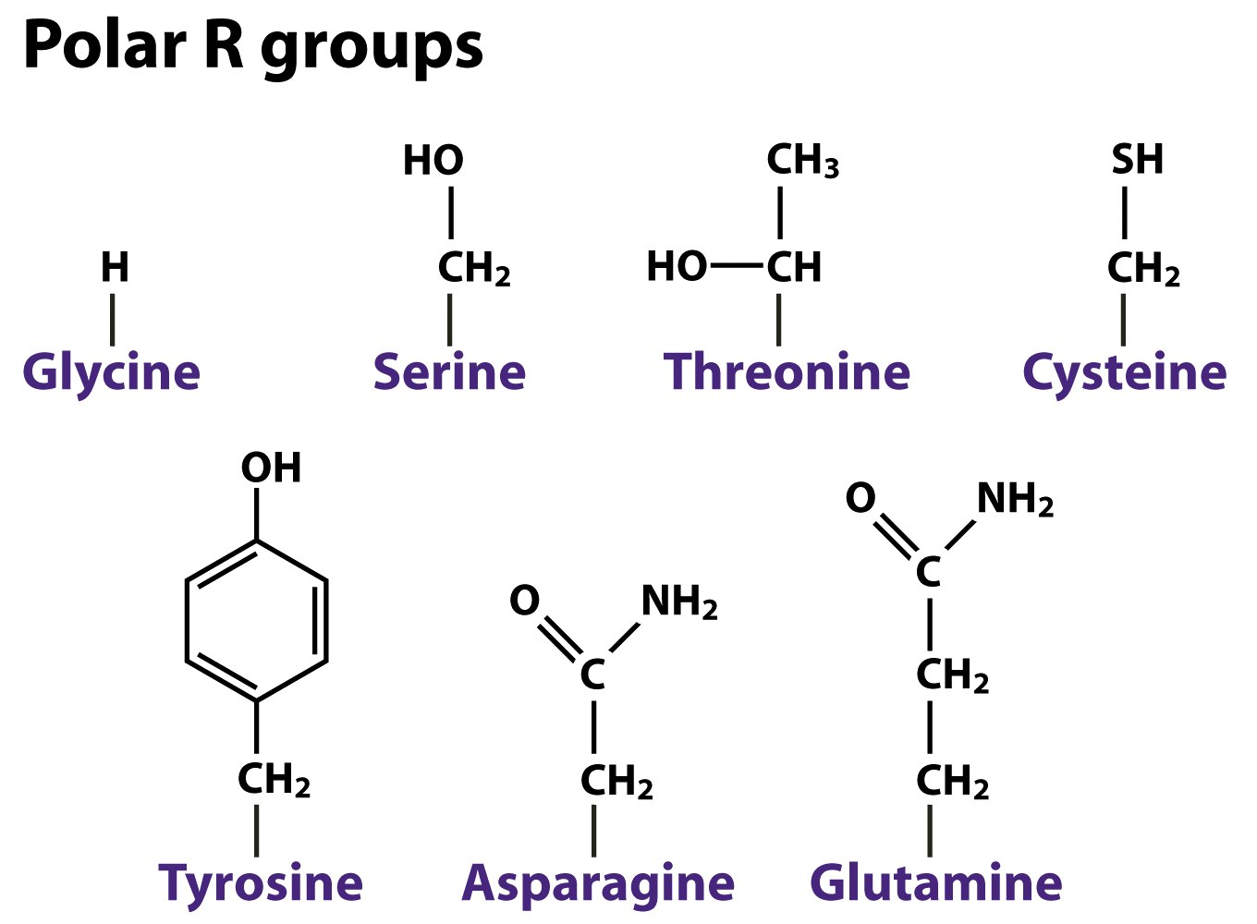
Figure 1.18b Genomes 3 (© Garland Science 2007)

Slide 29
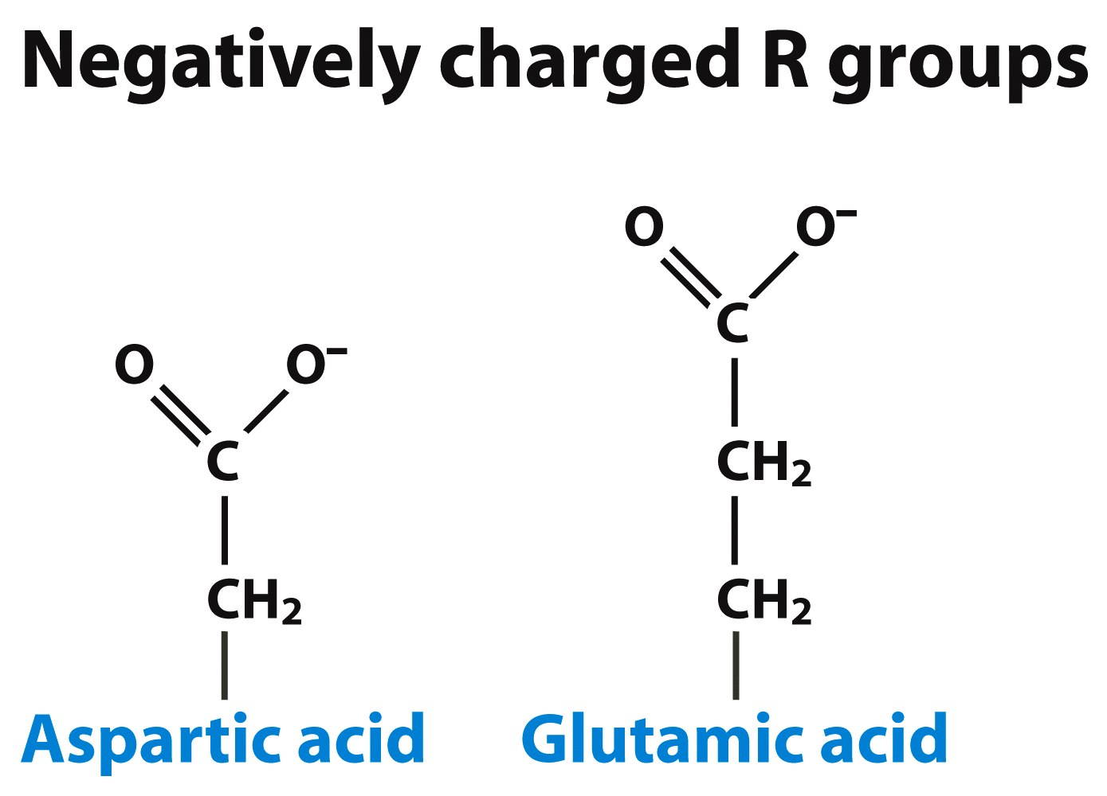
Figure 1.18c Genomes 3 (© Garland Science 2007)

Slide 30
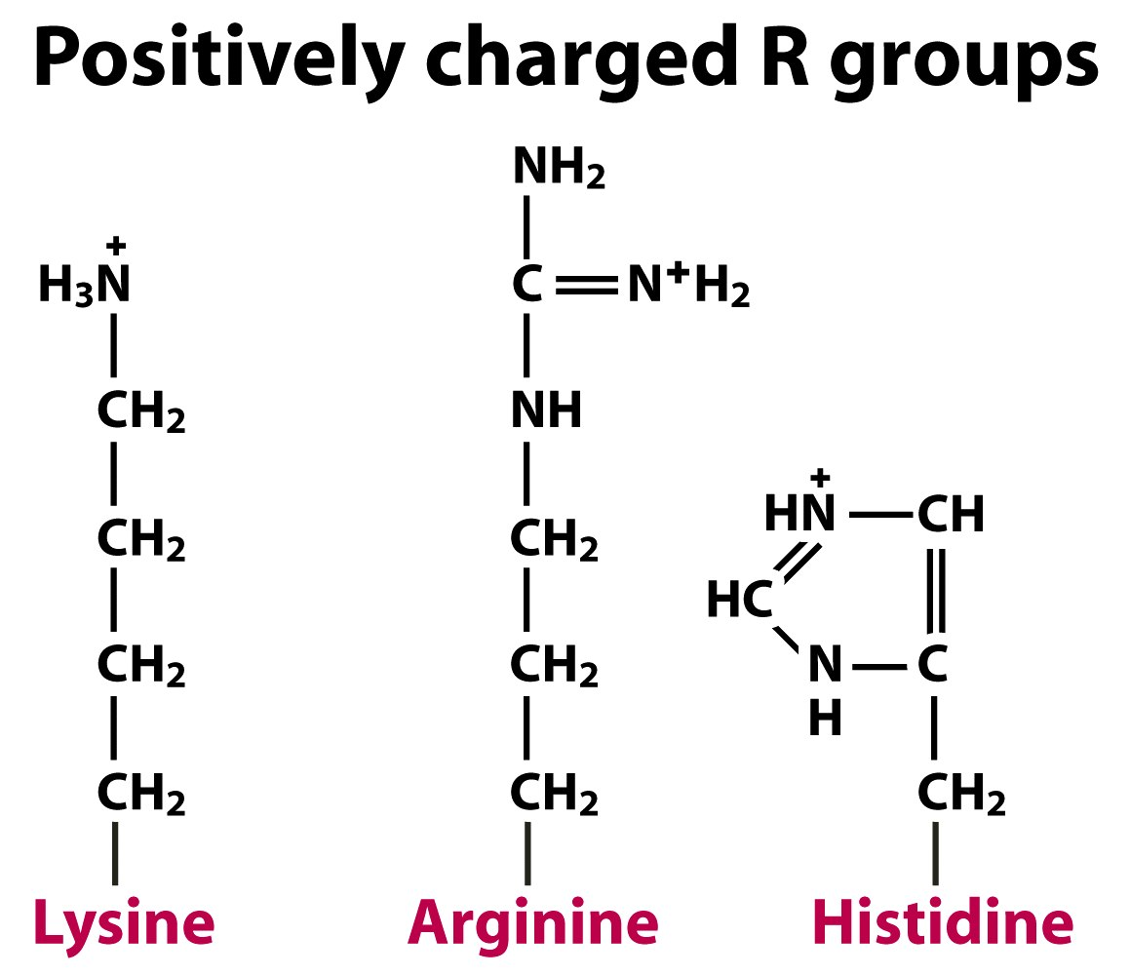
Figure 1.18d Genomes 3 (© Garland Science 2007)

Slide 31
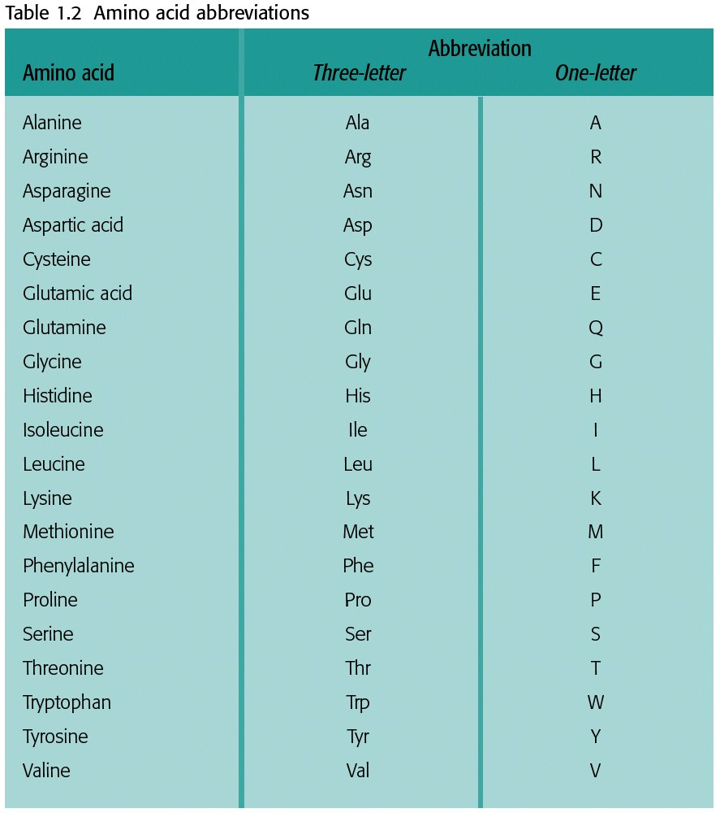
Table 1.2 Genomes 3 (© Garland Science 2007)

Slide 32
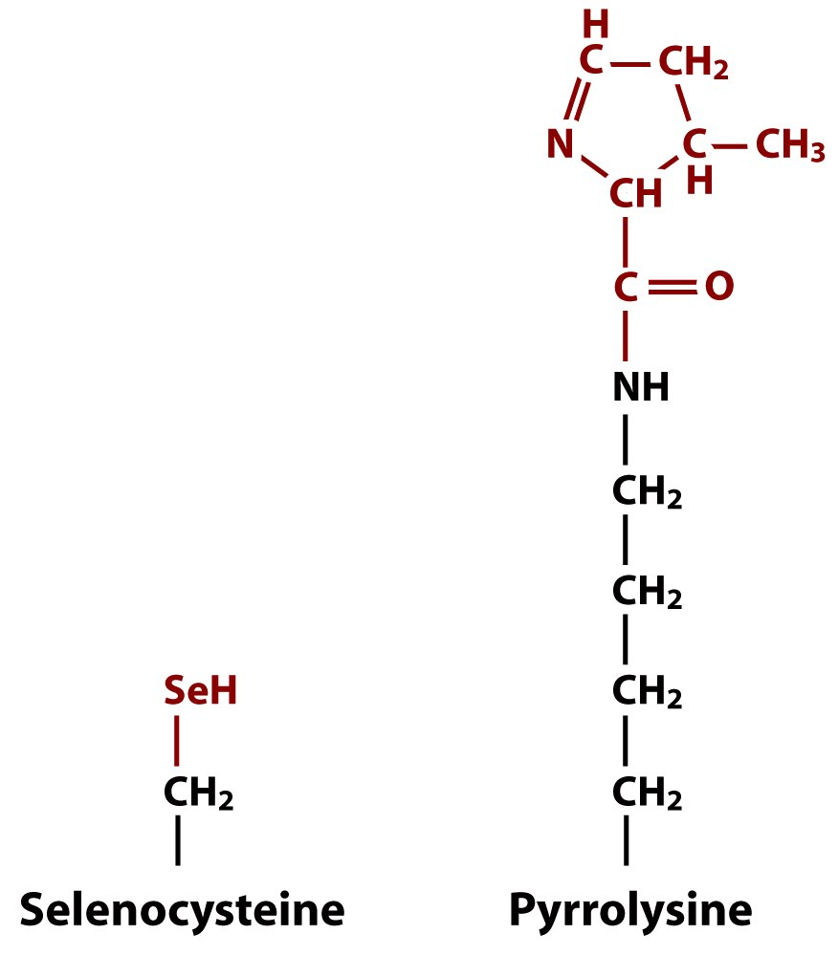
Figure 1.19 Genomes 3 (© Garland Science 2007)

Slide 33
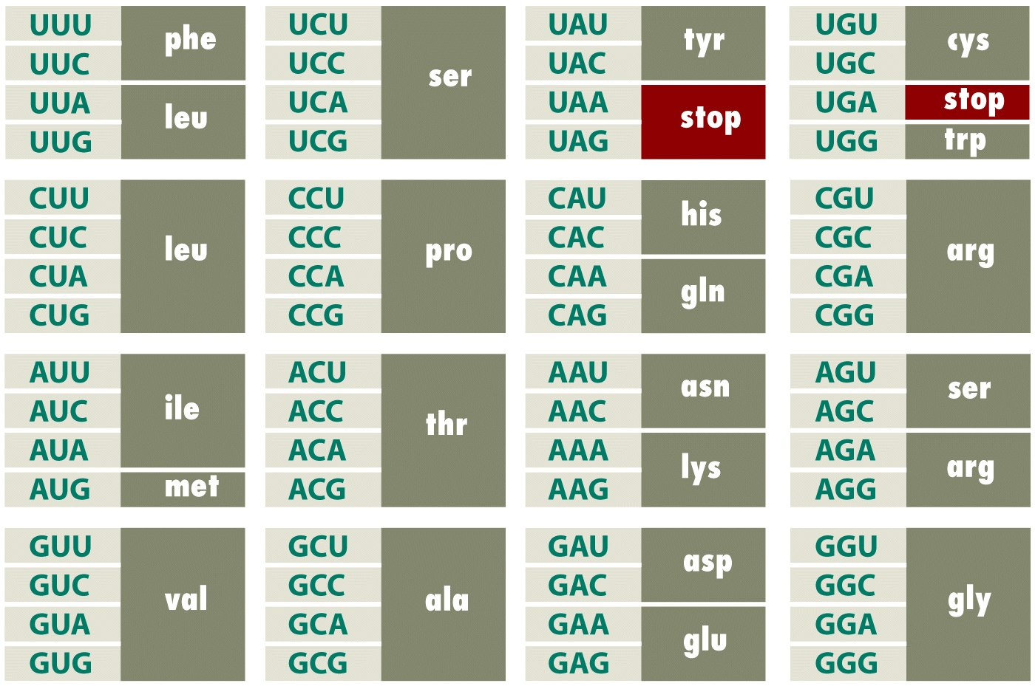
Figure 1.20 Genomes 3 (© Garland Science 2007)

Slide 34
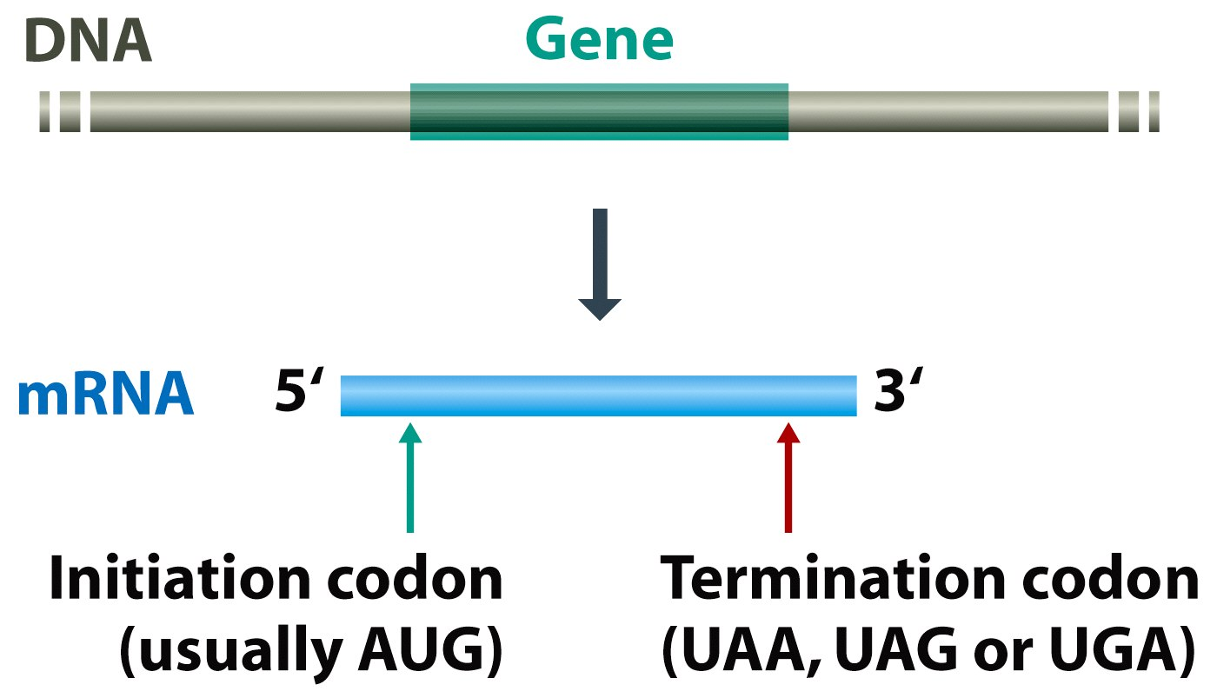
Figure 1.21 Genomes 3 (© Garland Science 2007)

Slide 35
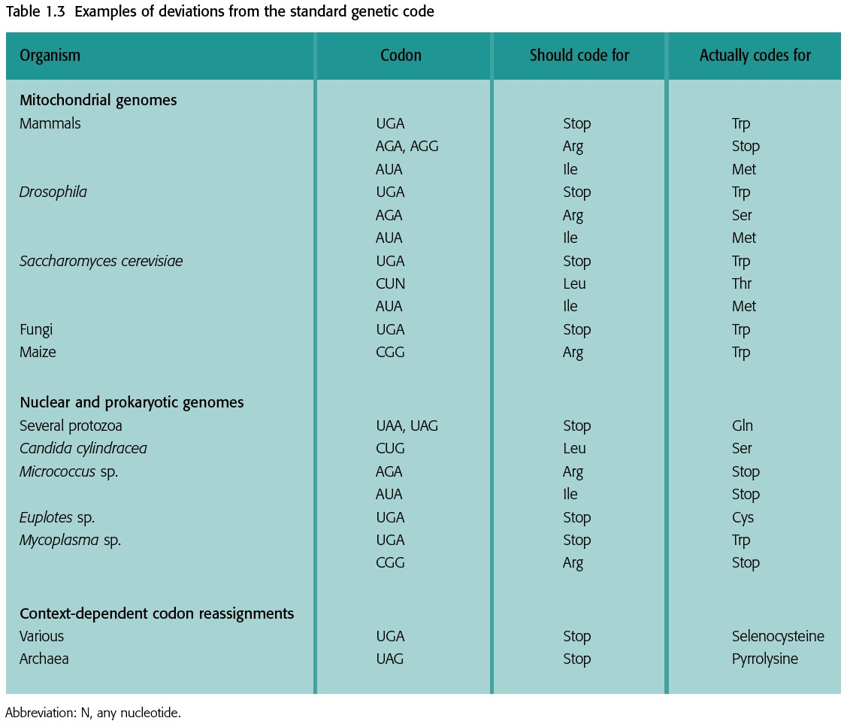
Table 1.3 Genomes 3 (© Garland Science 2007)

