Slide 1
Evaluation Warning : The document was created with Spire.Presentation for Python

Slide 2
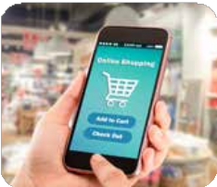

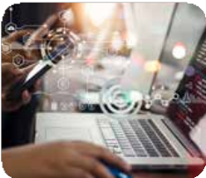



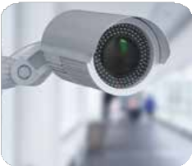
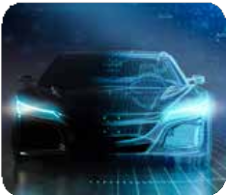

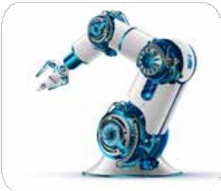

Artificial Intelligence is driving innovation across multiple mega trends
Evaluation Warning : The document was created with Spire.Presentation for Python
E-Commerce
Internet Surfing
Algorithmic Trading
Gaming
Healthcare Innovation
Cybersecurity
Automotive Technology
Transportation & Logistics
Industrial Automation
Social Media
Artificial Intelligence are supporting megatrends that are long term structural shifts in nature in various business
Source: iShare, Pwc, Investing in Tomorrow: A Whitepaper on Thematic Investing by Global X

Slide 3






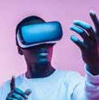
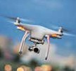



Artificial Intelligence creating or reshaping products and services
Evaluation Warning : The document was created with Spire.Presentation for Python
Smart Assistant
ChatBot
Facial Recognition
Speech Recognition
Navigation
Self Driving Cars Augmented & Virtual Reality Unmanned Drones Smart Home Malware Detection
Artificial Intelligence form part of our products and services more than ever before
Source: iShare, Pwc, Investing in Tomorrow: A Whitepaper on Thematic Investing by Global X

Slide 4


Quantifying the impact of Artificial Intelligence
Evaluation Warning : The document was created with Spire.Presentation for Python

Slide 5
Global Corporate Investment in AI has almost doubled in last two years
Evaluation Warning : The document was created with Spire.Presentation for Python
Global total corporate artificial intelligence (AI) investment (in US $ Billion)
93.5
67.9
48.9
44.1
43.8
_{12.8} 17.7
2015
2016
2017
2018
2019
2020
2021
Global total corporate investment in Artificial Intelligence (AI) has increased from US $ 12.8 billion in 2015 to US $ 93.5 billion in 2021 at a CAGR of 39.4%
Source: Statista, Data as on December 31, 2021, Private investment account for bulk of total Artificial Intelligence (AI) corporate investment. Past performance may or may not sustain in future.

Slide 6
Global market size of Artificial Intelligence is expected to cross USD 1.5 Trillion
Evaluation Warning : The document was created with Spire.Presentation for Python
Market Size (in US $ Billion)
1,591.0
1,148.0
829.0
599.0
433.5
313.9
165.0
227.5
87.0
119.8
2011 2022e 2023e 2024e 2025e 2026e 2027e 2028e 2029e 2030e
Global market size of Artificial Intelligence (AI) is expected to grow at a CAGR of ~33% over next decade
Source: Statista, Global News Wire, Data as on June 2022, AI includes: machine learning, deep learning, supervised learning, unsupervised learning, reinforcement learning, natural language processing, context-aware computing, computer vision.

