Slide 1

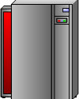
Deliberate Software Attacks
There is no foolproof method of preventing them from attaching themselves to your computer
Antivirus software compares virus signature files against the programming code of know viruses.
Regularly update virus signature files is crucial.
Slide

Slide 2
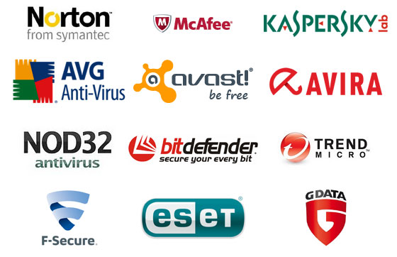
Anti-virus and Anti-spyware Software
Anti-virus software detects certain types of malware and can destroy it before any damage is done.
Install and maintain anti-virus and anti-spyware software.
Be sure to keep anti-virus software updated.
Many free and commercial options exist.
Contact your Technology Support Professional for assistance.

Slide 3
Deliberate Software Attacks
Virus is a computer program that attaches itself to an executable file or application.
It can replicate itself, usually through an executable program attached to an e-mail.
The keyword is “attaches”. A virus can not stand on its own.
You must prevent viruses from being installed on computers in your organizations.
Slide

