Slide 1

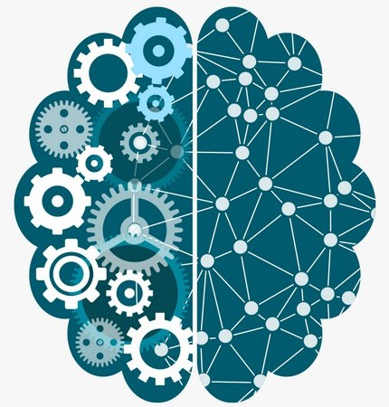

Advantages and Disadvantages of AI
Tushar B. Kute,
http://tusharkute.com

Slide 2
Advantages of Artificial Intelligence
Reduction in Human Error
One of the biggest advantages of Artificial Intelligence is that it can significantly reduce errors and increase accuracy and precision.
The decisions taken by AI in every step is decided by information previously gathered and a certain set of algorithms.
When programmed properly, these errors can be reduced to null.

Slide 3
Advantages of Artificial Intelligence
Zero Risks
Another big advantage of AI is that humans can overcome many risks by letting AI robots do them for us.
Whether it be defusing a bomb, going to space, exploring the deepest parts of oceans, machines with metal bodies are resistant in nature and can survive unfriendly atmospheres.
Moreover, they can provide accurate work with greater responsibility and not wear out easily.

Slide 4
Advantages of Artificial Intelligence
24x7 Availability
There are many studies that show humans are productive only about 3 to 4 hours in a day.
Humans also need breaks and time offs to balance their work life and personal life. But AI can work endlessly without breaks.
They think much faster than humans and perform multiple tasks at a time with accurate results.
They can even handle tedious repetitive jobs easily with the help of AI algorithms.

Slide 5
Advantages of Artificial Intelligence
Digital Assistance
Almost all the big organizations these days use digital assistants to interact with their customers which significantly minimizes the need for human resources.
You can chat with a chatbot and ask them exactly what you need.
Some chatbots have become so intelligent these days that you wouldn’t be able to determine whether you are chatting with a chatbot or a human being.

Slide 6
Advantages of Artificial Intelligence
New Inventions
AI has helped in coming up with new inventions in almost every domain to solve complex problems.
A recent invention has helped doctors to predict early stages of breast cancer in women using advanced AI-based technologies.

Slide 7
Advantages of Artificial Intelligence
Unbiased Decisions
Human beings are driven by emotions, whether we like it or not.
AI on the other hand, is devoid of emotions and highly practical and rational in its approach.
A huge advantage of Artificial Intelligence is that it doesn't have any biased views, which ensures more accurate decision-making.

Slide 8
Disadvantages of Artificial Intelligence
High Costs
The ability to create a machine that can simulate human intelligence is no small feat.
It requires plenty of time and resources and can cost a huge deal of money.
AI also needs to operate on the latest hardware and software to stay updated and meet the latest requirements, thus making it quite costly.

Slide 9
Disadvantages of Artificial Intelligence
No creativity
A big disadvantage of AI is that it cannot learn to think outside the box.
AI is capable of learning over time with pre-fed data and past experiences, but cannot be creative in its approach.
A classic example is the bot Quill who can write Forbes earning reports. These reports only contain data and facts already provided to the bot.
Although it is impressive that a bot can write an article on its own, it lacks the human touch present in other Forbes articles.

Slide 10
Disadvantages of Artificial Intelligence
Increase in Unemployment
Perhaps one of the biggest disadvantages of artificial intelligence is that AI is slowly replacing a number of repetitive tasks with bots.
The reduction in the need for human interference has resulted in the death of many job opportunities.
A simple example is the chatbot which is a big advantage to organizations, but a nightmare for employees.
A study by McKinsey predicts that AI will replace at least 30 percent of human labour by 2030.

Slide 11
Disadvantages of Artificial Intelligence
Make Humans Lazy
AI applications automate the majority of tedious and repetitive tasks.
Since we do not have to memorize things or solve puzzles to get the job done, we tend to use our brains less and less.
This addiction to AI can cause problems to future generations.

Slide 12
Disadvantages of Artificial Intelligence
No Ethics
Ethics and morality are important human features that can be difficult to incorporate into an AI.
The rapid progress of AI has raised a number of concerns that one day, AI will grow uncontrollably, and eventually wipe out humanity.
This moment is referred to as the AI singularity.

Slide 13
Summary
•
Artificial intelligence has massive potential for creating a better world to live in.
The most important role for humans will be to ensure that the rise of the AI doesn’t get out of hand.
Although there are both debatable pros and cons of artificial intelligence , its impact on the global industry is undeniable.
It continues to grow every single day driving sustainability for businesses.
•
•
•

Slide 14






Thank you
This presentation is created using LibreOffice Impress 7.0.1.2, can be used freely as per GNU General Public License
/mITuSkillologies
@mitu_group
/company/mitu- skillologies
MITUSkillologies
Web Resources https://mitu.co.in http://tusharkute.com
contact@mitu.co.in tushar@tusharkute.com

